Slide 1
DEEP NEURAL NETWORKS AS GAUSSIAN PROCESSES
Jaehoon Lee, Yasaman Bahri, Roman Novak , Samuel S. Schoenholz,
Jeffrey Pennington, Jascha Sohl-Dickstein
Published version in ICLR 2018. 10, Vancouver CANADA .
Seventh International Conference on Learning Representations
Presenter: Ke-Xin Zhu
Date: 2019/04/23
Notes:
https://iclr.cc/
https://zh.wikipedia.org/wiki/%E8%B0%B7%E6%AD%8C%E5%A4%A7%E8%84%91
https://ai.google/research/

Slide 2
Abstract (1/2)
It has long been known that a single-layer fully-connected neural network with an i.i.d. prior over its parameters is equivalent to a Gaussian process (GP), in the limit of infinite network width. This correspondence enables exact Bayesian inference for infinite width neural networks on regression tasks by means of evaluating the corresponding GP. Recently, kernel functions which mimic multi-layer random neural networks have been developed, but only outside of a Bayesian framework. As such, previous work has not identified that these kernels can be used as covariance functions for GPs and allow fully Bayesian prediction with a deep neural network.
In this work, we derive the exact equivalence between infinitely wide deep networks and GPs.

Slide 3
Abstract (2/2)
We further develop a computationally efficient pipeline to compute the covariance function for these GPs. We then use the resulting GPs to perform Bayesian inference for wide deep neural networks on MNIST and CIFAR-10. We observe that trained neural network accuracy approaches that of the corresponding GP with increasing layer width, and that the GP uncertainty is strongly correlated with trained network prediction error. We further find that test performance increases as finite-width trained networks are made wider and more similar to a GP, and thus that GP predictions typically outperform those of finite-width networks. Finally we connect the performance of these GPs to the recent theory of signal propagation in random neural networks.

Slide 4

1.1 Gaussian Processes
Notes:
Rasmussen, C. E. (2003). Gaussian processes in machine learning. Summer School on Machine Learning, Springer.

Slide 5
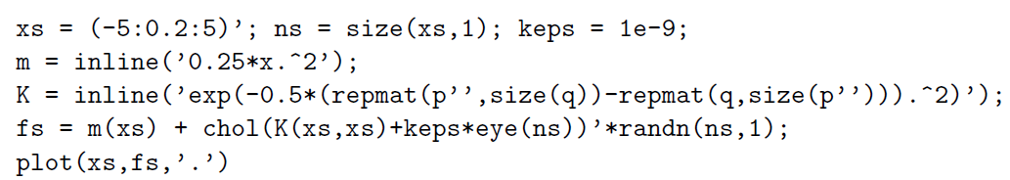
1.1 Gaussian Processes

Slide 6
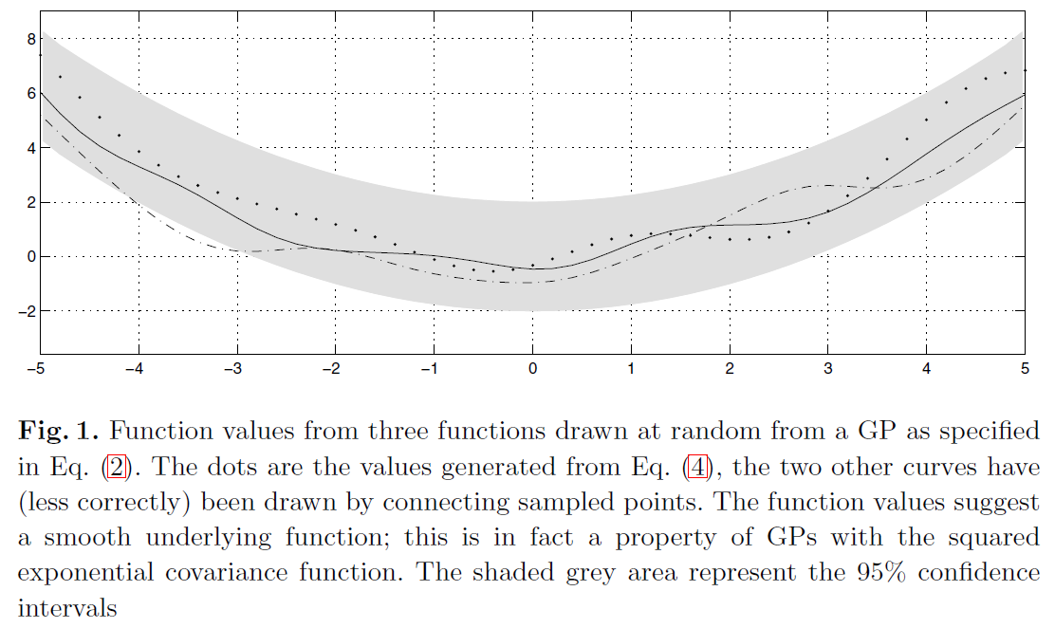
1.1 Gaussian Processes

Slide 7
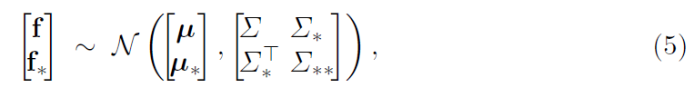
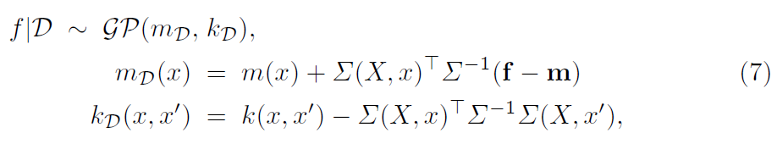
1.2 Posterior Gaussian Process

Slide 8
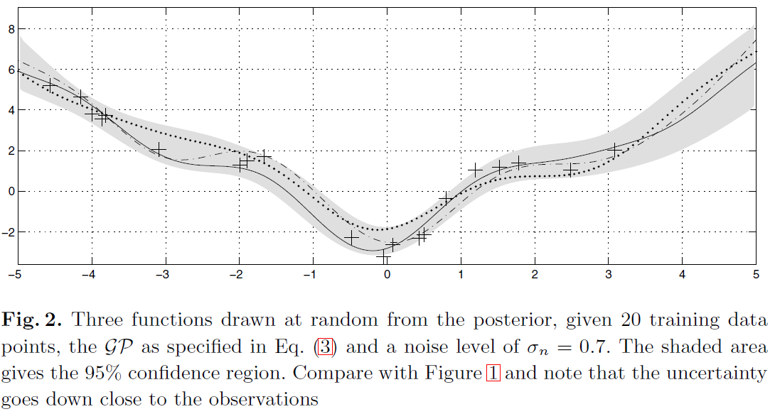
1.2 Posterior Gaussian Process

Slide 9
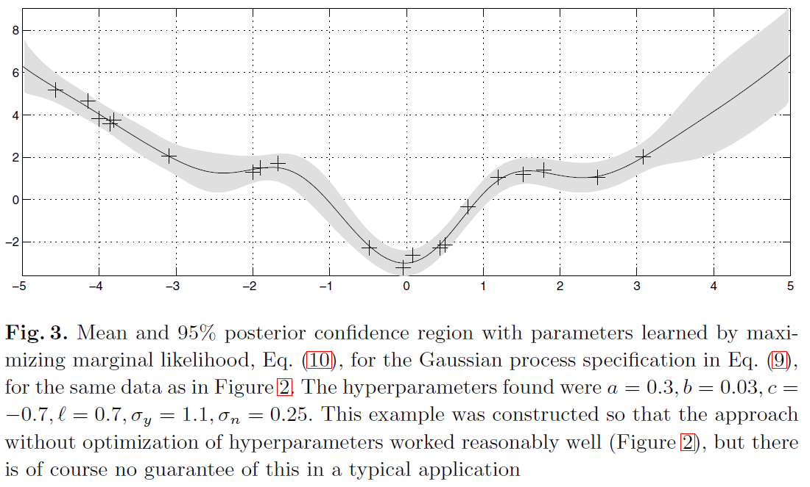
1.3 Training a Gaussian Process

Slide 10
2.1 Review Of Gaussian Processes And Single-Layer Neural Networks

Slide 11

2.2 Gaussian Processes And Deep Neural Networks

Slide 12
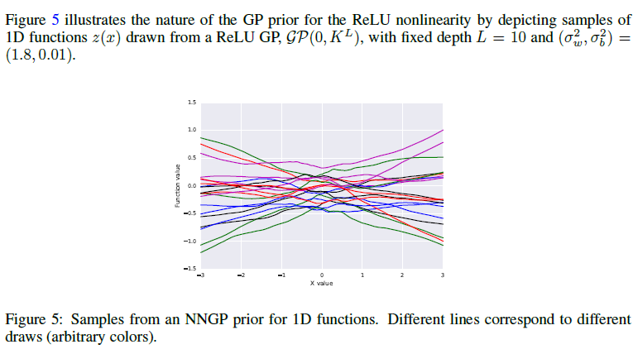
2.2 Gaussian Processes And Deep Neural Networks

Slide 13


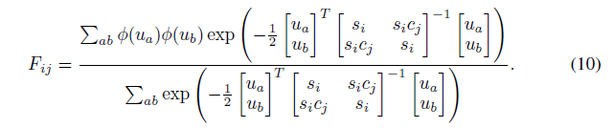
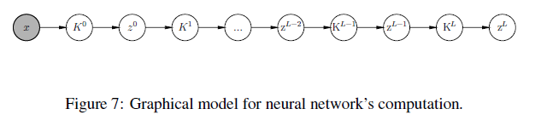
2.3 Bayesian Training Of Neural Networks Using Gaussian Process Priors

Slide 14
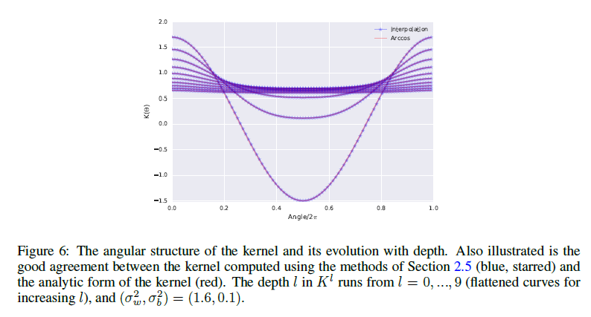
2.3 Bayesian Training Of Neural Networks Using Gaussian Process Priors

Slide 15
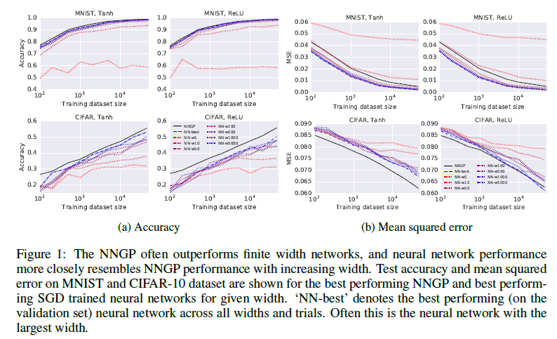
3. Experimental Results

Slide 16
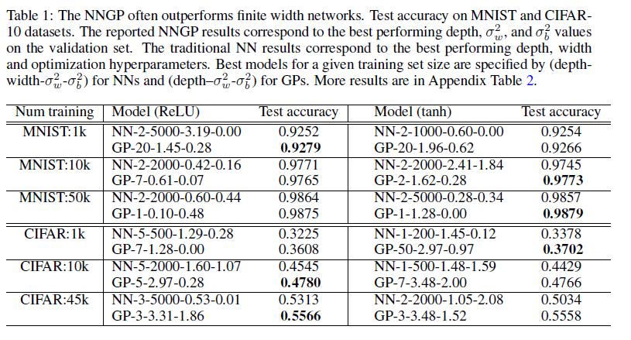
3. Experimental Results

Slide 17
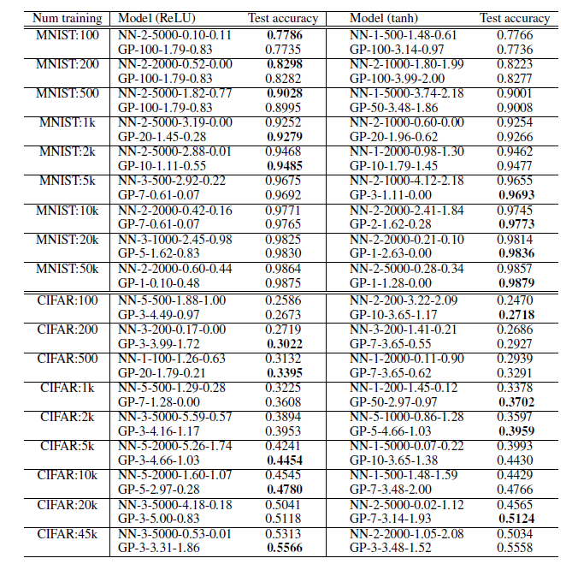
3. Experimental Results

Slide 18
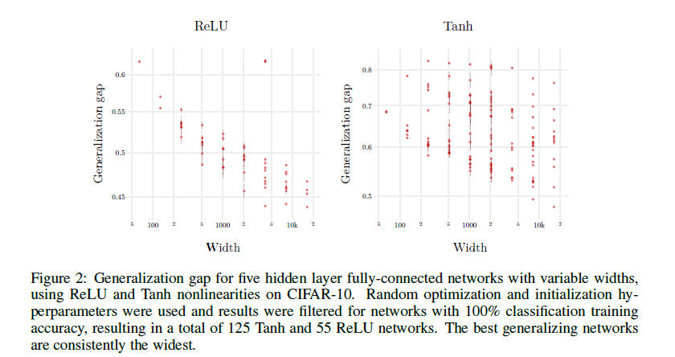
3.1 Generalization gap

Slide 19
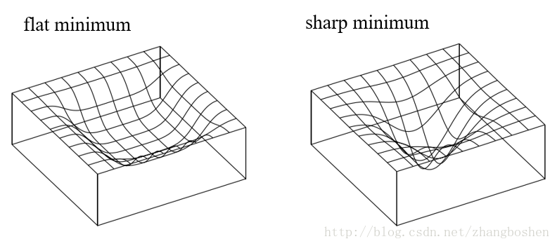
3.1 Generalization gap

Slide 20
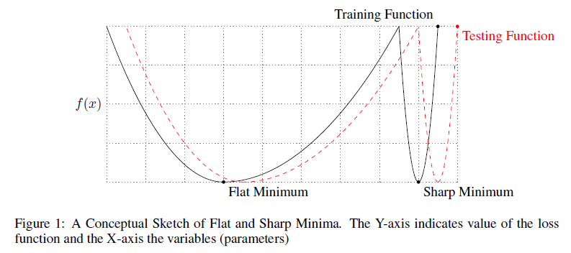
3.1 Generalization gap
Notes:
Keskar, N. S., et al. (2016). "On large-batch training for deep learning: Generalization gap and sharp minima." arXiv preprint arXiv:1609.04836.

Slide 21
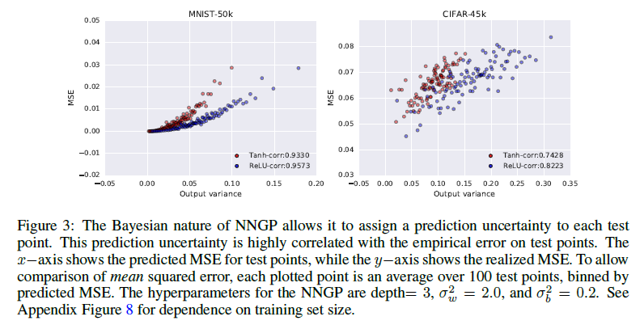
3.2 Pre-MSE vs Real-MSE

Slide 22
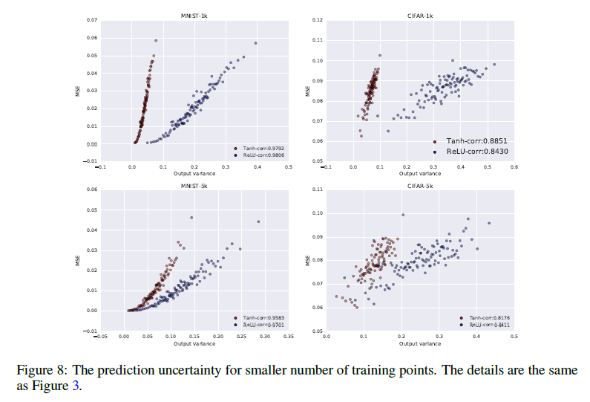
3.2 Pre-MSE vs Real-MSE

Slide 23
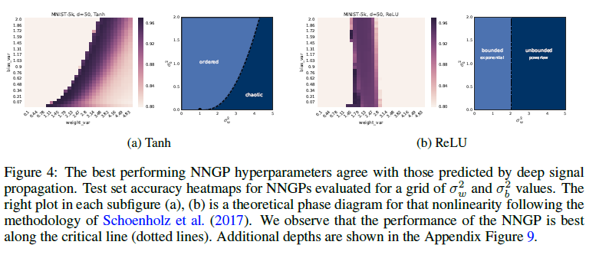
3.3 Best Hyperparameters

Slide 24
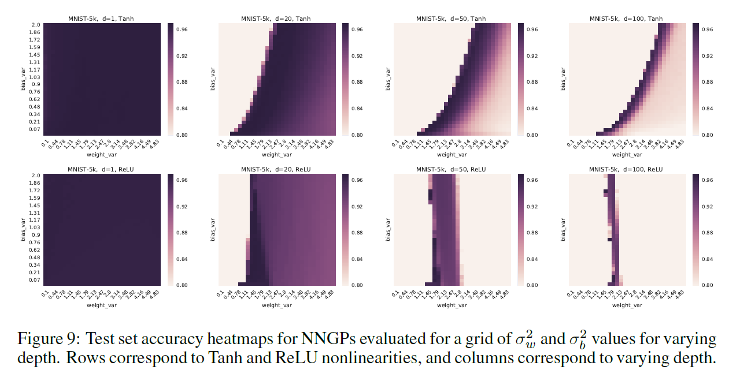
3.3 Best Hyperparameters

Slide 25
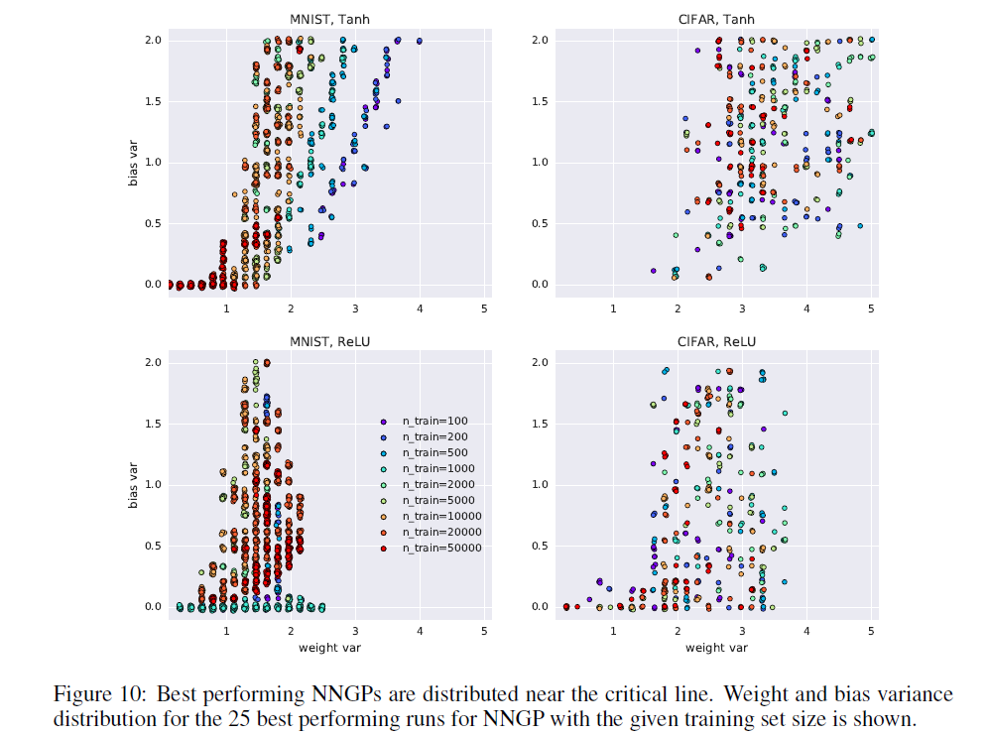
3.3 Best Hyperparameters

Slide 26
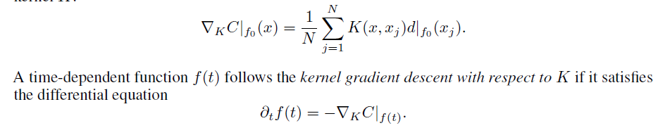
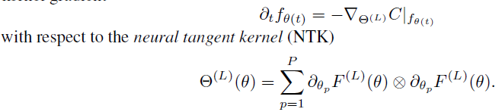
4 Neural Tangent Kernel

Slide 27
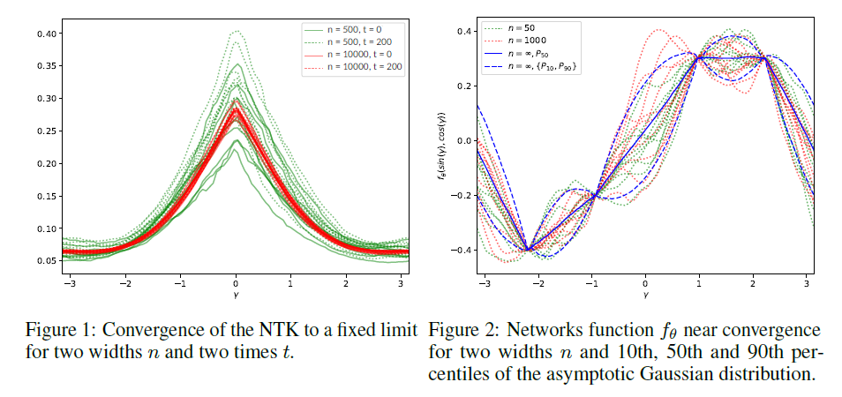
4 Neural Tangent Kernel

Slide 28


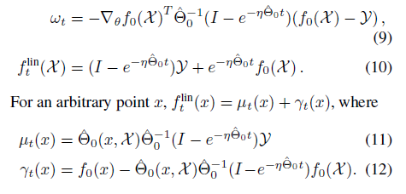

5 Wide Neural Networks Evolve as Linear Models Under Gradient Descent

Slide 29
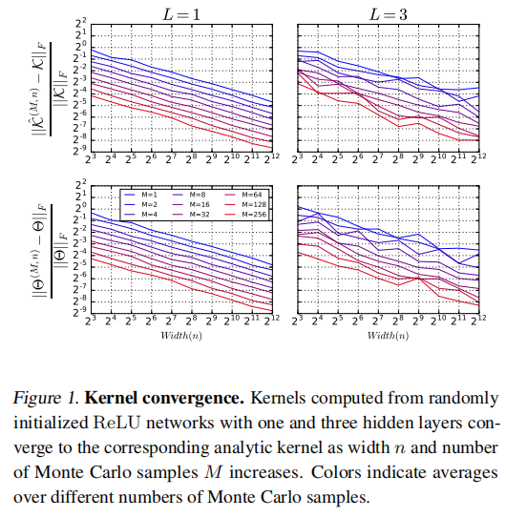
5 Wide Neural Networks Evolve as Linear Models Under Gradient Descent

Slide 30
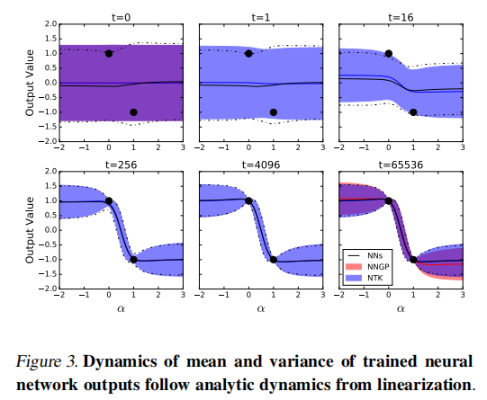
5 Wide Neural Networks Evolve as Linear Models Under Gradient Descent

Slide 31
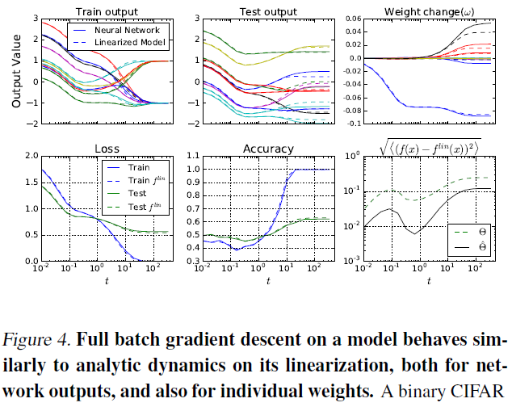
5 Wide Neural Networks Evolve as Linear Models Under Gradient Descent

Slide 32
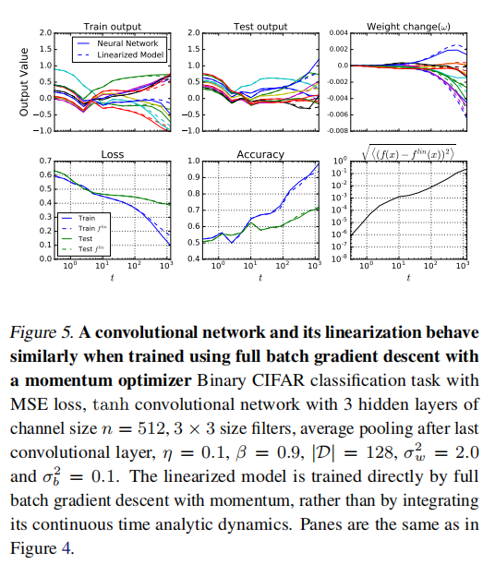
5 Wide Neural Networks Evolve as Linear Models Under Gradient Descent

Slide 33
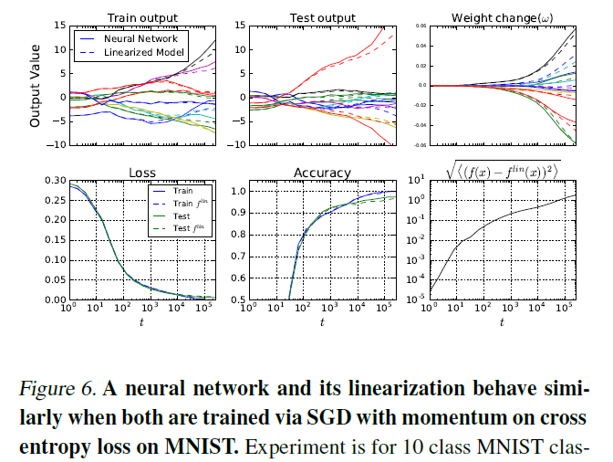
5 Wide Neural Networks Evolve as Linear Models Under Gradient Descent

