Slide 1
Palindromic rich words and run-length encodings
Chuan Guo ª, Jeffrey Shallit ª and Arseny M. Shur ^{b}
ª University of Waterloo, Ontario, Canada
^{b} Ural Federal University, Ekaterinburg, Russia
Information Processing Letters
Volume 116, Pages 735-738, 2016
Presenter: Ting-Wei Liang
Date: 2019/04/30

Slide 2
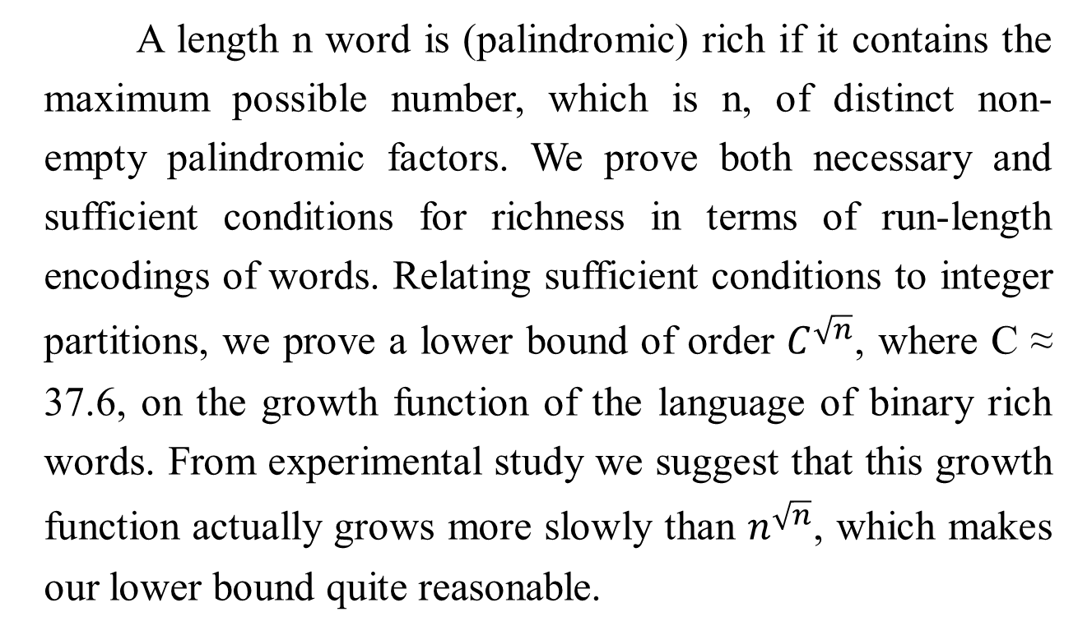
Abstract
A length n word is (palindromic) rich if it contains the maximum possible number, which is n, of distinct non-empty palindromic factors. We prove both necessary and sufficient conditions for richness in terms of run-length encodings of words. Relating sufficient conditions to integer partitions, we prove a lower bound of order $C^{\sqrt{n}}$, where C ≈ 37.6, on the growth function of the language of binary rich words. From experimental study we suggest that this growth function actually grows more slowly than $n^{\sqrt{n}}$, which makes our lower bound quite reasonable.

Slide 3
Palindromic rich
 | 1 | 2 | 3 | 4 | 5 | 6 | 7 | 8 | 9
W | t | e | n | n | e | s | s | e | e
distinct palindromic factor :
{t, e, n, s, nn, ss, ee, enne, esse}

Slide 4

Run-length encoding
$$w= a_{1}^{s_{1}}a_{2}^{s_{2}}…a_{k}^{s_{k}}$$
$w=aaabbccccaaaaa= a^{3}b^{2}c^{4}a^{5}$
$S=3, 2, 4, 5$ (run sequence of $w$)

Slide 5
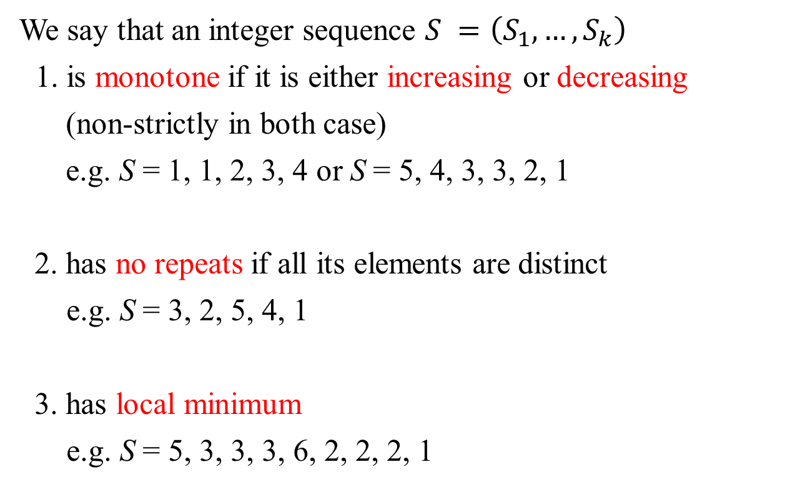
Run sequence
We say that an integer sequence $S =\left(S_{1},…,S_{k}\right)$
1. is monotone if it is either increasing or decreasing
(non-strictly in both case)
e.g. S = 1, 1, 2, 3, 4 or S = 5, 4, 3, 3, 2, 1
2. has no repeats if all its elements are distinct
e.g. S = 3, 2, 5, 4, 1
3. has local minimum
e.g. S = 5, 3, 3, 3, 6, 2, 2, 2, 1

Slide 6
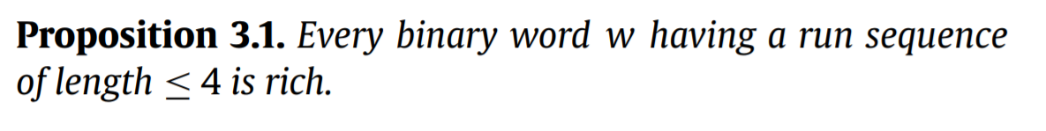
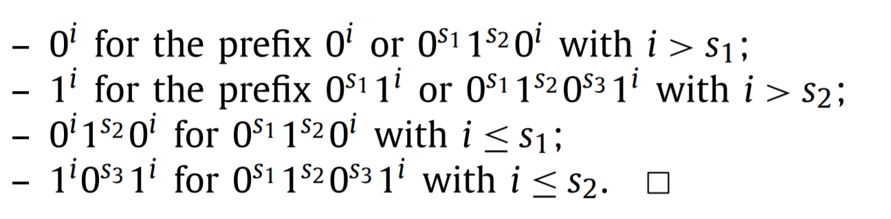


Run sequences of binary rich words
$$w=0^{s_{1}}1^{s_{2}}0^{s_{3}}1^{s_{4}}$$
$$001111000011$$

Slide 7

Run sequences of binary rich words
$$w=0^{s_{1}}1^{s_{2}}0^{s_{3}}1^{s_{4}}$$
$$001111000011$$

Slide 8

Run sequences of binary rich words
$$w=0^{s_{1}}1^{s_{2}}0^{s_{3}}1^{s_{4}}$$
$$001111000011$$

Slide 9

Run sequences of binary rich words
$$w=0^{s_{1}}1^{s_{2}}0^{s_{3}}1^{s_{4}}$$
$$001111000011$$

Slide 10
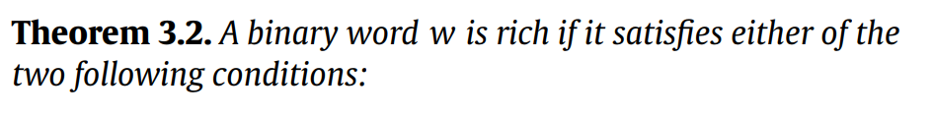
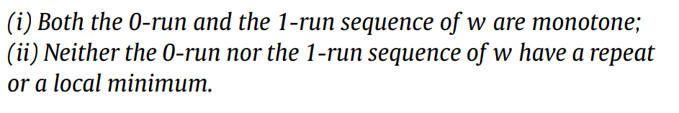
Run sequences of binary rich words

Slide 11

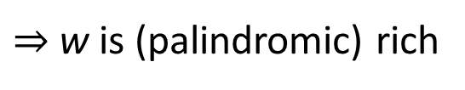
Examples
$$w=0^{1}1^{3}0^{2}{1^{2}0^{3}1}^{2}$$
1 | 2 | 3 | 4 | 5 | 6 | 7 | 8 | 9 | 10 | 11 | 12 | 13
0 | 1 | 1 | 1 | 0 | 0 | 1 | 1 | 0 | 0 | 0 | 1 | 1
{0, 1, 11, 111, 01110, 00, 1001, 110011, 0110, 001100, 000,
10001, 1100011}
$⇒$w is (palindromic) rich

Slide 12

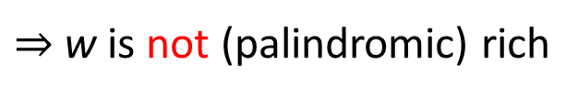
Examples
$$w=0^{2}1^{3}0^{1}{1^{1}0^{3}1}^{2}$$
1 | 2 | 3 | 4 | 5 | 6 | 7 | 8 | 9 | 10 | 11 | 12
0 | 0 | 1 | 1 | 1 | 0 | 1 | 0 | 0 | 0 | 1 | 1
{0, 00, 1, 11, 111, 01110, 101, 010, 00, 000, 10001, 11}
$⇒$w is not (palindromic) rich

Slide 13
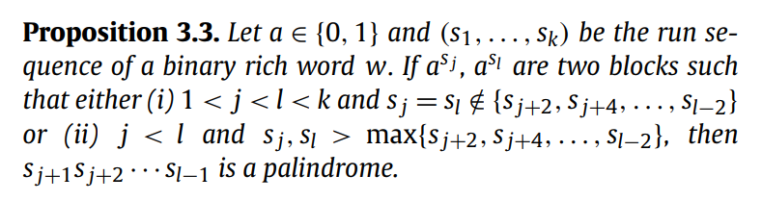
Run sequences of binary rich words

Slide 14

Condition(i)
$$w=0^{1}1^{1}0^{2}{1^{2}0^{2}1^{1}0}^{1}$$
1 | 2 | 3 | 4 | 5 | 6 | 7 | 8 | 9 | 10
0 | 1 | 0 | 0 | 1 | 1 | 0 | 0 | 1 | 0
{0, 1, 010, 00, 1001, 11, 0110, 001100, 10011001, 0100110010}
$⇒$w is (palindromic) rich

Slide 15

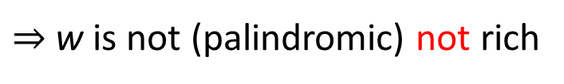
Condition (i)
$$w=0^{1}1^{1}0^{1}{1^{2}0^{2}1^{1}0}^{1}$$
1 | 2 | 3 | 4 | 5 | 6 | 7 | 8 | 9
0 | 1 | 0 | 1 | 1 | 0 | 0 | 1 | 0
{0, 1, 010, 101, 11, 0110, 00, 1001, 010}
$⇒$w is not (palindromic) not rich

Slide 16

Condition (ii)
$$w=0^{2}1^{1}0^{1}1^{1}0^{4}$$
1 | 2 | 3 | 4 | 5 | 6 | 7 | 8 | 9
0 | 0 | 1 | 0 | 1 | 0 | 0 | 0 | 0
{0, 00, 1, 010, 101, 01010, 0010100, 000, 0000}
$⇒$w is (palindromic) rich

Slide 17

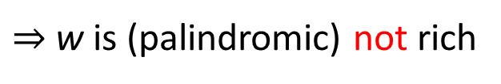
Condition (ii)
$$w=0^{2}1^{1}0^{1}1^{2}0^{4}$$
1 | 2 | 3 | 4 | 5 | 6 | 7 | 8 | 9 | 10
0 | 0 | 1 | 0 | 1 | 1 | 0 | 0 | 0 | 0
{0, 00, 1, 010, 101, 11, 0110, 00, 000, 0000}
$⇒$w is (palindromic) not rich

Slide 18
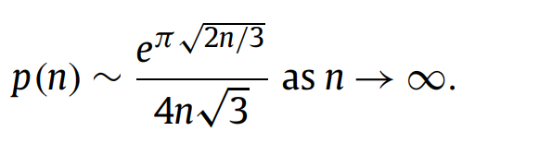
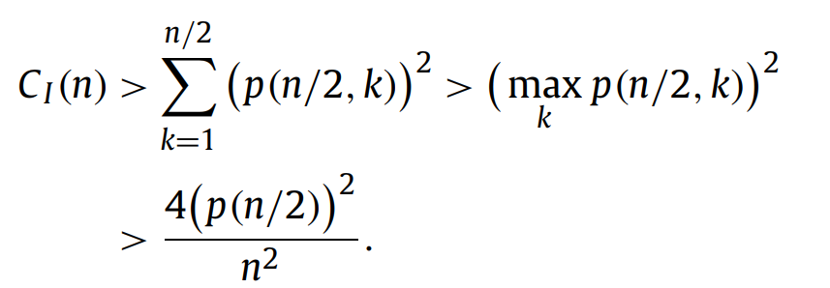
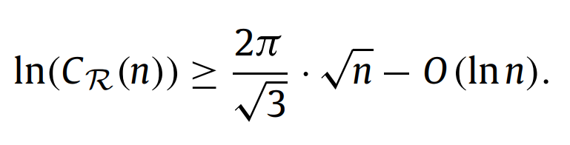


Lower bound of C_{R}(n)
Hardy Ramanujan-Uspensky formula :
$${⇒C}_{R}\left(n\right)≥C^{\sqrt{n}}$$
$$C≈37.6$$

Slide 19
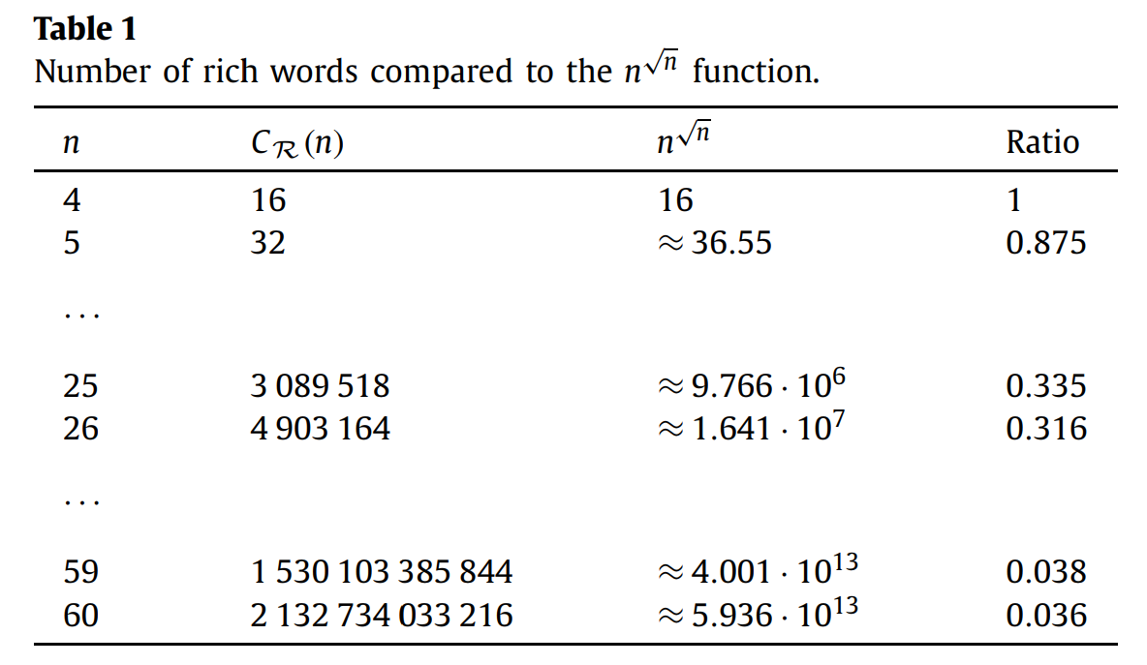
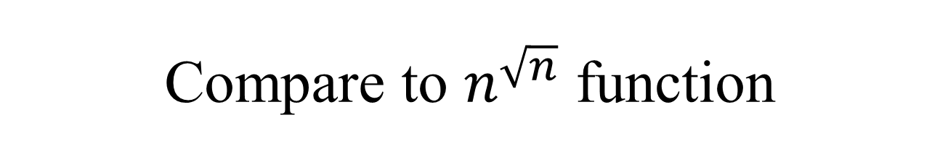
Compare to $n^{\sqrt{n}}$ function

