Slide 1
DNA sequence representation without degeneracy
Stephen S.-T. Yau, Jiasong Wang, Amir Niknejad, Chaoxiao Lu, Ning Jin, and Yee-Kin Ho.
Nucleic Acids Research, Vol. 31, No. 12, 2003.
Presenter : Feng-Yang Tsai
Date:Apr. 30, 2019.

Slide 2
Abstract(1/2)
Graphical representation of DNA sequence provides a simple way of viewing, sorting and comparing various gene structures. A new two-dimensional graphical representation method using a two-quadrant Cartesian coordinates system has been derived for mathematical denotation of DNA sequence. The two-dimensional graphic representation resolves sequences' degeneracy and is mathematically proven to eliminate circuit formation. Given x-projection and y-projection of any point on the graphical representation, the number of A, G, C and T from the beginning of the sequence to that point could be found. Compared with previous methods, this graphical representation is more

Slide 3
Abstract(2/2)
inline with the conventional recognition of linear sequences by molecular biologists, and also provides a metaphor in two dimensions for local and global DNA sequence comparison.

Slide 4
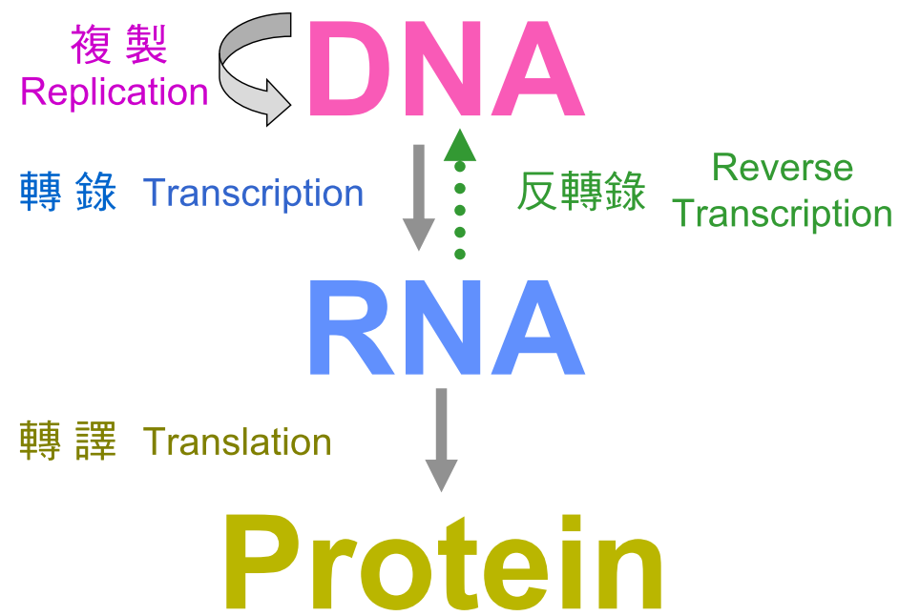
DNA->ATTGAC
mRNA->TAACTG

Slide 5
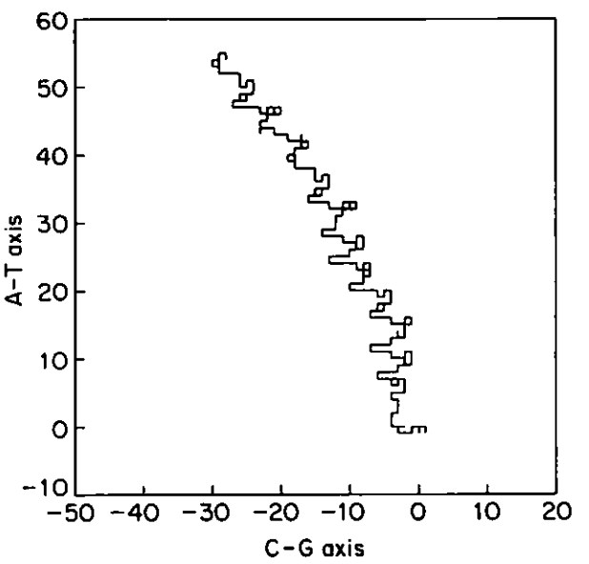
2-D Graphical Representation of DNA Sequence:
Gates, M. A. A simple way to look at DNA. J. Theor. Biol. 1986, 119, 319 - 328.
G, C, T, and A bases are depicted as coordinate shifts of +[1, 0],
-[1, 0], +[0, 1], and -[0, 1].

Slide 6
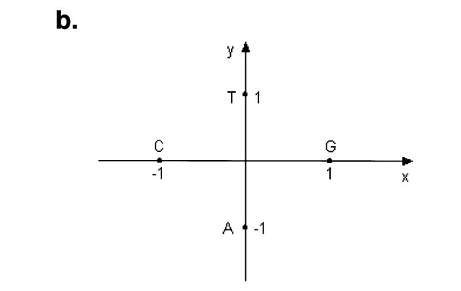
Sequences’ degeneracy(Circuit):
Ex:AGTC, AGTCA, AGTCAG

Slide 7
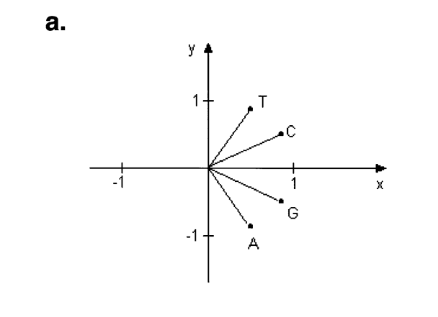
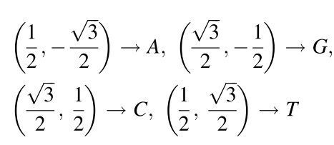
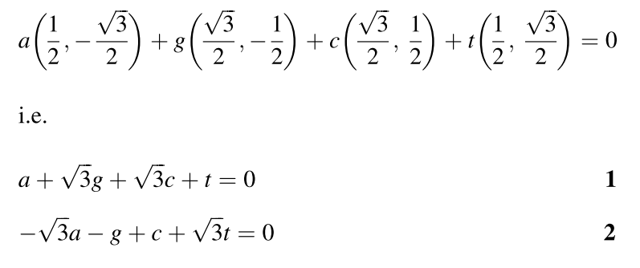

Slide 8


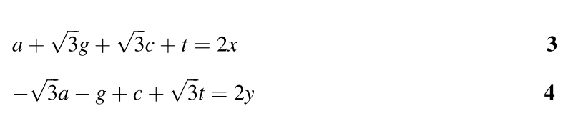
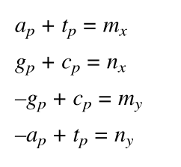
.
Ex:GCTAA

Slide 9
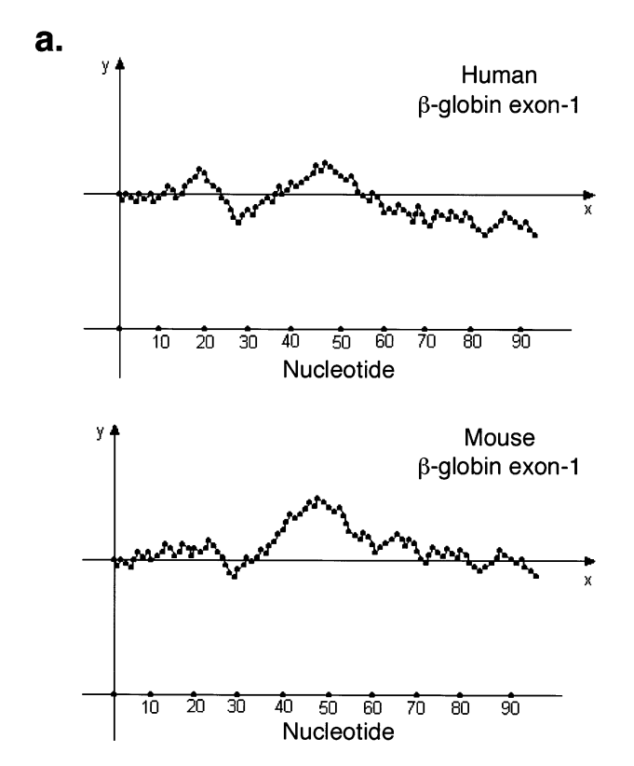
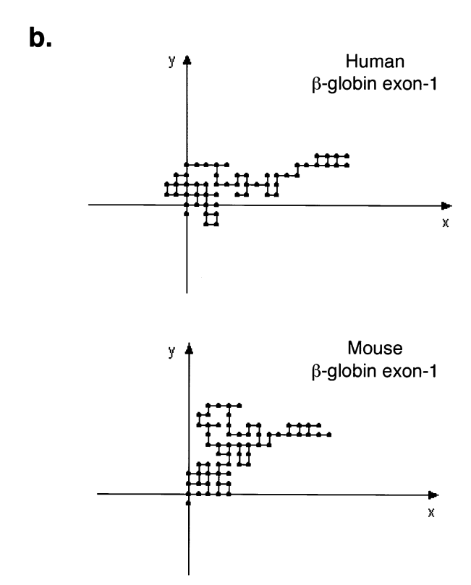
Results:

