Slide 1
Disease phenotype similarity improves the prediction of novel disease-associated microRNAs
Duc-Hau Le
2nd National Foundation for Science and Technology Development Conference on Information and Computer Science (NICS), 2015, pages 76 - 81, Ho Chi Minh City, Vietnam
Speaker: Jheng-Yan Lyu
Date: Dec. 18, 2019

Slide 2
Abstract (1/2)
Many studies have shown roles of miRNAs (microRNAs) on human disease and a number of computational methods have been proposed to predict such associations by ranking candidate microRNAs according to their relevance to a disease. Among them, network-based methods are becoming dominant since they well exploit the “disease module” principle in miRNA functional similarity networks. Of which, Random Walk with Restart (RWR) algorithm-based method on a miRNA functional similarity network, namely RWRMDA, is state-of-the-art one. The use of this algorithm was inspired from its success in predicting disease gene because “disease module” principle also exists in protein interaction networks. Besides, many other algorithms were also designed for prediction of disease genes. However, they have not yet been utilized for disease microRNA prediction. In this study, we proposed a method, namely RWRHMDA, for prediction of disease-associated miRNAs. This method was based on RWRH algorithm, which was successfully proposed for disease gene prediction on a heterogeneous network of genes and disease phenotypes.

Slide 3
Abstract (2/2)
We used this algorithm to rank disease candidate miRNAs on a heterogeneous network of phenotypes and miRNAs, which was constructed by integrating a shared target gene-based microRNA functional similarity network and a disease phenotype similarity network. Comparing the prediction performance of RWRHMDA with that of RWRMDA on a set of 35 disease phenotypes, we found that RWRHMDA significantly outperformed RWRMDA irrespective of parameter settings since it better exploited “disease module” principle. In addition, using RWRHMDA method, we identified eight novel Alzheimer's disease-associated miRNAs.

Slide 4
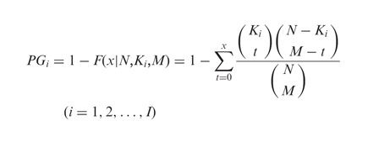
Construction of a Homogeneous miRNA Network
N is the number of all targets.
K_{i} is the total number of genes that are annotated in the GO term i and targeted by miRNAs.
M is the size of A ∩ B

Slide 5

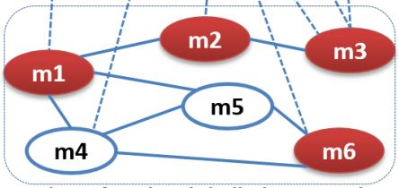
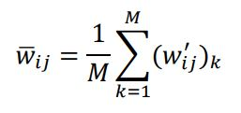
Construction of a Homogeneous miRNA Network
w_{ij} is weight of interaction between miRNA i and j.
min and max are the smallest and largest values of interaction weights of each miRNA functional network.

Slide 6
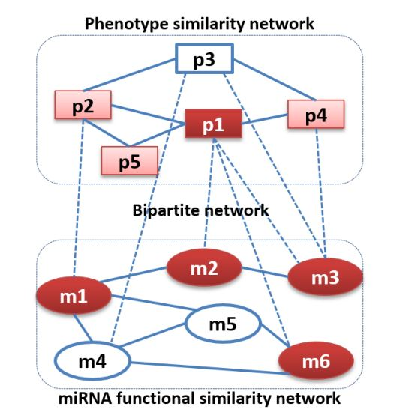
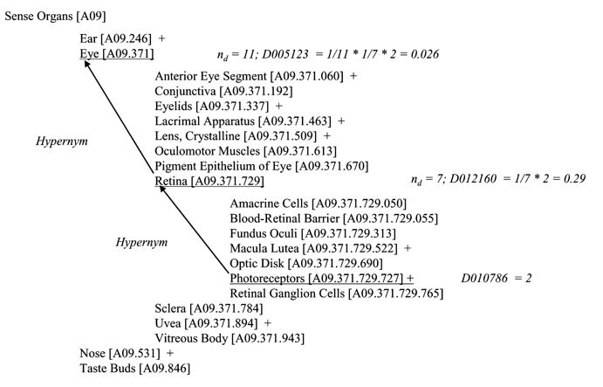
Construction of a Heterogeneous Network of Disease Phenotypes and MiRNAs

Slide 7
Construction of a Heterogeneous Network of Disease Phenotypes and MiRNAs
Example of concept expansion using the MeSH hierarchical structure. The concept ‘Photoreceptors’ (with MeSH descriptor: D010786) is found twice in an OMIM record. Expansion of this concept gives the hypernym ‘Retina’ (D012160). The relevance of the concept ‘Retina’ is derived from ‘Photoreceptors’ according to equation (1). ‘Retina’ has seven descendants or hyponyms, thus its relevance becomes 1/7 × 2 (for two times ‘Photoreceptors’). Similarly, Retina's hypernym ‘Eye’ (D005123) has 11 hyponyms, so that ‘Photoreceptors’ contributes 1/11 × 1/7 × 2 (=0.026) to the relevance of ‘Eye’. (Squared brackets indicate the MeSH tree position and a ‘+’ sign that there are more specific concepts underneath).

Slide 8



Random Walk with Restart on a Homogenous MiRNA Network
The set of source nodes (S) was specified by miRNAs known to be associated with d

Slide 9

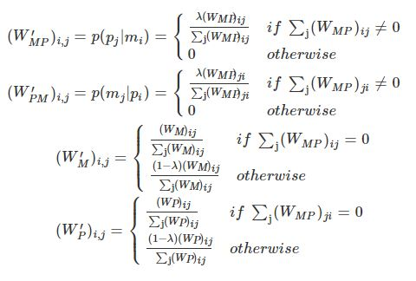
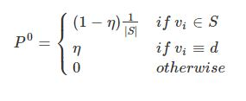
Random Walk with Restart on a Heterogeneous MiRNA Network
Notes:
λ be the jumping probability the random walker jumps from the miRNA network to the phenotype network

Slide 10
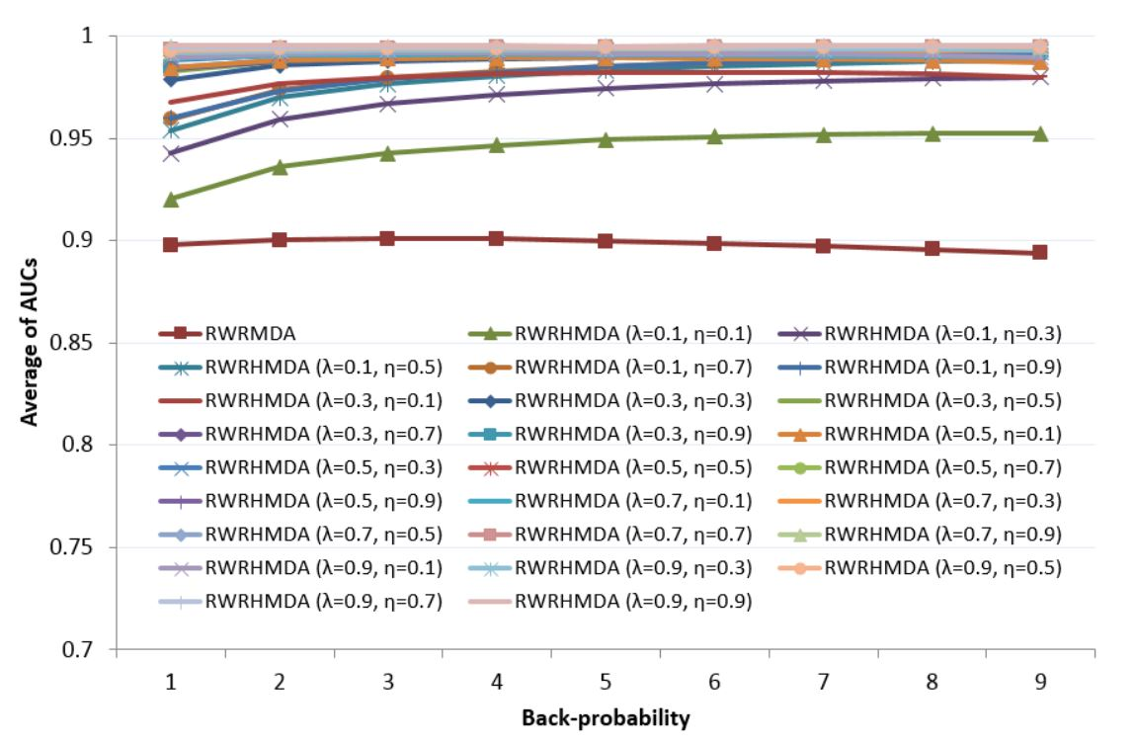
Results

Slide 11
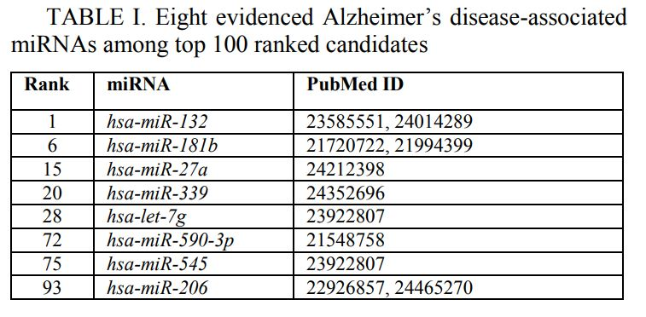
Results

