Slide 1
A Comparison of the Animal Recognition between the Real Objects and the Modeled 3D Objects
Matuska Slavomir, Hudec Robert, Hlubik Jan, Talapka Jozef
26th Conference Radioelektronika 2016, April 19-20, Košice, Slovak Republic
Presenter : Chih-Kai Wu
Date: Dec.18, 2019.

Slide 2
Abstract
This paper proposed about comparison of the animal recognition processed on the real world objects and the modeled 3D objects. The object classification consists of the
three main steps – feature extraction, training classifier and image evaluation. Feature description is based on locale visual descriptors like SIFT or SURF. Support Vector
Machine (SVM) in combination with the bags of visual keypoints (BOW) is used to classify descriptors. The 3D models were created using photogrammetry and 3D
modeling for ideal 3D models of mammals. This method of 3D model creation is described in details.

Slide 3
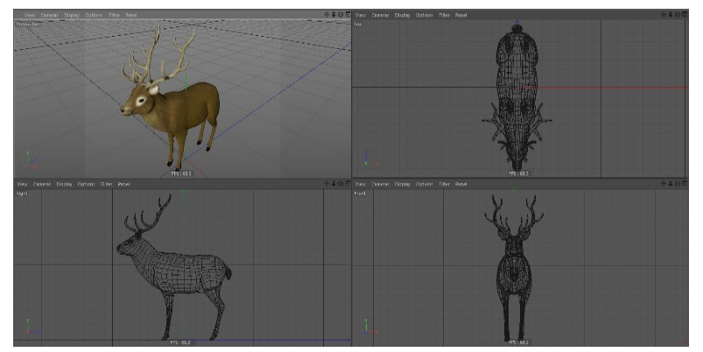
The generation of the 3D model
The first step in the procedure of 3D object creation was taking the photos of the mounted animals from the different angles and positions. Some part of the animals were pictured in the more detail to increase the model precision. For every model, more than 150 pictures were taken.

Slide 4
Experimental
There were two different testing databases.
The first one was created by randomly selected and removed images from training database.
The second testing database was created from the 3D models of the animal, where these models were inserted to the background images.
Four detectors, SURF, SUSIFT, SIFT and SISURF,
four descriptors SURF, OpponentSURF, SIFT, OpponentSIFT

Slide 5
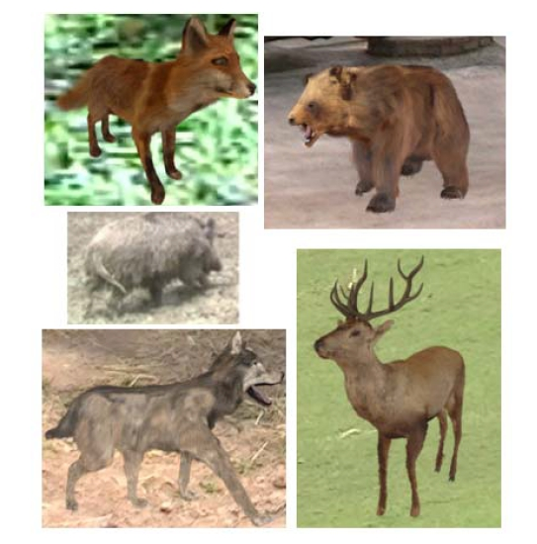

Slide 6
Experimental
The horizontal axis defines the keypoint detector and the vertical axis defines success rate of classification.

Slide 7
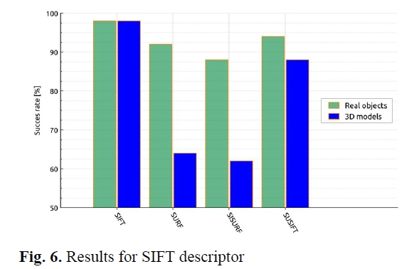

Slide 8
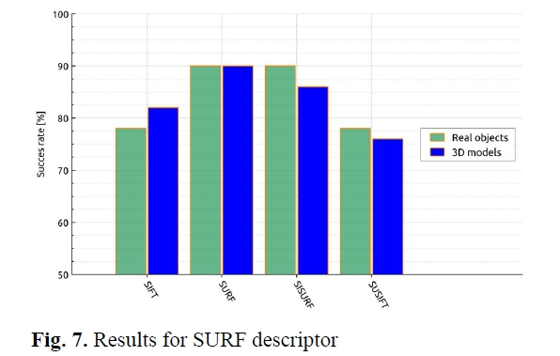

Slide 9
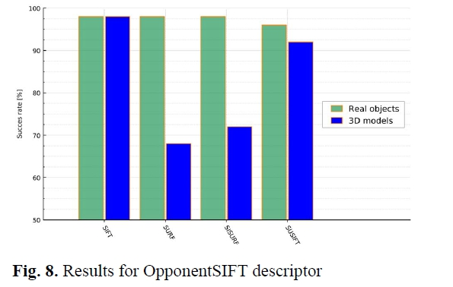

Slide 10
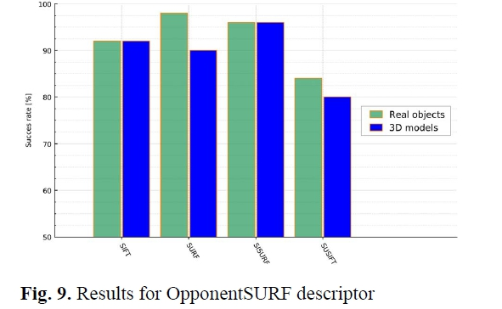

Slide 11
Conclusion
From the realized experiment is evident, that the success rate of the 3D model database was in the most case comparable with success rate of the database with the real objects. Creating the testing database using 3D modeling can save a lot of time and money and we can model the different scenes and situations. In the future, the 3D models will be animated and the videos with 3D models will be created. With these videos, we can simulate the migration of the wild animals and then we can create the migration corridors for particular mammals in particular areas.

