Slide 1
Human-Agent Cooperation in Bridge Bidding
Lockhart, E., Burch, N., Bard, N., Borgeaud, S., Eccles, T., Smaira, L., & Smith, R.
arXiv:2011.14124, 2020.
Presenter: Yun-An Chen
Date: Dec. 13, 2023

Slide 2
Abstract
We introduce a human-compatible reinforcement-learning approach to a cooperative game, making use of a third-party hand-coded human-compatible bot to generate initial training data and to perform initial evaluation. Our learning approach consists of imitation learning, search, and policy iteration. Our trained agents achieve a new state-of-the-art for bridge bidding in three settings: an agent playing in partnership with a copy of itself; an agent partnering a pre-existing bot; and an agent partnering a human player.

Slide 3
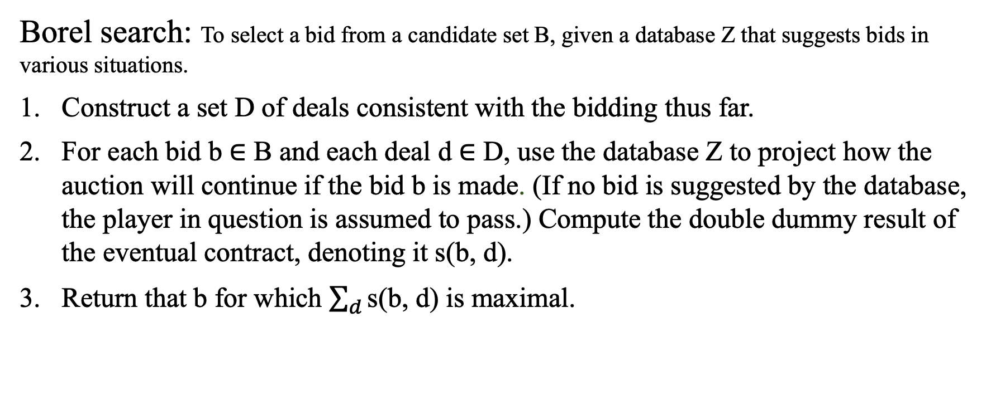
Prior work
Borel search: To select a bid from a candidate set B, given a database Z that suggests bids in various situations.
Construct a set D of deals consistent with the bidding thus far.
For each bid b ∈ B and each deal d ∈ D, use the database Z to project how the auction will continue if the bid b is made. (If no bid is suggested by the database, the player in question is assumed to pass.) Compute the double dummy result of the eventual contract, denoting it s(b, d).
Return that b for which $\sum_{d}{\text{s}\text{(}\text{b}\text{, }\text{d}\text{)}}$ is maximal.

Slide 4
Tasks
Human-compatible play: produce agents which can play well in a partnership with humans.
Partnership play: produce agents that can play well in a partnership with themselves.

Slide 5
Imitation learning
Learn a model which can predict the bids made by WBridge5.
480-element input feature vector:
Phase of the game: 2
Vulnerability (always neither side vulnerable): 2
Per player, did this player pass before the opening bid: 4
Per player and bid, did this player make this bid: 140
Per player and bid, did this player double this bid: 140
Per player and bid, did this player redouble this bid: 140
13-hot vector indicating the cards we hold: 52

Slide 6
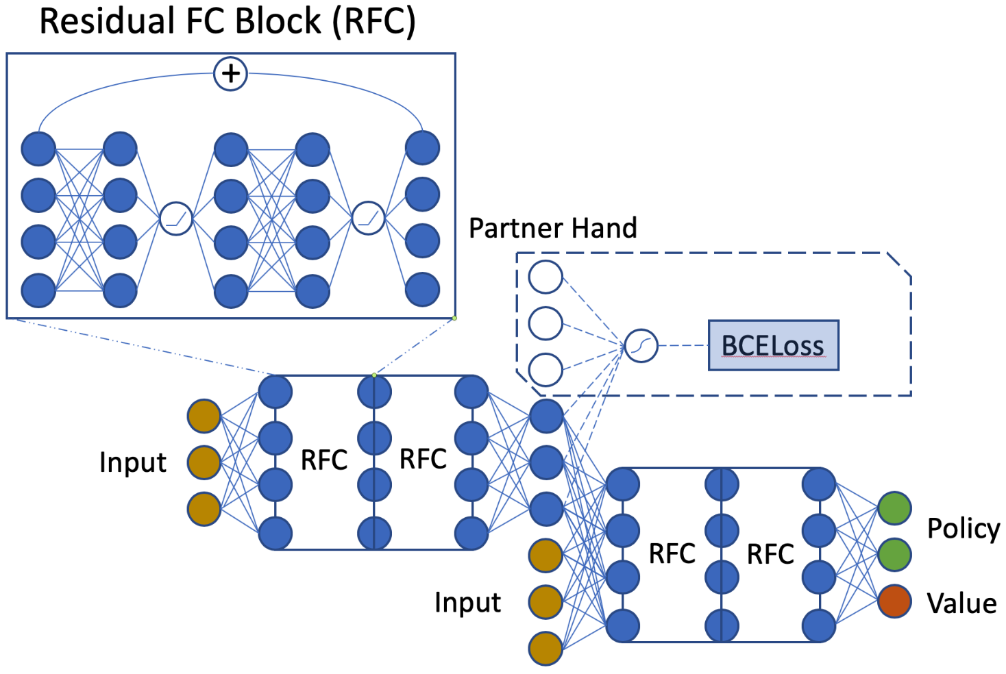
Policy network
Dataset: Wbridge5.
4-layer MLP policy network with 1024 neurons per layer.
480-element input.
38 output neurons:
Giving probabilities for each of the 38 actions.
Masking out illegal actions.
1 value neuron.
No auxiliary losses.
Qucheng Gong, Yu Jiang, and Yuandong Tian. Simple is better: Training an end-to-end con- tract bridge bidding agent without human knowledge, 2020.

Slide 7
Search
Represent policies by neural nets.
Select actions according to a stochastic policy, allowing for more diversity of possible outcomes.
Adjust prior policy towards the search results.

Slide 8
Bot evaluation
Test set: 10000 deals.
The deal is played with agent as p(N), q(E), r(S), s(W).
S(pqrs): the score obtained by the N-S partnership.
w represents WBridge5; a represents the agent under evaluation.
WBridge5-compatible play:
IMP (S(awww) − S(wwww)) − IMP (S(waww) − S(wwww)) +
IMP (S(wwaw) − S(wwww)) − IMP (S(wwwa) − S(wwww))
Team play:
IMP (S(awaw) − S(wawa))

Slide 9
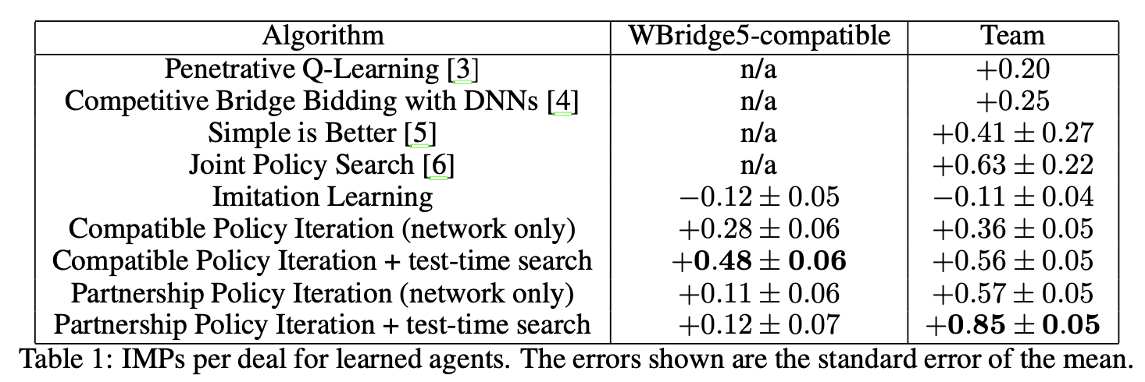
Experiments

Slide 10
Human evaluation
Instructions for the human expert were as follows:
Bid each hand according to SAYC.
The second time you play a deal in a particular seat, make the same call as the first time if the situation is identical.
Representing the human as h, the score is:
IMP (S(hwaw) − S(hwww)) − IMP (S(whwa) − S(whww)) +
IMP (S(awhw) − S(wwhw)) − IMP (S(wawh) − S(wwwh))
The agent outperforms WBridge5 by 0.97 IMPs/deal in 32 deals.

