Slide 1
Log-logarithmic Worst Case Range Queries Are Possible in Space O(N)
Dan E. Willard
Information Processing Letters,
Vol. 17, pp. 81-84, 1983.
Date: Nov. 11, 2008
Introducer: Hsing-Yen Ann

Slide 2


Abstract
Let S denote a set of N records whose keys are distinct nonnegative integers less than some initially specified bound U. This paper introduces a new data structure, called the y-fast trie, which uses space and
time for range queries on a random access machine. We will also define a simpler but less efficient structure, called the x-fast trie.

Slide 3






The Goal of vEB Tree
Maintain a sorted set , s.t. the following operations can be executed in time:
  INSERT(j):
  DELETE(j):
  MEMBER(j): Find whether
  PREDECESSOR(j): Find the largest x, s.t. x < j and
  SUCCESSOR(j): Find the smallest x, s.t. x > j and
  ( j may not belong to S)

Slide 4
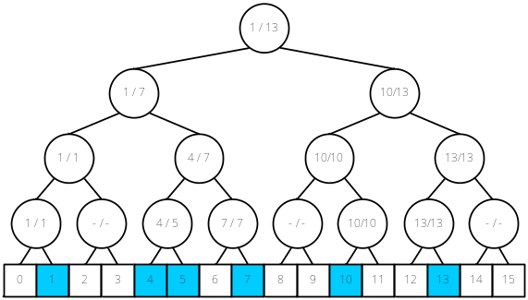



Complete Binary Tree
Implemented by a Complete Binary Tree
  INSERT / DELETE:
  MEMBER:
  PREDECESSOR / SUCCESSOR:
  Initial space:

Slide 5
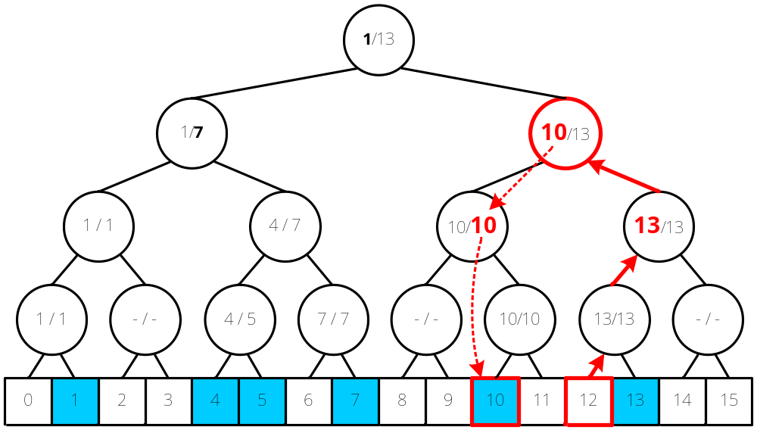
Example: Complete Binary Tree
Finding PREDECESSOR(12)

Slide 6



vEB Tree Version 1
Modified from a Complete Binary Tree
  INSERT / DELETE:
  MEMBER:
  PREDECESSOR / SUCCESSOR:
  Initial space :

Slide 7
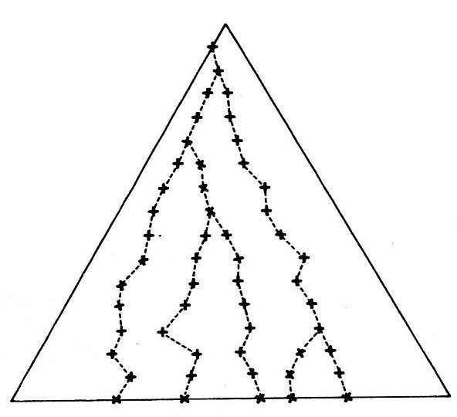
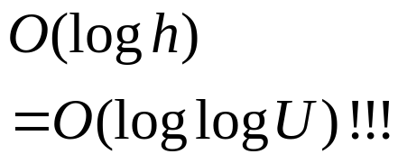
Idea: Binary Search on the Levels
Level
16
15
14
13
12
11
10
9
8
7
6
5
4
3
2
1
0
2
4
3
1

Slide 8
The k+1 Lowest Proper Fathers (Ancestors) of a Node
v.father[4]
Level | Rank
16 | 4
15 | 0
14 | 1
13 | 0
12 | 2
11 | 0
10 | 1
9 | 0
8 | 3
7 | 0
6 | 1
5 | 0
4 | 2
3 | 0
2 | 1
1 | 0
0 | 5
father[0..k]: k+1 pointers
v.father[2] = v.father[3]
v.father[0] = v.father[1]
v

Slide 9
Result: vEB Tree Version 1
Modified from a Complete Binary Tree
  INSERT / DELETE:
  MEMBER:
  PREDECESSOR / SUCCESSOR:
  Initial space :

Slide 10
vEB Tree Version 2
Modified from a vEB Tree v1 + Balanced Binary Search Trees
  INSERT / DELETE:
  MEMBER:
  PREDECESSOR / SUCCESSOR:
  Initial space:

Slide 11
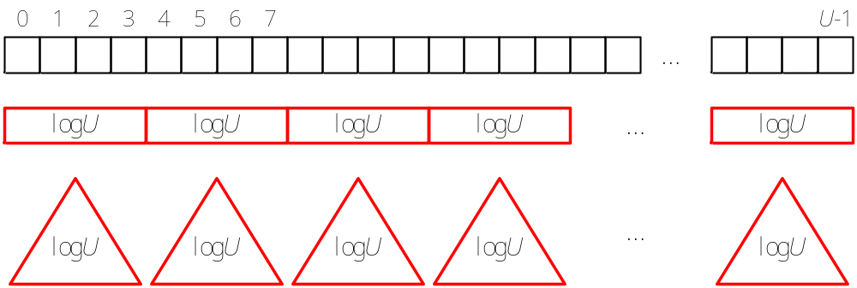
Divide the Universe (1/2)
Divide the universe of size U into segments of size logU
There are U / logU segments
Each segment is implemented by a balanced binary search tree

Slide 12
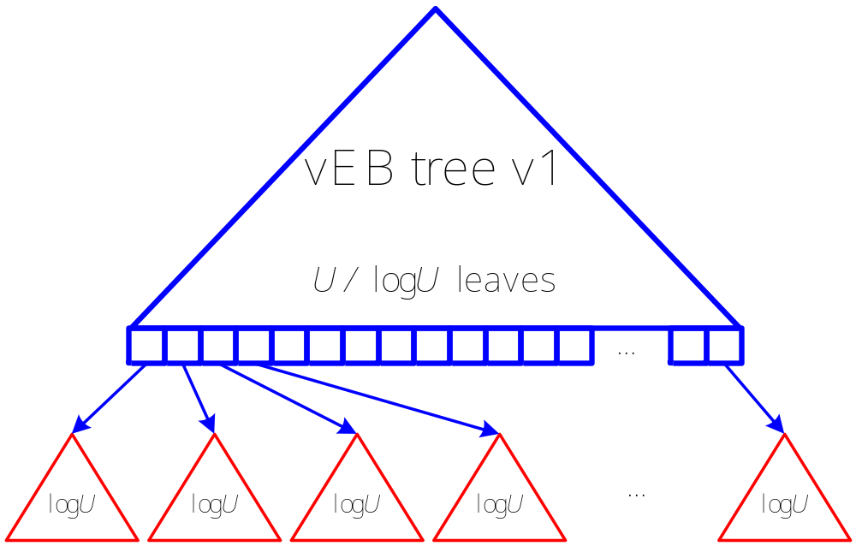
Divide the Universe (2/2)
The summary of segments is implemented by a vEB tree version 1

Slide 13
Result: vEB Tree Version 2
Modified from a vEB Tree v1 + Balanced Binary Search Trees
  INSERT / DELETE:
  MEMBER:
  PREDECESSOR / SUCCESSOR:
  Initial space:

Slide 14

The Goal of y-Fast Trie
Further reduce the space requirement
Relax the time complexity of insertions / deletions
  Good expected insertion-deletion time
  No control on the time of the worst case
  INSERT / DELETE:
  MEMBER:
  PREDECESSOR / SUCCESSOR:
  Initial space:
O(N log U) !!!
How much??
Don’t care!!

Slide 15
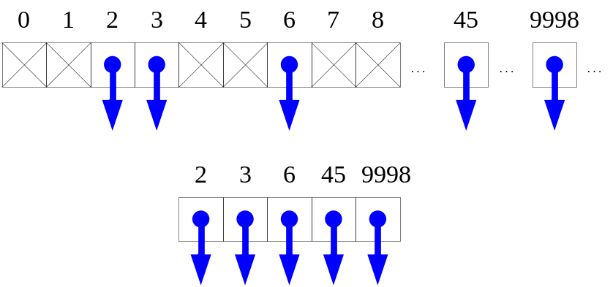

Dynamic Perfect Hashing
A magic data structure for storing a sparse array.
  INSERT / DELETE:
  MEMBER:
  Initial space:
  Total pace:
  Rehashing:

Slide 16
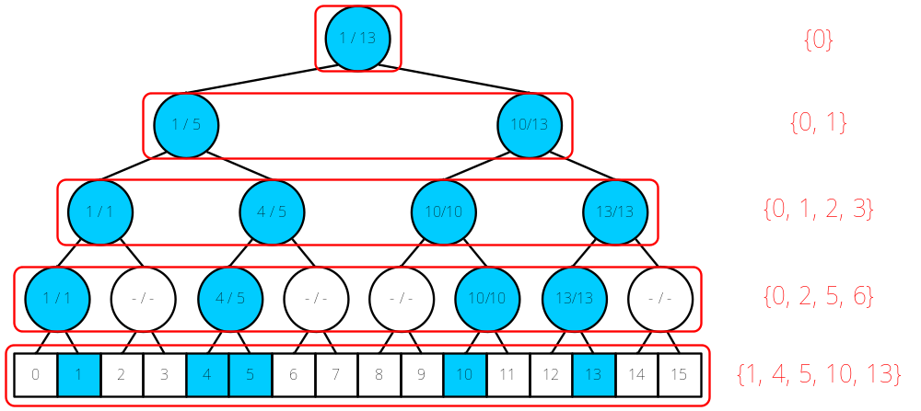
x-Fast Trie
Implemented by a conceptual Complete Binary Tree
For each level i, maintain a dynamic perfect hash table H_{i} ,
which points to a set of active nodes
  There are O(log U) hash tables

Slide 17



Analysis of x-Fast Trie
N active leaves ➔ O(N logU) active internal nodes
In the worst case, all levels will rehash
  INSERT / DELETE:
  MEMBER:
  PREDECESSOR / SUCCESSOR:
  Initial space:
  Total space:
O(N log U) !!!

Slide 18
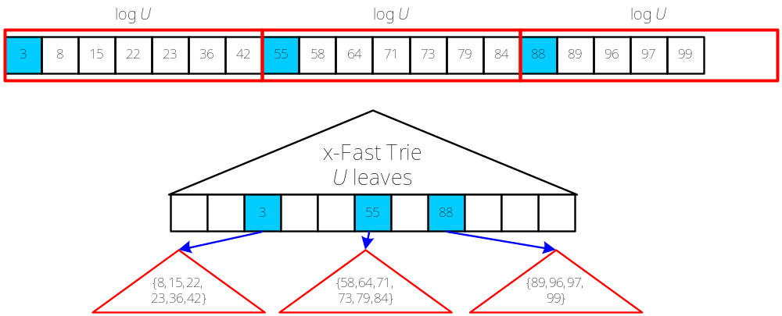
y-Fast Trie
Apply the strategy similar to vEB tree 2:
divide the N elements into segments of size logU
There are N / logU segments
  Each segment is stored in a balanced binary search tree

Slide 19



Analysis of y-Fast Trie
N / logU active leaves ➔ O(N) active internal nodes
Only for the static data
  INSERT / DELETE: Not Allowed!!
  MEMBER:
  PREDECESSOR / SUCCESSOR:
  Initial time:
  Total space:

Slide 20
Conclusion
The space requirement can be reduced if some restrictions are added.
x-fast trie and y-fast trie reduce the space by giving up the control on the worst-case time complexities on insertions / deletions.
If the data is static, y-fast trie reduces the space complexity to O(N).
For the dynamic data, x-fast trie reduces the space complexity to O(N logU).

