Slide 1
Feature Extraction for Nearest
Neighbour Face Recognition
David Masip and Jordi Vitrià
IEEE TRANSACTIONS ON NEURAL NETWORKS,
VOL. 19, NO. 4, APRIL 2008

Slide 2
Abstract
In this paper, we propose a new supervised linear feature extraction technique for multi-class classification problems that is specially suited to the nearest neighbor classifier (NN). The problem of finding the optimal linear projection matrix is defined as a classification problem and the Adaboost algorithm is used to compute it in an iterative way.

Slide 3
Abstract
This strategy allows the introduction of a multitask learning (MTL) criterion in the method and results in a solution that makes no assumptions about the data distribution and that is specially appropriated to solve the small sample size problem. The performance of the method is illustrated by an application to the face recognition problem. The experiments show that the representation obtained following the multitask approach improves the classic feature extraction algorithms when using the NN (nearest neighbor) classifier, especially when we have a few examples from each class.

Slide 4
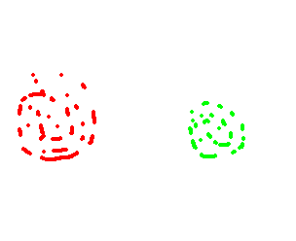



Within & between class scatter
Within-class
Within-class
Class 1
Class 2
Between-class
Within-class scatter指的是同一類別內資料的分散程度
Between-class scatter指的是不同類別間資料的分散程度

Slide 5


Fisher Linear Discriminant (FLD)
Suppose we have n d-dimensional samples x₁, x₂, …, x_{n} belonging to c different classes with n_{i} samples in the subset Di labeled ω_{i}.
The objective of FLD is seek the direction w not only maximizing the between-class scatter of the projected samples but also minimizing the within-class scatter.

Slide 6
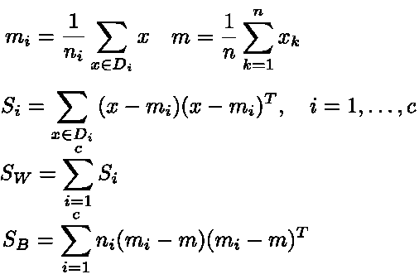
Fisher Linear Discriminant (FLD)
m_{i}: sample mean for class ω_{i}
m: sample mean for the whole set
S_{B}: between-class scatter matrix
S_{i}: scatter matrix corresponding to ω_{i}
S_{w}: within-class scatter matrix

Slide 7
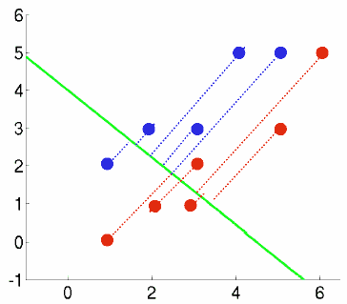
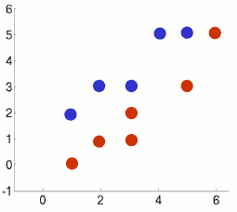
FLD example
Class 1 has 5 samples c1 = [(1,2),(2,3),(3,3),(4,5),(5,5)]
Class 2 has 6 samples c2 = [(1,0),(2,1),(3,1),(3,2),(5,3),(6,5)]
m1=(3,3.6), m2=(3.3,2),m=(3.2,2.7)
S1=[10,8;8,7.2],S2=[17.3,16;16,16],Sw=S1+S2=[27.3,24;24,23.2],Sb=[0.3,-1.5;-1.5,7]
w=(-0.67,0.75), λ1=4.6
λ2=0, 這表示二維資料最多取得一個最佳旋轉方向=>傳統FLD缺點
Notes:
c1=[1 2;2 3;3 3;4 5;5 5]’
c2=[1 0;2 1;3 1;3 2;5 3;6 5]‘
m1=mean(c1,'c')
m2=mean(c2,'c')
m=(m1*5+m2*6)/11
c1_m1=c1-mtlb_repmat(m1,1,5)
S1=c1_m1*c1_m1’
c2_m2=c2-mtlb_repmat(m2,1,6)
S2=c2_m2*c2_m2’
Sw=S1+S2
Sb=5*(m1-m)*(m1-m)'+6*(m2-m)*(m2-m)‘
[V,D] = mtlb_eig(inv(Sw)*Sb)

Slide 8
FLD example 1
FLD分析後，兩類別分得更開，但各自類別卻縮的較近
Notes:
c1=[1 2;2 3;3 3;4 5;5 5]’
c2=[1 0;2 1;3 1;3 2;5 3;6 5]‘
m1=mean(c1,'c')
m2=mean(c2,'c')
m=(m1*5+m2*6)/11
c1_m1=c1-mtlb_repmat(m1,1,5)
S1=c1_m1*c1_m1’
c2_m2=c2-mtlb_repmat(m2,1,6)
S2=c2_m2*c2_m2’
Sw=S1+S2
Sb=5*(m1-m)*(m1-m)'+6*(m2-m)*(m2-m)‘
[V,D] = mtlb_eig(inv(Sw)*Sb)

Slide 9
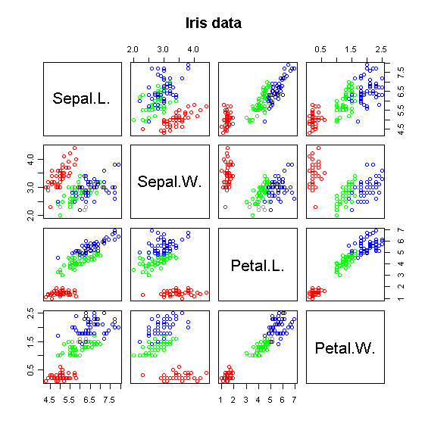
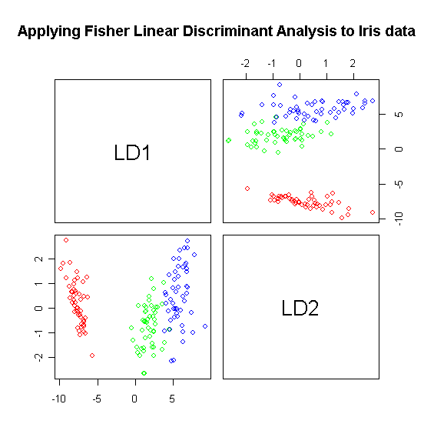
FLD example 2
在原本4特徵，似乎只有Petal.W.特徵是較有鑑別力的，LD1為擷取出相當有鑑別力的特徵
Notes:
LD1 LD2
Sepal.L. -0.8293776 0.02410215
Sepal.W. -1.5344731 2.16452123
Petal.L. 2.2012117 -0.93192121
Petal.W. 2.8104603 2.83918785

Slide 10
Feature selection / extraction
The Feature selection or extraction in this paper
  In the feature selection approach, only a subset from the original feature vector is preserved.
  In feature extraction, the original features are combined or transformed into the new extracted features.

Slide 11
Adaboost
Train classifier1
classified
test
unclassified
data
越後面分類器負責學習前面分類器認為困難的資料
分類時所有分類器以加權投票方式決定類別
Train classifier2
…

Slide 12
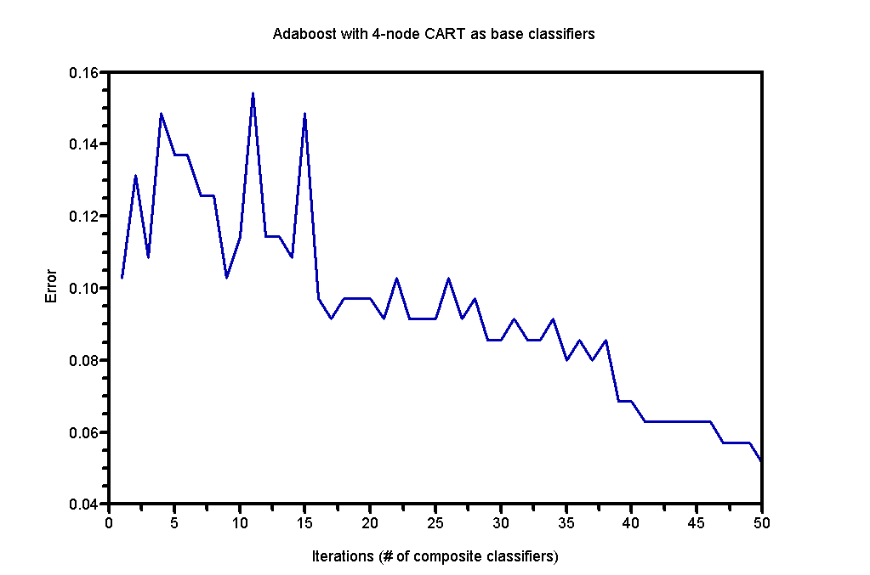
Adaboost
Data: Ionosphere from UCI Repository of machine learning databases
50 CART classifier are built.

Slide 13
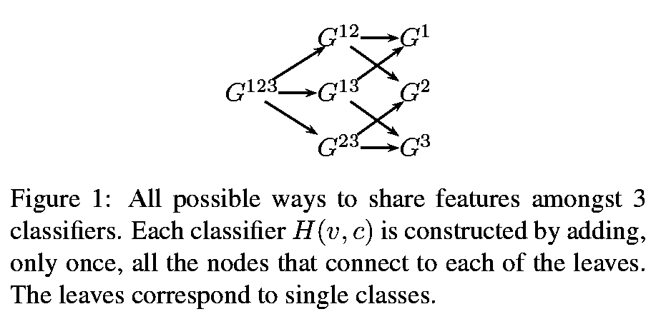
Sharing features

Slide 14
Sharing features
Common features that can be shared across the classes
  Features selected by independently trained classifiers are often specific to the class, whereas the features selected by the jointly trained classifiers are more generic features.
  Many fewer features are needed to achieve a desired level of performance.
This results in a faster classifier (since there are fewer features to compute) and one which works better (since the features are fit to larger, shared data sets).

Slide 15
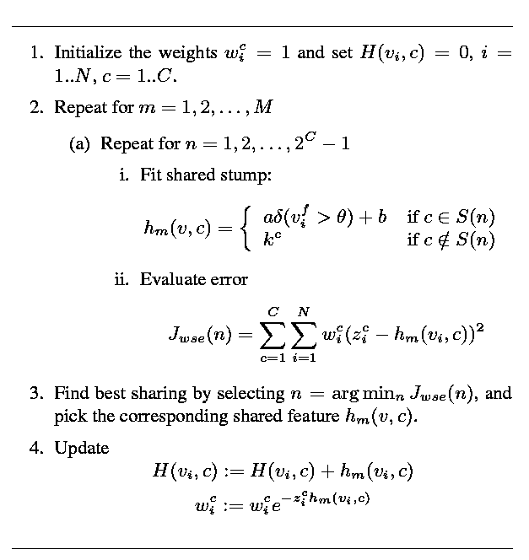
Joint boosting (training) algorithm for sharing features
C為類別數量
找出對某些類別組合有益之共同特徵
找出最佳之共同特徵，即使誤差函數J最小
如果本階段分錯，z_{i}*h_{m}會負，致使wi變大，第i樣本下一階段被選入訓練之機會加大

Slide 16

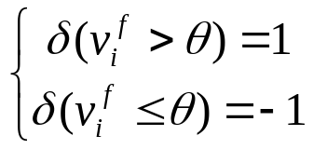

Joint boosting parameters
上圖之h_{m}(v,c)定義為
其中δ為indicator function
誤差函數J_{wse}為

Slide 17
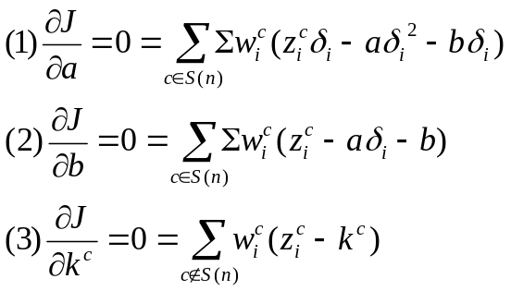
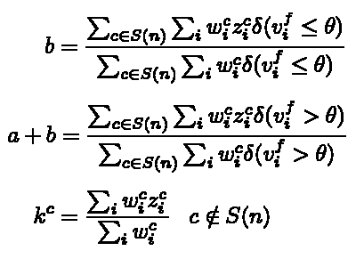
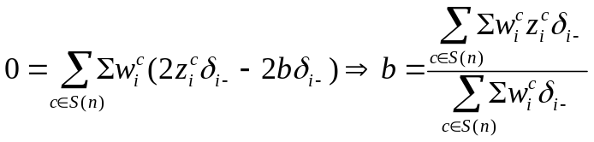
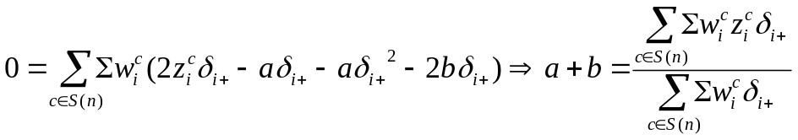
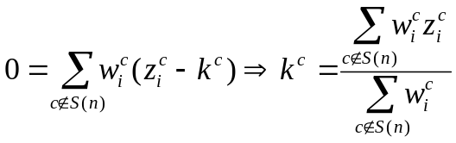
Joint boosting parameters
以誤差函數J_{wse}對a、b及k^{c}微分，令為零
(1)-(2)
(1)+(2)
(3)

Slide 18
Alternative to exhaustive search of all shared stumps
Assuming C classes
There is O(2^{C}) combinations to consider in order to obtain best common features
An O(C²) alternative
  Find the best feature for each individual class
  Find the second class that has the best error reduction jointly with the previous class
  Iterate until all classes are added
  Total C+C(C-1)/2=C(C+1)/2 sharing patterns

Slide 19
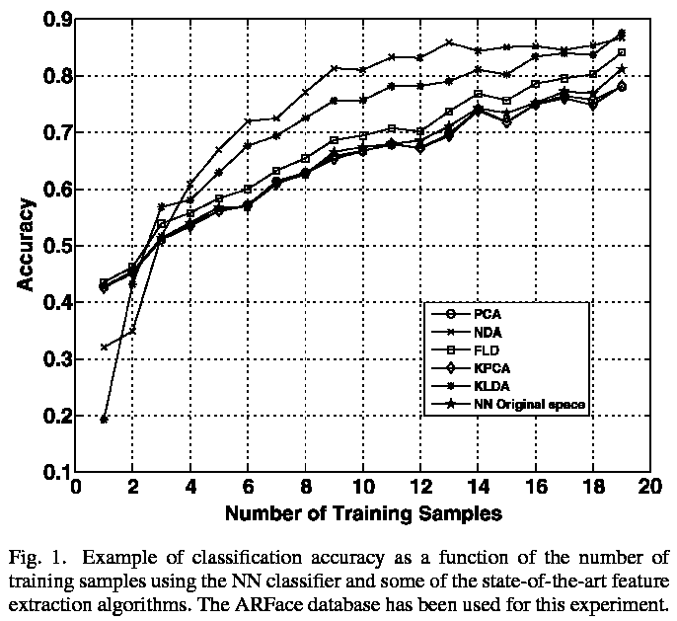
Small sample size problem
In face recognition problems, the number of images from each class is considerably limited: only one or two faces can be acquired from each person. Under this assumption, most of the traditional feature extraction methods suffer a significant performance drop.

Slide 20
MTL (multitask learning)
The MTL approach learns from different tasks in parallel, obtaining improved classification rates given that the “knowledge” learned for one task can help in learning about the other tasks.
Torralba et al. adapted the multitask approach to the Adaboost classifier. They proposed a joint boosting algorithm for an object detection problem with background and multiple objects involved. Their results show an improvement on the accuracies, obtaining faster classifiers, and also requiring less training data.

Slide 21
Contributions of this paper
Introducing the MTL approach into the feature extraction task. => Small sample size problem
FLD + Adaboost : Adaboost-based feature extraction algorithm
Multitask boosted discriminant projections (MBDP)

Slide 22
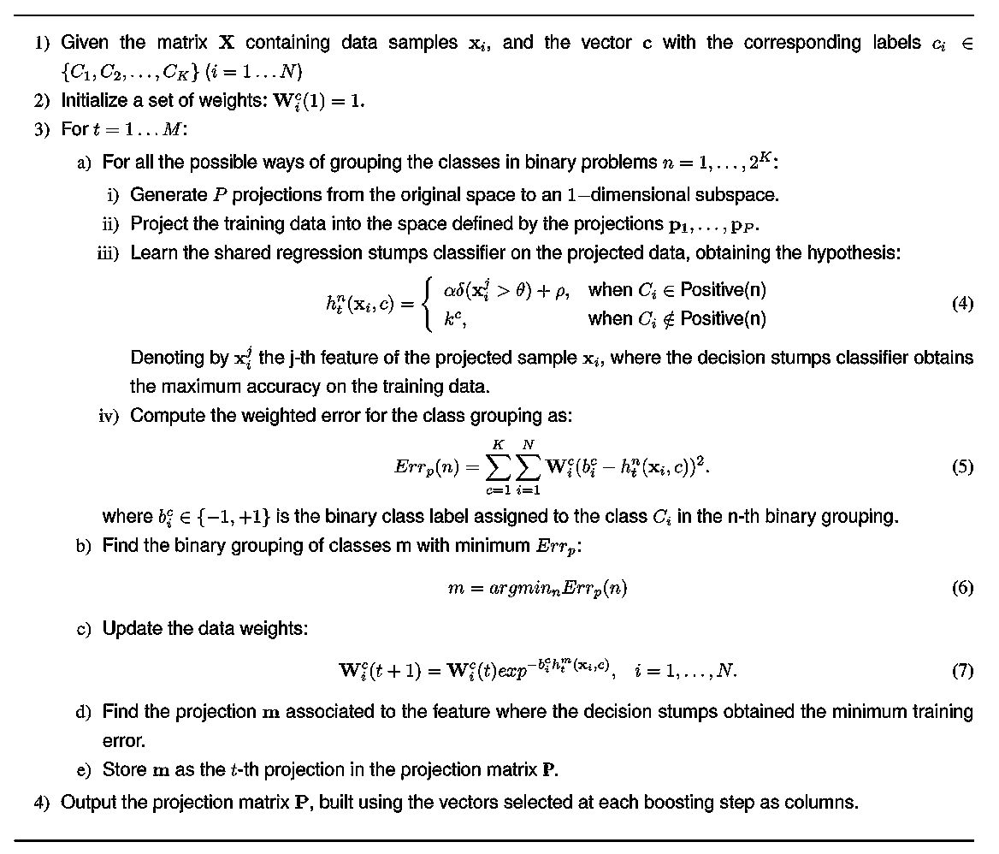
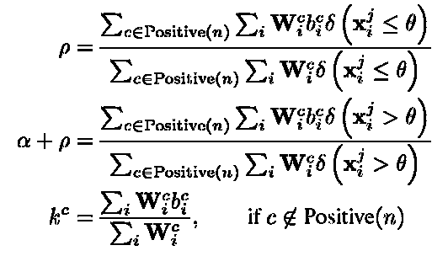
MBDP algorithm

Slide 23
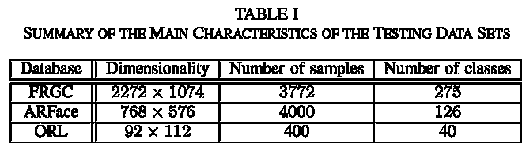
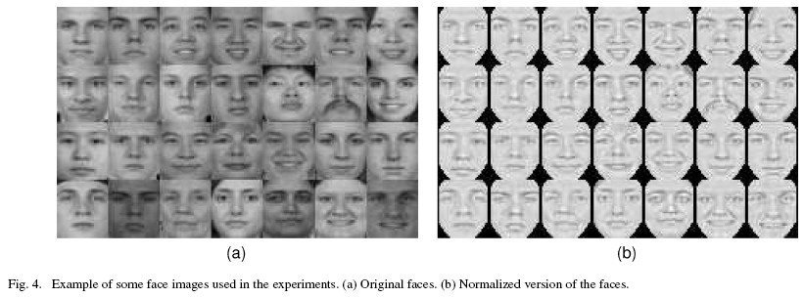
Dataset

Slide 24
Preprocessing
RGB -> Grayscale
A light normalization based on anisotropic filtering
Performing a geometric normalization using the coordinates of each eye.
The samples were then cropped obtaining a 37x33 thumbnail
the thumbnails were masked using an elliptical mask.
Histogram equalization
The pixels have been normalized to have zero mean and standard deviation of one

Slide 25
Feature & Classifier
Using MBDP , PCA, NDA, FLD, KPCA, KLDA, NN to extract features
Using nearest neighbor (NN) to classify

Slide 26
Experiments
For I=1 to 100
  Extracting up to (not more than) 100 features
    50 (or 40) classes, each containing 2 samples were retrieved (80~100 samples)
    Extracting features (MPDB,PCA,NDA,FLD,KPCA,KLDA,NN)
  Using the rest of data for NN testing
Calculating mean & standard deviation

Slide 27
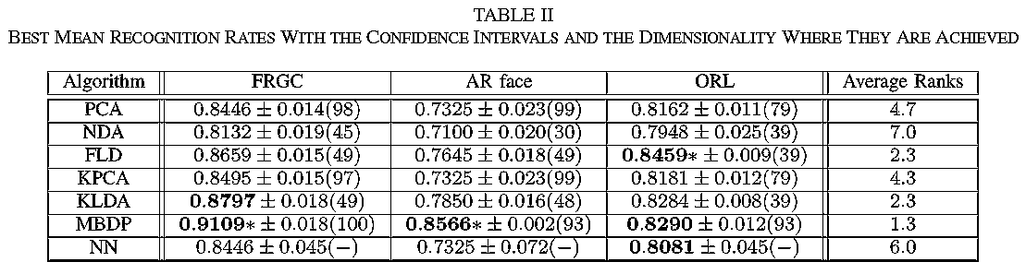
Results

Slide 28
Friedman tests
Freidman test 就是拿剛剛所得的Rank(Rj)、訓練方法次數與樣本數計算F_{F}，然後與某一信心水準下的F相比較，如果F_{F}大於F，就表示具顯著性，並可拒絕虛無假設
Define null & alternative hypothesis
  Null: the algorithms are equivalent, and the performance differences observed can be considered merely random.
  Alternative: There is significant difference between feature extraction algorithms.

Slide 29
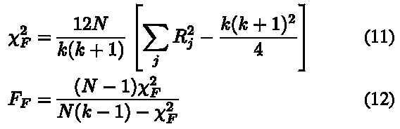
Friedman tests
Friedman statistics
Result:
  F_{F} =29.5
  F = 4.821
  Reject null hypothesis.
  The difference between feature extraction algorithms is significant.

Slide 30
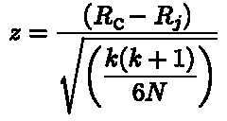
Post hoc significance test
F-test reports significant difference between feature extraction algorithms.
The post hoc significant test is employed to assure MBDP outperforms other feature extraction algorithms.
如果實驗所得z和某信心水準z相較夠大，則可拒絕虛無假設
z-statistics

Slide 31
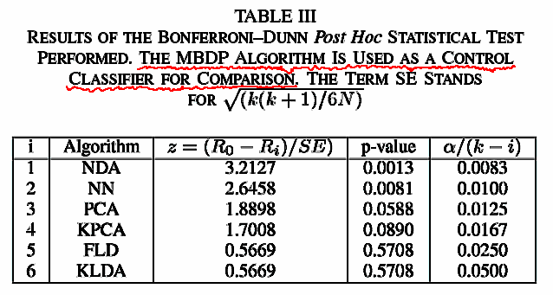
Post hoc significance test
Significant
Yes
Yes
No
No
No
No
表示MBDP+NN比NDA+NN以及原本NN好

Slide 32
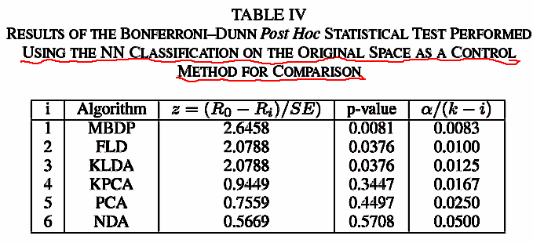
Post hoc significance test
Significant
Yes
No
No
No
No
No
表示MBDP+NN比原本NN好

Slide 33
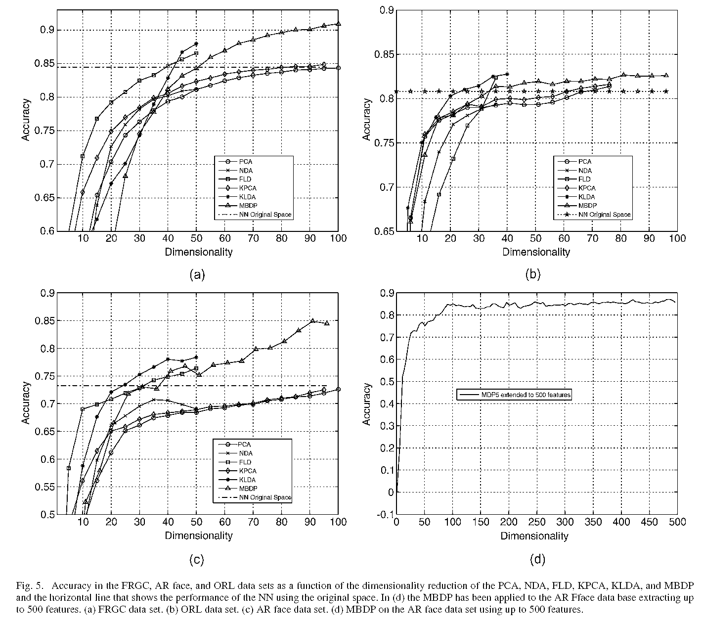
Classification rate vs. features#

