Slide 1

Multi-class Protein Fold Recognition Using Support Vector Machines and Neural Networks
Chirs H.Q. Ding and Inna Dubchak
NERSC Divison, Lawrence Berkeley National Laboratory, University of California, Berkeley, CA 94720, USA
Bioinformatics Vol. 17 no. 4 2001 Pages 349-358
Presenter: Hsin-Wei Yen
Date: Dec. 29 , 2008

Slide 2

Abstract
  Motivation: Protein fold recognition is an important approach to structure discovery without relying on sequence similarity. We study this approach with new multi-class classification methods and examined many issues important for a practical recognition system.

Slide 3
Abstract
  Results: Most current discriminative methods for protein fold prediction use the one-against-others method, which has the well-known ‘False Positives’ problem. We investigated two new methods: the unique one-against-others and the all-against-all methods. Both improve prediction accuracy by 14-110% on a dataset containing 27 SCOP folds.

Slide 4
Abstract
  We used the Support Vector Machine (SVM) and the Neural Network (NN) learning methods as base classifiers. SVMs converges fast and leads to high accuracy. When scores of multiple parameter datasets are combined, majority voting reduces noise and increases recognition accuracy.

Slide 5
Abstract
  We examined many issues involved with large number of classes, including dependencies of prediction accuracy on the number of folds and on the number of representatives in a fold. Overall, recognition systems achieve 56% fold prediction accuracy on a protein test dataset, where most of the protein s have below 25% sequence identity with the proteins used in training.

Slide 6
One-versus-others Method
  K classes problem
  partition the K classes into a two-class problem
  one class contains the original class, and the ‘others’ class contains the rest

Slide 7





One-versus-others Method
  we have 5 classes
  build 5 classifiers
A/ BCDE ?
B/ACDE ?
C/ABDE ?
D/ABCE ?
E/ABCD ?

Slide 8
One-versus-others Method
  “false positive problem”
  A , C ,or D ??
  use more parameters, voting
A/ BCDE
B/ACDE
C/ABDE
D/ABCE
E/ABCD

Slide 9








Unique one-versus-others Method
A/ BCDE
B/ACDE
C/ABDE
D/ABCE
E/ABCD
  Add second step
  Add the numbers of classifier but reduce the noise
A / C ?
A / D ?
C / D ?

Slide 10










All-versus-all Method
A / B ?
A / C ?
A / D ?
A / E ?
B / C ?
  we have K classes
  build K(K-1)/2 classifiers (if K=5, we have 10 classifiers )
B / D ?
B / E ?
C / D ?
C / E ?
D / E ?

Slide 11
Dataset
  Training dataset:
      utilized 27 most populated folds from the 128 folds based on the PDB_select sets
      the sequence identity is no more than 35%
      longer than 80 residues

Slide 12
Dataset
  Independent test dataset:
      use the PDB40D set developed by the authors of the SCOP database
      less than 40% identity with each other
      selected 386 representatives of the same 27 folds
      proteins had higher than 35% identity were excluded from the testing set

Slide 13
Feature Vector Extraction
  C: Amino acids composition
  S: Predicted secondary structure
  H: Hydrophobicity
  V: Normalized van der Waals volume
  P: Polarity
  Z: Polarizability

Slide 14
Accuracy Measure
  In the one-versus-others method
      TPR: True Positive Rates = TPi / ni
      FPR: False Positives Rates = FPi / ni
  In the all-versus-all method, there are no such concepts as true positive and false positive

Slide 15
Accuracy Measure
  In the all-versus-all method, use the “standard Q percentage accuracy”
  N = n1 + n2 + ... + nk
  C = c1 + c2 + ... + ck
      if a protein is tested positive for 4 classes, and one of them is correct, then c = 1/4

Slide 16
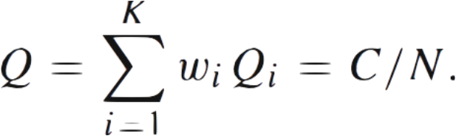
Accuracy Measure
  ωi = ni / N
  this generalized accuracy definition is called “unique accuracy”

Slide 17
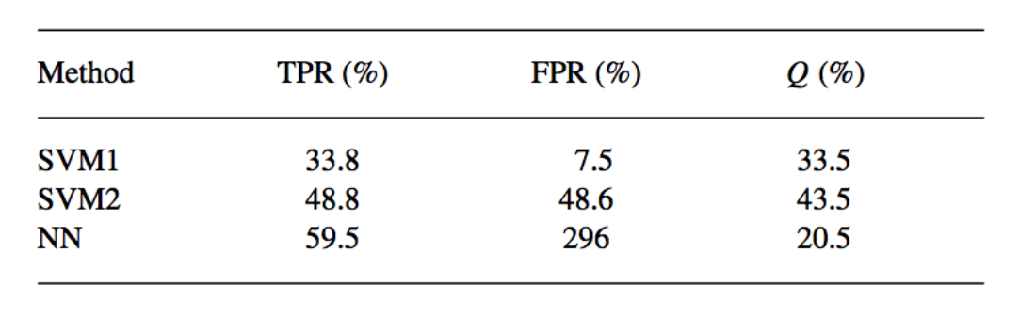
one-versus-others, the composition data only

Slide 18
Test on Independent Datasets
  one-versus-others method
    example:
      1hbg (F1) 1:1 46:1 47:1 51:1
      (1 parameter)
      1hbg (F1) 1:6 20:2 46:2 47:2 51:2 4:1
      7:1 9:1 11:1 30:1 32:1
      (6 parameters)

Slide 19
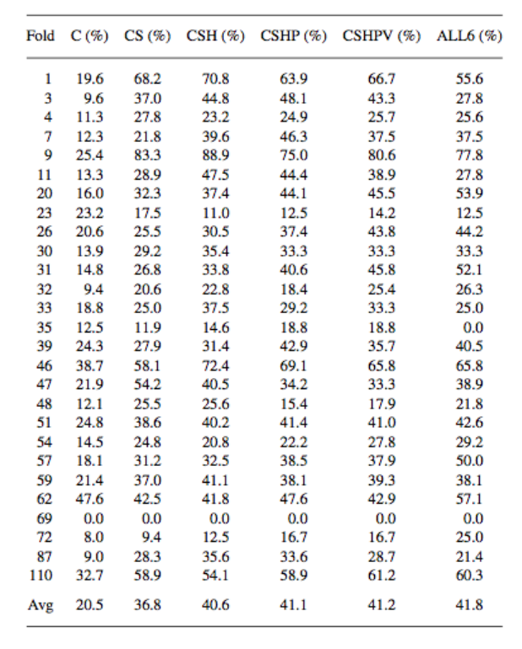
Test on Independent Datasets

Slide 20






Test on Independent Datasets
  Unique one-versus-others method
  example:
    1hbg (F1) 1:1 46:1 47:1 51:1
1 / 46 ?
1 / 47 ?
1 / 51 ?
46 / 47 ?
46 / 51 ?
47 / 51 ?

Slide 21
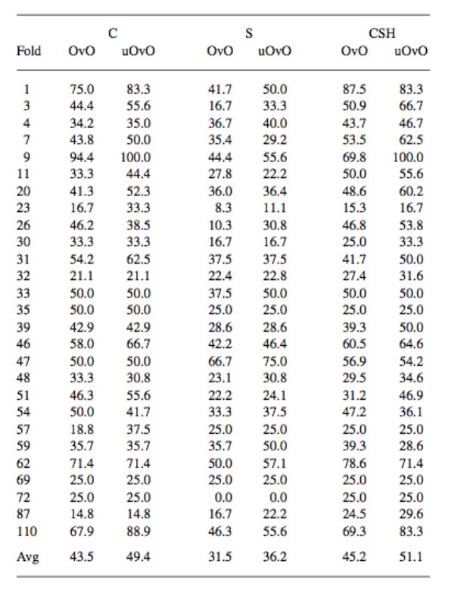
Test on Independent Datasets

Slide 22
Test on Independent Datasets
  All-versus-all method
  example:
  ihbg (F1) 1:26 46:24 47:24 51:23 3:22
  69:21 48:20 35:18 59:18 23:16
  repeated for all 6 parameter sets, resulting in a total of 2106 two-way classifiers
  (27 * 26 / 2) * 6 = 2106

Slide 23
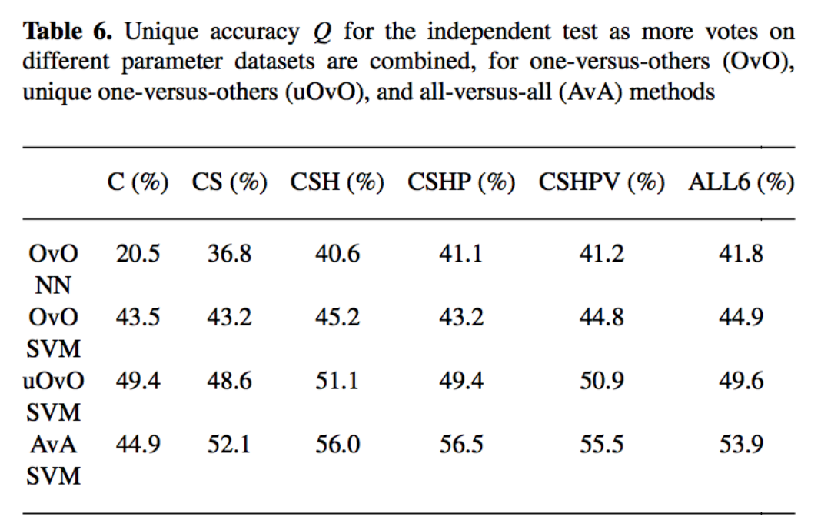
Test on Independent Datasets

Slide 24
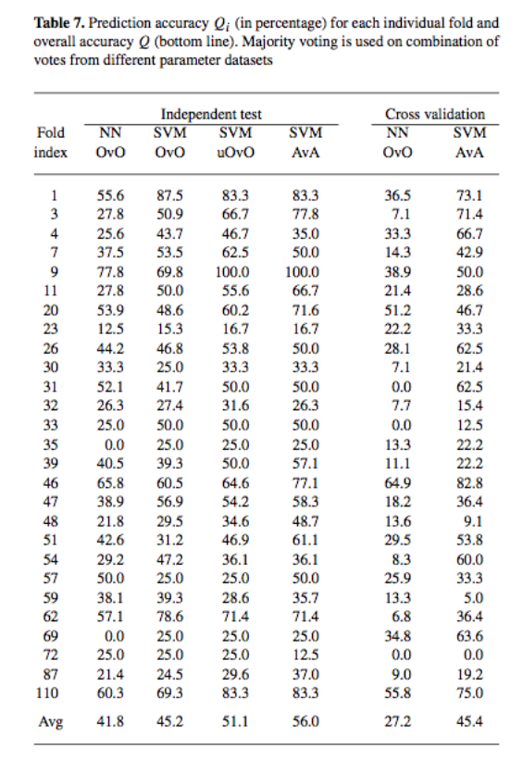
Cross-validation (CV)

Slide 25
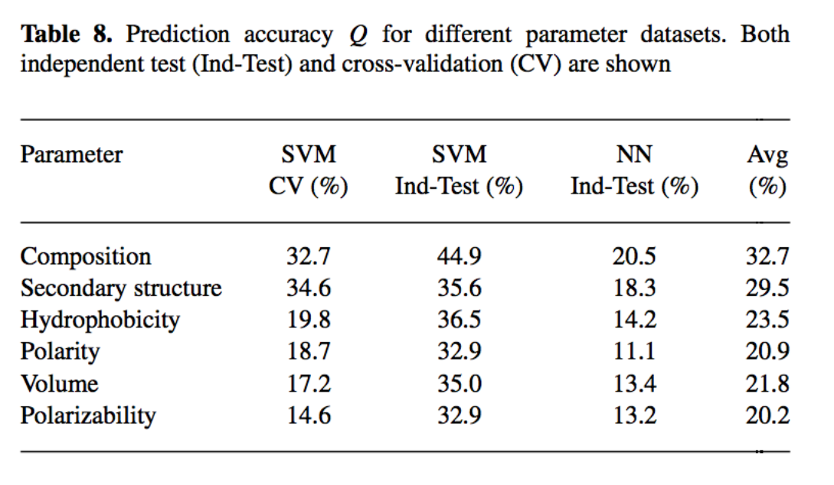
Effectiveness of Parameter Sets

Slide 26
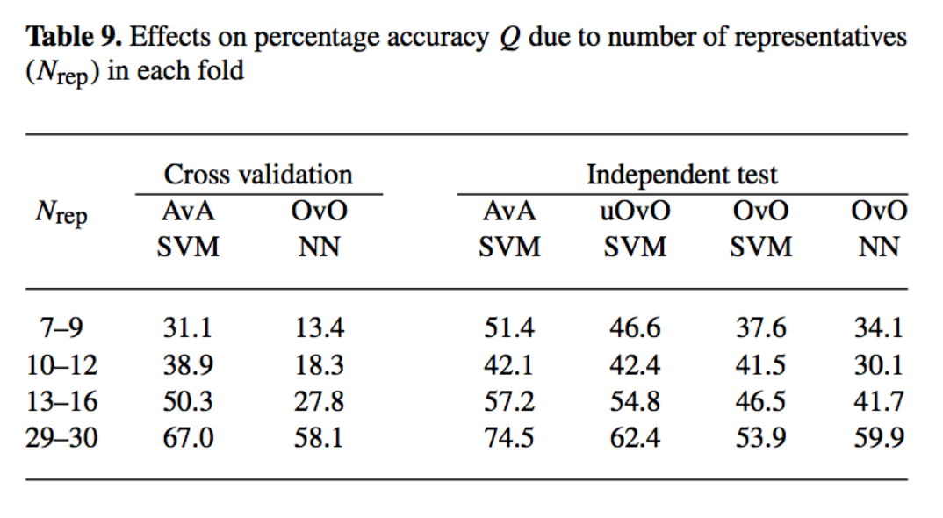
How many representatives does each fold need?

Slide 27
Conclusions
  both methods appear to perform equally well
  all-versus-all method has cleaner decision boundaries between all pairs of classes, but has larger noise due to the involvement of all possible pairs.
  unique one-versus-others method involves substantially fewer pairs of classes, thus less noise. The second step reduce noise.

