Slide 1
Research on Longest Common Subsequence Fast Algorithm
Jiamei Liu(劉佳梅), Suping Wu(吳素萍)
Consumer Electronics, Communications and Networks (CECNet), 2011 International Conference on
Presenter: Che-Jui Hsu(許哲睿)
Date: 2012/9/21

Slide 2
Abstract
In order to improve the efficiency of searching the longest common subsequence (LCS) a method of finding LCS (here, the length of the LCS p is much smaller than the length of smaller string of two strings m) is realized in this paper, which transform this problem into solving the problem of matrix L (p, m), by theorem the process of computing each element in the matrix is optimized. Algorithm analysis and experimental results show this algorithm is better than dynamic programming method. And a parallel algorithm based on OpenMP is provided in this paper, which speed of sloving large-scale data is greatly improved.

Slide 3
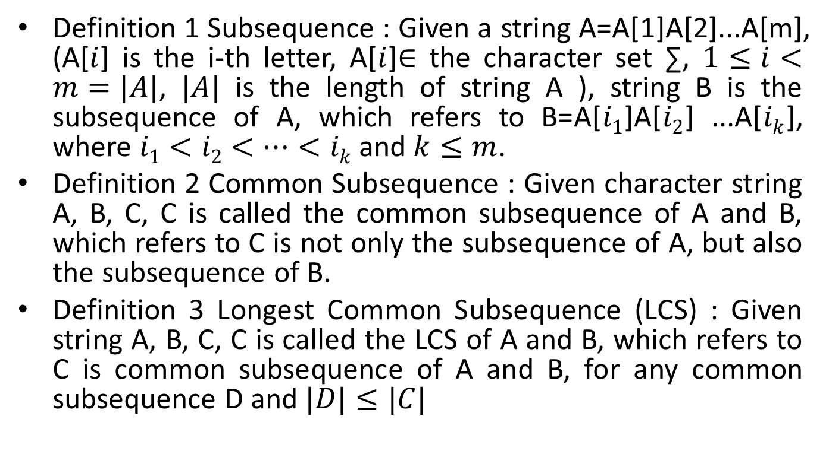
Definitions (1)
Definition 1 Subsequence : Given a string A=A[1]A[2]...A[m], (A[$i$] is the i-th letter, A[$i$]∈ the character set ∑, $1≤i<m=|A|$, $|A|$ is the length of string A ), string B is the subsequence of A, which refers to B=A[$i1$]A[$i2$] ...A[$ik$], where $i1<i2<…<ik$and $k≤m$.
Definition 2 Common Subsequence : Given character string A, B, C, C is called the common subsequence of A and B, which refers to C is not only the subsequence of A, but also the subsequence of B.
Definition 3 Longest Common Subsequence (LCS) : Given string A, B, C, C is called the LCS of A and B, which refers to C is common subsequence of A and B, for any common subsequence D and $|D|≤|C|$

Slide 4
Definitions (2)
Definition 4 : Given a string A=A[1]A[2]...A[m] and the other one, B=B[1]B[2]...B[n], A(1: i) means continuous sequence A, A[1]A[2]...A[i], in the same way B(1: j) means continuous sequence B, B[1]B[2]...B[j]. L_{i}(k) refers to that the string A(1: i) and B(1: j) has the LCS with length k, which is the minimum value of j. With the formula is L_{i}(k) = Min(j) (LCS (A(1: i), B(1: j)) = k).

Slide 5
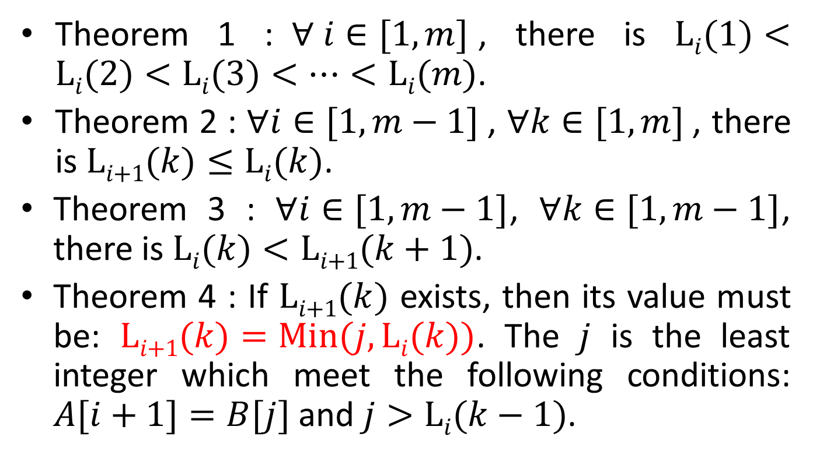
Theorems
Theorem 1 :$∀ i∈[1,m]$, there is $\text{L}i(1)<\text{L}i(2)<\text{L}i(3)<…<\text{L}i(m)$.
Theorem 2 : $∀i∈[1, m−1]$, $∀k∈[1, m]$, there is $\text{L}i\text{+}1(k)≤\text{L}i(k)$.
Theorem 3 : $∀i∈[1,m−1]$, $∀k∈[1,m−1]$, there is $\text{L}i(k)<\text{L}i\text{+}1(k+1)$.
Theorem 4 : If $\text{L}i\text{+}1(k)$ exists, then its value must be: $\text{L}i\text{+}1(k)=\text{Min}(j, \text{L}i(k))$. The $j$ is the least integer which meet the following conditions: $A[i+1]=B[j]$ and $j>\text{L}i(k−1)$.

Slide 6
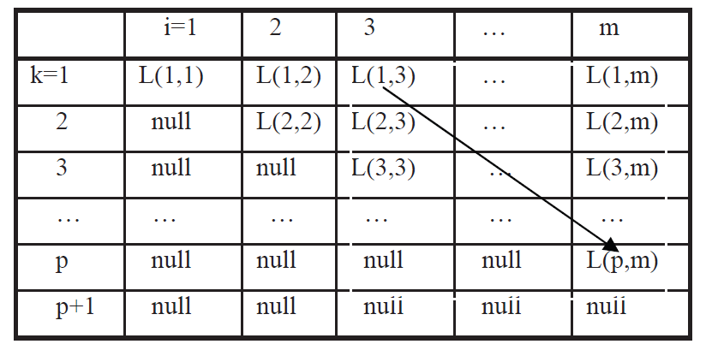

Algorithmic Idea
$L(k,i)=\text{L}i(k)$
$\text{LCS}=\text{B}[L(1,m−p+1)]\text{B}[L(2,m−p+2)]…\text{B}[L(p, m)]$

Slide 7
Example
A = acdabbc, |A| = 7
B = cddbacaba, |B| = 9
LCS = B[1]B[2]B[4]B[6] = cdbc
i k | 1 | 2 | 3 | 4 | 5 | 6 | 7
1 | 5 | 1 | 1 | 1 | 1 | 1 | 1
2 | null | 6 | 2 | 2 | 2 | 2 | 2
3 | null | null | null | 5 | 4 | 4 | 4
4 | null | null | null | null | 8 | 8 | 6
5 | null | null | null | null | null | null | null

Slide 8
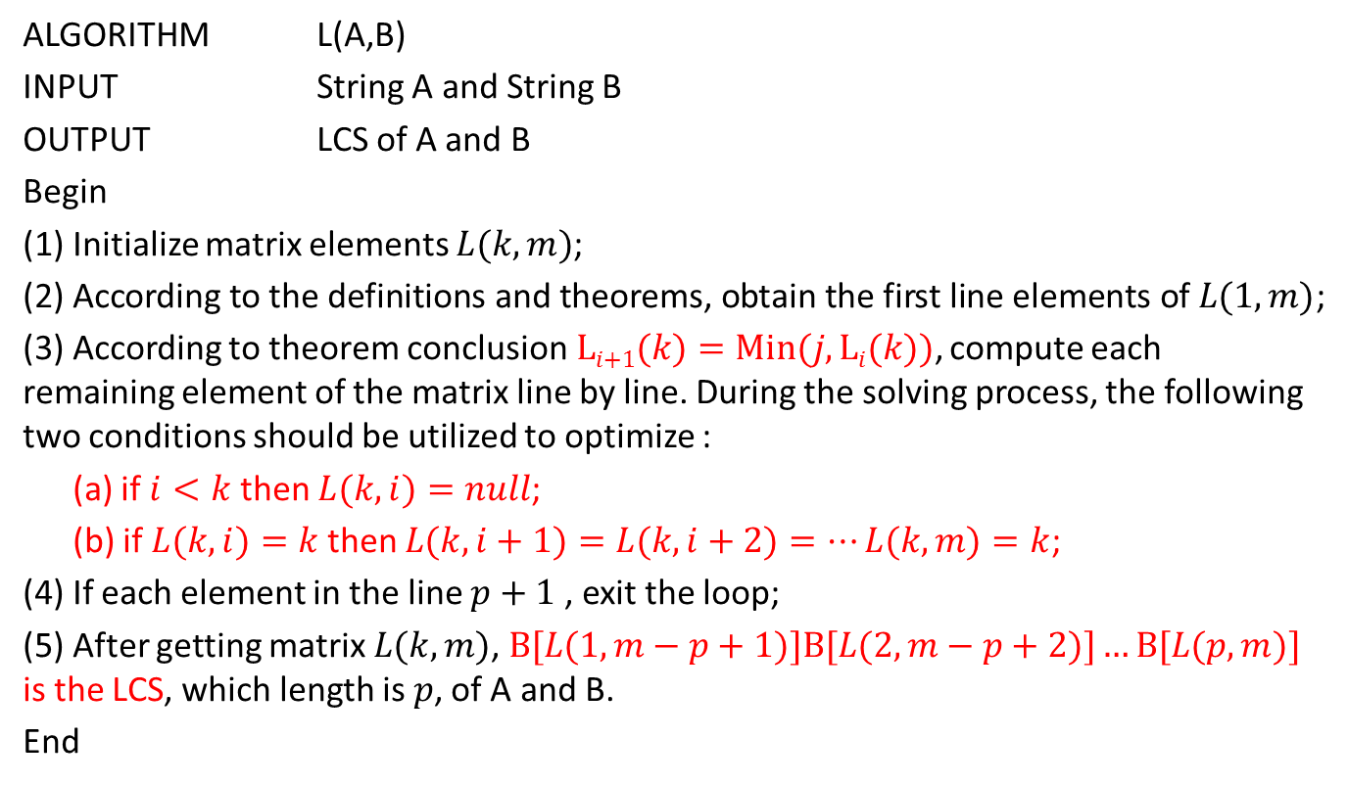
Algorithm Pseudo-code
ALGORITHM L(A,B)
INPUT String A and String B
OUTPUT LCS of A and B
Begin
(1) Initialize matrix elements $L(k,m)$;
(2) According to the definitions and theorems, obtain the first line elements of $L(1, m)$;
(3) According to theorem conclusion$\text{L}i\text{+}1(k)=\text{Min}(j,\text{L}i(k))$, compute each remaining element of the matrix line by line. During the solving process, the following two conditions should be utilized to optimize :
(a) if $i<k$ then $L(k,i)=null$;
(b) if $L(k,i)=k$then $L(k,i+1)=L(k,i+2)=…L(k,m)=k$;
(4) If each element in the line $p+1$ , exit the loop;
(5) After getting matrix $L(k, m)$, $\text{B}[L(1, m−p+1)]\text{B}[L(2, m−p+2)]…\text{B}[L(p, m)]$ is the LCS, which length is $p$, of A and B.
End

Slide 9
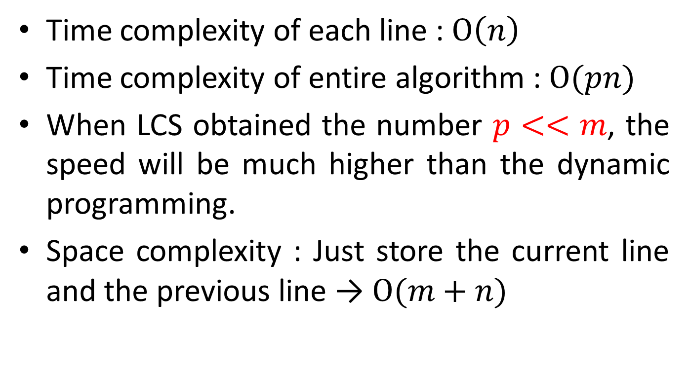
Algorithm Analysis
Time complexity of each line : $\text{O}\left(n\right)$
Time complexity of entire algorithm : $\text{O}(pn)$
When LCS obtained the number $p<<m$, the speed will be much higher than the dynamic programming.
Space complexity : Just store the current line and the previous line → $O(m+n)$

Slide 10
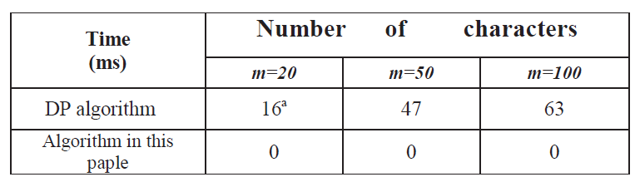
Experimental Results
Hardware environment : Intel^{(R)} Core^{(TM)}2 Dual-core processor, 1G memory.
Software environment : Windows XP

Slide 11
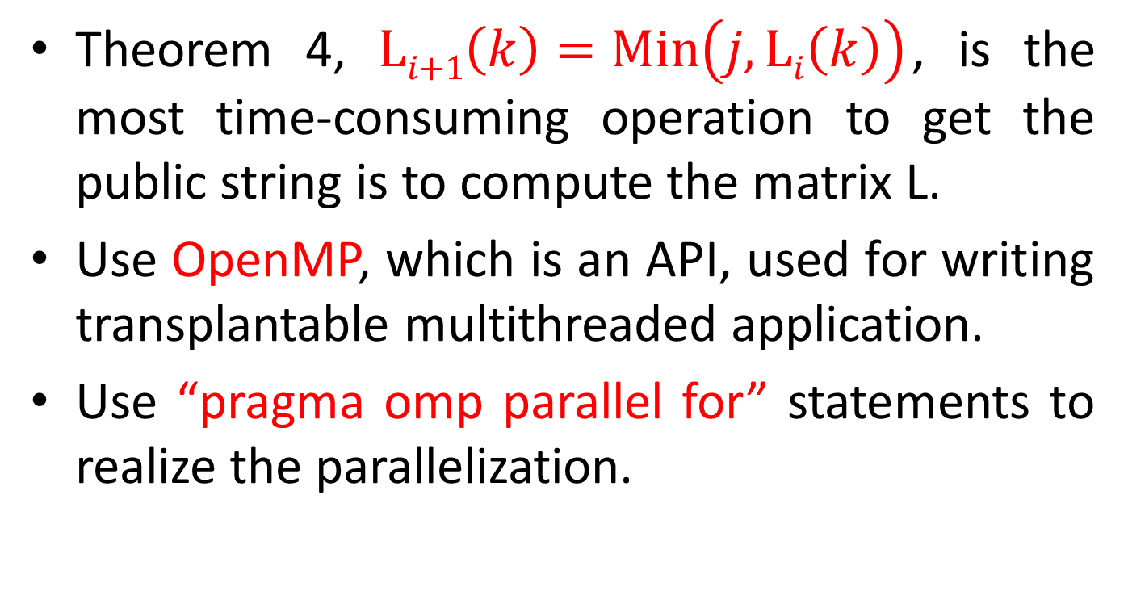
Parallel Idea
Theorem 4, $\text{L}i\text{+}1\left(k\right)=\text{Min}\left(j,\text{L}i\left(k\right)\right)$, is the most time-consuming operation to get the public string is to compute the matrix L.
Use OpenMP, which is an API, used for writing transplantable multithreaded application.
Use “pragma omp parallel for” statements to realize the parallelization.

Slide 12
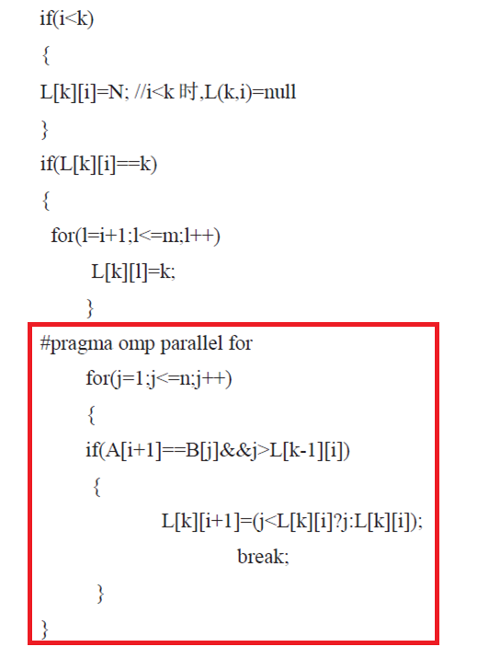

Slide 13
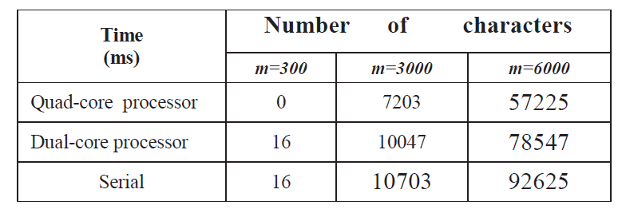
Parallel Experimental Results (1)
Hardware environment :
Intel^{(R)} Core^{(TM)}2 Dual-core processor, 1G memory.
Intel^{(R)} Core^{(TM)}2 Quad-cores processors, 4G memory.
Software environment : Windows XP

Slide 14
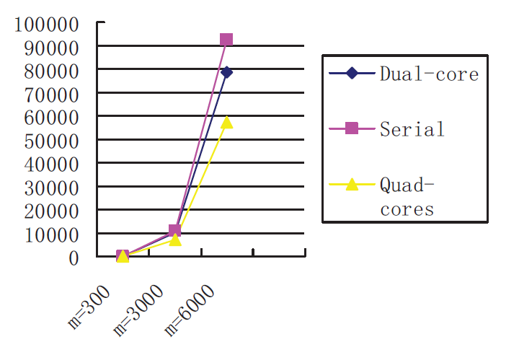
Parallel Experimental Results (2)

