Slide 1
Computing Constrained Longest Common Subsequence for Degenerate Strings Using Finite Automata
Costas S. Iliopoulos, M. Sohel Rahman, Michal Voracek, and Ladislav Vagner
In Algorithms and Complexity in Durham 2007. London: King's College, 2007, Vol. 1, pp. 94–106
Presenter: Chiou-Ting Tseng
Date: Sept. 21, 2012

Slide 2
The Constrained Longest Common Subsequence Problem for Degenerate Strings
Costas Iliopoulos, M. Sohel Rahman, Michal Voráček and Ladislav Vagner
Proceedings of the 12th international conference on Implementation and application of automata, pp. 309-311

Slide 3
Abstract
In this paper, we study the Constrained Longest Common Subsequence (CLCS) problem for degenerate strings, which is a new variant of the classical Longest Common Subsequence problem. In CLCS, the computed longest common subsequence must also be a supersequence of a third given string. We present a finite automata based algorithm to solve the problem. The algorithm requires O(|Σ|nmr) time in the worst case, where |Σ| is size of alphabet, n, m and r are the lengths of the three given degenerate strings. To the best of our knowledge, this is the first attempt to solve the CLCS problem for degenerate strings.

Slide 4
Degenerate String
每個位置都有多種可能的字元
The motivation of our study comes from the fact that degenerate strings are extensively used in molecular biology to express polymorphism in DNA sequences, e.g. the polymorphism of protein coding regions caused by redundancy of the genetic code or polymorphism in binding site sequences of a family of genes.

Slide 5
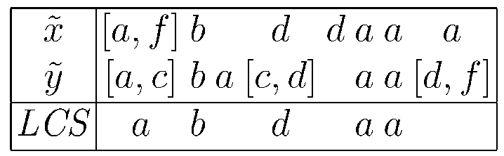
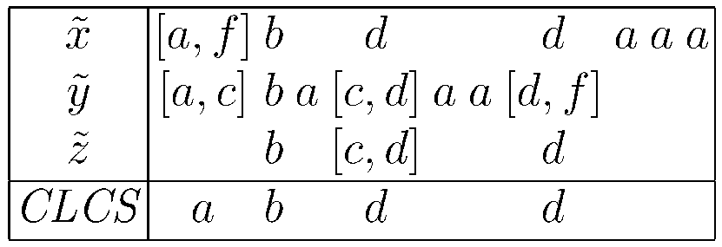
Degenerate String / LCS / CLCS

Slide 6
Finite Automata
A nondeterministic finite automaton M is a quintuple (Q, Σ, δ, q₀ , F), where: Q is a finite set of states, Σ is an input alphabet, δ is the state transition function, q₀ ⊆ Q is a set of initial states, and F ⊆ Q is a set of final states.
A deterministic finite automaton M is a special case of nondeterministic finite automaton such that transition mapping is a function Q × Σ → Q and there is only one initial state q₀ ∈ Q.

Slide 7
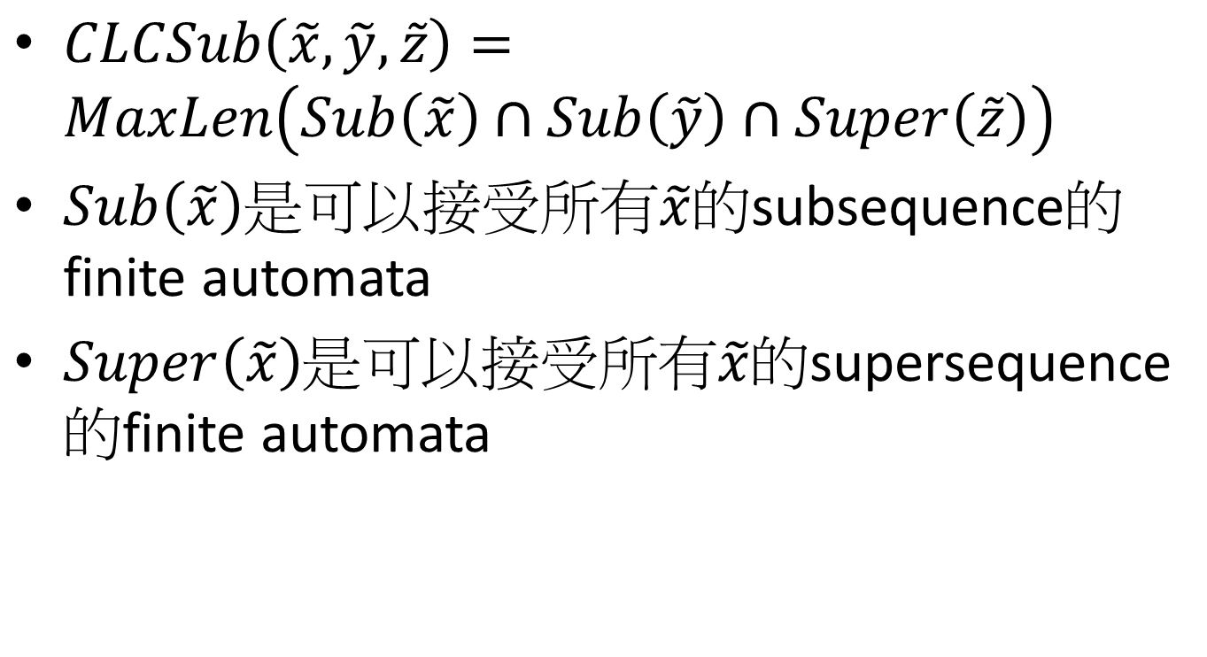
Algorithm
$CLCSub\left(\tilde{x},\tilde{y},\tilde{z}\right)=MaxLen\left(Sub\left(\tilde{x}\right)∩Sub\left(\tilde{y}\right)∩Super\left(\tilde{z}\right)\right)$
$Sub\left(\tilde{x}\right)$是可以接受所有$\tilde{x}$的subsequence的finite automata
$Super\left(\tilde{x}\right)$是可以接受所有$\tilde{x}$的supersequence的finite automata

Slide 8
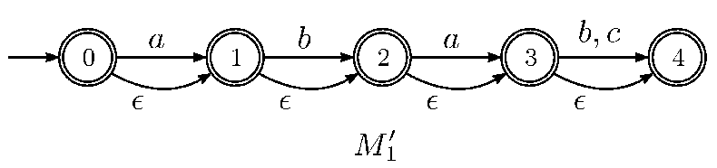
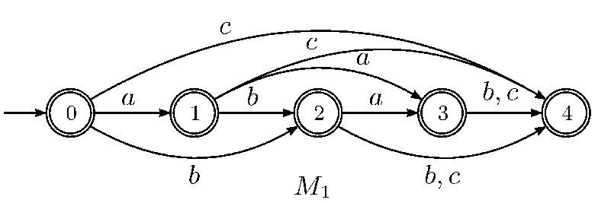


$$Sub\left(\tilde{x}\right)$$
$\tilde{x}$=aba[b, c]

Slide 9
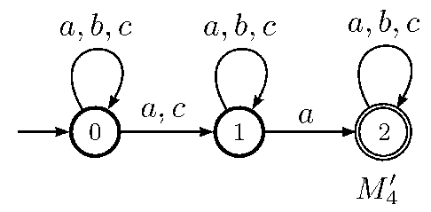
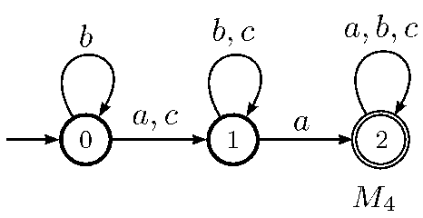


$$Super\left(\tilde{z}\right)$$
$\tilde{z}$=[a, c]a

Slide 10
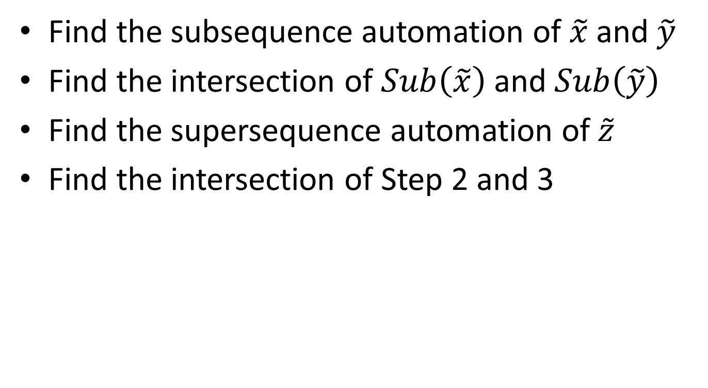
Algorithm
Find the subsequence automation of $\tilde{x}$ and $\tilde{y}$
Find the intersection of $Sub\left(\tilde{x}\right)$ and $Sub\left(\tilde{y}\right)$
Find the supersequenceautomation of $\tilde{z}$
Find the intersection ofStep 2 and 3

Slide 11
Subsequence Automation
Construct the non-deterministic automation
Amend it into the deterministic automation

Slide 12
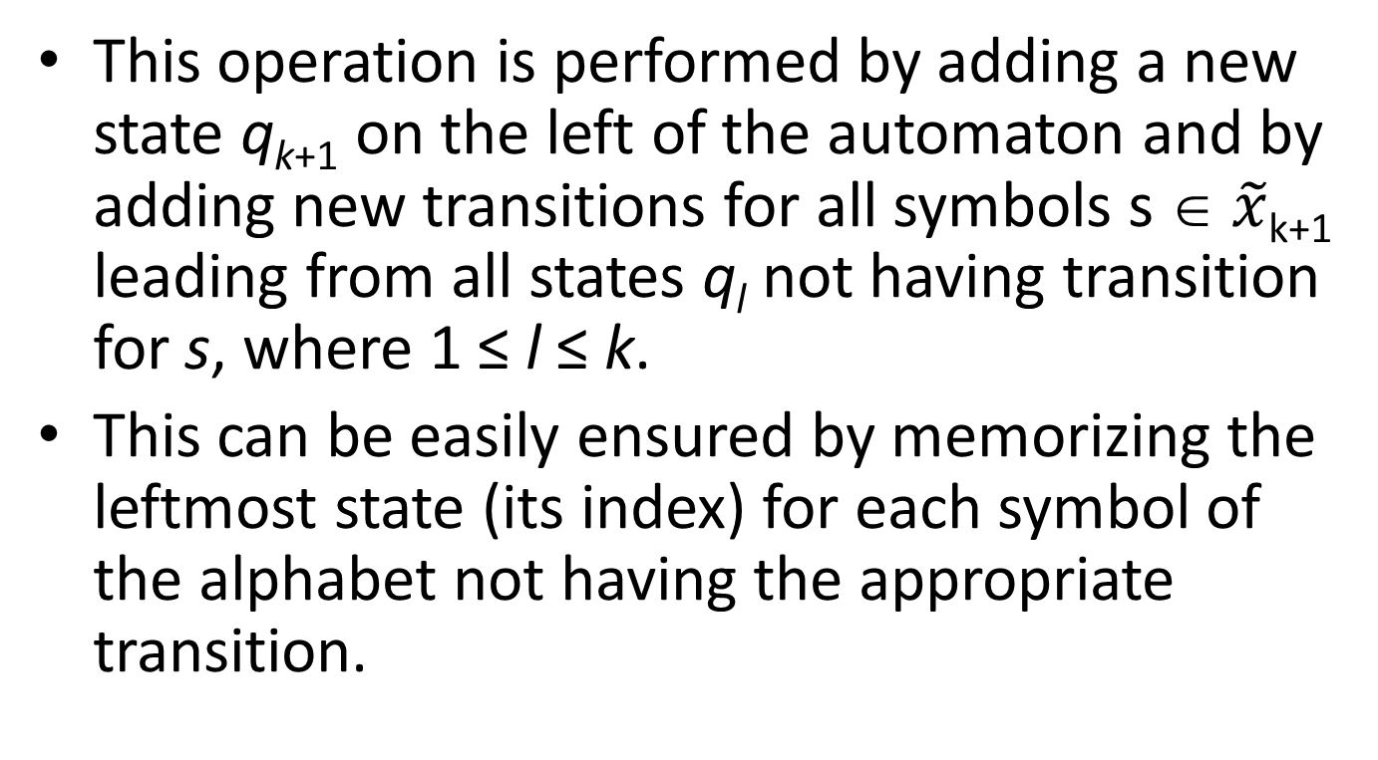
Subsequence Automation
This operation is performed by adding a new state q_{k+1} on the left of the automaton and by adding new transitions for all symbols s ∈ $\tilde{x}$_{k+1} leading from all states q_{l} not having transition for s, where 1 ≤ l ≤ k.
This can be easily ensured by memorizing the leftmost state (its index) for each symbol of the alphabet not having the appropriate transition.

Slide 13
Subsequence Automation
$\tilde{x}$=aba[b, c]
 | 0 | 1 | 2 | 3 | 4
a | 1 | 3 | 3
b | 2 | 2 | 4 | 4
c | 4 | 4 | 4 | 4
a
b
c
a
1
-1
-1
b
1
2
-1
a
3
2
-1
b
3
4
-1
c
3
4
4

Slide 14
Time Complexity
O(n|Σ|) time using O(|Σ|) additional space.
M is acyclic, minimal and has exactly n + 1 states and O(|Σ|n) transitions.

Slide 15
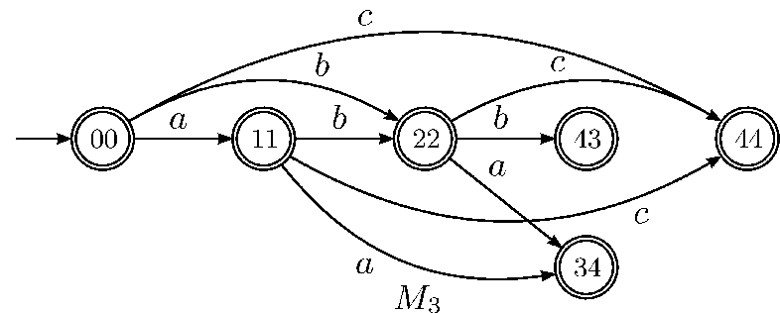
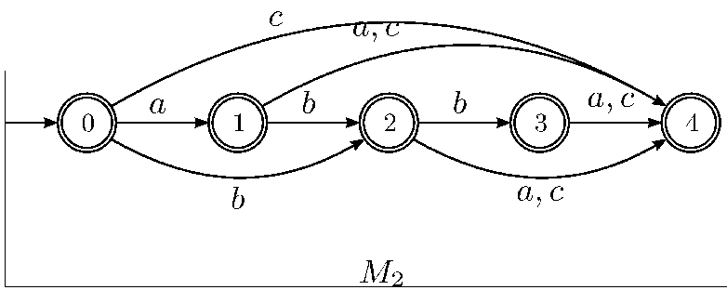
Intersection

Slide 16
Time Complexity
Given deterministic finite automata M₁ and M₂ having n and m states, respectively, Algorithm 3 correctly constructs deterministic finite automaton M accepting language L(M) = L(M₁ ) ∩ L(M₂ ) in O(|Σ|nm) time.
M has at most nm states and at most |Σ|nm transitions. Moreover, if M₁ (or M₂ ) is acyclic, then M is also acyclic.

Slide 17
Supersequence Automation
$\tilde{z}$=[a, c]a

Slide 18
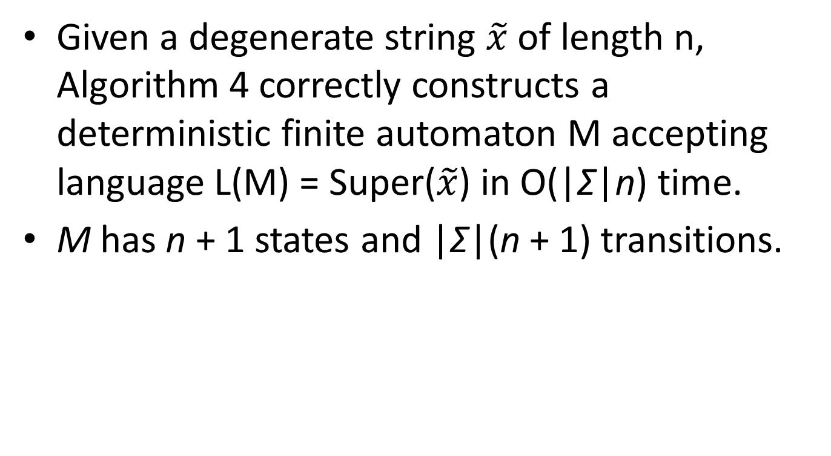
Time Complexity
Given a degenerate string $\tilde{x}$ of length n, Algorithm 4 correctly constructs a deterministic finite automaton M accepting language L(M) = Super($\tilde{x}$) in O(|Σ|n) time.
M has n + 1 states and |Σ|(n + 1) transitions.

Slide 19
Max Length Strings Automation
只留下能夠走到final state的 transition並且每個state之間都留從initial state走到他最長的路徑。
Remove from the automaton all transitions and states which are not part of any longest path from the initial state to some of final states.
Employ a modification of the longest path algorithm for directed acyclic graphs (DAGs) based on the topological ordering of nodes (states), which works in linear time with respect to a number of edges of a given graph.

Slide 20
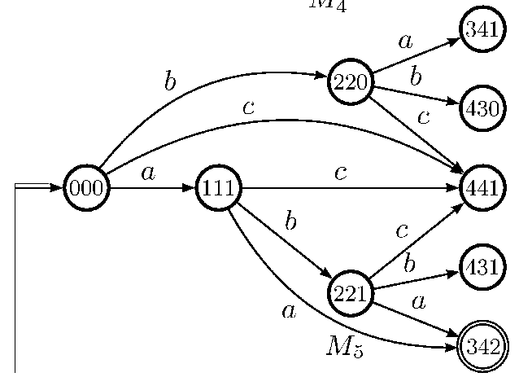
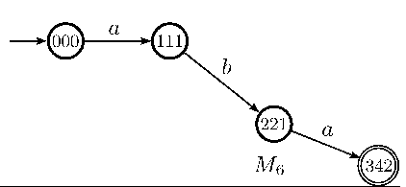
Max Length Strings Automation

Slide 21
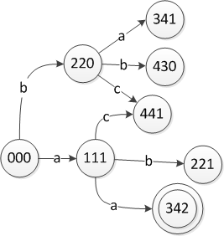
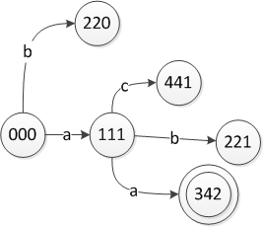
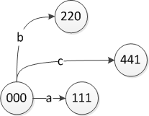
Max Length Strings Automation

Slide 22
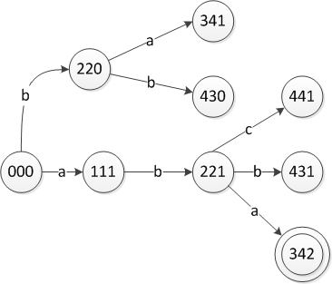
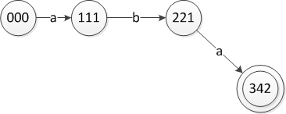
Max Length Strings Automation

Slide 23
Time Complexity
Given an acyclic deterministic finite automaton M’ with n transitions, Algorithm 5 correctly constructs a deterministic finite automaton M accepting language L(M) = MaxLen(L(M’)) in O(n) time.
M has at most as many states and at most as many transitions as M’.

Slide 24
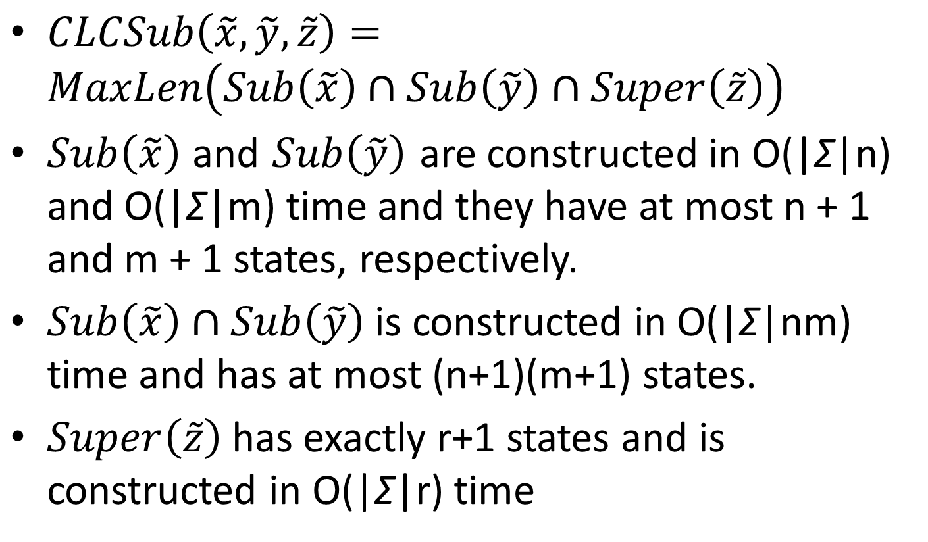
Time Complexity
$CLCSub\left(\tilde{x},\tilde{y},\tilde{z}\right)=MaxLen\left(Sub\left(\tilde{x}\right)∩Sub\left(\tilde{y}\right)∩Super\left(\tilde{z}\right)\right)$
$Sub\left(\tilde{x}\right)$and $Sub\left(\tilde{y}\right)$ are constructed in O(|Σ|n) and O(|Σ|m) time and they have at most n + 1 and m + 1 states, respectively.
$Sub\left(\tilde{x}\right)∩Sub\left(\tilde{y}\right)$is constructed in O(|Σ|nm) time and has at most (n+1)(m+1) states.
$Super\left(\tilde{z}\right)$has exactly r+1 states and is constructed in O(|Σ|r) time

Slide 25
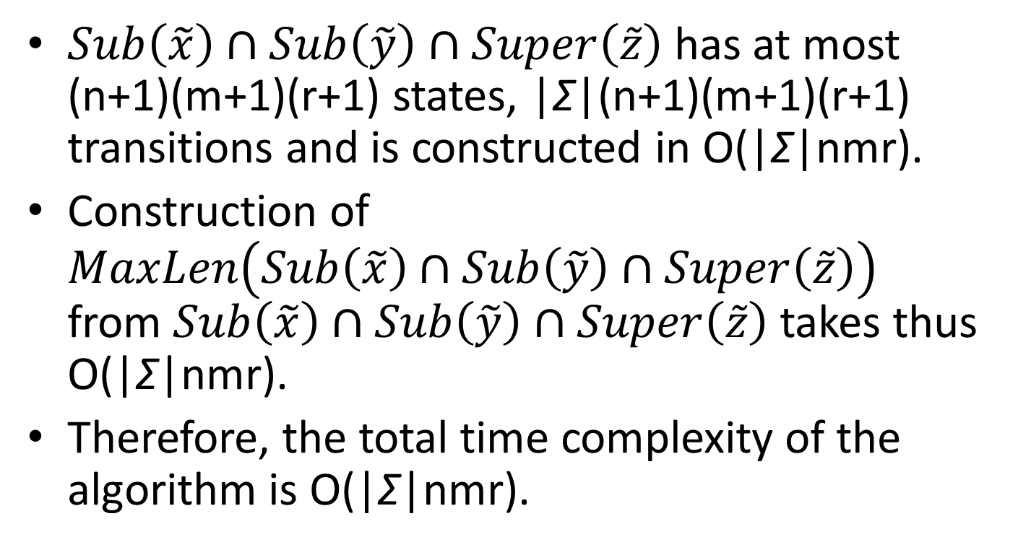
Time Complexity
$Sub\left(\tilde{x}\right)∩Sub\left(\tilde{y}\right)∩Super\left(\tilde{z}\right)$has at most (n+1)(m+1)(r+1) states, |Σ|(n+1)(m+1)(r+1) transitions and is constructed in O(|Σ|nmr).
Construction of $MaxLen\left(Sub\left(\tilde{x}\right)∩Sub\left(\tilde{y}\right)∩Super\left(\tilde{z}\right)\right)$ from $Sub\left(\tilde{x}\right)∩Sub\left(\tilde{y}\right)∩Super\left(\tilde{z}\right)$ takes thus O(|Σ|nmr).
Therefore, the total time complexity of the algorithm is O(|Σ|nmr).

Slide 26
End

Slide 27
Max Length Strings Automation
The algorithm keeps for each state q of the automaton M , its input degree d_{in}[q] (number of incoming transitions) and the length of the current longest path to state q from the initial state, i.e. len[q].
The algorithm uses queue C for closed states (states with zero input degree).
On the beginning, the initial state q₀ of the automaton M is put into queue C.
The main loop of the algorithm works as follows:
a closed state p is dequeued.
Target state q of each transition leading from p is visited, its input degree is decreased by 1 and the length of path from q₀ via p to q is computed.
If such a path is the longest one from q₀ to q, p is set as a predecessor of q. Predecessor is memorized in the form of reversed transition. Obviously, if there exist more than one longest path to state q, it has more predecessors.
If the input degree of state q is decreased to zero, it is closed and put into queue C.
The algorithm keeps a set S of states being targets of the longest paths form state q₀ in graph. This set is actualized during visit of each state.
Finally, the states in set S becomes the initial states of the reversed automaton M_{R} and state q₀ becomes its the only final state.

