Slide 1
Window Subsequence Problems for Compressed Texts
Patrick Cégielski, Irène Guessarian, Yury Lifshits, Yuri Matiyasevich Lecture Notes in Computer Science Volume 3967, 2006, pp 127-136
Presenter: Yi-Pu Guo 2012/10/16

Slide 2
Abstract
Given two strings (a text t of length n and a pattern p) and a natural number w, window subsequence problems consist in deciding whether p occurs as a subsequence of t and/or finding the number of size (at most) w windows of text t which contain pattern p as a subsequence, i.e. the letters of pattern p occur in the text window, in the same order as in p, but not necessarily consecutively (they may be interleaved with other letters). We are searching for subsequences in a text which is compressed using Lempel-Ziv-like compression algorithms, without decompressing the text, and we would like our algorithms to be almost optimal, in the sense that they run in time O(m) where m is the size of the compressed text. The pattern is uncompressed (because the compression algorithms are evolutive: various occurrences of a same pattern look different in the text).

Slide 3
Problems to Solve
Text: t=t₁t₂ … t_{n} ∈ A* compressed by SLP (Straight-line programs): t=val(X_{m}), X_{m} := X_{p}X_{q}, … (不解壓縮)
Pattern: p=p₁p₂ … p_{k} ∈ A* (不壓縮)
A number w (so total n-w+1 windows)
Problems: (P should be the subsequence of the window of t)
Minimal windows (先不管 w)
Minimal windows of size bounded by w
Windows of constant size w
Notes:
A={a1, a2, …, ai} 表示一個有限個數字元的集合； A* 表示使用 A 裡面的字元所能產生的所有字串之集合。
Val(Xm) 將 Xm 中間符號完全解析至 terminal character 所產生的字串。

Slide 4
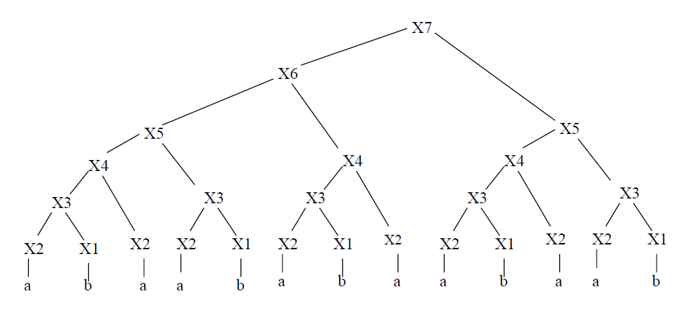
SLP
p₁ p₂ p₃ p₄ p₅
只要shift 一格就不是 subseq
The minimal window

Slide 5
Data Structures - L_{i,j} (1/2)
abbcc
abbc
bbcc
abb
bbc
bcc
ab
bb
bc
cc
a
b
b
c
c
P_{i}: 的所有可能 subword。(P₁=P)
Left inclusion array: L_{i,j} (mxl)
val(X_{i}) 的 prefix
prefix 的 subseq 要含有 P_{j}
最短的這種 prefix 的長度
Ex:
P=abbcc, P₆=bbc
X₁₃=ababcba
L_{13,6}=5
P₁
P_{j}
P_{l}
X₁
X_{i}
X_{m}

Slide 6
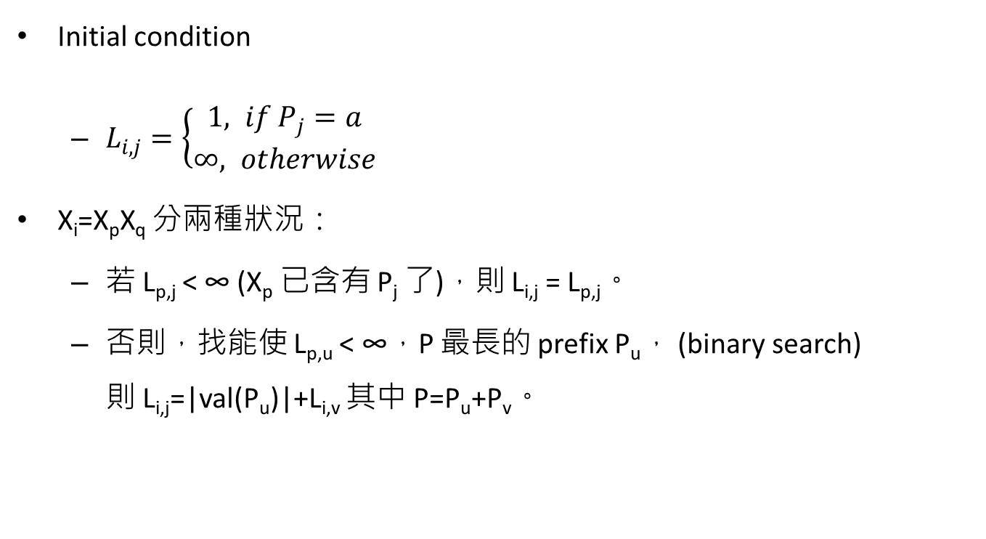
Data Structures - L_{i,j} (2/2)
Initial condition
$L_{i,j}=\left\{\begin{aligned}1, if P_{j}=a \\ ∞, otherwise\end{aligned}\right.$
X_{i}=X_{p}X_{q} 分兩種狀況：
若 L_{p,j} < ∞ (X_{p} 已含有 P_{j} 了)，則 L_{i,j} = L_{p,j}。
否則，找能使 L_{p,u} < ∞，P 最長的 prefix P_{u}， (binary search) 則 L_{i,j}=|val(P_{u})|+L_{i,v} 其中 P=P_{u}+P_{v}。

Slide 7
Data Structures - R_{i,j}
Right inclusion array: Ri,j (mxl)
與 L_{i,j} 同理，prefix 改做 suffix。

Slide 8
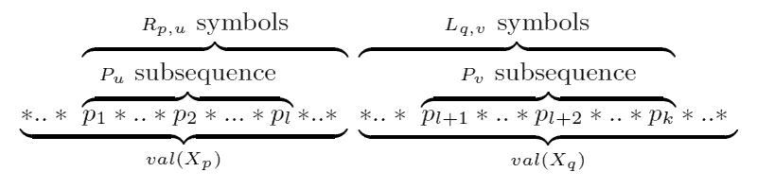
Minimal windows - MW_{i}
val(X_{i}) 的 Minimal windows 個數, X_{i} := X_{p}X_{q}
X_{p} 與 X_{q} 中已算過的 window 個數 (MW_{p} 與 MW_{q})。
橫跨 X_{p} 與 X_{q} 的 window 個數 B_{p,q}。
從 |Pu|=k-1 算到 |Pu|=1：
Pu 於 Xp 中；Pv 於 Xq 中
以 flag α 來判斷是否為 minimal window。

Slide 9
Minimal windows of size bounded by w
將前面的方法在 (L_{p,u}+R_{q,v}) ≤ w 時才將 B_{p,q} 加 1。
Windows of constant size w
找包含有一個以上 minimal window 的 w-windows 即可。

Slide 10
Time Complexity
O(m l logk) ,l =1+2+…+k =k(k+1)/2 <k²
O(m k² logk)

