Slide 1
Correlation based dynamic time warping of multivariate time series
Expert Systems with Applications, Volume 39, Issue 17, 1 December 2012, Pages 12814–12823
University of Pannonia, Department of Process Engineering, P.O. Box 158, H-8200, Veszprem, Hungary
Zoltán Bankó, János Abonyi

Slide 2
Abstract
In recent years, dynamic time warping (DTW) has begun to become the most widely used technique for comparison of time series data where extensive a priori knowledge is not available. However, it is often expected a multivariate comparison method to consider the correlation between the variables as this correlation carries the real information in many cases. Thus, principal component analysis (PCA) based similarity measures, such as PCA similarity factor (SPCA), are used in many industrial applications.

Slide 3
Abstract
In this paper, we present a novel algorithm called correlation based dynamic time warping (CBDTW) which combines DTW and PCA based similarity measures. To preserve correlation, multivariate time series are segmented and the local dissimilarity function of DTW originated from SPCA. The segments are obtained by bottom-up segmentation using special, PCA related costs. Our novel technique qualified on two databases, the database of signature verification competition 2004 and the commonly used AUSLAN dataset. We show that CBDTW outperforms the standard SPCA and the most commonly used, Euclidean distance based multivariate DTW in case of datasets with complex correlation structure.

Slide 4
Introduction
Time series
Multivariate time series
Dynamic time warping (DTW)
Principal component analysis (PCA)

Slide 5
Dynamic Time Warping (DTW)
假設兩個向量t 、 r長度分別為m、n，那DTW的目標就是找到一組路徑( p1, q1 ) 、 ( p2, q2 ) ,…,(pk, qk)最小值。
滿足兩端點( p1, q1 ) = ( 1, 1 )，( pk, qk ) = (m, n)
D(i, j) = distance(t [1, i], r[j, 1])
Example:
Char a, b : 0 if a==b else 1
 | 讚 | 啦 | 今 | 今 | 今 | 今 | 今 | 天 | 天 | 氣 | 氣 | 氣 | 氣 | 氣 | 好 | 好 | 好 | 好 | 啊 | 啊 | 啊
今 | 1 | 1 | 0 | 0 | 0 | 0 | 0 | 1 | 1 | 1 | 1 | 1 | 1 | 1 | 1 | 1 | 1 | 1 | 1 | 1 | 1
天 | 1 | 1 | 1 | 1 | 1 | 1 | 1 | 0 | 0 | 1 | 1 | 1 | 1 | 1 | 1 | 1 | 1 | 1 | 1 | 1 | 1
天 | 1 | 1 | 1 | 1 | 1 | 1 | 1 | 0 | 0 | 1 | 1 | 1 | 1 | 1 | 1 | 1 | 1 | 1 | 1 | 1 | 1
氣 | 1 | 1 | 1 | 1 | 1 | 1 | 1 | 1 | 1 | 0 | 0 | 0 | 0 | 0 | 1 | 1 | 1 | 1 | 1 | 1 | 1
好 | 1 | 1 | 1 | 1 | 1 | 1 | 1 | 1 | 1 | 1 | 1 | 1 | 1 | 1 | 0 | 0 | 0 | 0 | 1 | 1 | 1
好 | 1 | 1 | 1 | 1 | 1 | 1 | 1 | 1 | 1 | 1 | 1 | 1 | 1 | 1 | 0 | 0 | 0 | 0 | 1 | 1 | 1
啊 | 1 | 1 | 1 | 1 | 1 | 1 | 1 | 1 | 1 | 1 | 1 | 1 | 1 | 1 | 1 | 1 | 1 | 1 | 0 | 0 | 0

Slide 6
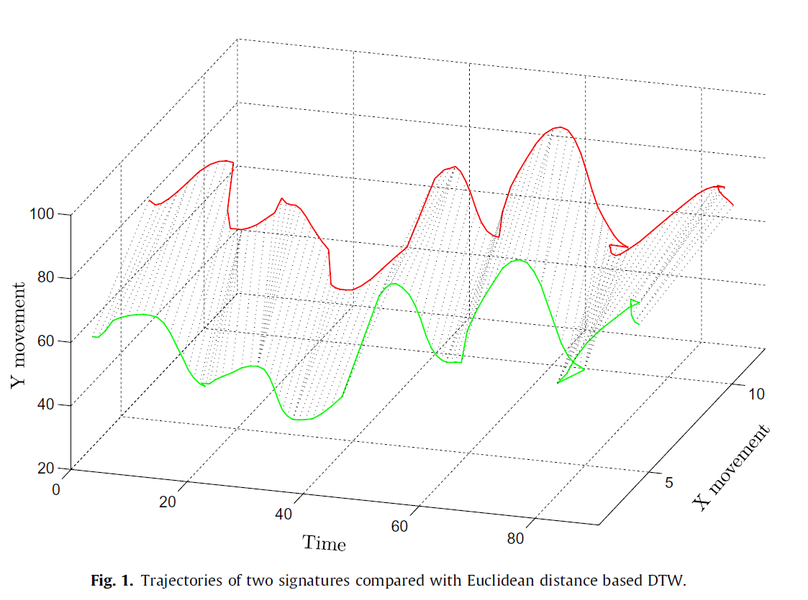

Slide 7
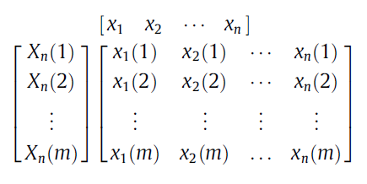


Multivariate Time Series
X_{n} is an n-variable, m-element time series where x_{i} is the ith
variable and x_{i}(j) denotes its jth element: homogenous
X_{n} = [x₁, x₂, x₃, . . . , x_{n}]
x_{i} = [x_{i}(1), x_{i}(2), , . . . , x_{i}(m)]^{T}

Slide 8
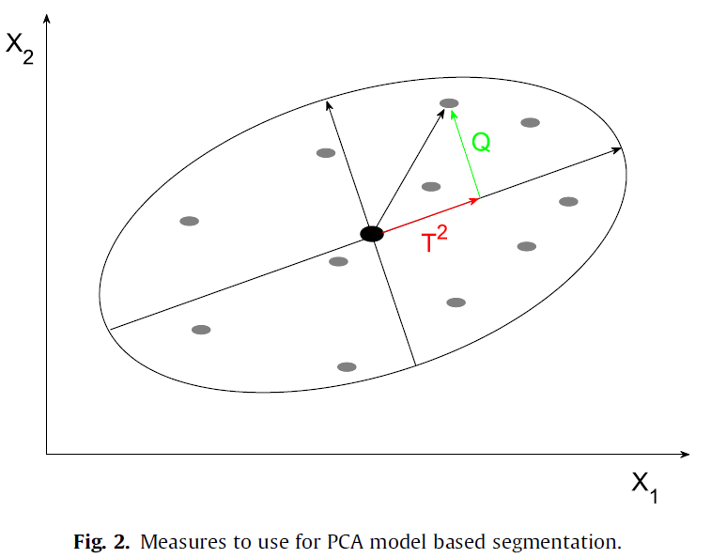
Principal Component Analysis (PCA)

Slide 9
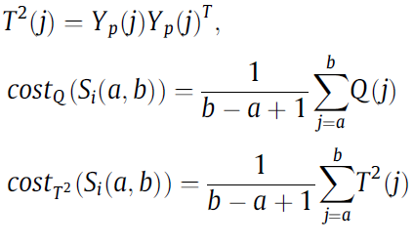
Principal Component Analysis (PCA)
(reconstruction error)
(Hotelling’s T² statistic)

Slide 10
Correlation Based Dynamic Time Warping (CBDTW)
Segment the time series of the given database based on correlation to create the most homogenous segments. The projection error or Hotelling’s statistics can be used as basis of the cost function. This segmentation can be done off-line in most cases.
Segment the query time series according to the database.
Calculate the DTW dissimilarity between the query and the time series of the database. The local dissimilarity measure of DTW can be chosen arbitrarily. In this paper, it is derived from a covariance based similarity measure, i.e., 1 SPCA.

Slide 11
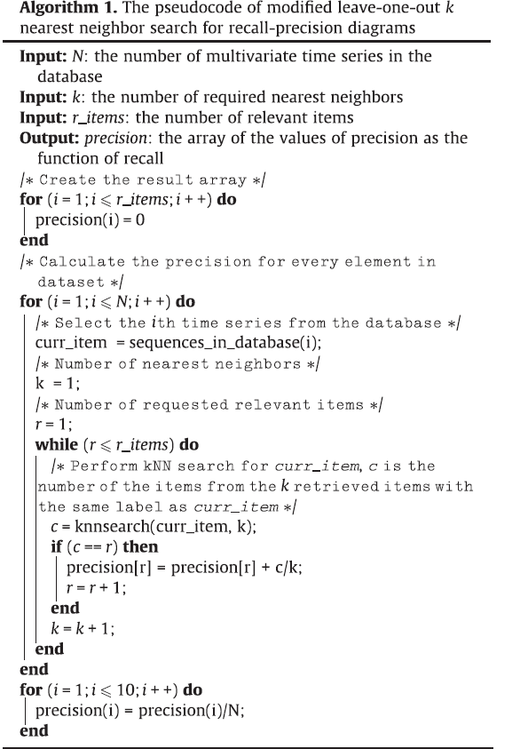

Slide 12
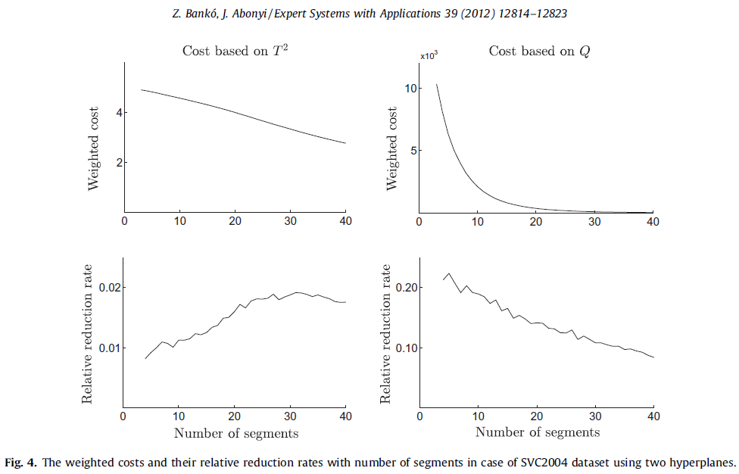
Experimental Results
1. signature verification conference 2004 (SVC2004)

Slide 13
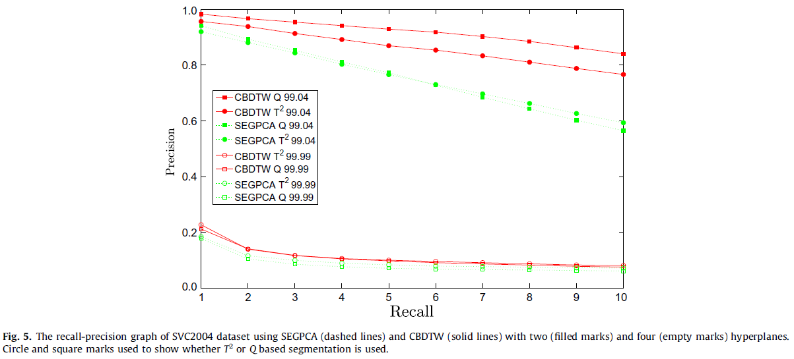

Slide 14
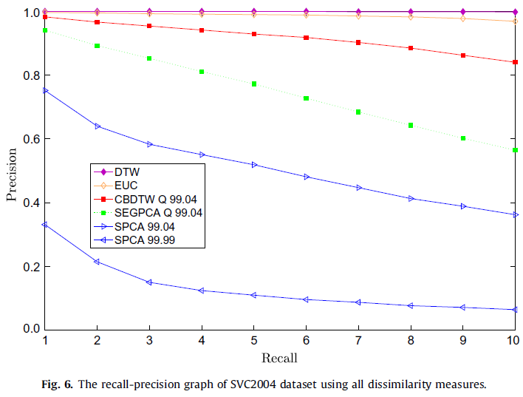

Slide 15
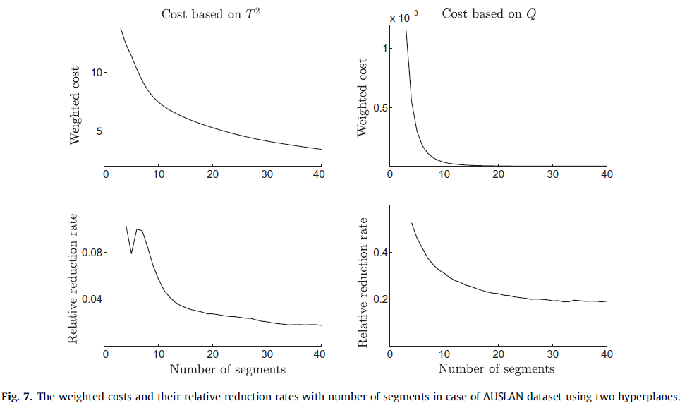
2. Australian language sign dataset (AUSLAN)

Slide 16
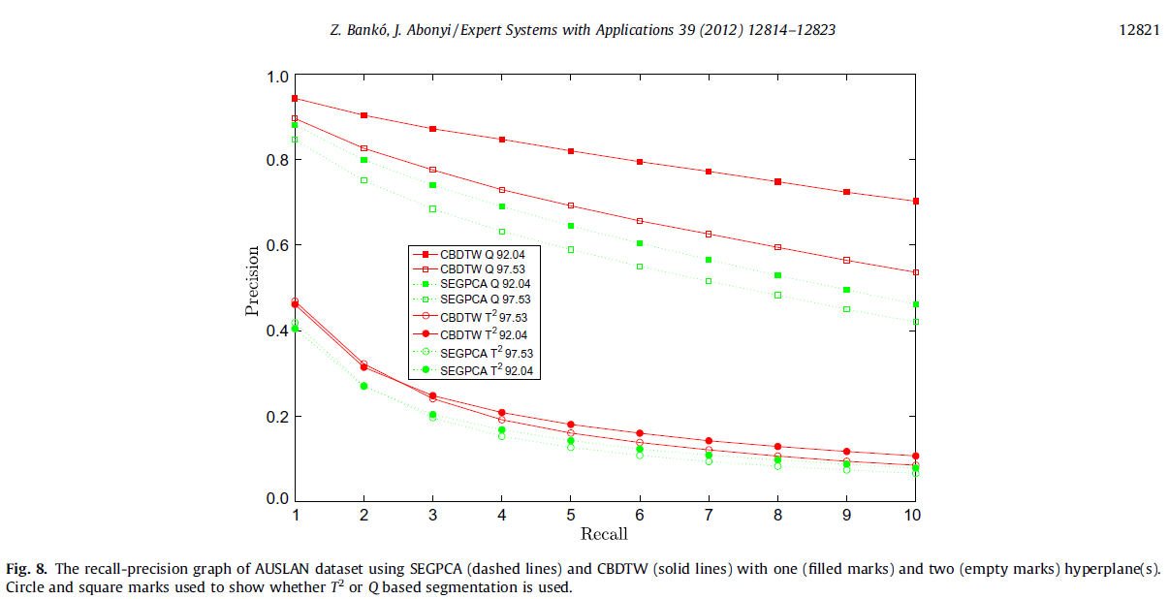

Slide 17
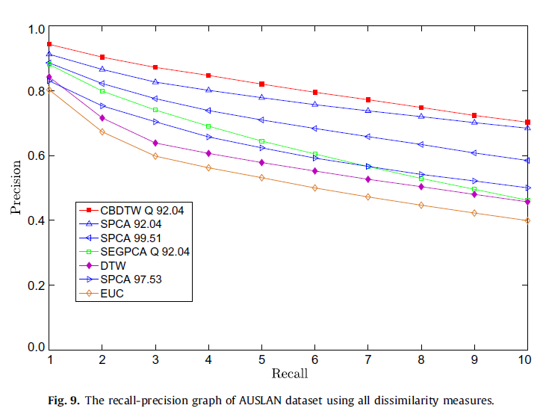

Slide 18
