Slide 1
Approximating the Smallest Grammar: Kolmogorov Complexity in Natural Models
Eric Lehmany, Ding Liu, Rina Panigrahyz, April Rasalay, Amit Sahai and abhi shelaty
STOC '02 Proceedings of the 34th annual ACM symposium on Theory of computing
Pages 792-801
Presenter: Yi-Pu Guo
2012-10-30

Slide 2
Abstract (1/2)
We consider the problem of finding the smallest context-free grammar that generates exactly one given string of length n. The size of this grammar is of theoretical interest as an efficiently computable variant of Kolmogorov complexity. The problem is of practical importance in areas such as data compression and pattern extraction.
The smallest grammar is known to be hard to approximate to within a constant factor, and an o(logn/loglogn) approximation would require progress on a long-standing algebraic problem [10]. Previously, the best proved approximation ratio was O(n^{1/2}) for the Bisection algorithm [8]. Our main result is an exponential improvement of this ratio; we give an O(log (n/g*)) approximation algorithm, where g* is the size of the smallest grammar.

Slide 3
Abstract (2/2)
We then consider other computable variants of Kolomogorov complexity. In particular we give an O(log² n) approximation for the smallest non-deterministic finite automaton with advice that produces a given string. We also apply our techniques to "advice-grammars" and "edit-grammars", two other natural models of string complexity.

Slide 4
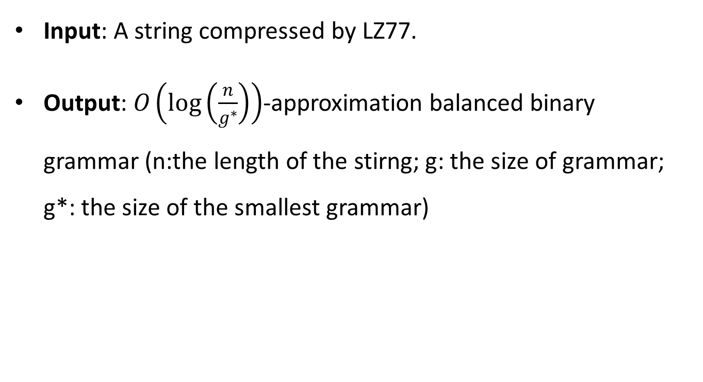
The Problem to Solve
Input: A string compressed by LZ77.
Output: $O\left(\log\left(\frac{n}{g^{∗}}\right)\right)$-approximation balanced binary grammar (n:the length of the stirng; g: the size of grammar; g*: the size of the smallest grammar)

Slide 5

LZ77
A string σ: $\left(p_{1},l_{1}\right),\left(p_{2},l_{2}\right),…,\left(p_{s},l_{s}\right)$
$if p_{i}=0, \left(p_{i},l_{i}\right)$ 表示終端字串 $l_{i}$
$if p_{i}≠0, (p_{i},l_{i})$ 表示從 $p_{i}$ 開始算長度 $l_{i}$ 的字串

Slide 6
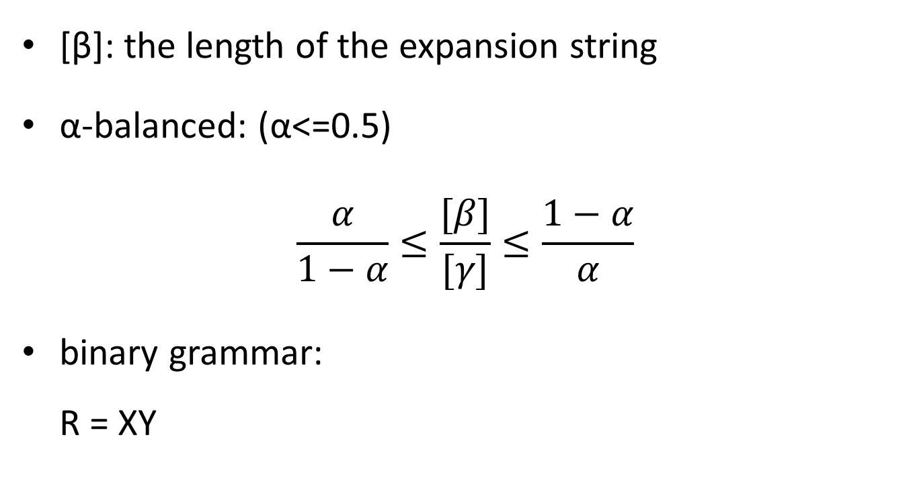
Definitions
[β]: the length of the expansion string
α-balanced: (α<=0.5) $\frac{α}{1−α}≤\frac{[β]}{[γ]}≤\frac{1−α}{α}$
binary grammar: R = XY

Slide 7
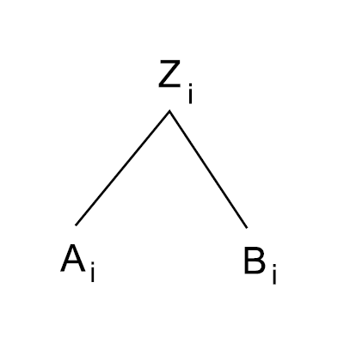
ADDPAIR
Input: Two balanced symbols X, Y
Output: A balanced symbol Z, val(Z) = val(X) val(Y)
The active rule: X Y X Y₁Y₂ X Y₁Y₂ … Y_{t} until Y₁ is in balanced with X and create a new rule Z₁ → X Y₁.
接著便一個個向右合併過去，直到 Z_{t}。

Slide 8
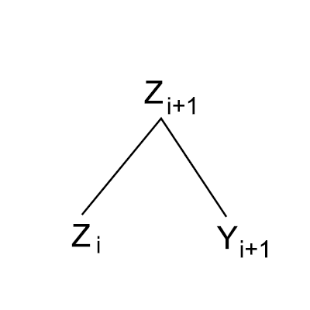

ADDPAIR – Case 1
$if Z_{i} and Y_{i+1} are in balanced$, create a new rule $Z_{i+1}→Z_{i}Y_{i+1}$.

Slide 9
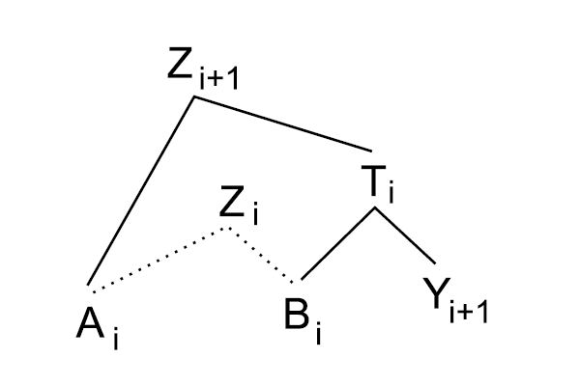

ADDPAIR – Case 2
$Otherwise, if A_{i} is balance with B_{i}Y_{i+1}$, create 2 new rules: $Z_{i+1}→A_{i}T_{i}$ $T_{i}→B_{i}Y_{i+1}$

Slide 10
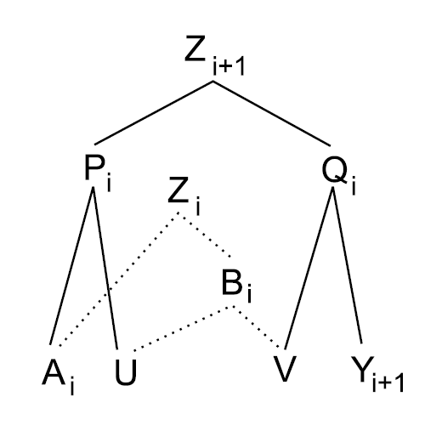

ADDPAIR – Case 3
$if we bypass cases 1 and 2$, create 3 new rules: ($B_{i}→UV$) $Z_{i+1}→P_{i}Q_{i}$ $P_{i}→A_{i}U$ $Q_{i}→VY_{i+1}$

Slide 11

All the 3 tools
ADDPAIR (所增加的 symbol) $O(1+\left|log\frac{[X]}{[Y]}\right|)$
ADDSQEUENCE $O(t(1+log\frac{[X_{1}…X_{t}]}{t}))$
ADDSUBSTRING $O(log\left|β\right|)$

Slide 12
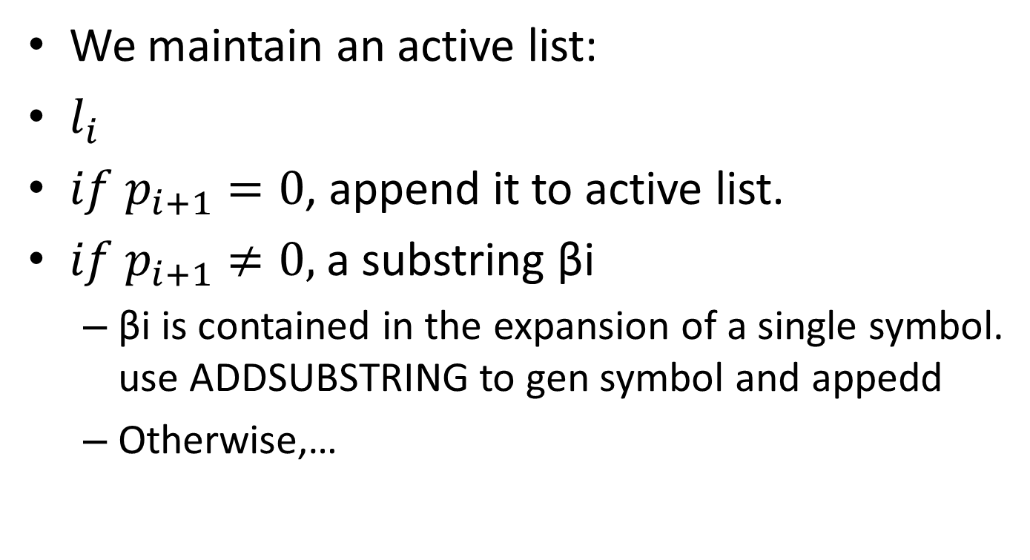
The Algorithm (1/1)
We maintain an active list:
$l_{i}$
$if p_{i+1}=0$, append it to active list.
$if p_{i+1}≠0,$ a substring βi
βi is contained in the expansion of a single symbol. use ADDSUBSTRING to gen symbol and appedd
Otherwise,…

Slide 13
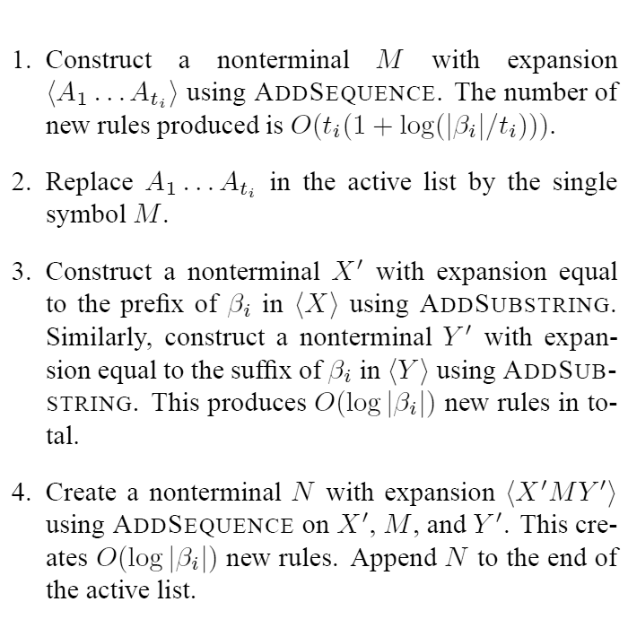
The Algorithm (2/2)

