Slide 1
DNA Splice Site Sequences Clustering Method for Conservativeness Analysis Progress in Natural Science vol.19, pp.511-516, 2009
Quanwei Zhang, Qinke Peng *, Tao Xu State Key Laboratory for Manufacturing Systems Engineering, School of Electronic and Information Engineering, Xi’an Jiaotong University, Xi’an 710049, China
Presentor：Hsin-Chuan Yuan

Slide 2
Abstract
DNA sequences that are near to splice sites have remarkable conservativeness, and many researchers have contributed to the prediction of splice site. In order to mine the underlying biological knowledge, we analyze the conservativeness of DNA splice site adjacent sequences by clustering. Firstly, we propose a kind of DNA splice site sequences clustering method which is based on DBSCAN, and use four kinds of dissimilarity calculating methods. Then, we analyze the conservative feature of the clustering results and the experimental data set.

Slide 3
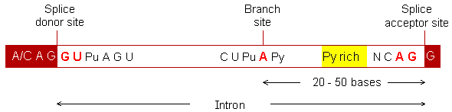
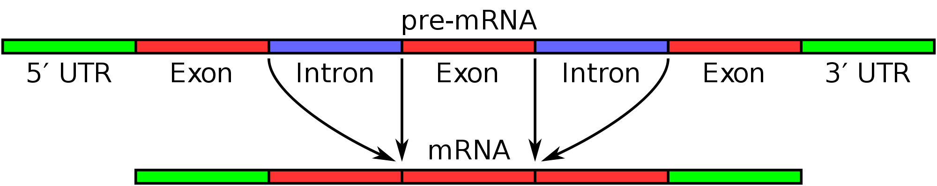
RNA Splice Site Adjacent Sequences(1)
內含子
外顯子

Slide 4
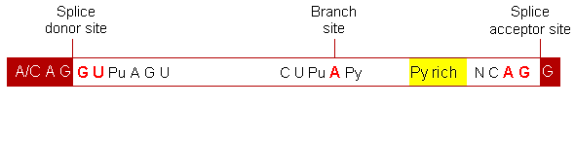
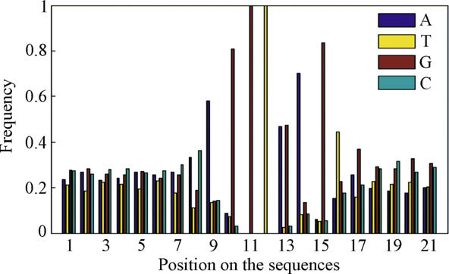
RNA Splice Site Adjacent Sequences(2)

Slide 5
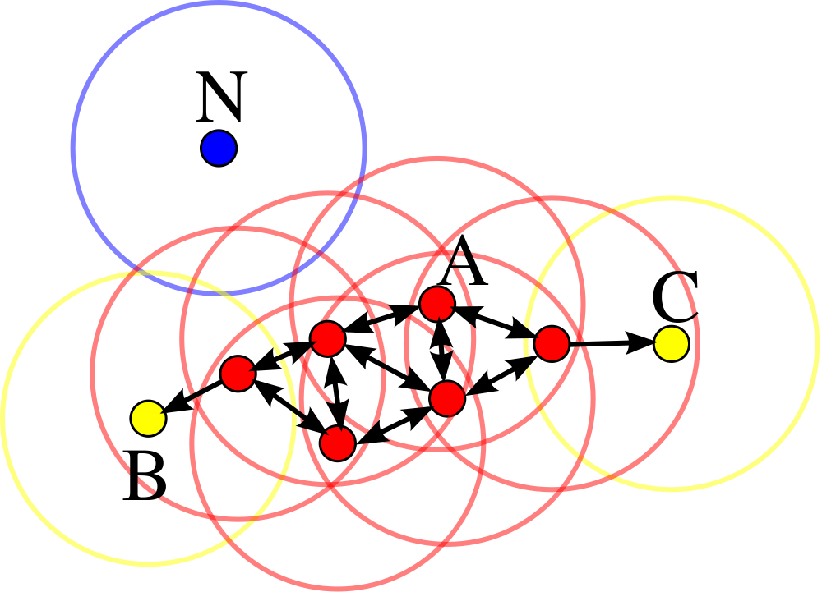
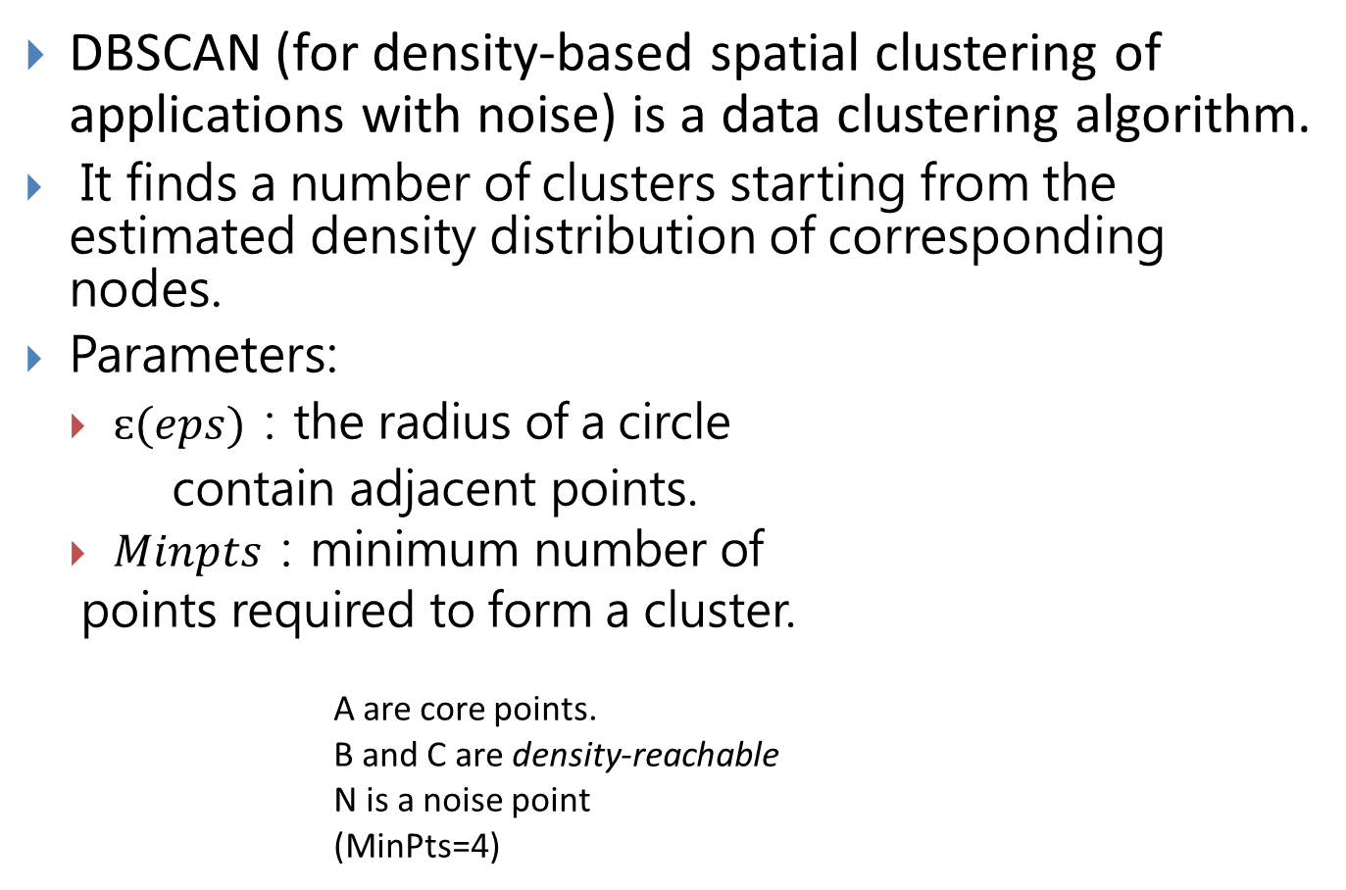
DBSCAN(1)
DBSCAN (for density-based spatial clustering of applications with noise) is a data clustering algorithm.
It finds a number of clusters starting from the estimated density distribution of corresponding nodes.
Parameters:
$ɛ(eps)$：the radius of a circle
contain adjacent points.
$Minpts$：minimum number of
points required to form a cluster.
A are core points.
B and C are density-reachable
N is a noise point
(MinPts=4)

Slide 6
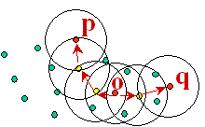
DBSCAN
Check the object p that has not yet been processed. If p is a core object, a new cluster C is created, the neighbors of p which are not yet contained in any cluster are added into cluster C.
Check the object q in C which has not been checked, if q is a core object, the neighbors of q which are not yet contained in any cluster are added into cluster C.
Repeat until all the objects in C are checked.
Repeat , and until all the objects are classified as some cluster or noise.
Time complexity: O(m*m)
2
1
2
3

Slide 7
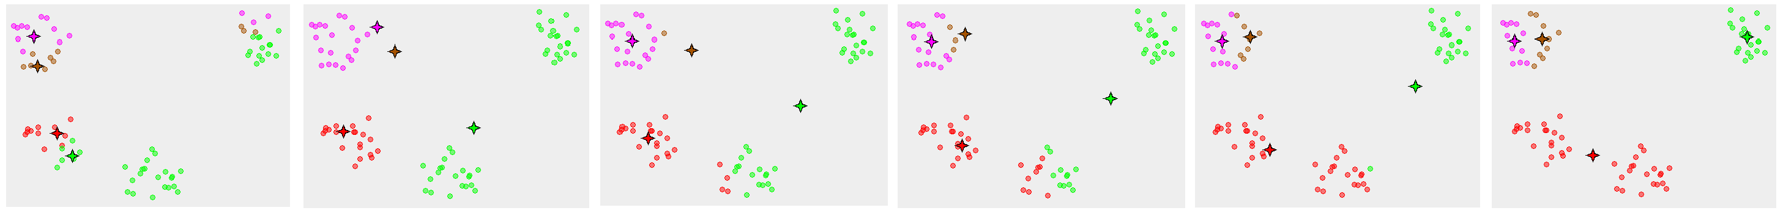

K-means
sum of the squares error (SSE)
SSE $=\sum_{i=1}^{K}{\sum_{x∈c_{i}}^{ }{{dist(c_{i},x)}^{2}}}$

Slide 8
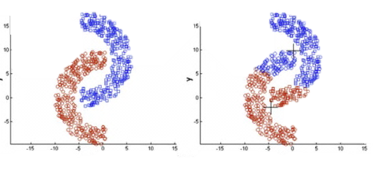
Comparison of K-means and DBSCAN
K-means must determine a cluster number before clustering, while DBSCAN does not need it, DBSCAN finds dense clusters automatically for a given density threshold.
K-means is sensitive with noises, but DBSCAN handles noises well.
K-means is only applicable to find circular or spherical clusters, but DBSCAN can find clusters with arbitrary shapes.
K-means has the numeric-only limitation, but DBSCAN can work well with categorical data.

Slide 9

Direct alignment
Given two DNA sequences $X = (x1, x2,. . . , xn)$ and $Y = ( y1,y2, . . . ,yn)$.
$Dist(X,Y) =\sum_{i=0}^{n}{σ(x_{i},y_{i})}$
where $σ\left(x_{i},y_{i}\right)=\left\{\begin{aligned}0,x_{i}=y_{i} \\ 1,,x_{i}≠y_{i}\end{aligned}\right.$
T | G | C | G | T | T | G | A | G | T
A | G | A | G | T | T | C | C | T | C
1 | 0 | 1 | 0 | 0 | 0 | 1 | 1 | 1 | 1
sum |  |  |  |  |  |  |  |  | 6

Slide 10

Dynamic programming alignment
Smith–Waterman Algorithm
V_{i,j} $=min\left\{\begin{aligned}\text{V}\text{i}\text{−1, }\text{j}\text{ + 1} \\ \text{V}\text{i}\text{, }\text{j}\text{−1 + 1} \\ \text{V}\text{i}\text{−1, }\text{j}\text{−1 + }\text{t}\text{i}\text{, }\text{j}\end{aligned}\right.$
where t_{i, j} = 0, if a_{i} = b_{j}
t_{i, j} = 1, if a_{i} ≠ b_{j}
Time complexity: O(mn)
T | G | C | G | T | T | G | A | G | T
A | G | A | G | T | T | C | C | T | C
V_{i,j} |  |  |  |  |  |  |  |  | 6

Slide 11
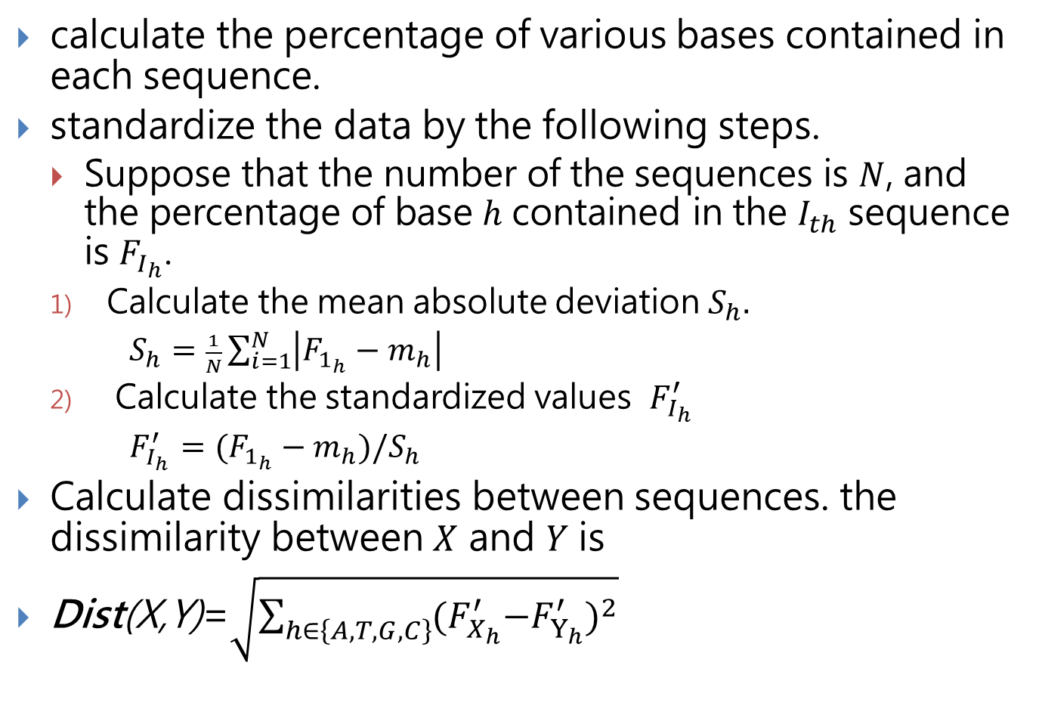
Statistical probability-based method
calculate the percentage of various bases contained in each sequence.
standardize the data by the following steps.
Suppose that the number of the sequences is $N$, and the percentage of base $h$ contained in the $I_{th}$ sequence is $F_{I_{h}}$.
Calculate the mean absolute deviation $S_{h}.$
$S_{h}=\frac{1}{N}\sum_{i=1}^{N}{\left|F_{1_{h}}−m_{h}\right|}$
Calculate the standardized values $F_{I_{h}}^{′}$
$F_{I_{h}}^{′}=(F_{1_{h}}−m_{h})/S_{h}$
Calculate dissimilarities between sequences. the dissimilarity between $X$ and $Y$ is
$\text{Dist}\text{(}\text{X}\text{,}\text{Y}\text{)}\text{=}\sqrt{\sum_{h∈\left\{A,T,G,C\right\}}{{{(F}_{X_{h}}^{′}−F_{Y_{h}}^{′})}^{2}}}$

Slide 12
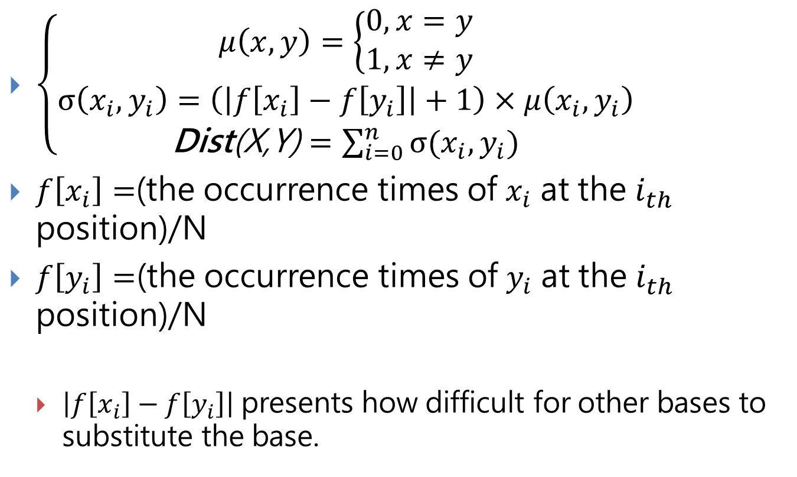
Direct alignment in combination with statistical information
$\left\{\begin{aligned}μ\left(x,y\right)=\left\{\begin{aligned}0, x=y \\ 1, x≠y\end{aligned}\right. \\ σ\left(x_{i},y_{i}\right)=\left(\left|f\left[x_{i}\right]−f\left[y_{i}\right]\right|+1\right)×μ\left(x_{i},y_{i}\right) \\ \text{Dist}\text{(}\text{X}\text{,}\text{Y}\text{)}=\sum_{i=0}^{n}{σ(x_{i},y_{i})}\end{aligned}\right.$
$f\left[x_{i}\right]=$(the occurrence times of $x_{i}$ at the $i_{th}$ position)/N
$f\left[y_{i}\right]=$(the occurrence times of $y_{i}$ at the $i_{th}$ position)/N
$\left|f\left[x_{i}\right]−f\left[y_{i}\right]\right|$ presents how difficult for other bases to substitute the base.

Slide 13
Experimental results
2796 donor sequences of human being as the experimental data set

Slide 14
Frequencies of various bases at each position
Dissimilarity definition formula：
using Direct alignment in combination with statistical information
parameters：MinPts = 6, e = 1.57
Results：4 clusters and 153 noise objects

Slide 15
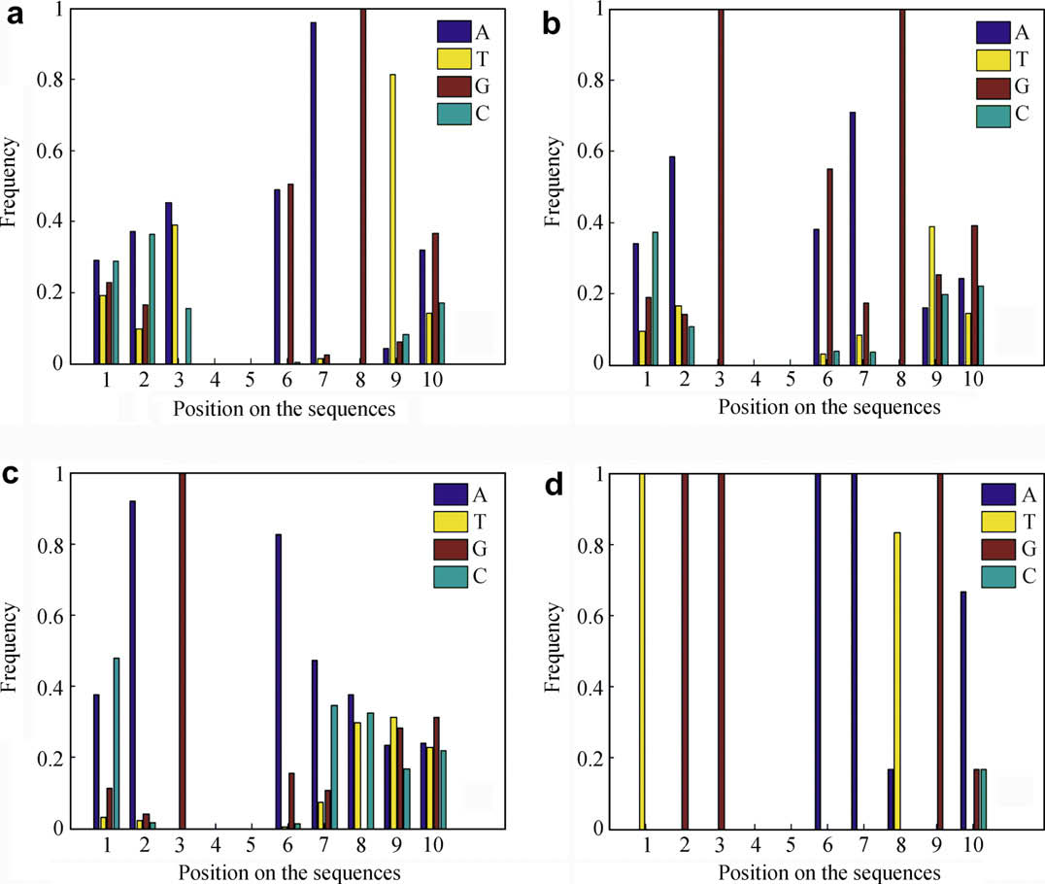

Slide 16
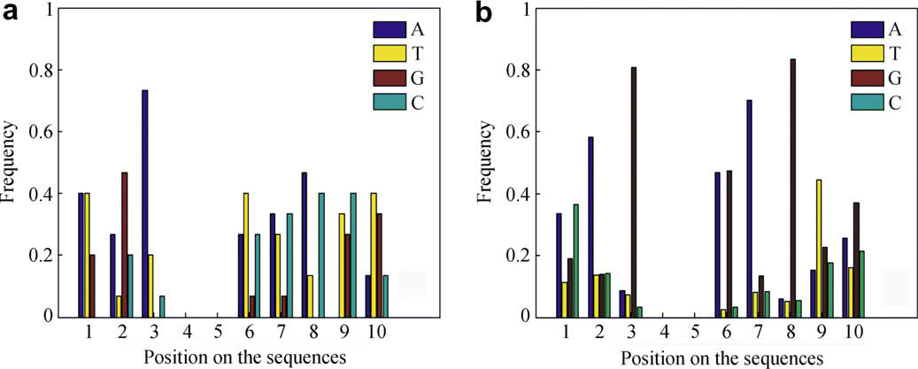
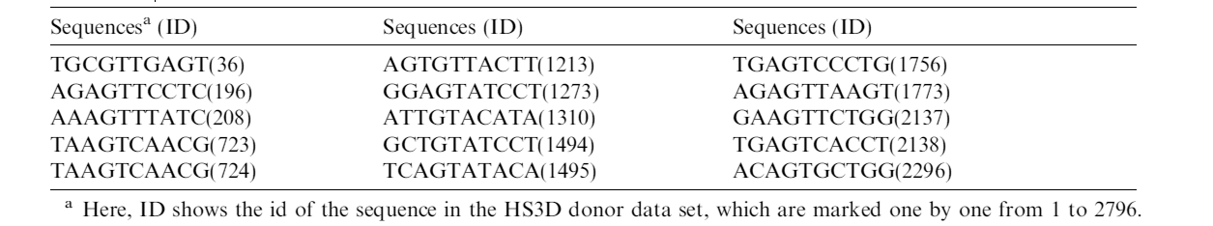
Noise set analysis
Dissimilarity definition formula：
using Direct alignment in combination with statistical information
parameters：MinPts = 4, e = 2.0
Results：1 clusters and 15 noise objects

Slide 17
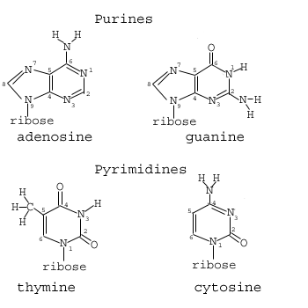
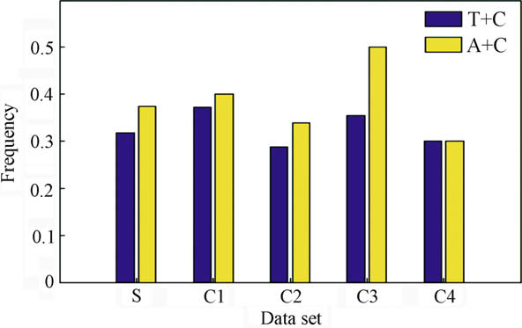
Frequency of base combinations
the percentage of ”T+C” (or “A+G”) is used to describe a given sequence sometimes.
A and C have the same functional amino-group
T and G have functional keto-group

Slide 18
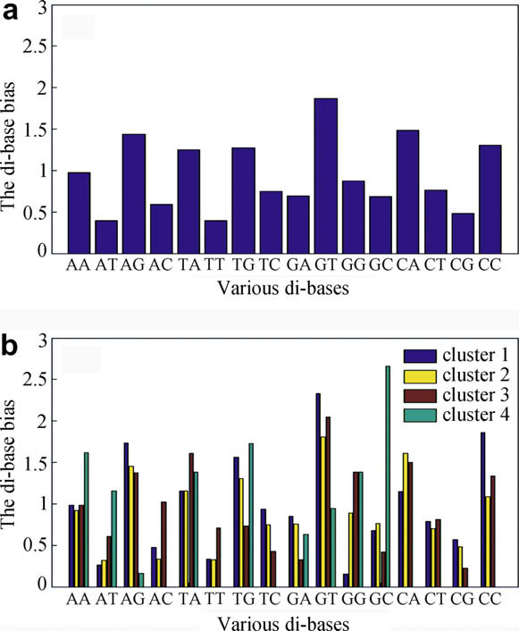

Di-bases bias
$f_{x}$ denote the frequency of the base $X=\left(X∈\left\{A,T,G,C\right\}\right)$
$f_{xy}$ denote the frequency of di-bases $XY=\left(X,Y∈\left\{A,T,G,C\right\}\right)$.
We can use $Pxy =\frac{fxy}{fx fy}$ to describe the bias of $XY$ in the sequence.

Slide 19
Conclusions
These features can help us to predict the functions of the sequences in each cluster, and it will be also helpful to mine more biological knowledge from the clustering results.
Although the clustering results show us some important features, they do not provide enough biological knowledge directly. In the future, some further works will be done based on the clustering results to improve the prediction accuracy of splice sites.

