Slide 1
Improved algorithms for the K overlapping maximum convex sum problem
Mohammed Thaher, Tadao Takaoka
Procedia Computer Science
Volume 9, 2012, Pages 754–763
Department of Computer Science and Software Engineering, University of Canterbury, Christchurch 8140, New Zealand
Presenter: 方鈞毅
Date: Oct. 09, 2012

Slide 2
Abstract
This paper presents efficient algorithms that improve the time complexity of the K-Overlapping Maximum Convex Sum Problem (K-OMCSP).
Previous research has solved this problem by using the K-tuples approach in a time complexity of O(Kn^3).
In this paper, efficient algorithms based on dynamic programming are derived to improve the time complexity for the overlapping case. The algorithms find the first, second and third maximum convex sum, and up to the K-th maximum convex sum in the time complexity of O( n^3 + Kn^2 ) applying a new method which we call Active Trace Overlapping-Shape (ATOS).

Slide 3
Abstract
In addition, efficient techniques have been developed for designing and implementing the derived algorithms. Moreover, experiments performed to compare the running time for the two methods. The experiments showed that the running time of ATOS was faster than the K-tuples.

Slide 4

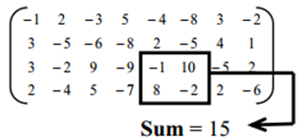

Maximum Subarray Problem(MSP)
Find the maximum subarray in a given array
1D array
2D array
Find a rectangular regions of a given m × n array of real numbers , which has the maximal sum .

Slide 5
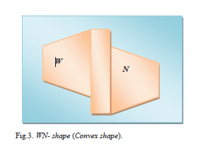
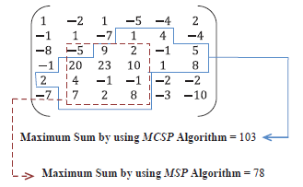
Maximum Convex Sum Problem (MCSP)
MCSP is to use a convex shape instead the previous rectangular shape(MSP)
convex shape is the combine of W ship and N ship here.

Slide 6
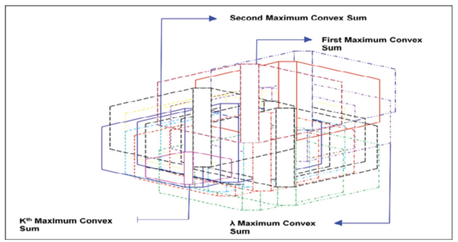
K-Overlapping MCSP(K-OMCSP)

Slide 7
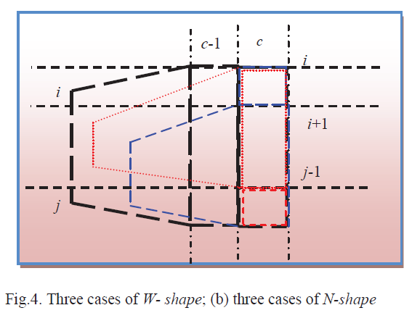
Meaning of the Three Case

Slide 8
How to Find K-OMCSP
Find the first convex shape and record the anchor column
Build a tournament tree and trace back the winner path
Set negative infinite to the bottom of the winning path and update it to find the next winner ^
Finally run a top tournament between different anchor columns and ranking them

Slide 9
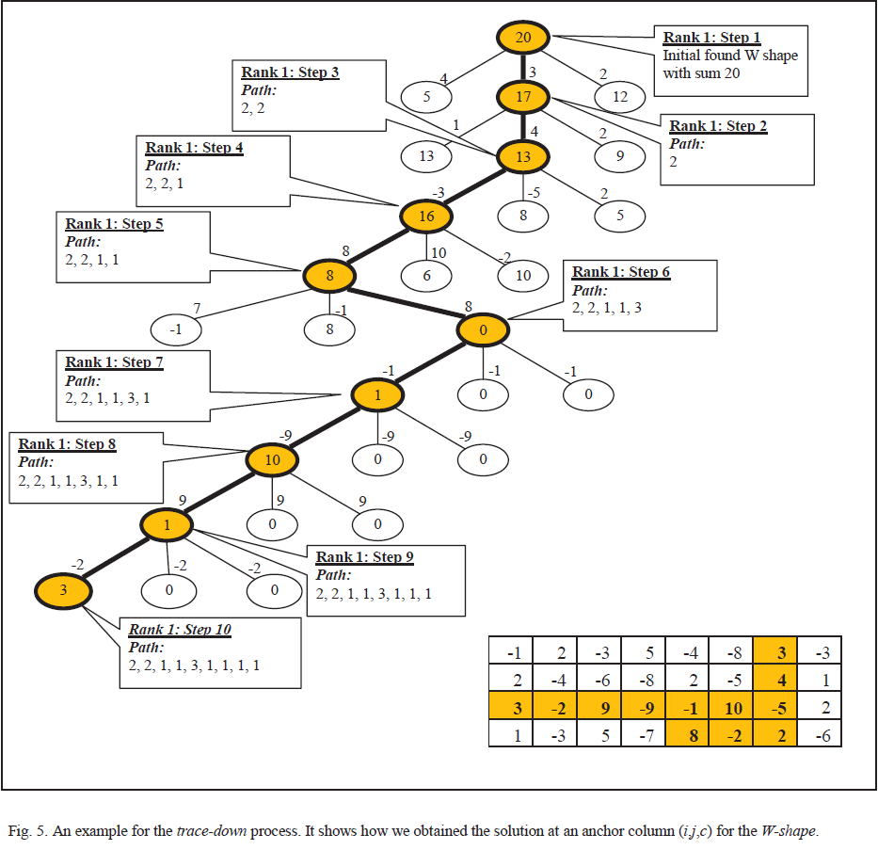

Slide 10
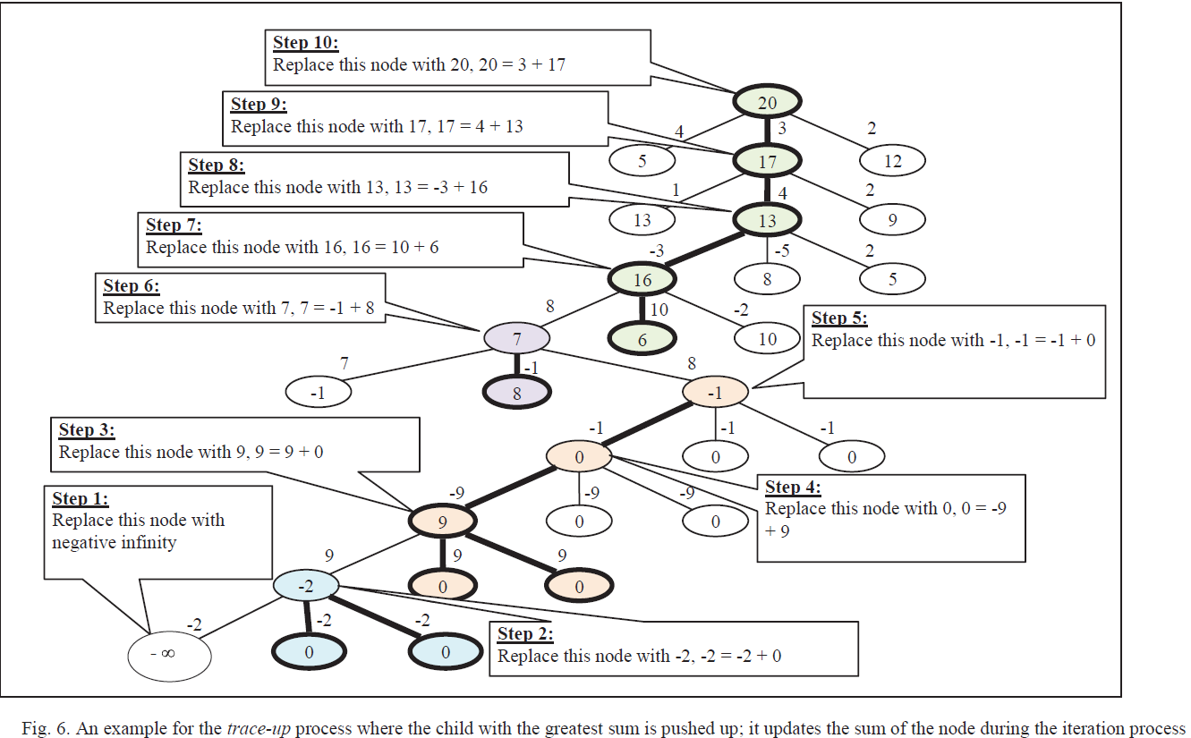
Trace Up

Slide 11
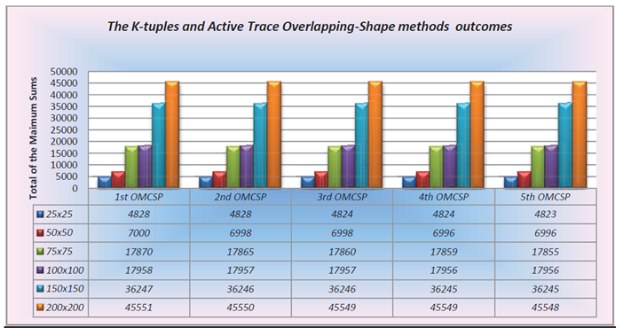
Results

Slide 12
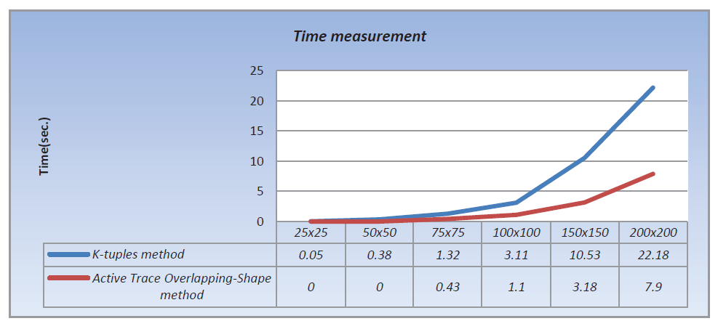
Results

Slide 13
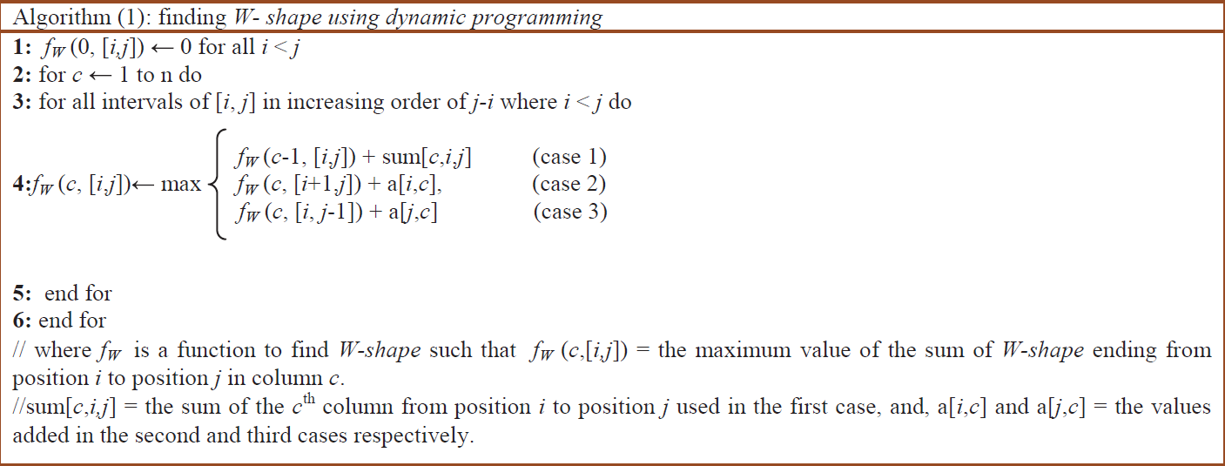
Algorithm 1

Slide 14
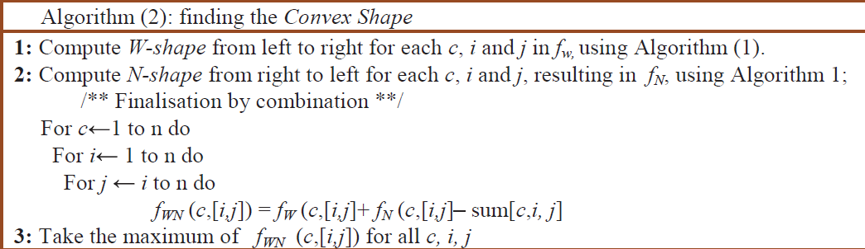
Algorithm 2

