Slide 1
Very Fast and Simple Approximate String Matching
Gonzalo Navarro, Ricardo Baeza-Yates
Information Processing Letters Volume 72, Issues 1-2, 29 October 1999, Pages 65-70
Presenter: Yi-Pu Guo 2012-11-20

Slide 2
Abstract
We improve the fastest known algorithm for approximate string matching, which can be used only for low error levels. By using a new method to verify potential matches and a new optimization technique for biased texts (such as English), the algorithm also becomes the fastest one for medium error levels. This includes most of the interesting cases in this area.

Slide 3
Approximate String Matching
(long) Text of length n
(short) Pattern of length m
Maximum k errors are allowed
Edit distance: (Ex: k=1) dog --> dogs (insert), do_ (delete), fog (replace)

Slide 4
Lemma
Lemma. If a pattern is partitioned into k + 1 pieces, then at least one of the pieces can be found with no errors in any approximate occurrence of the pattern.
將 pattern 平分成 4 段，而只能錯 3 個地方，必定至少有一段是和原來完全相等的。
abcd efgh ijkl mno

Slide 5
This Paper
A filtration (過濾) algorithm 快速排除大部份不可能的區域，剩下的才仔細檢查。
Filtration an extension of Boyer-Moore-Sunday algorithm with a trie
Verification Hierarchical veritication

Slide 6
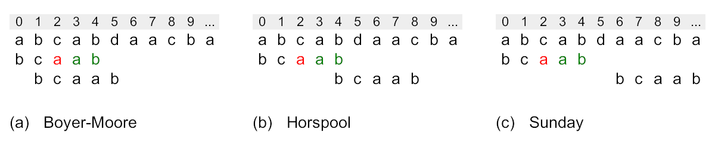
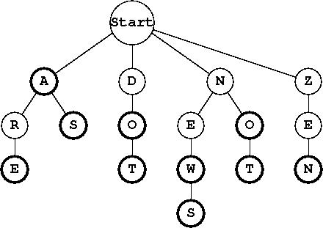
Boyer-Moore-Sunday
Trie
(a) uses the "bad" text character c to determine the shift distance. (b) uses the rightmost character b of the current text window. (c) uses the character directly right of the text window.

Slide 7
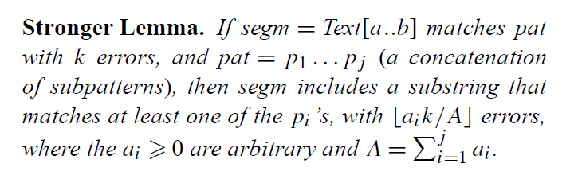
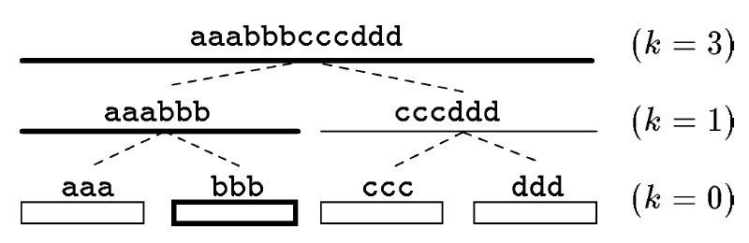
Hierarchical Verification

Slide 8
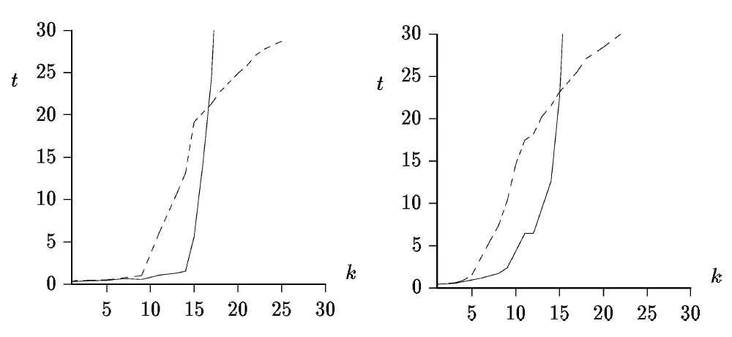
Result
random
English text
The old (dashed line) versus the new (solid line) verification techniques. We use m = 30.

