Slide 1
Approximability of Constrained LCS
Minghui Jiang(江銘輝)
Journal of Computer and System Sciences Vol. 78, pp. 689–697, 2012
Presenter: Chiou-Ting Tseng
Date: Nov. 20, 2012

Slide 2
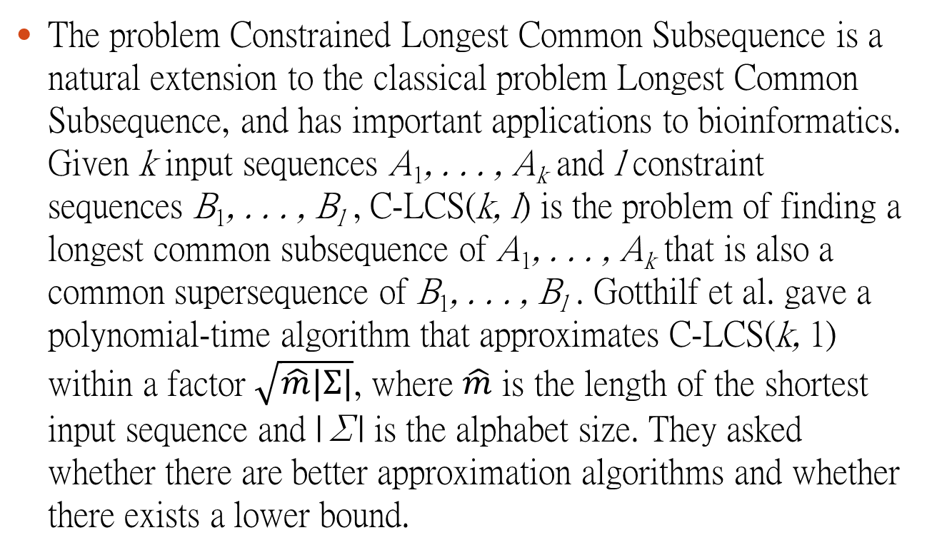
Abstract
The problem Constrained Longest Common Subsequence is a natural extension to the classical problem Longest Common Subsequence, and has important applications to bioinformatics. Given k input sequences A₁, . . . , A_{k} and l constraint sequences B₁, . . . , B_{l} , C-LCS(k, l) is the problem of finding a longest common subsequence of A₁, . . . , A_{k} that is also a common supersequence of B₁, . . . , B_{l} . Gotthilf et al. gave a polynomial-time algorithm that approximates C-LCS(k, 1) within a factor $\sqrt{\hat{m}|Σ|}$, where $\hat{m}$ is the length of the shortest input sequence and |Σ| is the alphabet size. They asked whether there are better approximation algorithms and whether there exists a lower bound.

Slide 3
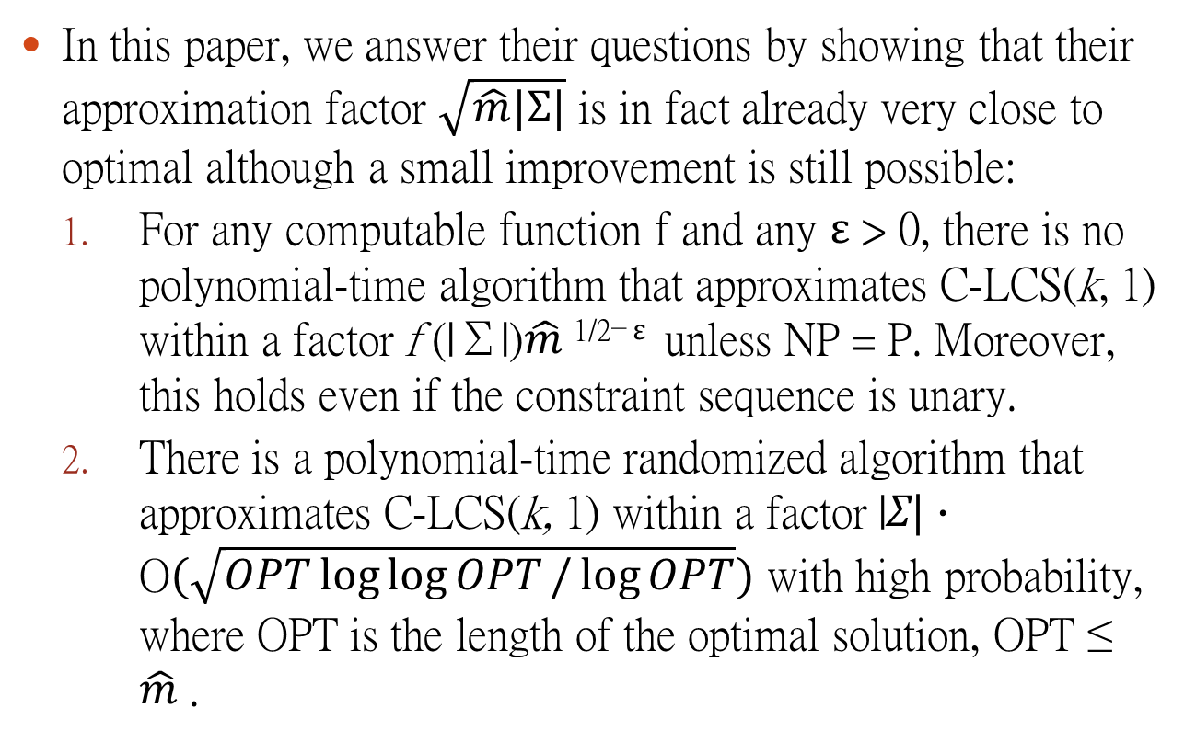
Abstract
In this paper, we answer their questions by showing that their approximation factor $\sqrt{\hat{m}|Σ|}$ is in fact already very close to optimal although a small improvement is still possible:
For any computable function f and any ε > 0, there is no polynomial-time algorithm that approximates C-LCS(k, 1) within a factor f (|Σ|)$\hat{m}$^{1/2− ε} unless NP = P. Moreover, this holds even if the constraint sequence is unary.
There is a polynomial-time randomized algorithm that approximates C-LCS(k, 1) within a factor |Σ| · O$(\sqrt{OPT\log{\log{OPT}/\log{OPT}}})$ with high probability, where OPT is the length of the optimal solution, OPT ≤ $\hat{m}$.

Slide 4
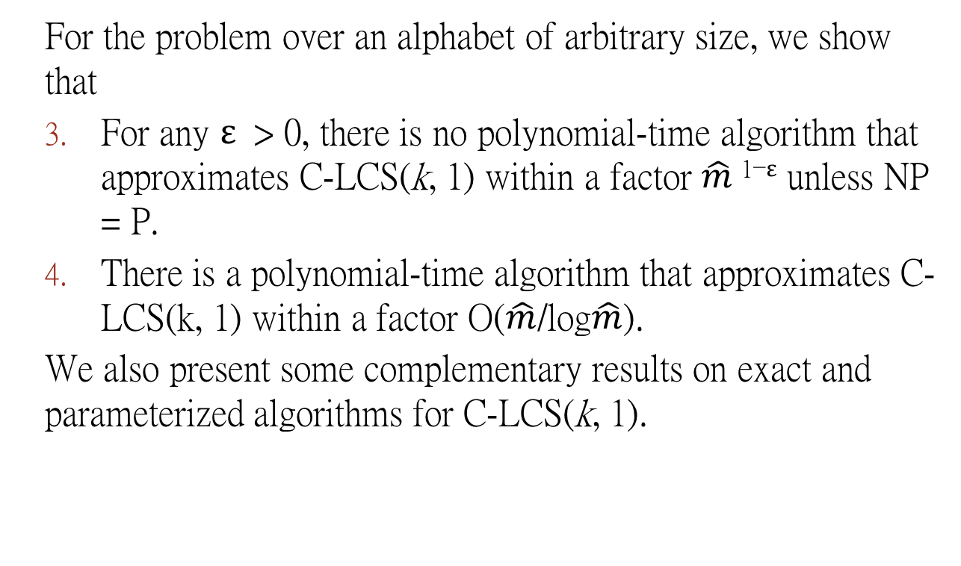
Abstract
For the problem over an alphabet of arbitrary size, we show that
For any ε > 0, there is no polynomial-time algorithm that approximates C-LCS(k, 1) within a factor $\hat{m}$^{1−ε} unless NP = P.
There is a polynomial-time algorithm that approximates C-LCS(k, 1) within a factor O($\hat{m}$/log$\hat{m}$).
We also present some complementary results on exact and parameterized algorithms for C-LCS(k, 1).

Slide 5
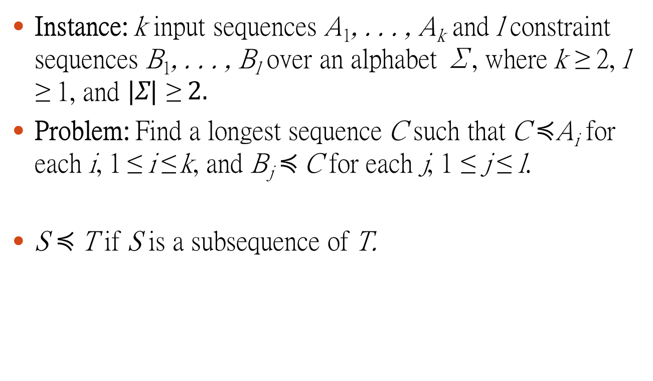
C-LCS(k, l)
Instance: k input sequences A₁, . . . , A_{k} and l constraint sequences B₁, . . . , B_{l} over an alphabet Σ, where k ≥ 2, l ≥ 1, and |Σ| ≥ 2.
Problem: Find a longest sequence C such that C$≼$A_{i} for each i, 1 ≤ i ≤ k, and B_{j} $≼$C for each j, 1 ≤ j ≤ l.
S $≼$T if S is a subsequence of T.

Slide 6
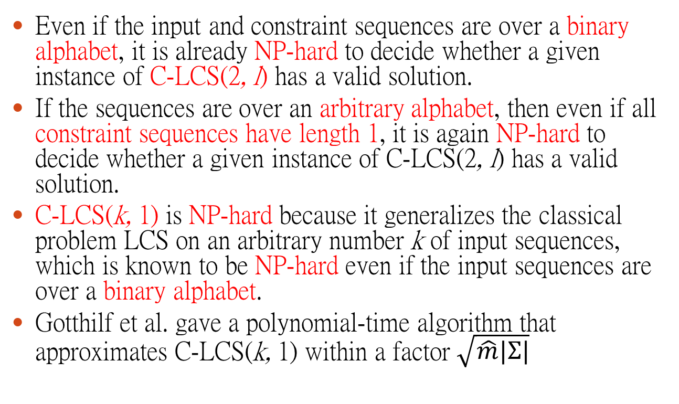
Previous Hardness Results
Even if the input and constraint sequences are over a binary alphabet, it is already NP-hard to decide whether a given instance of C-LCS(2, l) has a valid solution.
If the sequences are over an arbitrary alphabet, then even if all constraint sequences have length 1, it is again NP-hard to decide whether a given instance of C-LCS(2, l) has a valid solution.
C-LCS(k, 1) is NP-hard because it generalizes the classical problem LCS on an arbitrary number k of input sequences, which is known to be NP-hard even if the input sequences are over a binary alphabet.
Gotthilf et al. gave a polynomial-time algorithm that approximates C-LCS(k, 1) within a factor $\sqrt{\hat{m}|Σ|}$

Slide 7

Theorem 1
For any computable function f and any ε > 0, there is no polynomial-time algorithm that approximates C-LCS(k, 1) within a factor f (|Σ|)$\hat{m}$^{1/2− ε} unless NP = P. Moreover, this holds even if the constraint sequence is unary.
考慮Σ和$\hat{m}為參數$

Slide 8

Theorem 3
For any ε > 0, there is no polynomial-time algorithm that approximates C-LCS(k, 1) within a factor $\hat{m}$^{1−ε} unless NP = P.
只考慮$\hat{m}為參數$

Slide 9

Theorem 2
There is a polynomial-time randomized algorithm that approximates C-LCS(k, 1) within a factor |Σ| · O$(\sqrt{OPT\log{\log{OPT}/\log{OPT}}})$ with high probability, where OPT is the length of the optimal solution, OPT ≤ $\hat{m}$.
考慮Σ和$\hat{m}為參數$

Slide 10

Theorem 4
There is a polynomial-time algorithm that approximates C-LCS(k, 1) within a factor O($\hat{m}$/log$\hat{m}$).
只考慮$\hat{m}為參數$

Slide 11
Proof of Theorem 1
Reduce from MAX-CLIQUE.
Let G be a graph with n vertices and m edges. We construct a C-LCS(k, 1) instance consisting of k =C(n,2)−m +1 input sequences A₁, . . . , A_{k} over a binary alphabet and a single constraint sequence B.
The constraint sequence B is a unary sequence of n −1 zeros: B = 0^{n−1}
The last input sequence A_{k} consists of n² ones and n −1 zeros: A_{k} = 1^{n}(01^{n})^{n−1}

Slide 12
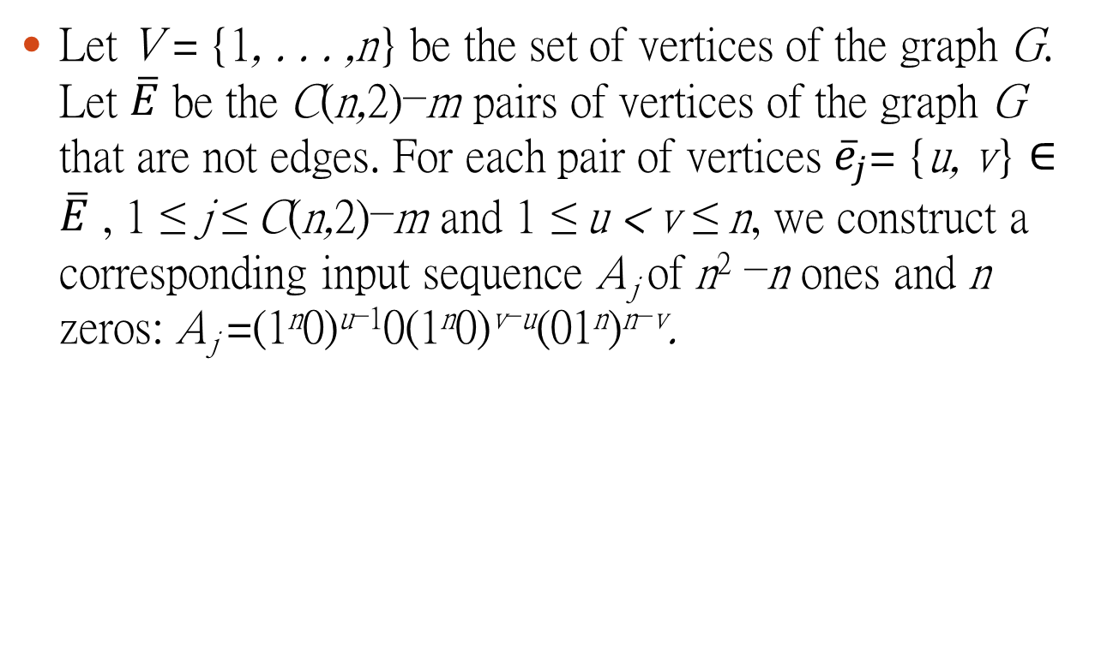
Proof of Theorem 1
Let V = {1, . . . ,n} be the set of vertices of the graph G. Let $\overline{E}$ be the C(n,2)−m pairs of vertices of the graph G that are not edges. For each pair of vertices ${\overline{e}}_{j}$= {u, v} ∈ $\overline{E}$ , 1 ≤ j ≤ C(n,2)−m and 1 ≤ u < v ≤ n, we construct a corresponding input sequence A_{j} of n² −n ones and n zeros: A_{j} =(1^{n}0)^{u−1}0(1^{n}0)^{v−u}(01^{n})^{n−v}.

Slide 13
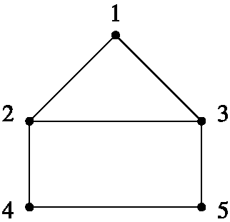
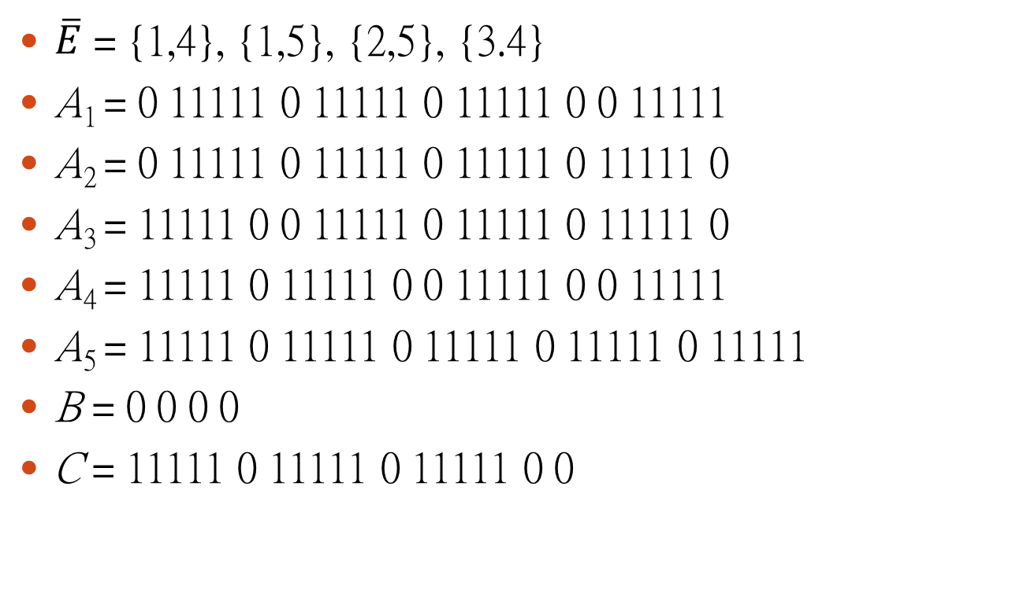
Example
$\overline{E}$ = {1,4}, {1,5}, {2,5}, {3.4}
A₁ = 0 11111 0 11111 0 11111 0 0 11111
A₂ = 0 11111 0 11111 0 11111 0 11111 0
A₃ = 11111 0 0 11111 0 11111 0 11111 0
A₄ = 11111 0 11111 0 0 11111 0 0 11111
A₅ = 11111 0 11111 0 11111 0 11111 0 11111
B = 0 0 0 0
C = 11111 0 11111 0 11111 0 0

Slide 14
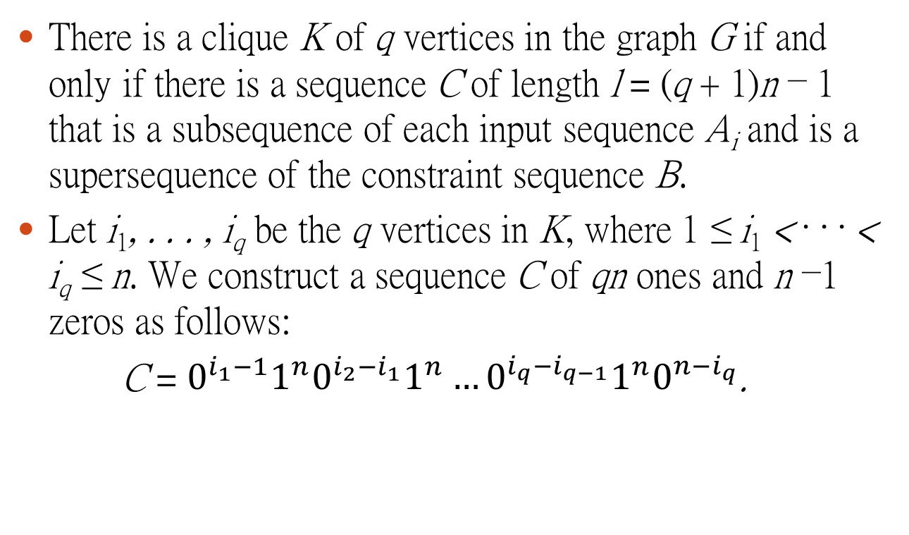
Lemma 1
There is a clique K of q vertices in the graph G if and only if there is a sequence C of length l = (q + 1)n − 1 that is a subsequence of each input sequence A_{i} and is a supersequence of the constraint sequence B.
Let i₁, . . . , i_{q} be the q vertices in K, where 1 ≤ i₁ < · · · < i_{q} ≤ n. We construct a sequence C of qn ones and n −1 zeros as follows:
C = $0^{i_{1}−1}1^{n}0^{i_{2}−i_{1}}1^{n}…0^{i_{q}−i_{q−1}}1^{n}0^{n−i_{q}}$.

Slide 15
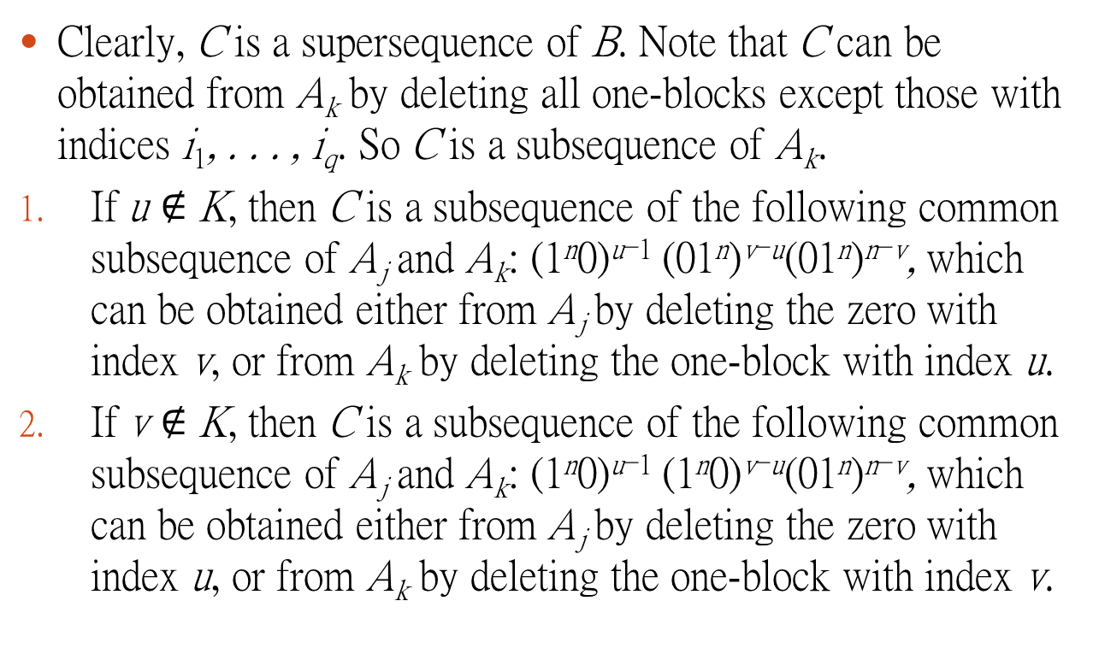
Lemma 1 (To be skipped)
Clearly, C is a supersequence of B. Note that C can be obtained from A_{k} by deleting all one-blocks except those with indices i₁, . . . , i_{q}. So C is a subsequence of A_{k}.
If u $∉$ K, then C is a subsequence of the following common subsequence of A_{j} and A_{k}: (1^{n}0)^{u−1} (01^{n})^{v−u}(01^{n})^{n−v}, which can be obtained either from A_{j} by deleting the zero with index v, or from A_{k} by deleting the one-block with index u.
If v $∉$ K, then C is a subsequence of the following common subsequence of A_{j} and A_{k}: (1^{n}0)^{u−1} (1^{n}0)^{v−u}(01^{n})^{n−v}, which can be obtained either from A_{j} by deleting the zero with index u, or from A_{k} by deleting the one-block with index v.

Slide 16
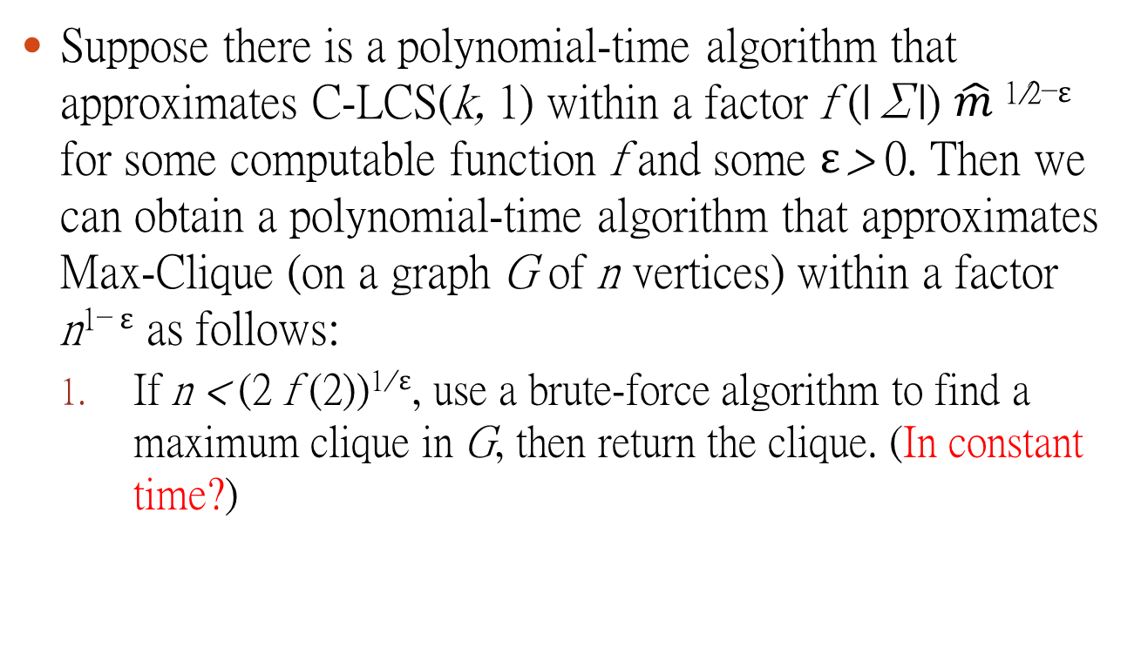
Reduction from MAX-CLIQUE
Suppose there is a polynomial-time algorithm that approximates C-LCS(k, 1) within a factor f (|Σ|) $\hat{m}$^{1/2−ε} for some computable function f and some ε > 0. Then we can obtain a polynomial-time algorithm that approximates Max-Clique (on a graph G of n vertices) within a factor n^{1− ε} as follows:
If n < (2 f (2))^{1/ ε}, use a brute-force algorithm to find a maximum clique in G, then return the clique. (In constant time?)

Slide 17

Reduction from MAX-CLIQUE
Construct a C-LCS(k, 1) instance as in our reduction, use the f (|Σ|) $c$-approximation algorithm to find a subsequence of length l, then obtain a clique of size q in G following the reverse implication of Lemma 1. If q ≥ 1, return the clique of size q. Otherwise, return any single vertex in G as a clique of size 1.

Slide 18
Theorem 6
Zuckerman (2007)
For any ε > 0, there is no polynomial-time algorithm that approximates Max-Clique within a factor n^{1−ε} unless NP = P.
So Theorem 1 is proved.

Slide 19
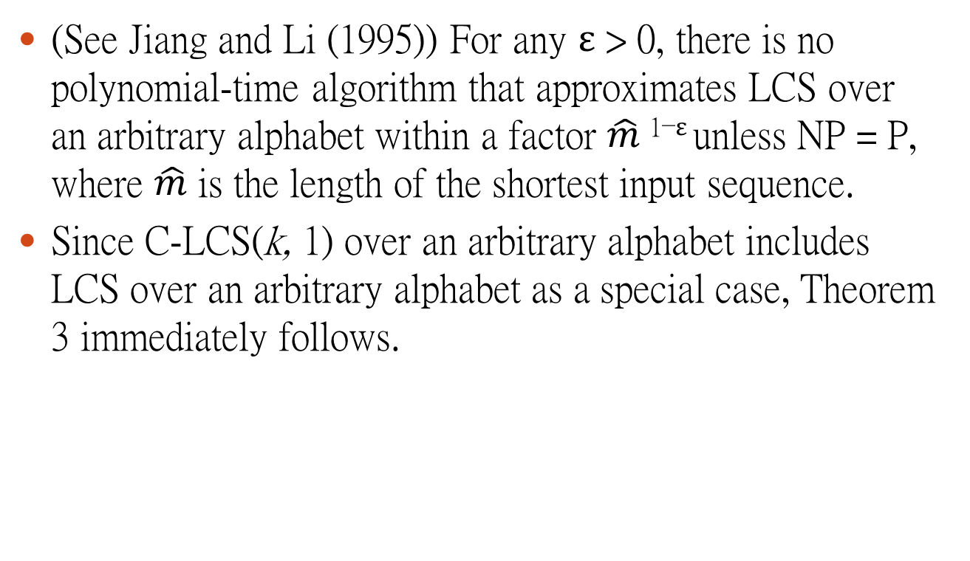
Proof of Theorem 3
(See Jiang and Li (1995)) For any ε > 0, there is no polynomial-time algorithm that approximates LCS over an arbitrary alphabet within a factor $\hat{m}$^{1−ε} unless NP = P, where $\hat{m}$ is the length of the shortest input sequence.
Since C-LCS(k, 1) over an arbitrary alphabet includes LCS over an arbitrary alphabet as a special case, Theorem 3 immediately follows.

Slide 20

Approximation Algorithm for Theorem 2
Let C∗ be a constrained longest common subsequence. Since B $≼$C∗, we can embed B inside C∗ in some fixed way such that C∗ = C₀B[1]C₁ . . . B[b]C_{b}, then assign each index a between 0 and b (which we call a slot) a value that is the length of the subsequence C_{a}.

Slide 21
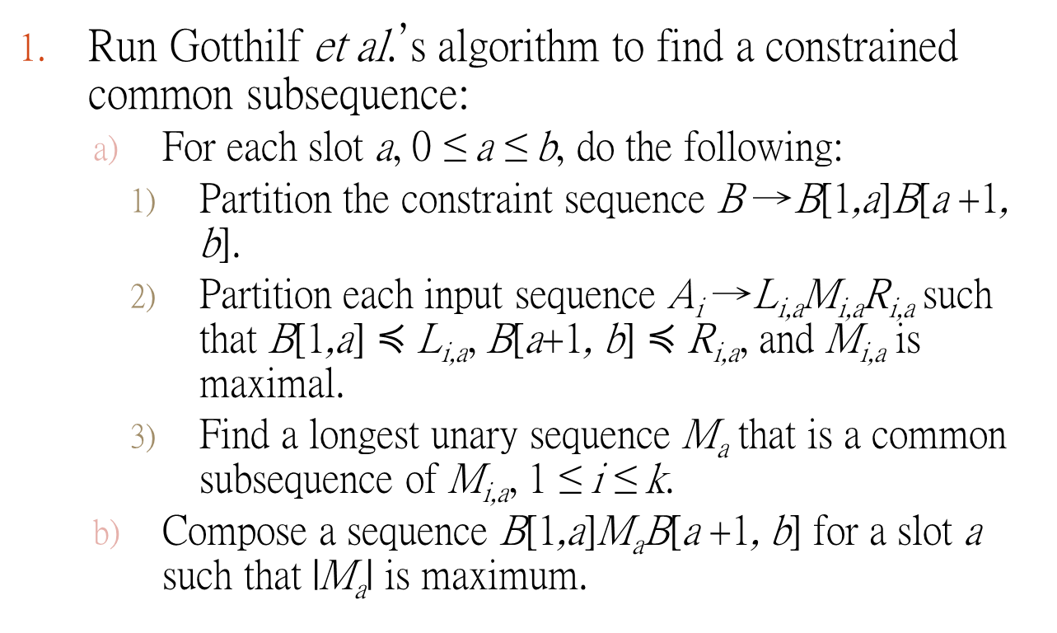
Algorithm 1
Run Gotthilf et al.’s algorithm to find a constrained common subsequence:
For each slot a, 0 ≤ a ≤ b, do the following:
Partition the constraint sequence B →B[1,a]B[a +1, b].
Partition each input sequence A_{i} →L_{i,a}M_{i,a}R_{i,a} such that B[1,a] $≼$ L_{i,a}, B[a+1, b] $≼$ R_{i,a}, and M_{i,a} is maximal.
Find a longest unary sequence M_{a} that is a common subsequence of M_{i,a}, 1 ≤ i ≤ k.
Compose a sequence B[1,a]M_{a}B[a +1, b] for a slot a such that |M_{a}| is maximum.

Slide 22
Example
A₁=acttagtaatgggatca
A₂=agcgttaggtaattacga
B=actga
Partition: atc ga
A₁ = act tagtaagg gatca，中間有3a, 2t, 3g,
A₂ = agcgt taggtaatac ga，中間有4a, 4t, 1c, 2g
C = atc aaa ga

Slide 23
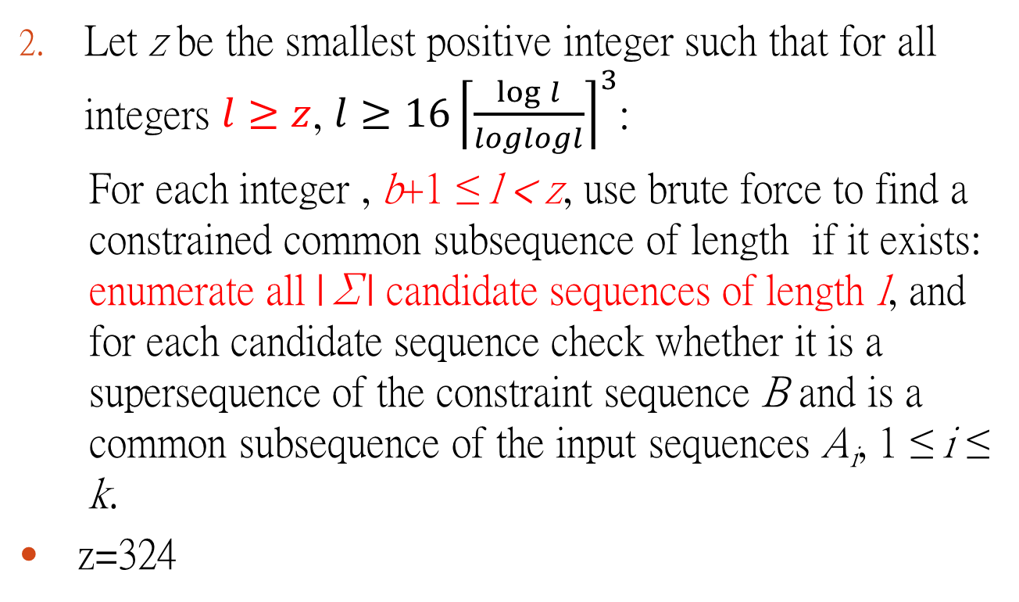
Algorithm 1
Let z be the smallest positive integer such that for all integers $l≥z$, ${l≥16\left\lceil \frac{\log{l}}{loglogl}\right\rceil }^{3}$:
For each integer , b+1 ≤ l < z, use brute force to find a constrained common subsequence of length if it exists: enumerate all |Σ| candidate sequences of length l, and for each candidate sequence check whether it is a supersequence of the constraint sequence B and is a common subsequence of the input sequences A_{i}, 1 ≤ i ≤ k.
z=324

Slide 24
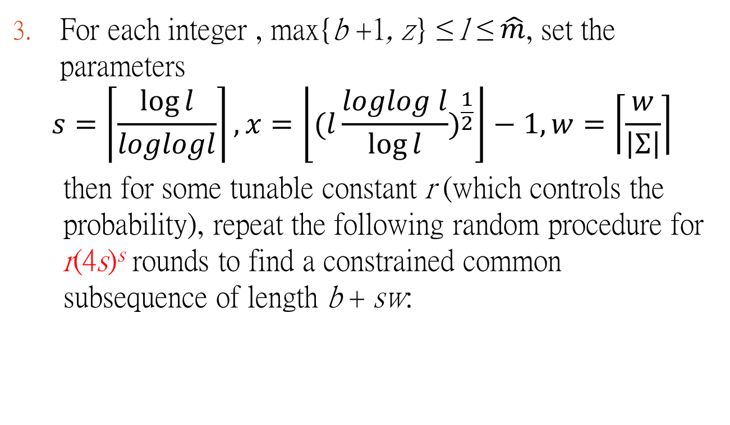
Algorithm 1
For each integer , max{b +1, z} ≤ l ≤ $\hat{m}$, set the parameters
$$s=\left\lceil \frac{\log{l}}{loglogl}\right\rceil ,x=\left\lfloor {(l\frac{loglog l}{\log{l}})}^{\frac{1}{2}}\right\rfloor −1,w=\left\lceil \frac{w}{\left|Σ\right|}\right\rceil$$
then for some tunable constant r (which controls the probability), repeat the following random procedure for r(4s)^{s} rounds to find a constrained common subsequence of length b + sw:

Slide 25
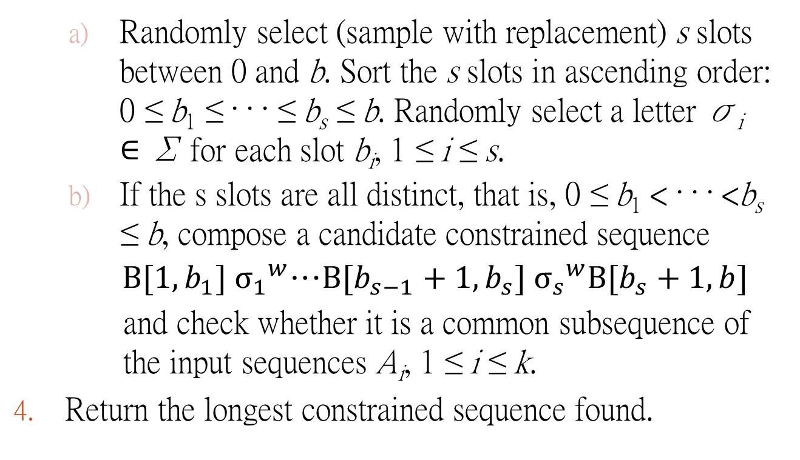
Algorithm 1
Randomly select (sample with replacement) s slots between 0 and b. Sort the s slots in ascending order: 0 ≤ b₁ ≤ · · · ≤ b_{s} ≤ b. Randomly select a letter σ_{i} ∈ Σ for each slot b_{i}, 1 ≤ i ≤ s.
If the s slots are all distinct, that is, 0 ≤ b₁ < · · · <b_{s} ≤ b, compose a candidate constrained sequence
$B[1,b_{1}] {σ_{1}}^{w}$…$B[b_{s−1}+1,b_{s}] {σ_{s}}^{w}B[b_{s}+1,b]$
and check whether it is a common subsequence of the input sequences A_{i}, 1 ≤ i ≤ k.
Return the longest constrained sequence found.

Slide 26
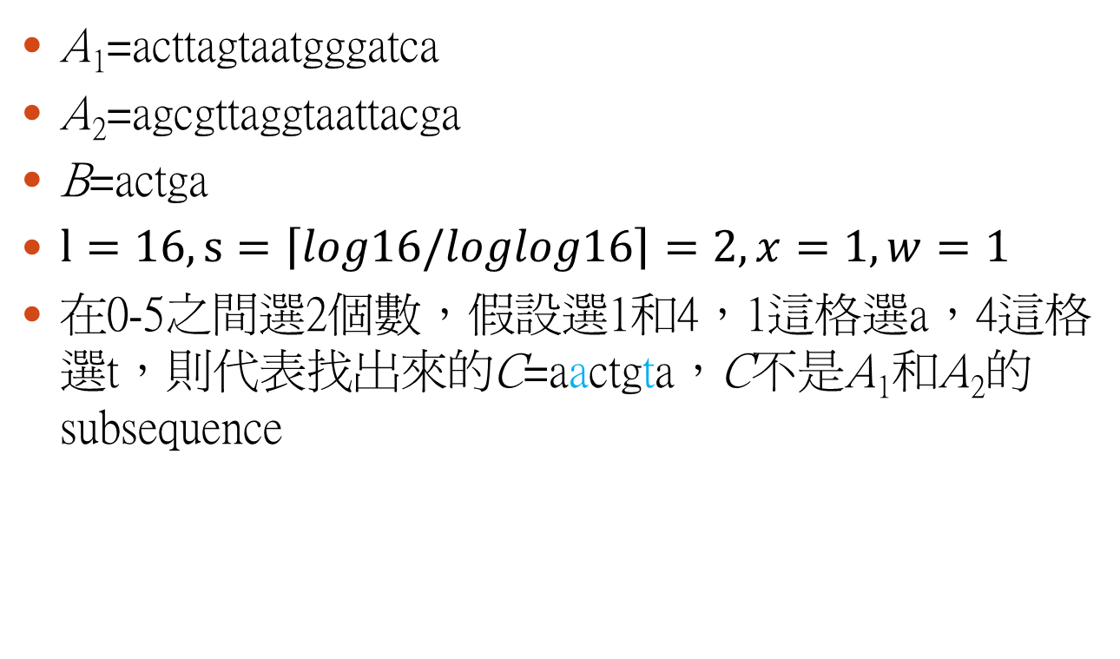
Example
A₁=acttagtaatgggatca
A₂=agcgttaggtaattacga
B=actga
$l=16, s=\left\lceil log16/loglog16\right\rceil =2, x=1,w=1$
在0-5之間選2個數，假設選1和4，1這格選a，4這格選t，則代表找出來的C=aactgta，C不是A₁和A₂的subsequence

Slide 27
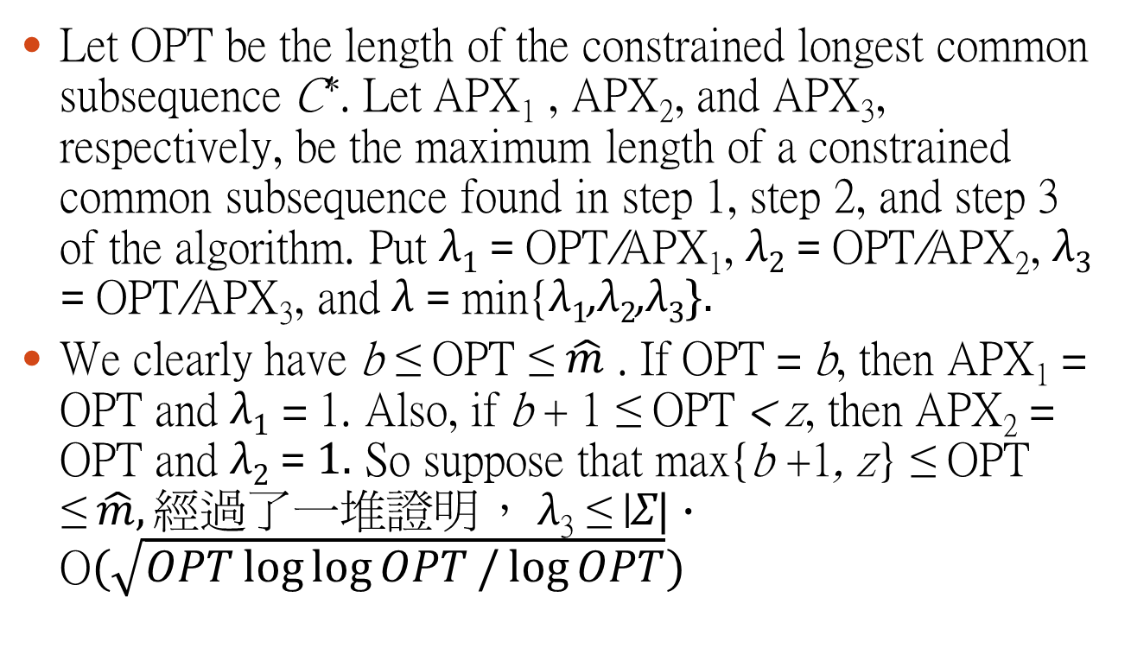
Approximate Ratio
Let OPT be the length of the constrained longest common subsequence C∗. Let APX₁ , APX₂, and APX₃, respectively, be the maximum length of a constrained common subsequence found in step 1, step 2, and step 3 of the algorithm. Put λ₁ = OPT/APX₁, λ₂ = OPT/APX₂, λ₃ = OPT/APX₃, and λ = min{λ₁,λ₂,λ₃}.
We clearly have b ≤ OPT ≤ $\hat{m}$ . If OPT = b, then APX₁ = OPT and λ₁ = 1. Also, if b + 1 ≤ OPT < z, then APX₂ = OPT and λ₂ = 1. So suppose that max{b +1, z} ≤ OPT ≤$\hat{m},經過了一堆證明$， λ₃ ≤ |Σ| · O$(\sqrt{OPT\log{\log{OPT}/\log{OPT}}})$

Slide 28
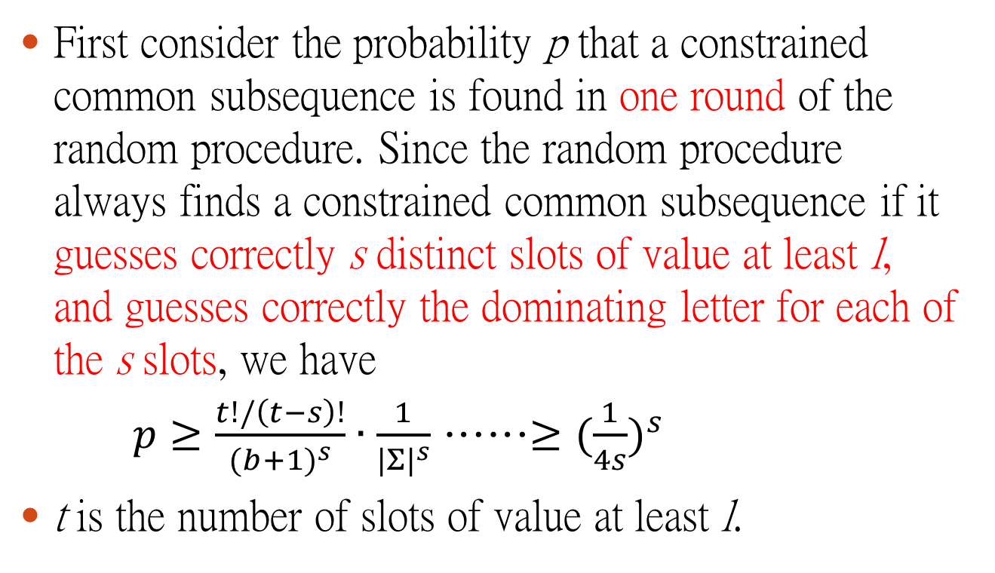
Probability
First consider the probability p that a constrained common subsequence is found in one round of the random procedure. Since the random procedure always finds a constrained common subsequence if it guesses correctly s distinct slots of value at least l, and guesses correctly the dominating letter for each of the s slots, we have
$p≥\frac{t!/\left(t−s\right)!}{{(b+1)}^{s}}∙\frac{1}{{|Σ|}^{s}}$ ……$≥{(\frac{1}{4s})}^{s}$
t is the number of slots of value at least l.

Slide 29
Probability
y=(4s)^{s}, so each round of the random procedure finds a constrained common subsequence with probability at least 1/y.
Since the random procedure is repeated for ry rounds, the probability that a constrained common subsequence is not found in ry consecutive rounds is at most
(1− 1/y)^{ry} ≤ 1/e^{r} ,
which can be made arbitrarily small by choosing the constant r sufficiently large.

Slide 30
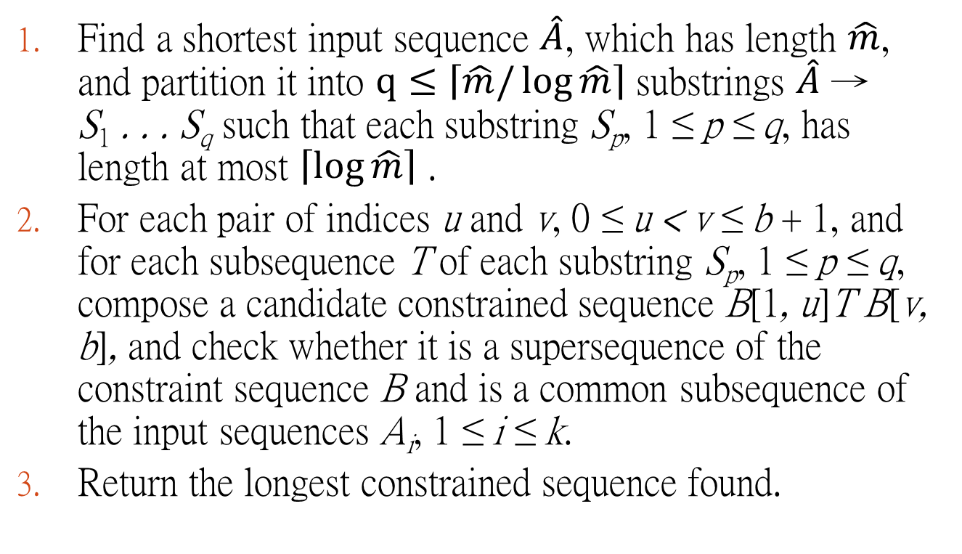
Approximation Algorithm for Theorem 4
Find a shortest input sequence $\hat{A}$, which has length $\hat{m}$, and partition it into $q≤\left\lceil \hat{m}/\log{\hat{m}}\right\rceil$ substrings $\hat{A}$ → S₁ . . . S_{q} such that each substring S_{p}, 1 ≤ p ≤ q, has length at most $\left\lceil \log{\hat{m}}\right\rceil$ .
For each pair of indices u and v, 0 ≤ u < v ≤ b + 1, and for each subsequence T of each substring S_{p}, 1 ≤ p ≤ q, compose a candidate constrained sequence B[1, u]T B[v, b], and check whether it is a supersequence of the constraint sequence B and is a common subsequence of the input sequences A_{i}, 1 ≤ i ≤ k.
Return the longest constrained sequence found.

Slide 31
Example
A₁=acttagtaatgggatca
A₂=agcgttaggtaattacga
B=actga
q=5, S₁=actt, S₂=agt, S₃=aatg, S₄=gga, S₅=tca
假設u=2, v=4, p=3, T=aag，C=acaagga，不是B的superstring
假設u=2, v=4, p=3, T=aat，C=acaatga，是B的superstring，也是A₁和A₂的substring

Slide 32

Approximate Ratio
假設正確答案是C*，我們也可以把C*依據跟$\hat{A}$的對應分成q塊，根據鴿籠原理，一定有一塊長度≧|C*|/q，假設是第i塊，這塊會在我們找S_{i}的子字串時找到，所以保證approximate ratio為$\hat{m}/\log{\hat{m}}$

Slide 33
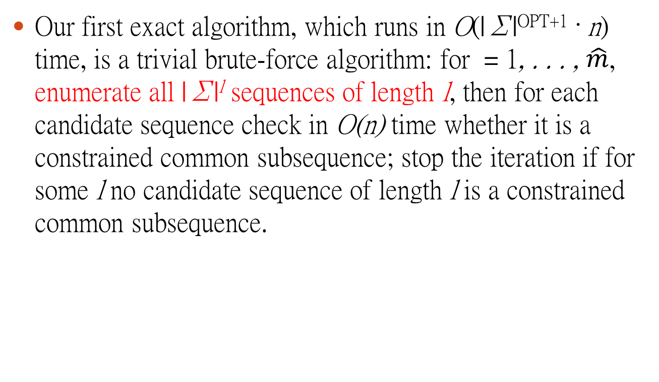
Exact algorithm for C(k, l)
Our first exact algorithm, which runs in O(|Σ|^{OPT+1} · n) time, is a trivial brute-force algorithm: for = 1, . . . , $\hat{m}$, enumerate all |Σ|^{l} sequences of length l, then for each candidate sequence check in O(n) time whether it is a constrained common subsequence; stop the iteration if for some l no candidate sequence of length l is a constrained common subsequence.

Slide 34




Exact algorithm for C(k, l)
where the second case applies only if A₁[a₁]=· · ·= A_{k}[a_{k}] = σ for some σ ∈ Σ; then we let b_{j}’= b_{j} − 1 if B_{j} [b_{j}] = σ and let b_{j}’=b_{j} if B_{j} [b_{j}] ≠σ.
The table L has $\prod_{i=1}^{k}{({|A}_{i}|+1)}\prod_{j=1}^{l}{({|B}_{j}|+1)}$ entries in total; each entry can be computed in O(k +l) time.

Slide 35
The End

