Slide 1
A novel clustering method on time series data
Xiaohang Zhang*, Jiaqi Liu, Yu Du, and Tingjie Lv
School of Economics and Management, Beijing University of Posts and Telecommunications
Expert Systems with Application, Vol. 38, pp. 11891-11900, 2011
Presenter: Hung-Hsin Chen (陳紘昕)
Date: Dec. 10, 2012

Slide 2
Abstract (1)
Time series is a very popular type of data which exists in many domains. Clustering time series data has a wide range of applications and has attracted researchers from a wide range of discipline. In this paper a novel algorithm for shape based time series clustering is proposed. It can reduce the size of data, improve the efﬁciency and not reduce the effects by using the principle of complex network. Firstly, one-nearest neighbor network is built based on the similarity of time series objects.

Slide 3
Abstract (2)
In this step, triangle distance is used to measure the similarity of the neighbor network each node represents one time series object and each link denotes neighbor relationship between nodes. Secondly, the nodes with high degrees are chosen and used to cluster. In clustering process, dynamic time warping distance function and hierarchical clustering algorithm are applied. Thirdly, some experiments are executed on synthetic and real data. The results show that the proposed algorithm has good performance on efﬁciency and effectiveness.

Slide 4
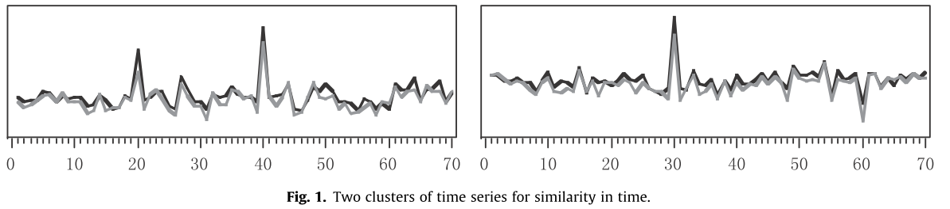
Introduction
Three main objectives in clustering time series.
Similarity in time
Cluster series that vary in a similar way on each time step
MSE, RMSE

Slide 5
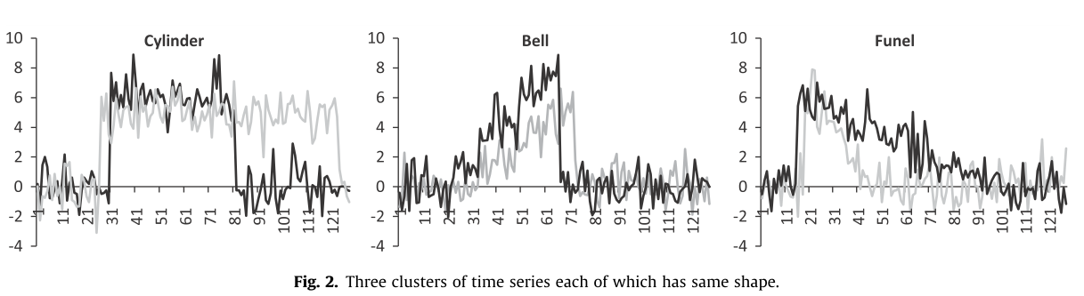
Introduction (2)
2.Similarity in shape
Identifying common trends occurring at different times or similar sub patterns in the data.
Dynamic time warping (DTW) or either algorithms
Ex: Stock price

Slide 6
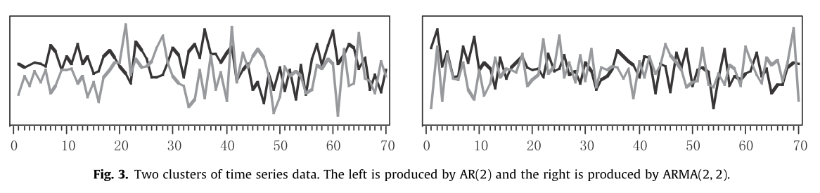
Introduction (3)
3. Similarity in change
Cluster series by the similarity in how they vary from time step to step
Hidden Markov model (HMM), ARMA,…

Slide 7
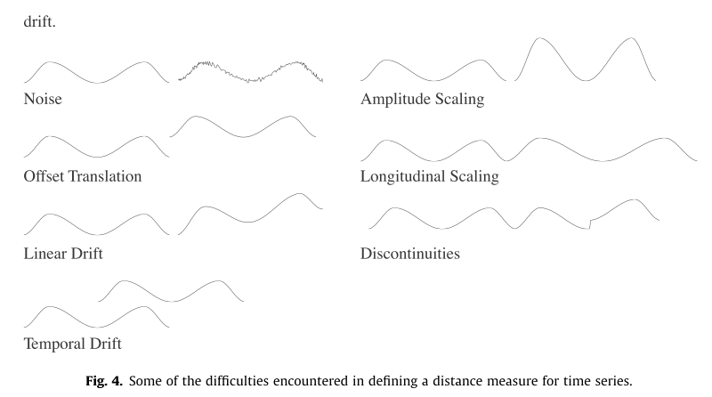
Time series clustering
The goal of clustering
within-group-object similarity is minimized
between-group-object dissimilarity is maximized
Time series properties:

Slide 8

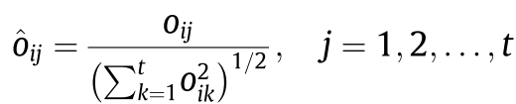
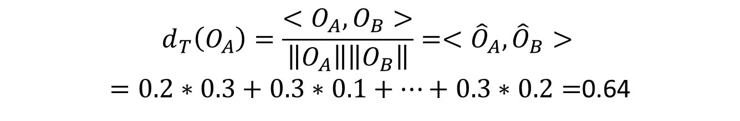
Similarity/distance measures (1)
1.Triangle similarity( cosine distance)
Original time series:
Idx | 1 | 2 | 3 | 4 | 5 | 6 | 7 | length
A | 2 | 3 | 8 | 2 | 3 | 1 | 3 | 10
Normalized time series:
Idx | 1 | 2 | 3 | 4 | 5 | 6 | 7 | length
A | 0.2 | 0.3 | 0.8 | 0.2 | 0.3 | 0.1 | 0.3 | 1
B | 0.3 | 0.1 | 0.2 | 0.3 | 0.8 | 0.3 | 0.2 | 1
$$d_{T}\left(O_{A}\right)=\frac{<O_{A}, O_{B}>}{\left\|O_{A}\right\|\left\|O_{B}\right\|}=<{\hat{O}}_{A},{\hat{O}}_{B}>$$ $=0.2∗0.3+0.3∗0.1+…+0.3∗0.2=$0.64

Slide 9
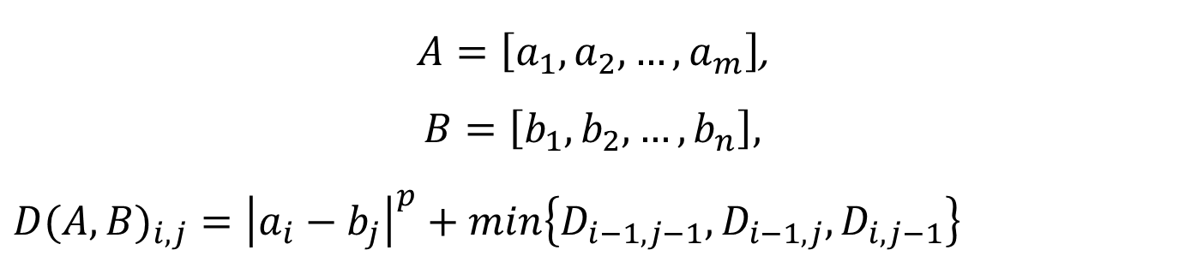
Similarity/distance measures (2)
2. Dynamic time warping (DTW) distance
$A=\left[a_{1},a_{2},…,a_{m}\right]$,
$$B=\left[b_{1},b_{2},…,b_{n}\right],$$
$${D(A,B)}_{i,j}={\left|a_{i}−b_{j}\right|}^{p}+min\left\{D_{i−1,j−1},D_{i−1,j},D_{i,j−1}\right\}$$
Usually p=2
Time & space complexity: O(nm)

Slide 10
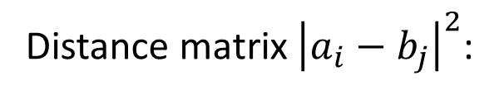
Index | 1 | 2 | 3 | 4 | 5 | 6 | 7
A | 2 | 3 | 8 | 2 | 3 | 1 | 3
B | 3 | 1 | 2 | 3 | 8 | 3 | 2
Distance matrix ${\left|a_{i}−b_{j}\right|}^{2}$:
Cumulative distance matrix:
 | 3 | 1 | 2 | 3 | 8 | 3 | 2
2 | 1 | 1 | 0 | 1 | 36 | 1 | 0
3 | 0 | 4 | 1 | 0 | 25 | 0 | 1
8 | 25 | 49 | 36 | 25 | 0 | 25 | 36
2 | 1 | 1 | 0 | 1 | 36 | 1 | 0
3 | 0 | 4 | 1 | 0 | 25 | 0 | 1
1 | 4 | 0 | 1 | 4 | 49 | 4 | 1
3 | 0 | 4 | 1 | 0 | 25 | 0 | 1
 | 3 | 1 | 2 | 3 | 8 | 3 | 2
2 | 1 | 2 | 2 | 3 | 39 | 40 | 40
3 | 1 | 5 | 3 | 2 | 27 | 27 | 28
8 | 26 | 50 | 38 | 27 | 2 | 27 | 63
2 | 27 | 27 | 27 | 28 | 38 | 3 | 3
3 | 27 | 31 | 28 | 27 | 52 | 3 | 4
1 | 31 | 27 | 28 | 31 | 76 | 7 | 4
3 | 31 | 27 | 28 | 28 | 53 | 7 | 5

Slide 11
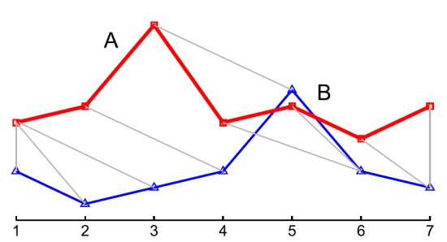
Index | 1 | 2 | 3 | 4 | 5 | 6 | 7
A | 2 | 3 | 8 | 2 | 3 | 1 | 3
B | 3 | 1 | 2 | 3 | 8 | 3 | 2
A | 2 |  |  | 3 | 8 | 2 | 3 | 1 | 3
B | 3 | 1 | 2 | 3 | 8 | 3 |  | 2
DTW’s advantage is that it can deal with temporal drift very well.

Slide 12
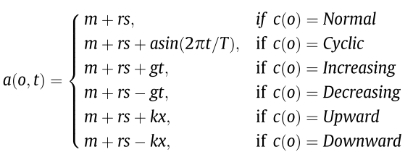
Experiment data (1)
Control chart (CC) [Alcock and Manolopoulos 99]
Each series has 60 real values, 6 classes

Slide 13
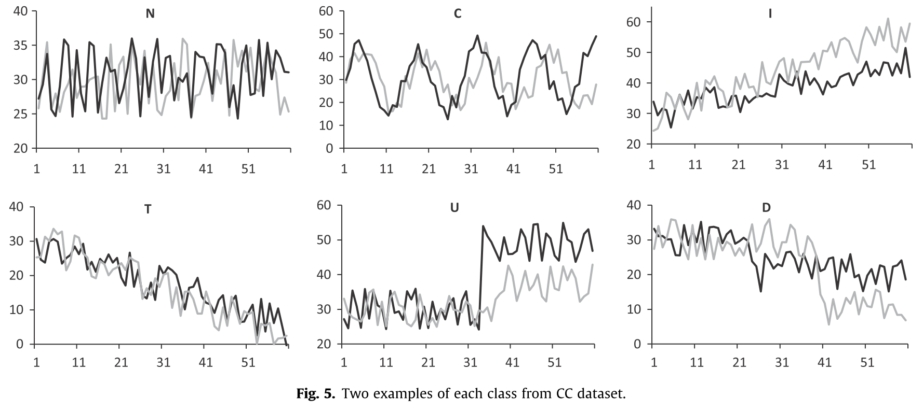
http://archive.ics.uci.edu/ml/datasets/Synthetic+Control+Chart+Time+Series

Slide 14
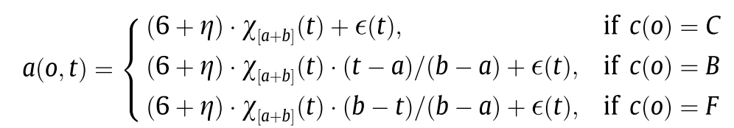
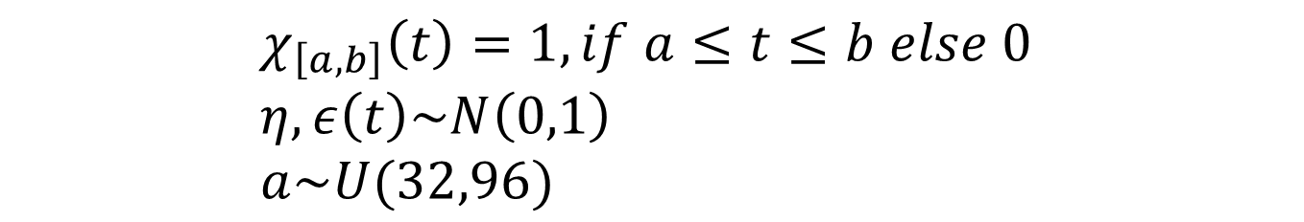
Experiment data (2)
2.Cylinder-Bell-Funnel (CBF) [Kadous, 99]
Each series has 128 real values ,3 classes
$$χ_{\left[a,b\right]}\left(t\right)=1, if a≤t≤b else 0 \\ η, ε\left(t\right)\sim N\left(0,1\right) \\ a\sim U(32,96)$$

Slide 15
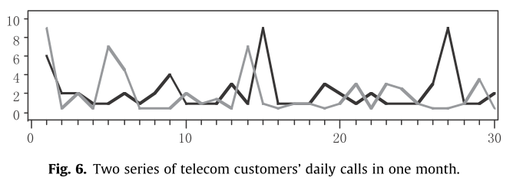
Experiment data (3)
3. Telecom customers’ consumption data (TCCD)
[from one mobile compay in China mainland]
Each series has 30 points (one customer’s daily call counts in one month)
Totally 86802 series in the dataset
Not label in advance

Slide 16

One-nearest neighbor network
Weighted directed graph
Each node N_{i} is a time series
Link l_{ij}: node j is the NN of node i
Weight w_{ij}: similarity between node i and node j (triangle distance)
Node_{i} strength (sum of weight from node i to j):
Out-degree of all nodes is 1.
In-degree of all nodes is arbitrary. (有較多in-degree的node為重要的節點)

Slide 17



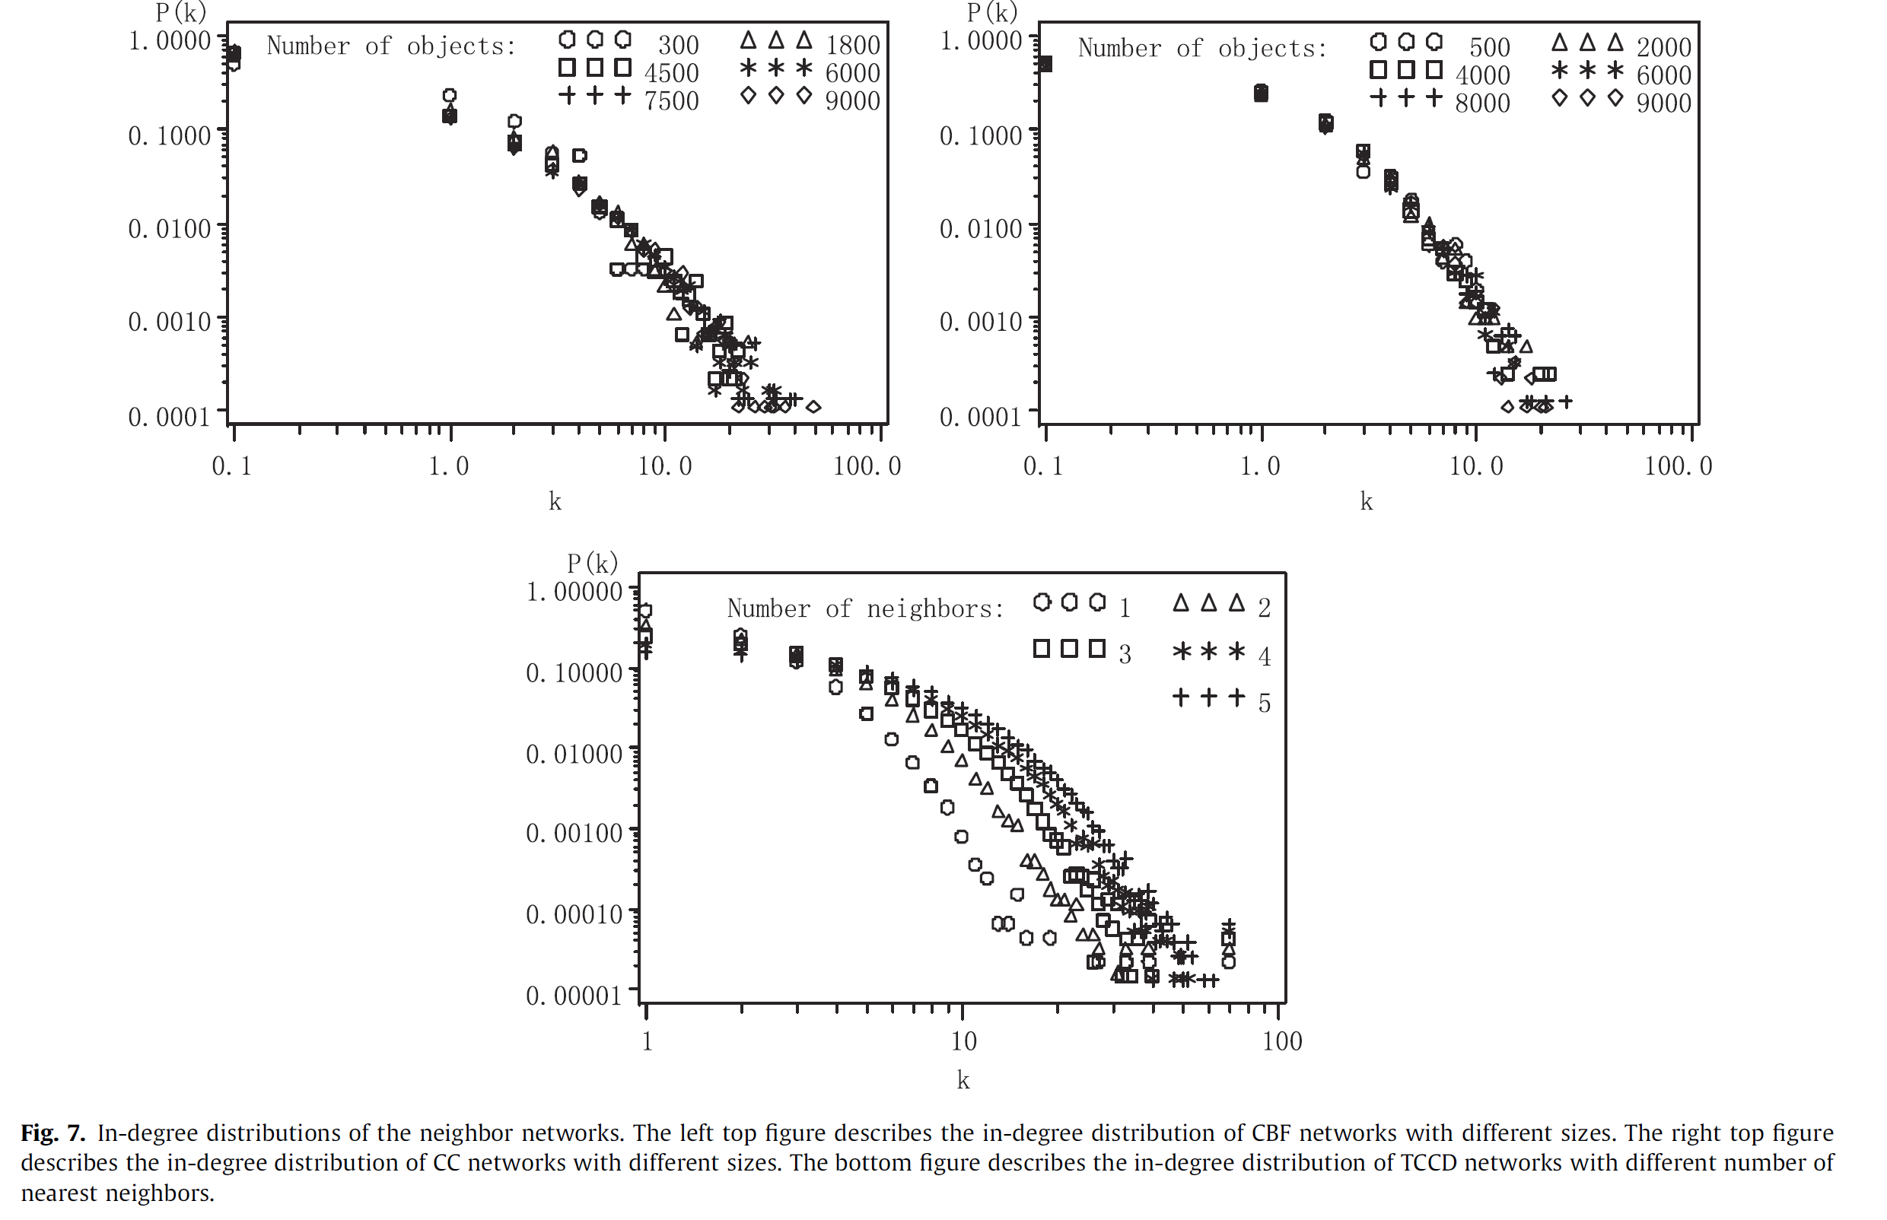
In-degree distribution of 1NN network
CBF
CC
K: number of nearest neighbors
So a little part of nodes has much bigger in-degree than other nodes and has central roles in terms of similarity
TCCD
17

Slide 18
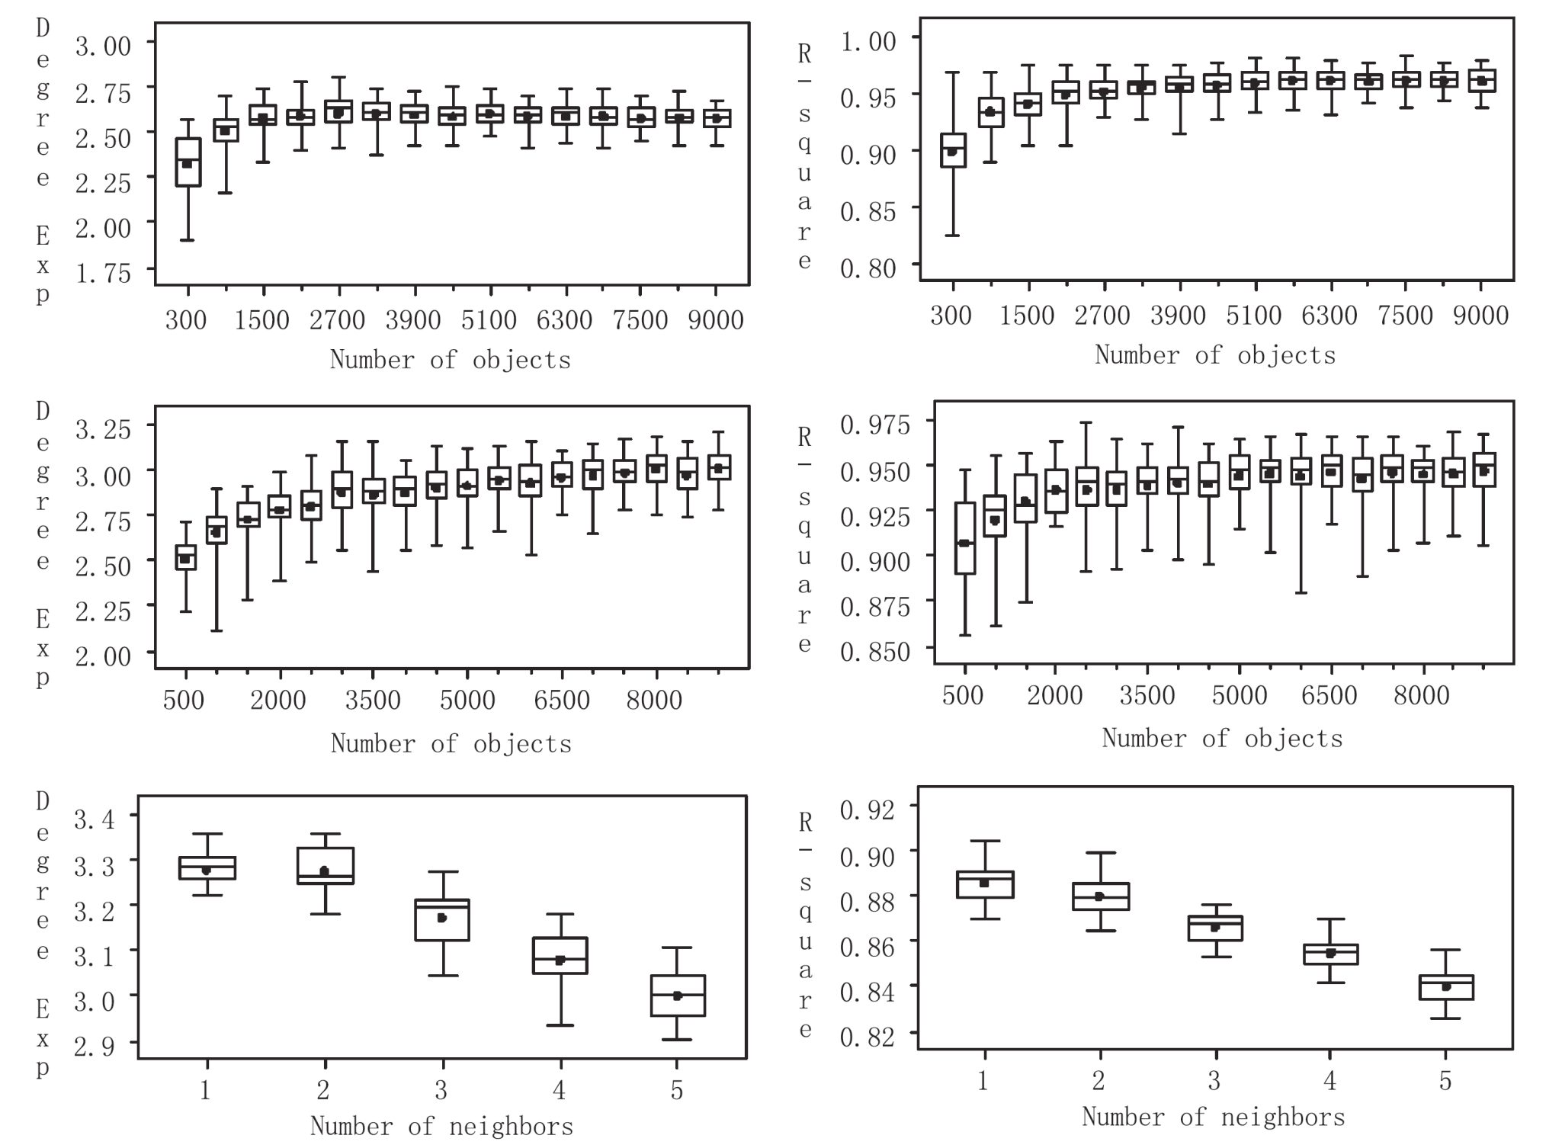
50 graphs for confirming distribution
CBF
CC
TCCD

Slide 19
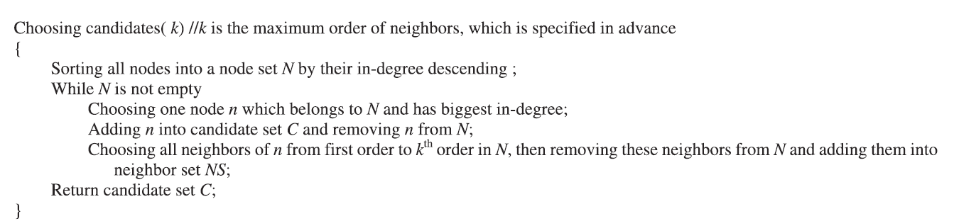
Choosing candidates for clustering
Clustering whole dataset -> clustering the candidates (properties of the in-degree distribution)
Eg.
If series A is NN of series B, and series C is NN of series B.
Then B is first order NN of series A, C is first order NN of series B
C is second order NN of series A.

Slide 20
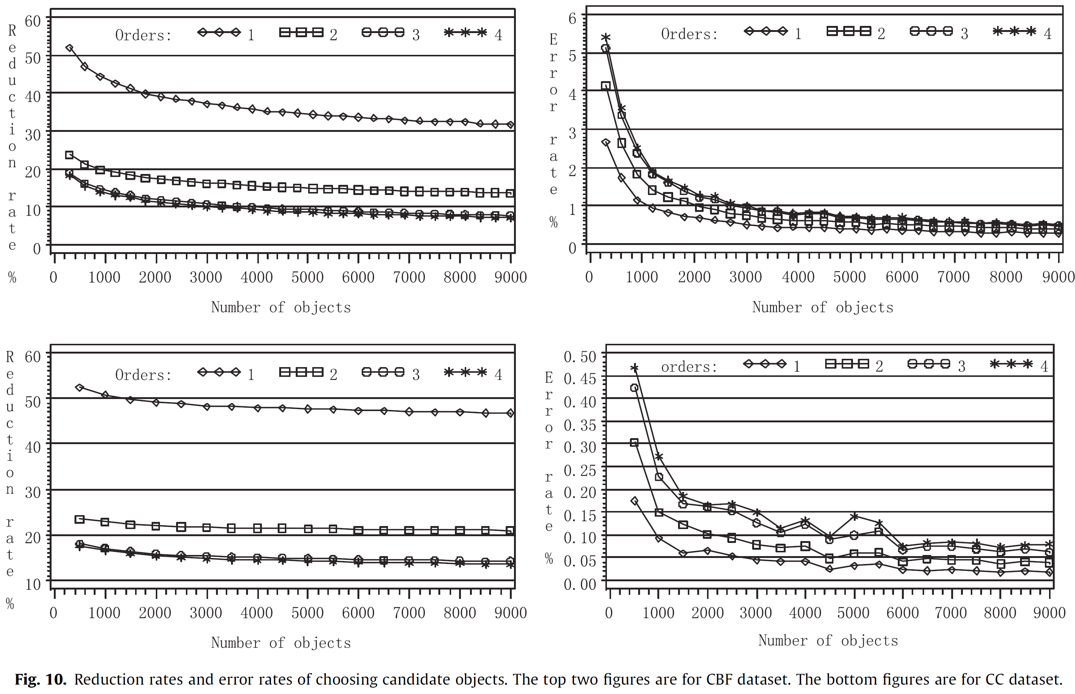
Reduction rate: size of candidate set/ size of data set
Error rate: ratio of number of misclassified objects

Slide 21
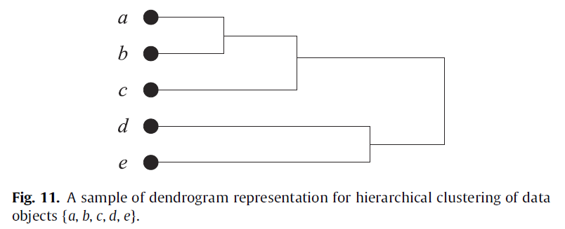
Hierarchical clustering
Aggomerative method: starts by placing each object in its own cluster and then merges these atomic clusters into larger clusters, until all objects are in a single cluster or until certain termination condition.

Slide 22


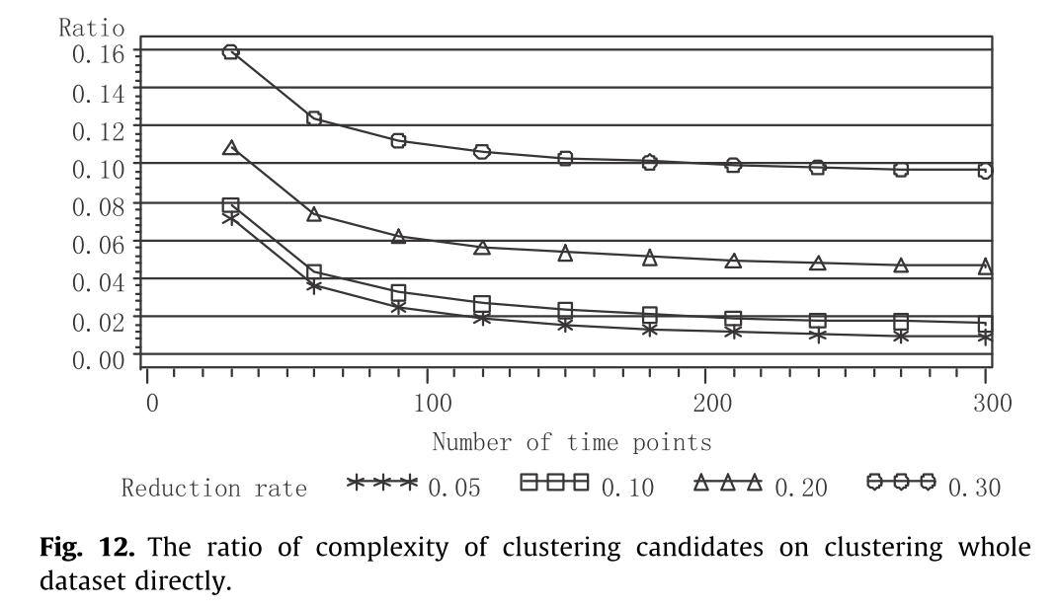
Distance measure (for series): DTW
Distance measure (for clusters) (two clusters中 ,任意兩點距離的平均值):

Slide 23
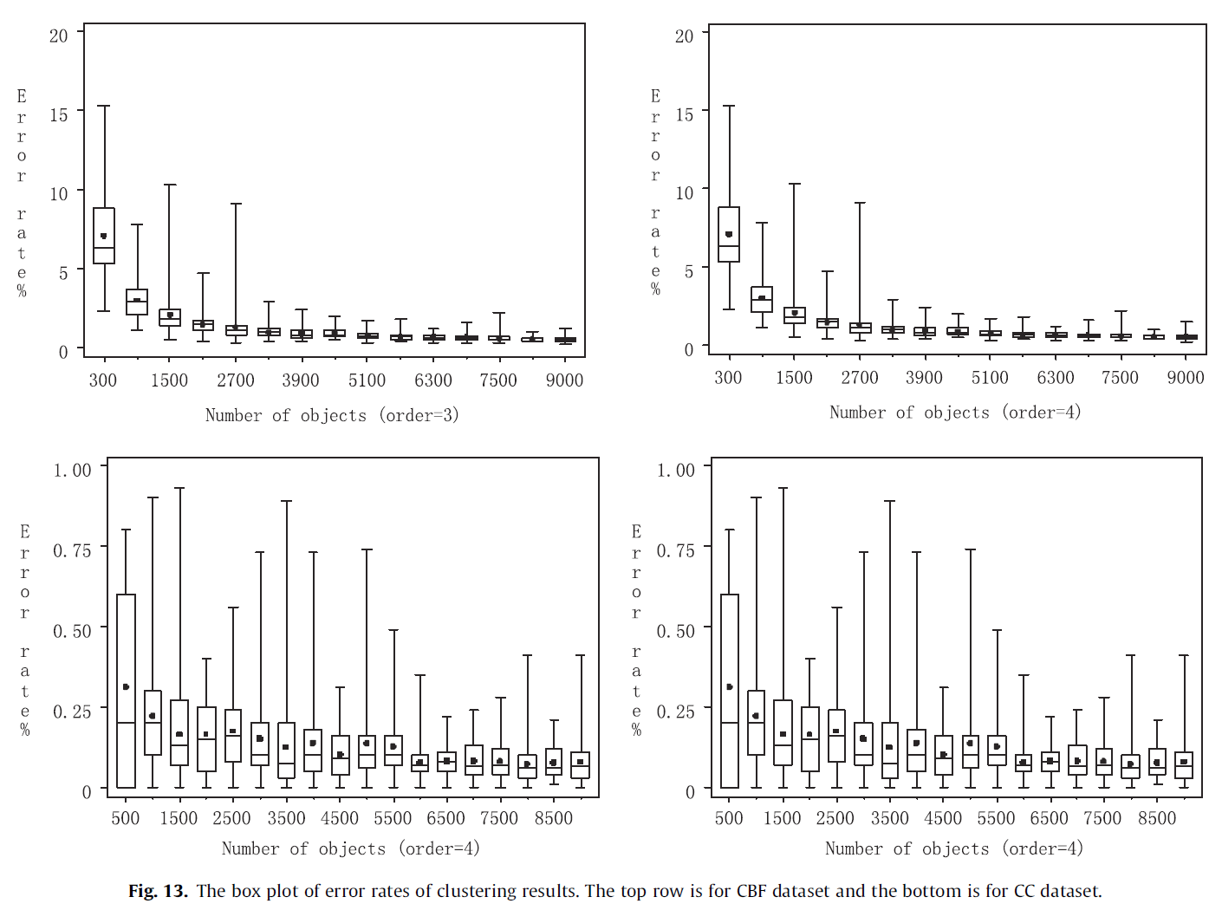
Clustering results

Slide 24

Thank you!!

