Slide 1
Dynamic time warping constraint learning for large margin nearest neighbor classiﬁcation
Information Sciences 181 (2011) 2787–2796
Daren Yu, Xiao Yu, Qinghua Hu, Jinfu Liu, Anqi Wu
Presenter: Cheng-Han Lee
Date:2012/12/10

Slide 2
Abstract
Nearest neighbor (NN) classiﬁer with dynamic time warping (DTW) is considered to be an effective method for time series classiﬁcation. The performance of NN-DTW is dependent on the DTW constraints because the NN classiﬁer is sensitive to the used distance function.
For time series classiﬁcation, the global path constraint of DTW is learned for optimization of the alignment of time series by maximizing the nearest neighbor hypothesis margin. In addition, a reduction technique is combined with a search process to condense the proto-types. The approach is implemented and tested on UCR datasets. Experimental results show the effectiveness of the proposed method.

Slide 3
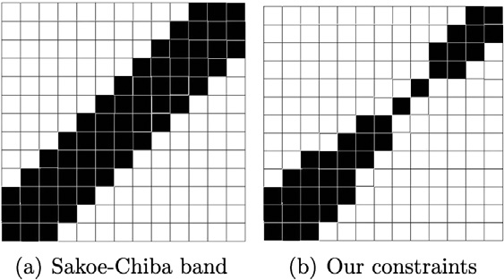
Constraints

Slide 4
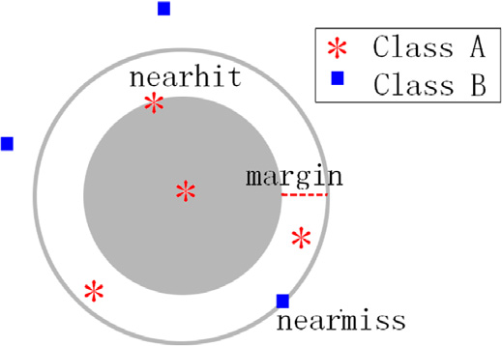
Margin

Slide 5
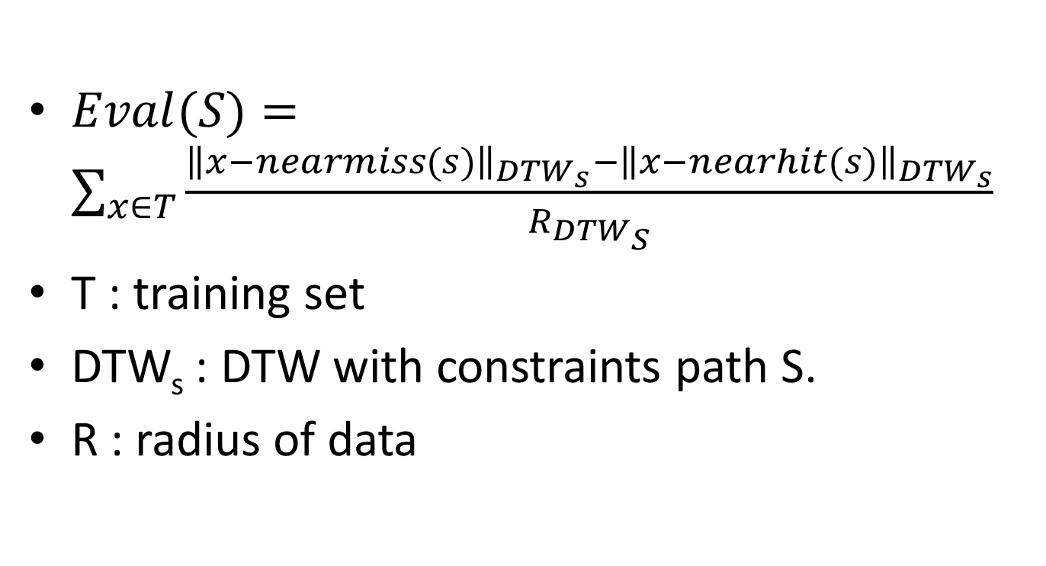
Evaluation function
$Eval(S)=\sum_{x∈T}{\frac{{\left\|x−nearmiss(s)\right\|}_{{DTW}_{s}}−{\left\|x−nearhit(s)\right\|}_{{DTW}_{s}}}{R_{{DTW}_{S}}}}$
T : training set
DTW_{s} : DTW with constraints path S.
R : radius of data

Slide 6
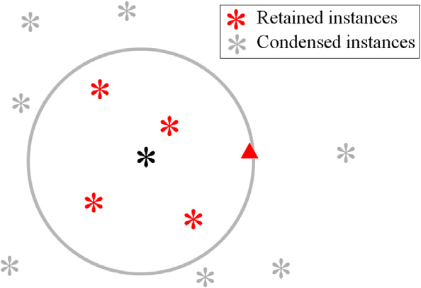

Data condensing
$DTW≤ {DTW}_{s} ≤D_{Eculidean}$
=>$y∈T can be ignored$ $$if ∃z∈T,D_{Eculidean}(z,x)≤DTW(y,x)$$

Slide 7
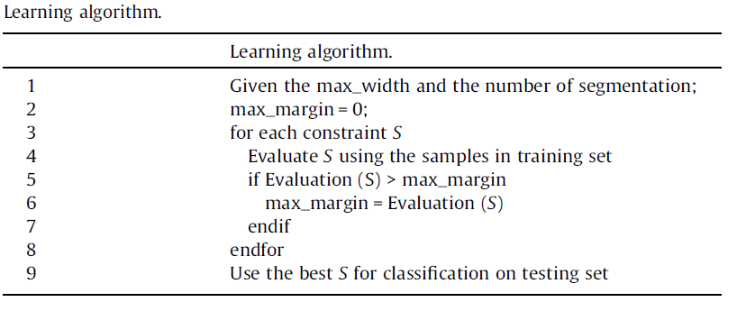

Slide 8
Experimental
UCR Time Series
Using a brute-force to choose path constraint.

Slide 9
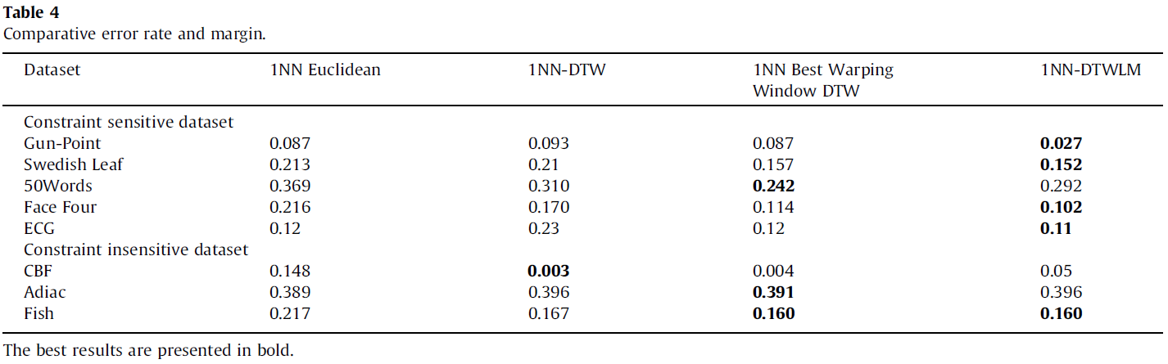
Experimental results

Slide 10
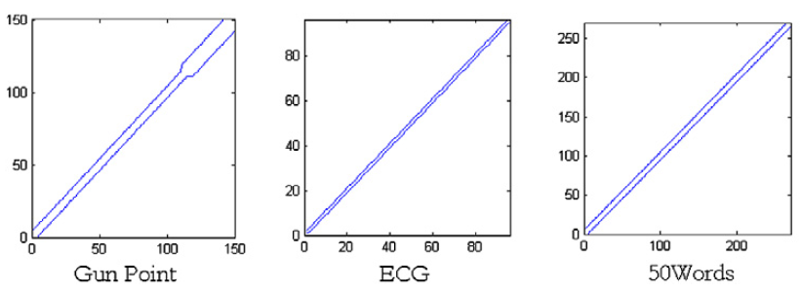
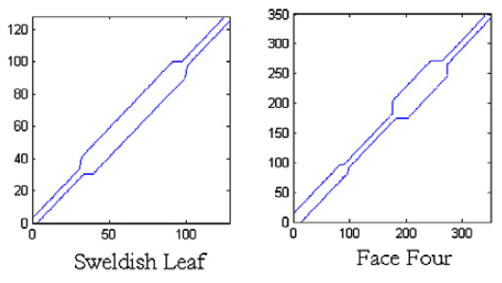
Shapes of constraint

Slide 11
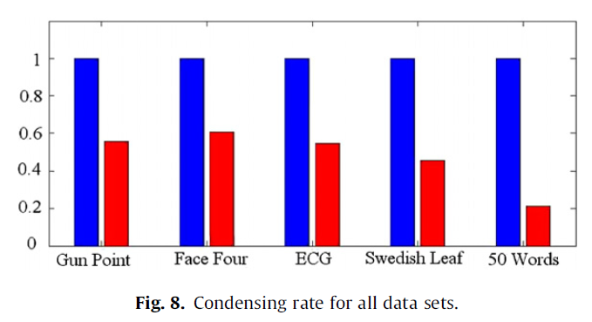

Slide 12
THE END

