Slide 1
Combining discrete SVM and fixed cardinality warping distances for multivariate time series classification Pattern Recognition Volume 43, Issue 11, November 2010, Pages 3787–3794
C. Orsenigo, C. Vercellis Dipartimento di Ingegneria Gestionale, Politecnico di Milano, Via Lambruschini 4b, 20156 Milano, Italy
Presentor：Hsin-Chuan Yuan

Slide 2
Abstract
Time series classification is a supervised learning problem aimed at labeling temporally structured multivariate sequences of variable length. The most common approach reduces time series classification to a static problem by suitably transforming the set of multivariate input sequences into a rectangular table composed by a fixed number of columns. Then, one of the alternative efficient methods for classification is applied for predicting the class of new temporal sequences.

Slide 3
Abstract
In this paper, we propose a new classification method, based on a temporal extension of discrete support vector machines, that benefits from the notions of warping distance and softened variable margin. Furthermore, in order to transform a temporal dataset into a rectangular shape, we also develop a new method based on fixed cardinality warping distances. Computational tests performed on both benchmark and real marketing temporal datasets indicate the effectiveness of the proposed method in comparison to other techniques.

Slide 4
Introduce
A new framework for the classification of multivariate time series of variable length composed by a two-phase procedure.
time series are converted into sequences of the same length by means of a new rectangularization technique based on a fixed cardinality version of the warping distance.
for addressing the classification task, we have developed a temporal variant of discrete SVM.

Slide 5
Static classification problem
a set of training input–output examples
S_{m}={(x_{i} , y_{i}), i∈M={1,2,…,m}} x_{i} ∈R^{n}
the categorical class label associated to x_{i}
y_{i} ∈D={1,2,…,D}
H denote a set of functions f :R^{n} ↦D that represent hypothetical relationships between x_{i} and y_{i}.
When D=2, we obtain a binary classification problem, y_{i} ∈{−1,1}

Slide 6
Temporal classification problem
A set of multivariate time series
{A_{i}}, i∈M, where each A_{i}=[a_{ilt}] is a rectangular matrix of size L×T_{i}
l ∈L={1,2,…,L} is the index associated to the attributes of the time series
t ∈T_{i}={1,2,…,T_{i}} is the temporal index
an appropriate function f * which optimally describes the relationship between the time series {A_{i}} and their labels {y_{i}},

Slide 7

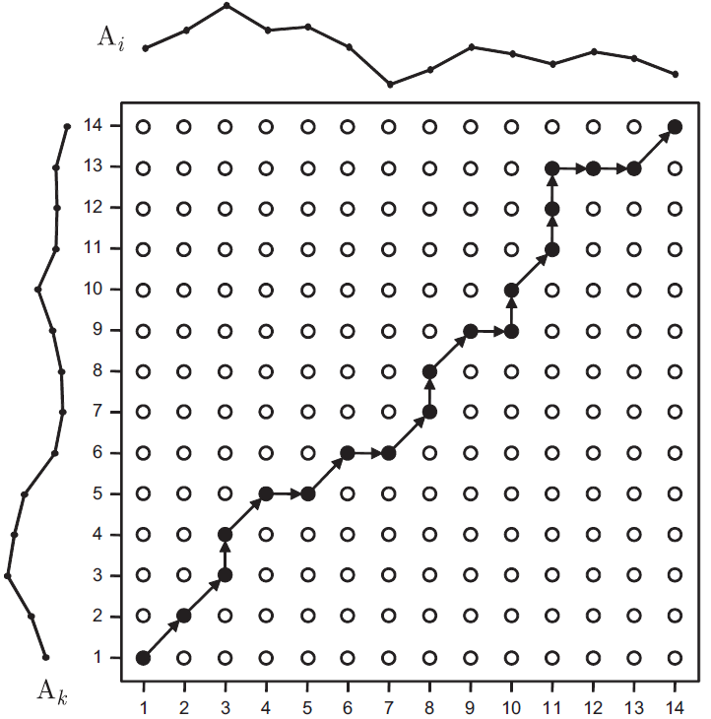
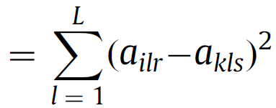

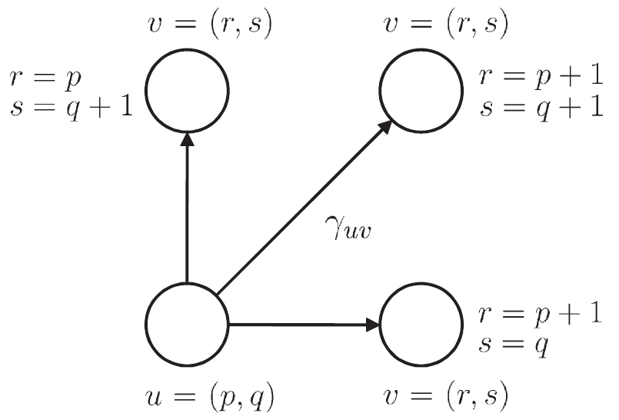
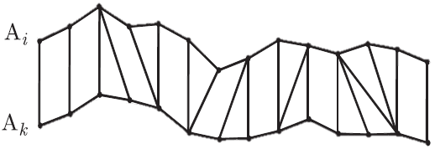
Dynamic time warping
DTW[i, j] := cost + min (DTW[i+1, j ], DTW[i , j+1], DTW[i+1, j+1] )
Time complexity
In multivariate time series

Slide 8
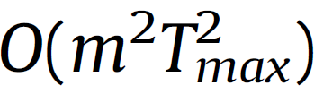

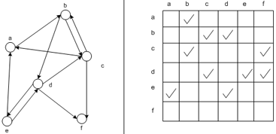
A DAGSP algorithm for warping distance computation
A weighted directed acyclic graph (DAG) and the outdegree of its vertices is at most three.
Time complexity : for all pairs of time series
imposed a global constraint that permits to include a vertex v =(r,s) in V only if | r−s |≤ ϑ, for a given integer parameter ϑ ≥ 0.
Time complexity :

Slide 9
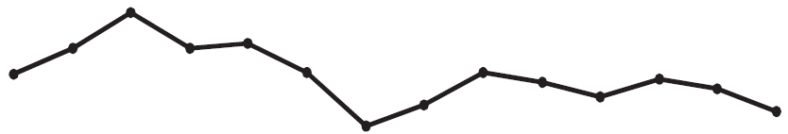


Rectangularization by fixed cardinality warping paths
Subdividing the time axis in T portions and then consolidating each attribute for each sequence over the time intervals by means of summaries or averages.
a new rectangularization scheme based on a fixed cardinality extension of the warping distance, in which the number H of arcs in the optimal warping path is fixed a priori and is constant for each pair of time series (A_{i},A_{k}).
we set

Slide 10

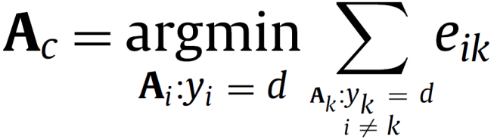
The rectangularization procedure
compute the warping distances calculate the centroid A_{c} of the class as the time series for which the sum of the warping distances to all other time series in the class is minimum
For each time series , having the class label y_{i}=d, we compute the fixed cardinality warping distance between A_{c} and A_{i}

Slide 11
The rectangularization procedure
build a three – dimensional m×L×H matrix, where r is the time period connecting the time series A_{i} to the corresponding centroid A_{c}.
obtain a rectangular m×n matrix, with n=L×H, we proceed by sequencing for each time series A_{i} the attributes and the time periods.

Slide 12
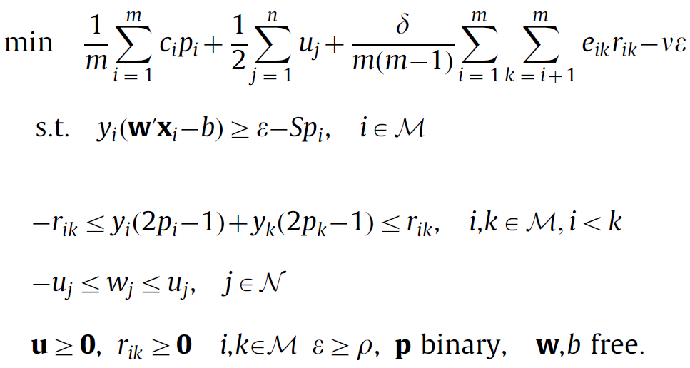
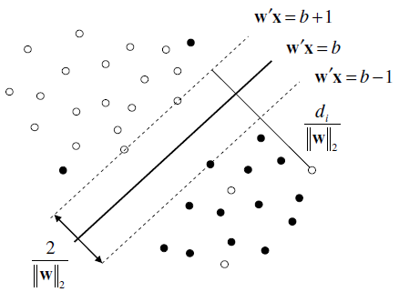
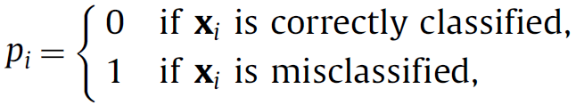
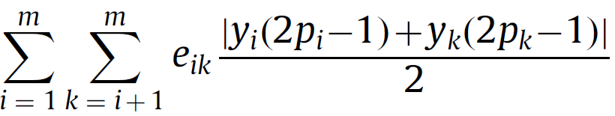
Temporal discrete support vector machines
To determining an optimal separating hyperplane is formulated through the following discrete support vector machines(DSVM) model
u_{j} : bounding variables
the sum of the warping distances between all pairs of time series assigned to the same class.

Slide 13
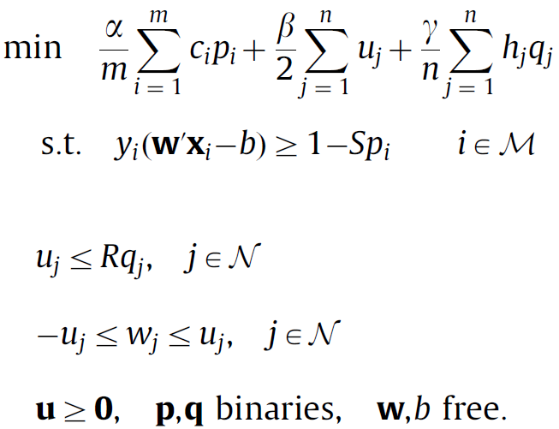
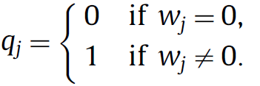
Temporal discrete support vector machines
To determining an optimal separating hyperplane is formulated through the following discrete support vector machines(DSVM) model
u_{j} : bounding variables

Slide 14
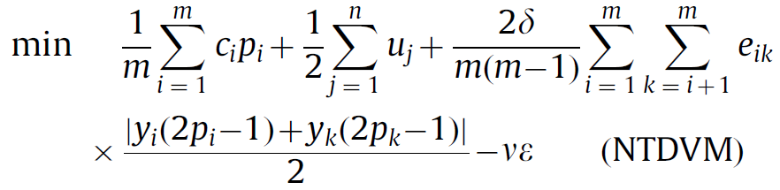
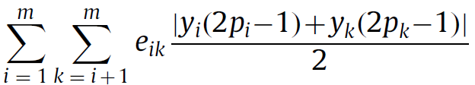
Let e_{ik} denote the warping distance between the pair of temporal sequences (x_{i} ,x_{k}) of the training set S_{m}. In order to determine the best separating function for time series classification

Slide 15
Computational setup and analysis
“Japanese vowels” consists of multivariate time series of variable length given by the utterances of two Japanese vowels provided by nine male speakers.
“robot execution failures” refers to five classification tasks concerning the identification of a robot execution failures.
“pen-based recognition of handwritten digits” consists of bivariate time series of fixed length representing handwriting digits samples.
ECG is composed by univariate sequences of fixed length reporting the measurements of the cardiac activity as recorded by one electrode during one heartbeat.
Telecom and Electronics are real world marketing datasets referring, contain sequences of variable length described both by numerical and categorical attributes.

Slide 16
Computational setup and analysis
 | Classes | Variables | Length | Examples
J-vowels | 9 | 12 | [7…29] | 640
Pen-digits | 10 | 2 | 8 | 10 992
ECG | 2 | 1 | 96 | 200
Telecom | 2 | 32 | [18…24] | 1200
Electronics | 2 | 27 | [35…48] | 1800
Robot
Failure 1 | 4 | 6 | 15 | 88
Failure 2 | 5 | 6 | 15 | 47
Failure 3 | 4 | 6 | 15 | 47
Failure 4 | 3 | 6 | 15 | 117
Failure 5 | 5 | 6 | 15 | 164

Slide 17
Computational setup and analysis
 | TDVM | DSVM | SVM_{LIN} | SVM_{SIG} | SVM_{RBF} | SVM_{DTW} | 1NN_{WD}(ϑ)
J-vowels | 96.6 | 93.6 | 96.3 | 96.7 | 96.6 | 94.6 | 92.3 (9)
Pen-digits | 96.3 | 94.6 | 94.8 | 94.7 | 97.2 | 93.4 | 94.5 (1)
ECG | 90.5 | 85.5 | 84.5 | 83.5 | 89.5 | 86.0 | 90.0 (1)
Telecom | 95.2 | 92.4 | 86.3 | 86.2 | 88.3 | 84.3 | 86.2 (3)
Electronics | 85.8 | 82.7 | 80.1 | 79.7 | 82.4 | 78.2 | 80.2 (2)
Robot
Failure 1 | 85.2 | 72.7 | 71.6 | 70.5 | 83.0 | 81.8 | 81.8 (3)
Failure 2 | 63.8 | 57.4 | 55.3 | 55.3 | 57.4 | 63.8 | 59.6 (3)
Failure 3 | 68.1 | 63.8 | 55.3 | 53.2 | 66.0 | 65.8 | 61.7 (1)
Failure 4 | 85.5 | 75.2 | 77.8 | 83.6 | 84.6 | 87.2 | 86.3 (3)
Failure 5 | 67.1 | 56.7 | 54.3 | 50.6 | 55.5 | 62.1 | 65.2 (2)

Slide 18
Future works
Future extensions of the proposed approach will be pursued along two main directions, concerning, respectively, the evaluation of alternative similarity measures among time series and the use of nonlinear kernels in the temporal discrete SVM classification model.

