Slide 1
Time Series Classification Method Based on Longest Common Subsequence and Textual Approximation
Abdulla-Al-Maruf, Hung-Hsuan Huang and Kyoji Kawagoe Ritsumeikan University Kusatsu, Japan
Digital Information Management (ICDIM), 2012 Seventh p130-137
Presenter: Yi-Pu Guo 2012-12-17

Slide 2
Abstract
Many symbolic representations of time series have been proposed by researchers over past decades. However, it is still not enough to classify time series with high accuracy in such applications as ubiquitous systems or sensor systems. In this paper, we propose a new symbolic representation of time series called l-TAX to increase the accuracy of time series classification. A time series can be represented by term sequences in l-TAX. l-TAX is based on a document like symbolic representation of time series called TAX. We use longest common subsequence as our distance measure between textually approximated time series. During time series classification, consideration of symbol sequences increases the accuracy significantly. In our evaluation, we have demonstrated that l-TAX is effective for classification as well as searching time series data set.

Slide 3
TAX
基於給定 model，自 time series 擷取 term： time series → document
只考慮 key-point，不是每個點都重要。
l-TAX
考慮順序的 TAX

Slide 4
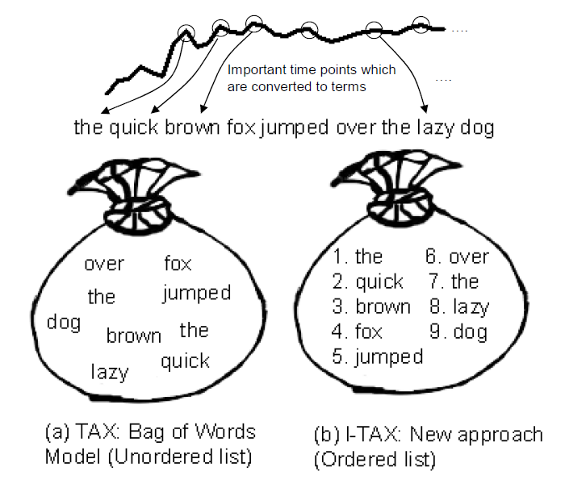
the lazy brown dog jumped over the quick fox

Slide 5
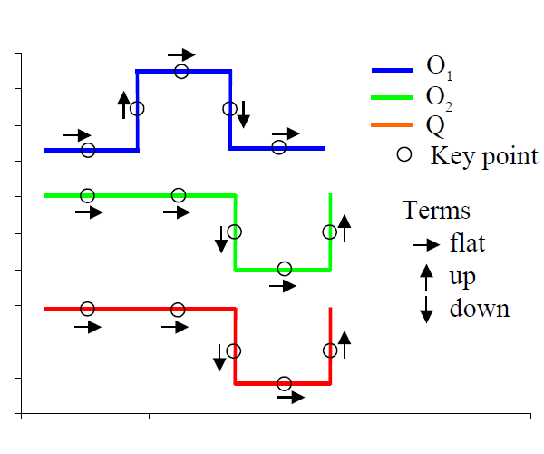
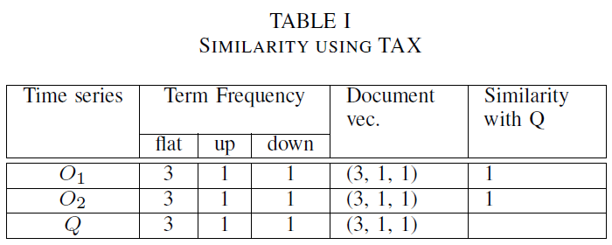
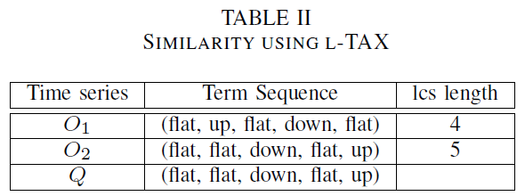

Concept
$T_{term}=\{flat, up, down\}$

Slide 6
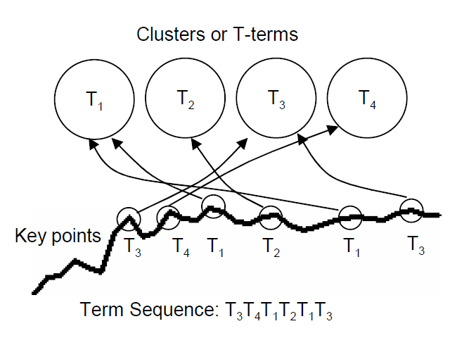
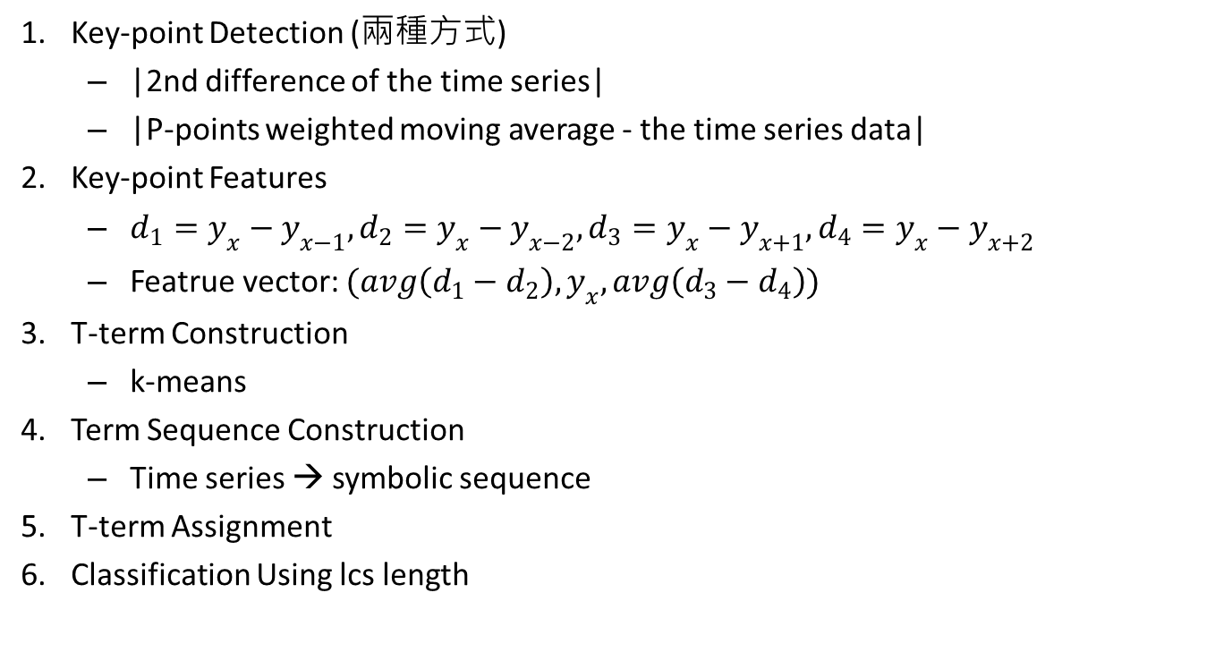
Algorithm
Key-point Detection (兩種方式)
|2nd difference of the time series|
|P-points weighted moving average - the time series data|
Key-point Features
$d_{1}=y_{x}−y_{x−1}, d_{2}=y_{x}−y_{x−2},d_{3}=y_{x}−y_{x+1},d_{4}=y_{x}−y_{x+2}$
Featrue vector: $(avg\left(d_{1}−d_{2}\right),y_{x},avg\left(d_{3}−d_{4}\right))$
T-term Construction
k-means
Term Sequence Construction
Time series → symbolic sequence
T-term Assignment
Classification Using lcs length

Slide 7
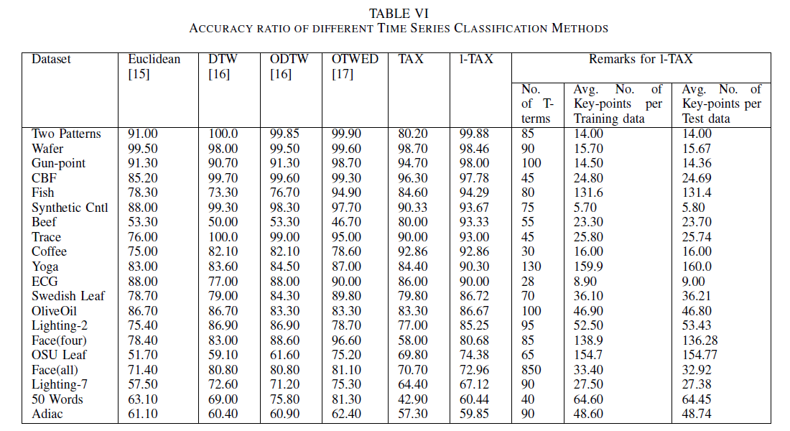
Result

