Slide 1
Time-Series Classification based on Individualised Error Prediction
Krisztian Buza, Alexandros Nanopoulos, Lars Schmidt-Thieme
IEEE 13th International Conference on Computational Science and Engineering (CSE), 2010
Presenter: Che-Jui Hsu(許哲睿)
Date: 2012/12/15

Slide 2
Abstract (1/2)
Time-series classification is an active research topic in machine learning, as it finds applications in numerous domains. The k-NN classifier, based on the discrete time warping (DTW) distance, had been shown to be competitive to many state-of-the art time-series classification methods. Nevertheless, due to the complexity of time-series data sets, our investigation demonstrates that a single, global choice for k (≥1) can become suboptimal, because each individual region of a data set may require a different k value.

Slide 3
Abstract (2/2)
In this paper, we proposed a novel individualized error prediction (IEP) mechanism that considers a range of k-NN classifiers (for different k values) and uses secondary regression models that predict the error of each such classifier. This permits to perform k-NN time-series classification in a more fine grained fashion that adapts to the varying characteristics among different regions by avoiding the restriction of a single value of k. Our experimental evaluation, using a large collection of real timeseries data, indicates that the proposed method is more robust and compares favorably against two examined baselines by resulting in significant reduction in the classification error.

Slide 4
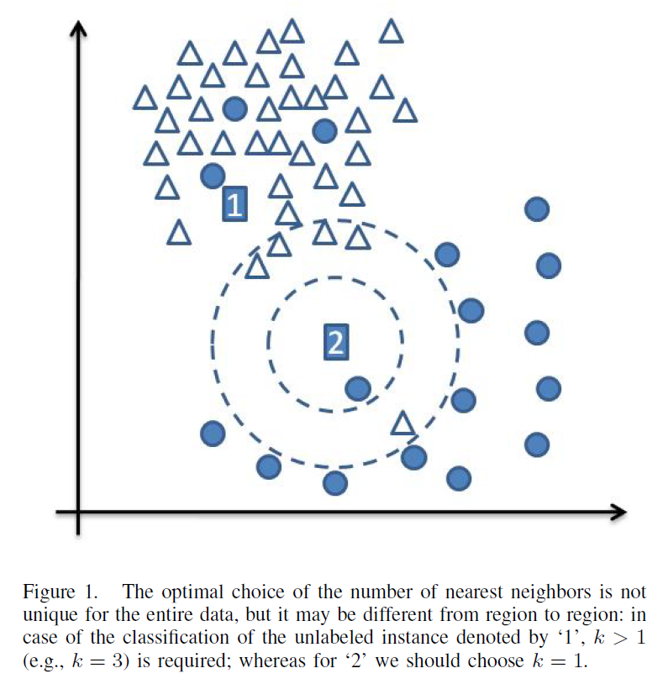
k-NN time series

Slide 5
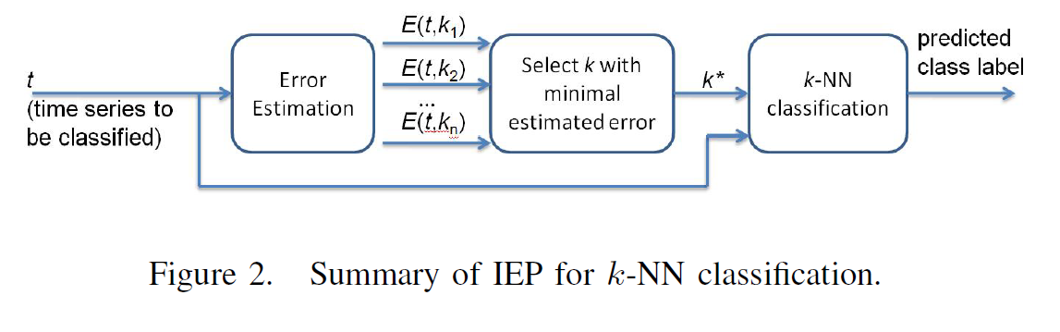
IEP
Primary models, which classify time series with the k-NN classifier (based on the DTW distance).
Secondary models, which predict the error of the primary models.

Slide 6
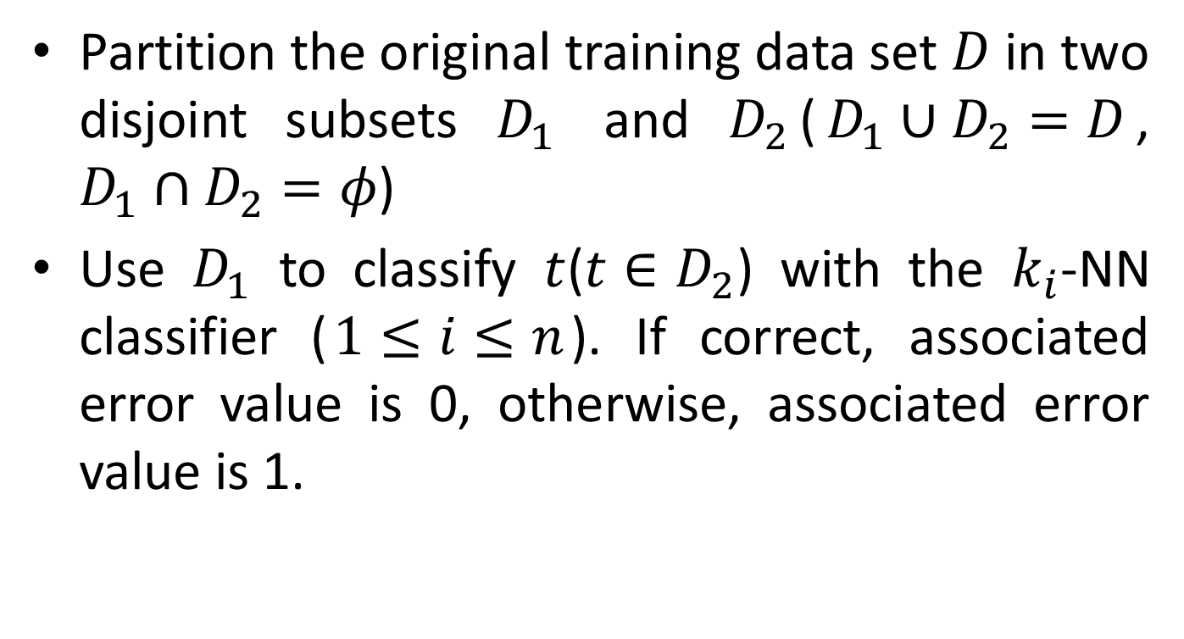
IEP Algorithm (1/3)
Partition the original training data set $D$ in two disjoint subsets $D_{1}$ and $D_{2}$($D_{1}∪D_{2}=D$, $D_{1}∩D_{2}=φ$)
Use $D_{1}$ to classify $t$($t∈D_{2}$) with the $k_{i}$-NN classifier ($1≤i≤n$). If correct, associated error value is 0, otherwise, associated error value is 1.

Slide 7
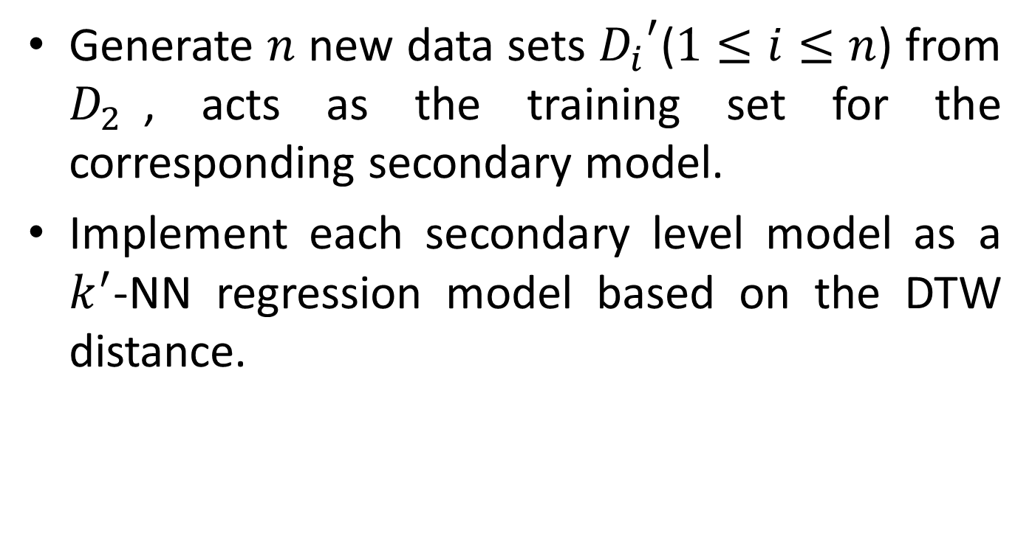
IEP Algorithm (2/3)
Generate $n$ new data sets ${D_{i}}^{′}$($1≤i≤n$) from $D_{2}$, acts as the training set for the corresponding secondary model.
Implement each secondary level model as a $k^{′}$-NN regression model based on the DTW distance.

Slide 8
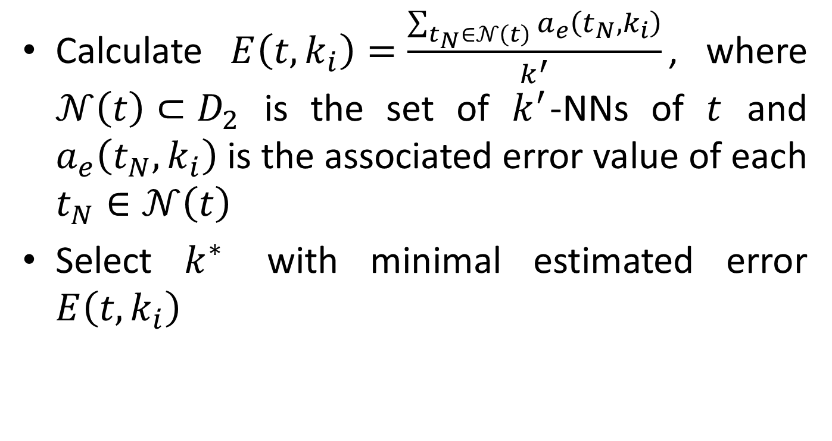
IEP Algorithm (3/3)
Calculate $E\left(t,k_{i}\right)=\frac{\sum_{t_{N}∈𝒩\left(t\right)}{a_{e}\left(t_{N},k_{i}\right)}}{k^{′}}$, where $𝒩\left(t\right)⊂D_{2}$ is the set of $k^{′}$-NNs of $t$ and $a_{e}\left(t_{N},k_{i}\right)$ is the associated error value of each $t_{N}∈𝒩\left(t\right)$
Select $k^{∗}$ with minimal estimated error $E\left(t,k_{i}\right)$

Slide 9
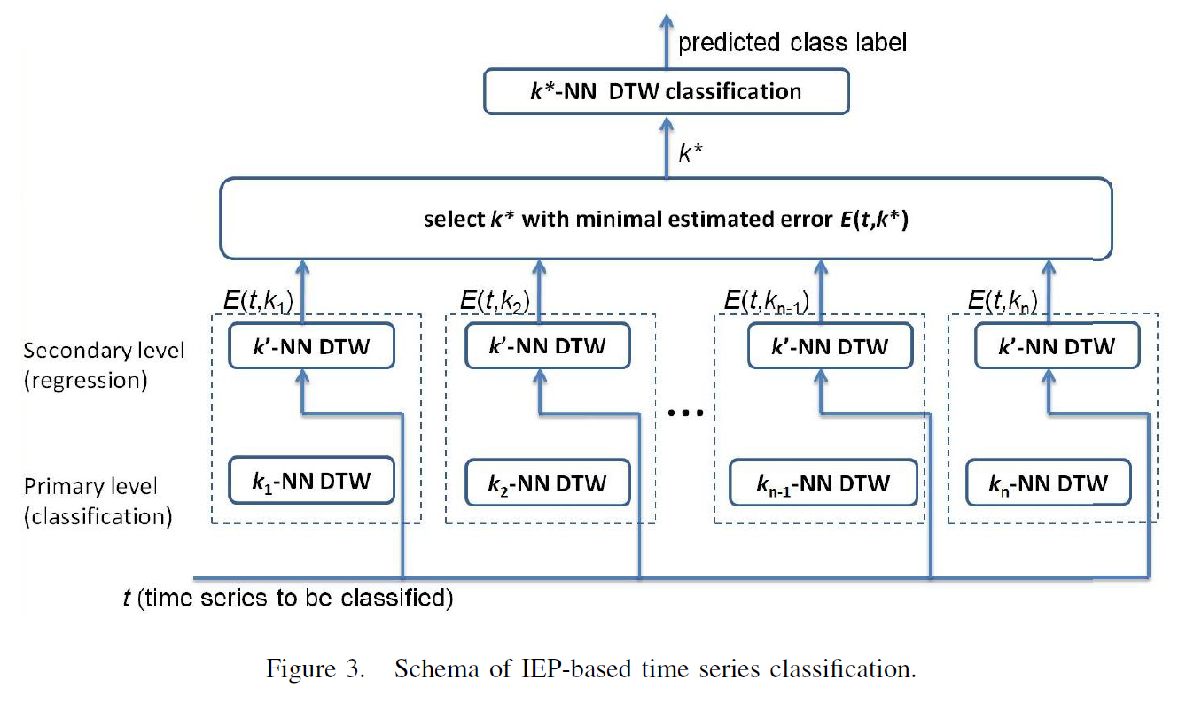

Slide 10
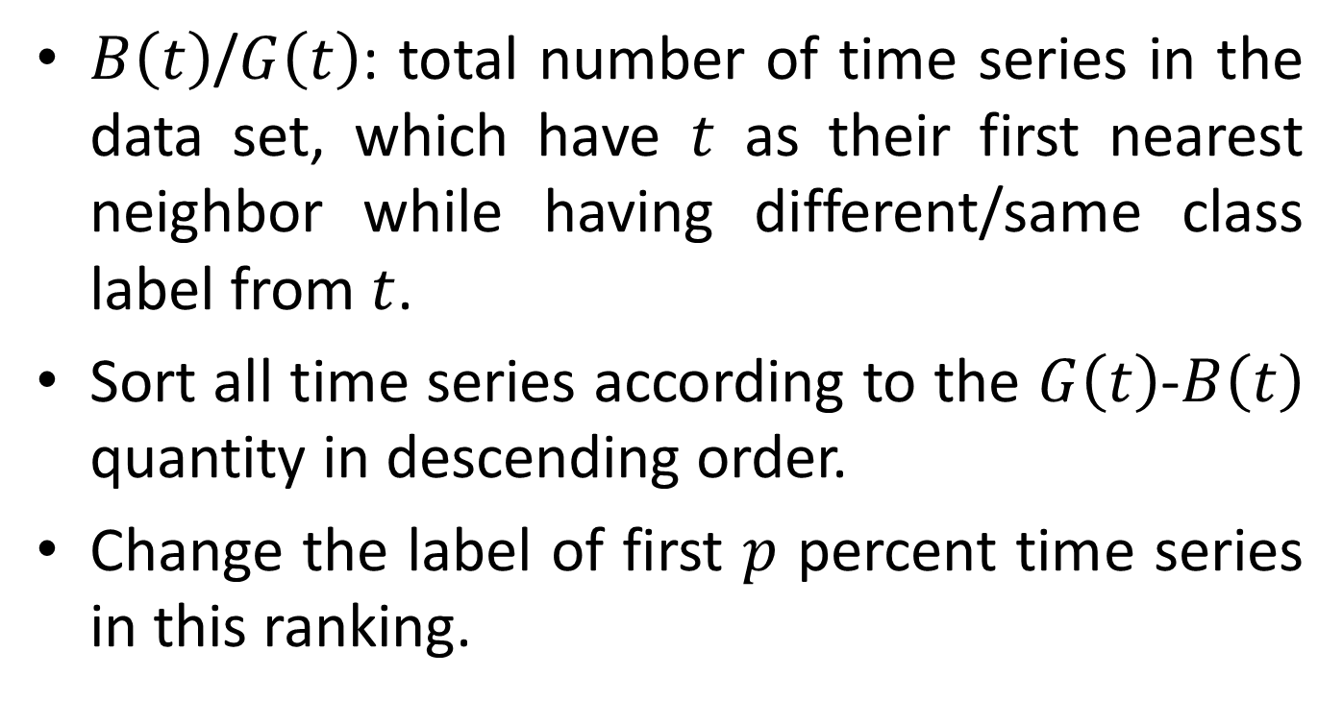
Experiment
$B\left(t\right)$/$G\left(t\right)$: total number of time series in the data set, which have $t$ as their first nearest neighbor while having different/same class label from $t$.
Sort all time series according to the $G\left(t\right)$-$B\left(t\right)$ quantity in descending order.
Change the label of first $p$ percent time series in this ranking.

Slide 11
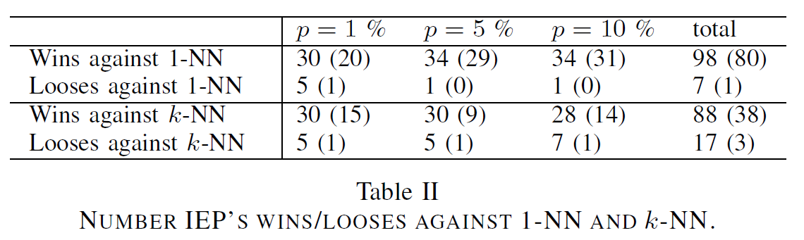
Experiment result (1/2)

Slide 12
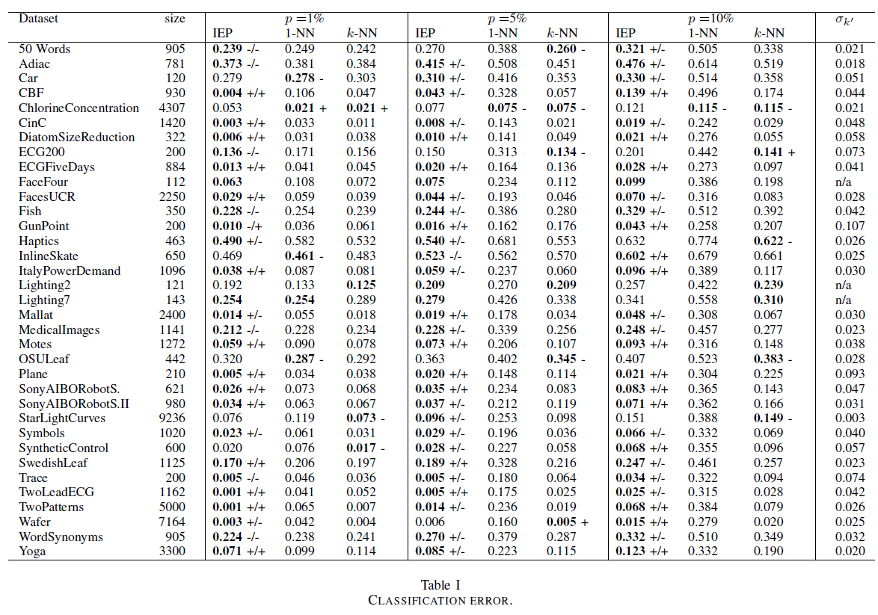

Slide 13
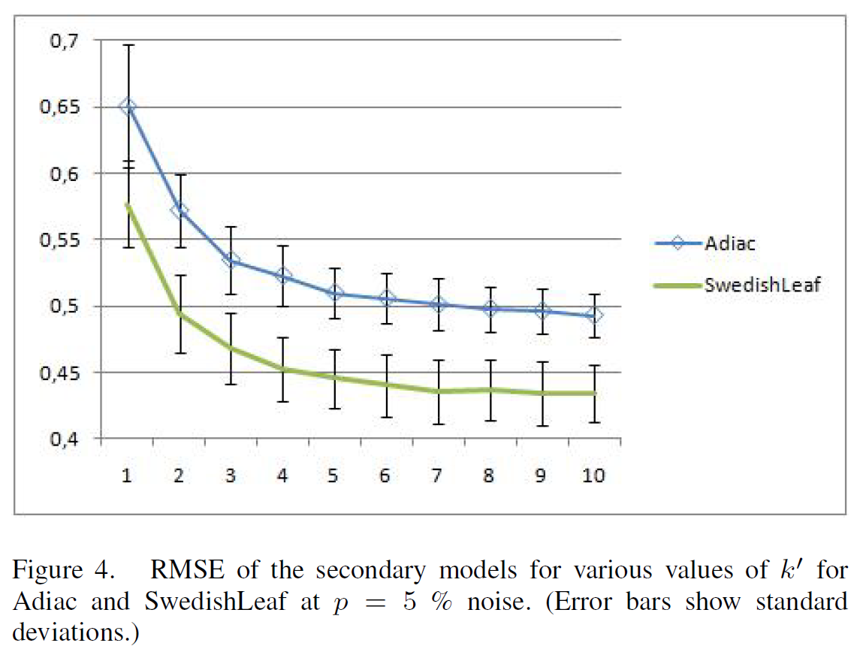
Quality of secondary model (1/2)

Slide 14
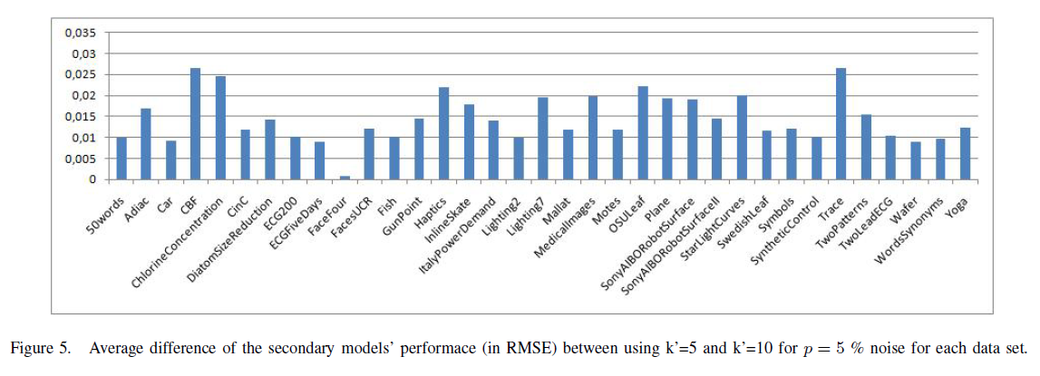

Quality of secondary model (2/2)
The last column of Table I shows for each dataset the overall standard deviation of the secondary models for all $k^{′}$ values in the range $5≤k^{′}≤10$.

Slide 15
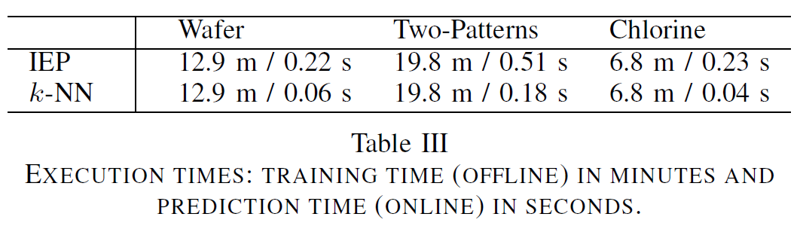
Execution time
Off-line time: the time required for training the secondary regression level.
Online time: the actual time needed to classify a new time-series.

