Slide 1
Skip Lists: A Probabilistic Alternative to Balanced Trees
Pugh, William. Communications of the ACM 33.6 (1990): 668-676.
Presenter: Yen-Yu Chen
Date: Mar.5, 2024

Slide 2
Abstract
Skip lists are a data structure that can be used in place of balanced trees. Skip lists use probabilistic balancing rather than strictly enforced balancing and as a result the algorithms for insertion and deletion in skip lists are much simpler and significantly faster than equivalent algorithms for balanced trees.

Slide 3
Skip List

Slide 4
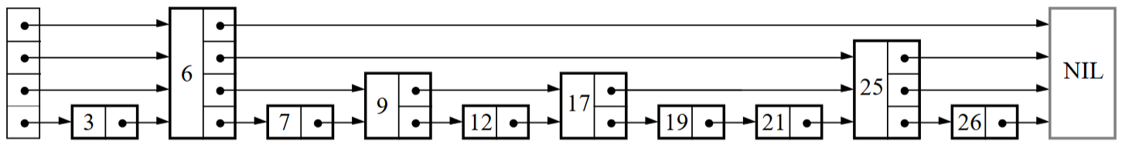
Search

Slide 5
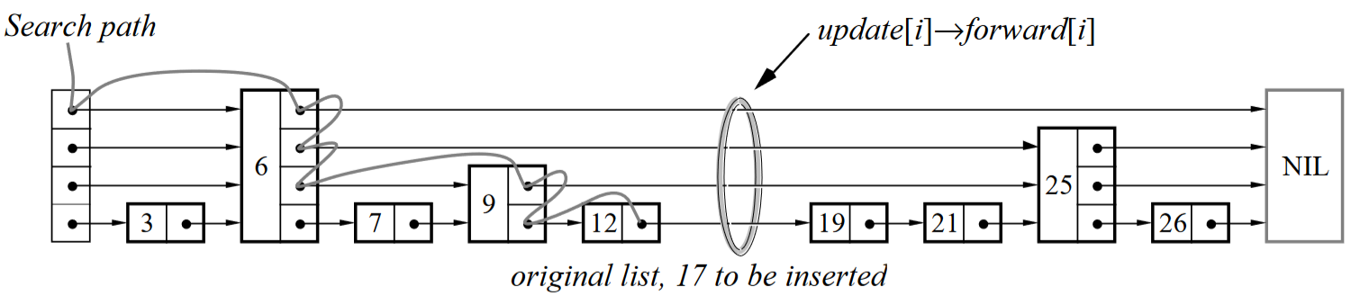
Insert

Slide 6
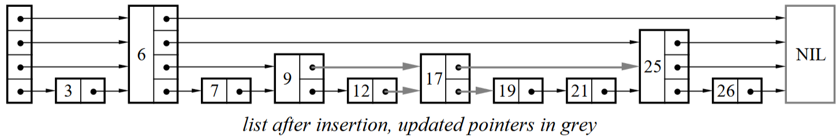
Delete

Slide 7
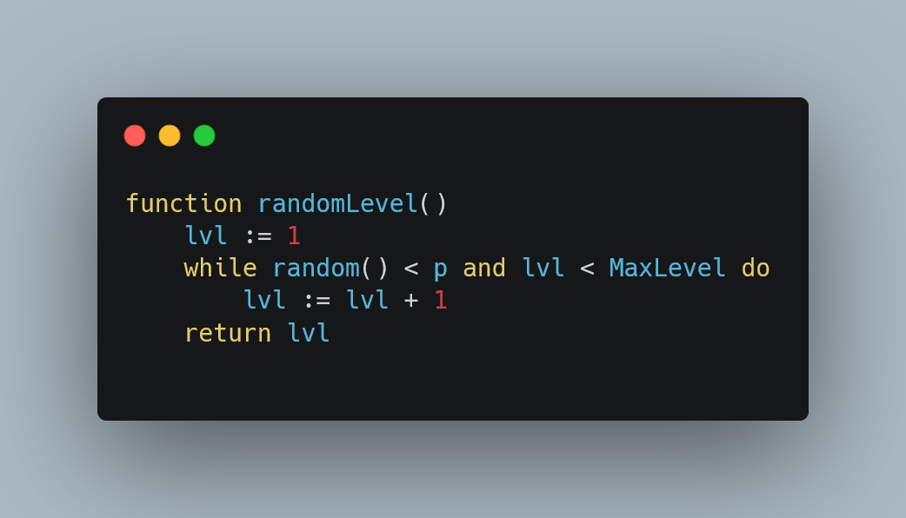
Random
Notes:
p越大越有可能產生高的level

Slide 8
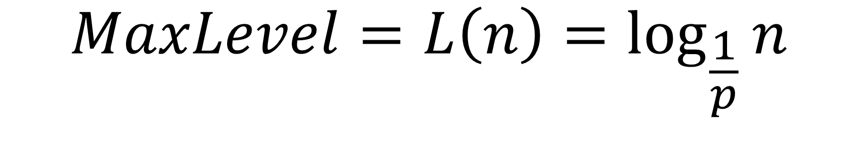
MaxLevel
$$MaxLevel=L\left(n\right)=\log_{\frac{1}{p}}{n}$$

Slide 9
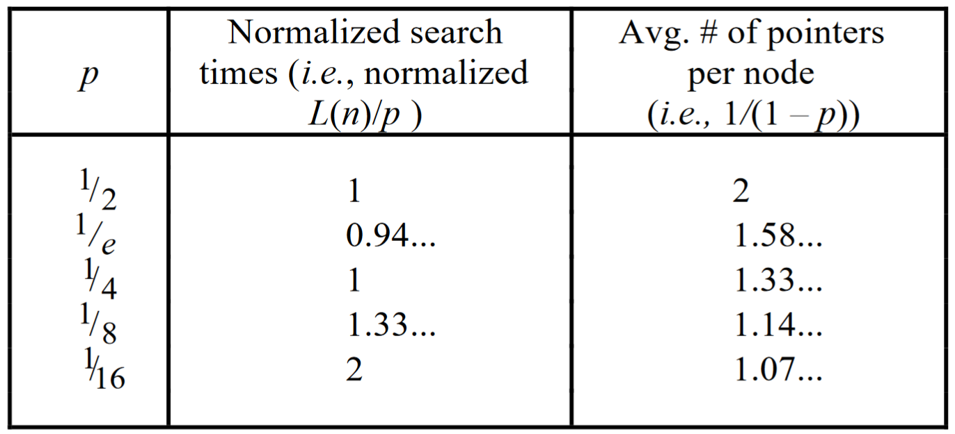
Relative search speed and space requirements

Slide 10
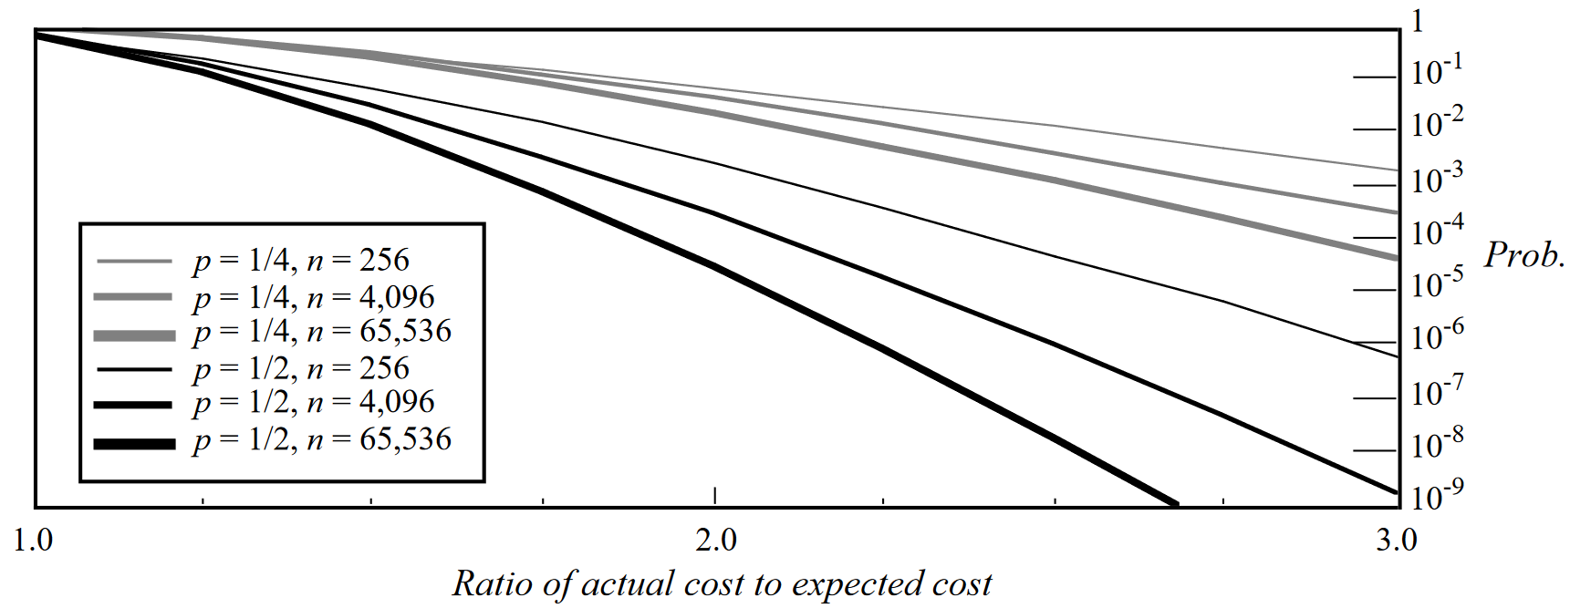
Upper bound on the probability of a search taking substantially longer than expected
Notes:
橫軸是比預期時間還要慢幾倍
y軸是機率

Slide 11
Conclusion
Skip lists and AVL trees both have O(logn) complexity but skip lists are easier to implement.
Skip lists quickly find the minimum and the next element.
Skip list's worst case is three times slower than the average case but is rare.

