Slide 1
Expertise Increases Planning Depth in Human Gameplay
Bas van Opheusden, Ionatan Kuperwajs, Gianni Galbiati, Zahy Bnaya, Yunqi Li, and Wei Ji Ma,
Nature, 2023.
Presenter: Yu-Yen Chu
Date: Mar. 5, 2024

Slide 2
Abstract
A hallmark of human intelligence is the ability to plan multiple steps into the future. Despite decades of research, it is still debated whether skilled decision-makers plan more steps ahead than novices. Traditionally, the study of expertise in planning has used board games such as chess, but the complexity of these games poses a barrier to quantitative estimates of planning depth. Conversely, common planning tasks in cognitive science often have a lower complexity and impose a ceiling for the depth to which any player can plan. Here we investigate expertise in a complex board game that offers ample opportunity for skilled players to plan deeply.

Slide 3
Abstract (Cont.)
We use model fitting methods to show that human behaviour can be captured using a computational cognitive model based on heuristic search. To validate this model, we predict human choices, response times and eye movements. We also perform a Turing test and a reconstruction experiment. Using the model, we find robust evidence for increased planning depth with expertise in both laboratory and large-scale mobile data. Experts memorize and reconstruct board features more accurately. Using complex tasks combined with precise behavioural modelling might expand our understanding of human planning and help to bridge the gap with progress in artificial intelligence.

Slide 4
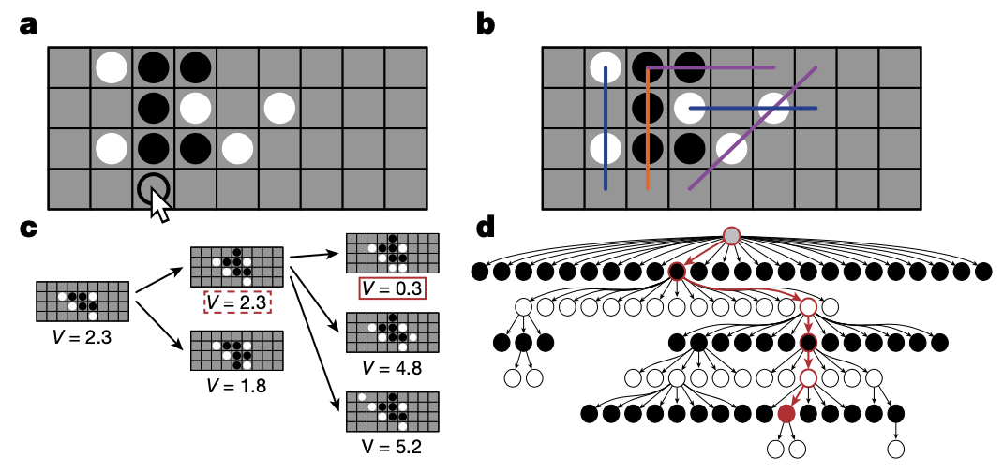
Four-in-a-row
Goal: get 4 pieces with same color horizontally, vertically, or diagonally.
4 x 9 board
Black and white place pieces alternatively on the board, one piece at once.
Features
Connected two-in-a-row
Unconnected two-in-a-row
Three-in-a-row
Four-in-a-row

Slide 5
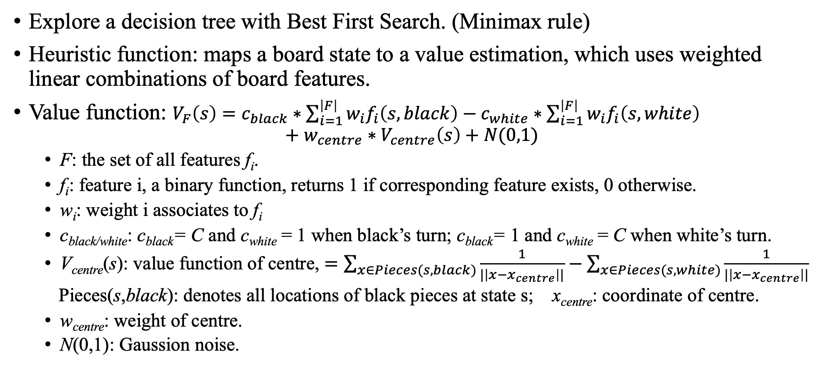
Computational Model
Explore a decision tree with Best First Search. (Minimax rule)
Heuristic function: maps a board state to a value estimation, which uses weighted linear combinations of board features.
Value function: $V_{F}\left(s\right)=c_{black}∗\sum_{i=1}^{\left|F\right|}{w_{i}f_{i}\left(s, black\right)}−c_{white}∗\sum_{i=1}^{\left|F\right|}{w_{i}f_{i}\left(s, white\right)}$
$$+ w_{centre}∗V_{centre}\left(s\right)+N(0,1)$$
F: the set of all features f_{i}.
f_{i}: feature i, a binary function, returns 1 if corresponding feature exists, 0 otherwise.
w_{i}: weight i associates to f_{i}
c_{black/white}: c_{black}= C and c_{white} = 1 when black’s turn; c_{black}= 1 and c_{white} = C when white’s turn.
V_{centre}(s): value function of centre, $=\sum_{x∈Pieces(s,black)}{\frac{1}{|\left|x−x_{centre}\right||}}−\sum_{x∈Pieces(s,white)}{\frac{1}{|\left|x−x_{centre}\right||}}$
Pieces(s,black): denotes all locations of black pieces at state s; x_{centre}: coordinate of centre.
w_{centre}: weight of centre.
N(0,1): Gaussion noise.

Slide 6
Computational Model
Parameters
Takes a random move with probability 𝜆.
Drops each feature independently with probability 𝛿.
Stop expanding a node with probability 𝛾.
Stop expanding a new node if the difference of value between best candidate node and new node exceeds a threshold 𝜃.
Constant C.
Weight parameters.
Model fitting
Data: 40 participants played against other human players with unlimited time.
Log-likelihood with inverse binomial sampling.
Use 5-fold cross validation to reduce overfitting.

Slide 7
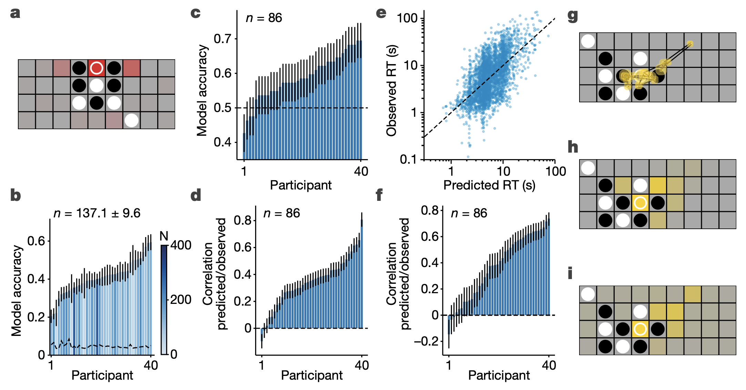
Model Validation
a. Probability distribution predicts a human’s next move.
b. Accuracy of predicting a human’s next move.
c. Accuracy of predicting a human’s choice of 2AFC decisions.
d. Correlation of predicted/observed human’s choice of 2AFC decisions.
e. Predicted/Observed human’s respond time.
f. Correlation of predicted/observed human’s respond time.
g. Trajectory of eye movement.
h. Estimated distribution convolves trajectory with a filter.
i. Squares visited by search algorithm.

Slide 8
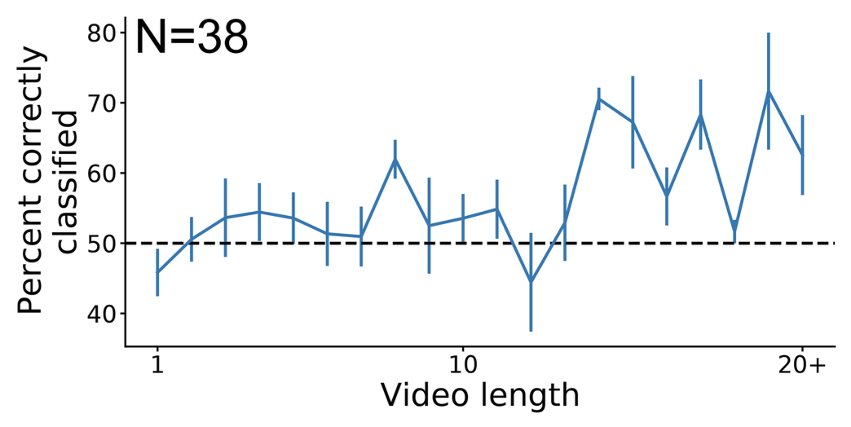
Turing Test
Let human judge a series of move is played by 2 humans or 2 computers.
90 human-versus-human games and 90 computer-versus-computer games.
Average of moves(video length): 9.38.
Discrimination accuracy: 55.4%.

Slide 9
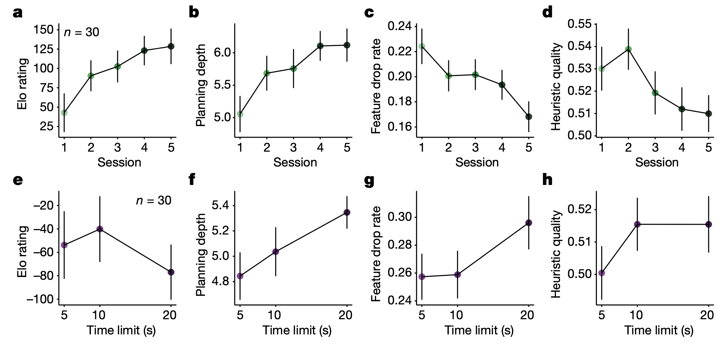
Effect of Expertise on Planning
30 participants played against computer for 5 sessions.
Measure the performance of participants with 4 parameters.
Elo rating: a rating to measure relative skills in two-player games.
Planning depth: the length of principal variation in the tree.
Feature drop rate
Heuristic quality: correlation between heuristic and objective values.

Slide 10
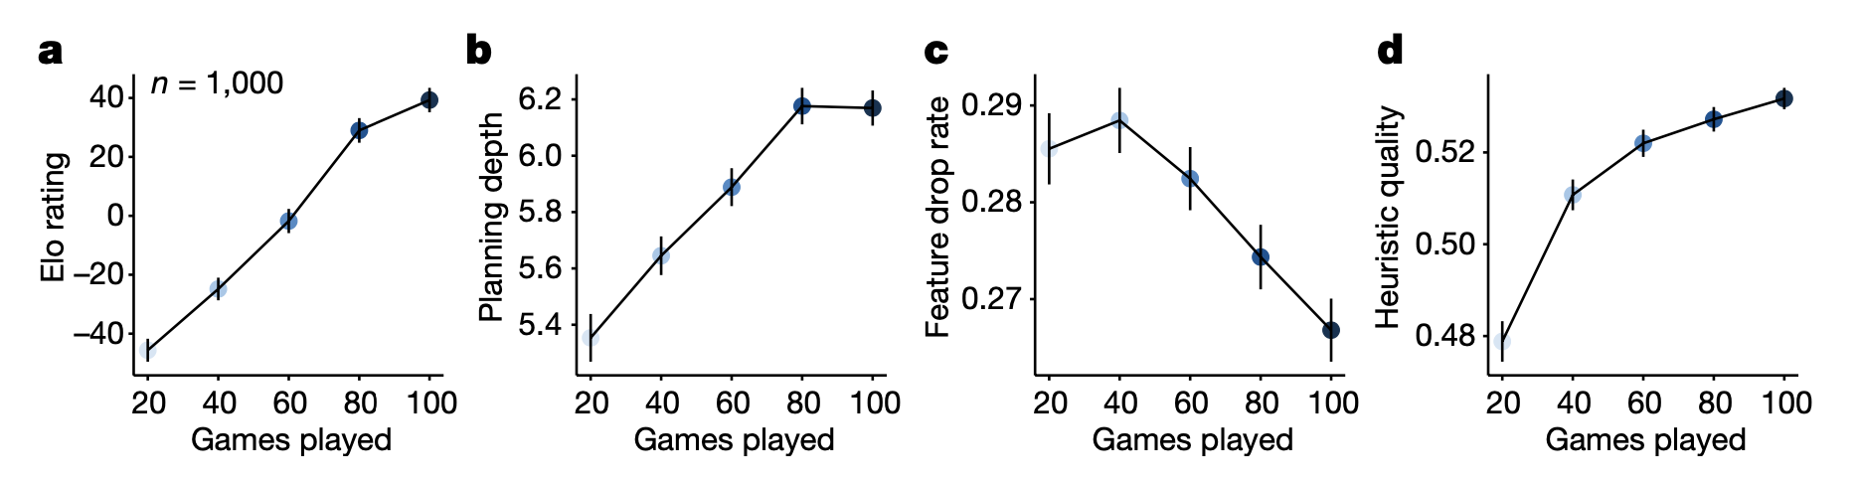
Effect of Expertise on Planning
Large scale dataset from mobile app.
1000 users who played at least 100 games are selected randomly.

