Slide 1
Fast Longest Common Subsequences for Bioinformatics Dynamic Programming
Arabi E.keshk, Mohammed Ossman, Lamiaa Fathi Hussein
International Journal of Computer Applications (0975 – 8887) Volume 57– No.22, November 2012
Presenter: Shih-Hong Li
Date: Mar. 5, 2024

Slide 2
Abstract
Bioinformatics applications represent an increasingly important workload to improve the programs of sequence analysis. It can be used to assign function to genes and proteins by the study of the similarities between the compared sequences. This paper introduces a modified implementation of bioinformatics algorithm for sequence alignment .The implemented algorithm is called Fast Longest Common Subsequence (FLCS). It is filling the three main diagonals without filling the entire matrix by the unused data. It gets the optimal solution but the execution time is decreased and the performance is high. To illustrate the effectiveness of optimizing the performance of the proposed FLCS algorithm and demonstrate its superiority, it is compared with Needleman-Wunsch, Smith-Waterman and Longest Common Subsequence algorithms.

Slide 3


Sequence alignment
Local alignment
part of the two sequences that match well
Global alignment
maximum match between the sequences

Slide 4
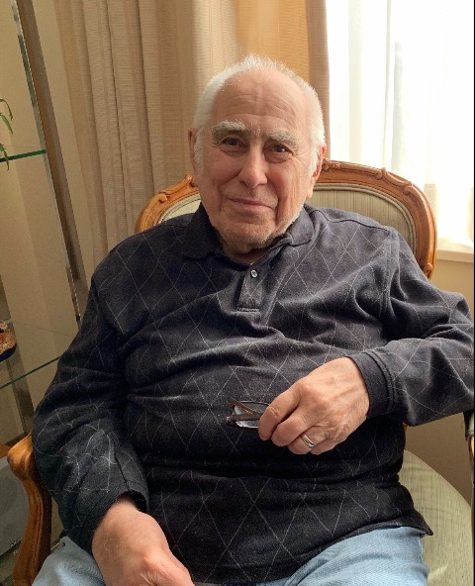

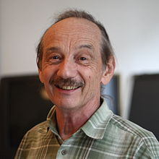
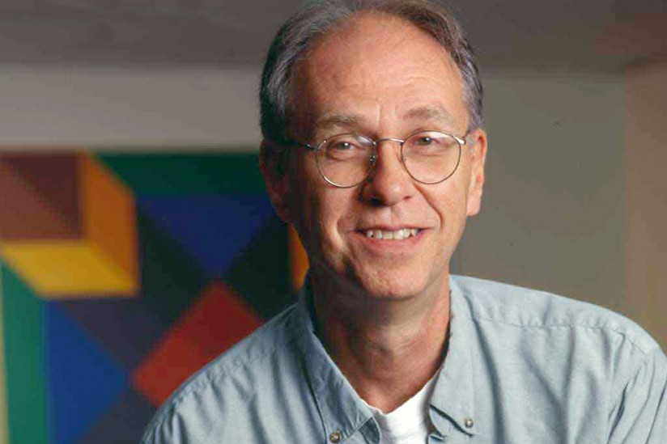
Dynamic algorithms
Needleman-Wunsch algorithm(global) in 1970
Smith-Waterman algorithm (local) in 1981
Saul B. Needleman
Christian D. Wunsch
Temple F. Smith
Michael Waterman
Notes:
问题定义：
LCS： LCS问题的目标是找到两个序列中的最长公共子序列，该子序列不要求在原序列中是连续的。LCS只关心序列中的相同字符的相对顺序。
全局比对： 全局比对问题涉及整个序列的比对，目标是找到使得比对得分最大的全局比对路径。这通常包括了整个序列的匹配和不匹配的情况。
应用场景：
LCS： 适用于解决两个序列中相同部分的问题，例如DNA序列中的保守区域。
全局比对： 适用于解决整个序列的相似性问题，例如比较两个蛋白质序列的结构或整体性质。

Slide 5
The heuristic algorithms
FASTA (fast all) in 1985
BLAST(Basic Local Alignment Search Tool) in 1990
Ignoring the unused data from computation this speed the performance
Faster than dynamic programming
Not the optimal solution
Notes:
兼顧我們在做搜尋時的速度以及搜尋結果的精確度。因為當我們所要搜尋的目標資料庫非常龐大的時候，速度就變成一項很需要考量的因素

Slide 6
Needleman-Wunsch algorithm
F[i, j] = max{
F[i-1, j-1] + mismatch/match
F[i-1, j] – gap
F[i, j-1] – gap
}
Match/mismatch =+1/-1
Gap = -2

Slide 7
Needleman-Wunsch algorithm
 | - | G | C | C | C | T | A | G | C | G
- | 0 | -2 | -4 | -6 | -8 | -10 | -12 | -14 | -16 | -18
G | -2 | 1 | -1 | -3 | -5 | -7 | -9 | -11 | -13 | -15
C | -4 | -1 | 2 | 0 | -2 | -4 | -6- | -8 | -10 | -12
G | -6 | -3 | 0 | 1 | -1 | -3 | -5 | -5 | -7 | -9
C | -8 | -5 | -2 | 1 | 2 | 0 | -2 | -4 | -4 | -6
A | -10 | -7 | -4 | -1 | 0 | 1 | 1 | -1 | -3 | -5
A | -12 | -9 | -6 | -3 | -2 | -1 | 2 | 0 | --2 | -4
T | -14 | -11 | -8 | -5 | -4 | -1 | 0 | 1 | -1 | -3
G | -16 | -13 | -10 | -7 | -6 | -3 | -2 | 1 | 0 | 0

Slide 8
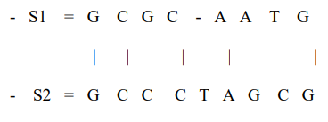
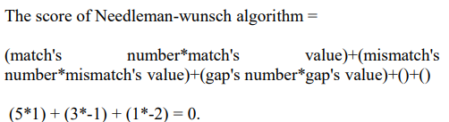
Result

Slide 9
Smith-Waterman algorithm
F[i, j] = max{
0
F[i-1, j-1] + mismatch/match
F[i-1, j] – gap
F[i, j-1] - gap
}
Match/mismatch =+1/-1
Gap = -2
Notes:
当gap为零时，Smith-Waterman算法的目标是找到最大得分的局部比对路径，而不过分惩罚插入或删除。这在寻找局部相似性区域，特别是在存在插入或删除的情况下，可以更容易地找到具有局部相似性的序列片段。

Slide 10
Smith-Waterman
0 | - | G | C | C | C | T | A | G | C | G
- | 0 | 0 | 0 | 0 | 0 | 0 | 0 | 0 | 0 | 0
G | 0 | 1 | 0 | 0 | 0 | 0 | 0 | 1 | 0 | 1
C | 0 | 0 | 2 | 1 | 1 | 0 | 0 | 0 | 2 | 0
G | 0 | 1 | 0 | 0 | 0 | 0 | 0 | 1 | 0 | 3
C | 0 | 0 | 2 | 1 | 2 | 0 | 0 | 0 | 2 | 1
A | 0 | 0 | 0 | 1 | 0 | 1 | 1 | 0 | 0 | 1
A | 0 | 0 | 0 | 0 | 0 | 0 | 2 | 0 | 0 | 0
T | 0 | 0 | 0 | 0 | 0 | 1 | 0 | 1 | 0 | 0
G | 0 | 1 | 0 | 0 | 0 | 0 | 0 | 1 | 0 | 1

Slide 11
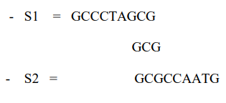

Result

Slide 12
Longest common subsequence
F[i,j] = {
F[i-1, j-1]+1 if match
max(F[i-1, j], F[i-1, j]) if mismatch
}

Slide 13
Longest common subsequence
0 | - | G | C | C | C | T | A | G | C | G
- | 0 | 0 | 0 | 0 | 0 | 0 | 0 | 0 | 0 | 0
G | 0 | 1 | 1 | 1 | 1 | 1 | 1 | 1 | 1 | 1
C | 0 | 1 | 2 | 2 | 2 | 2 | 2 | 2 | 2 | 2
G | 0 | 1 | 2 | 2 | 2 | 2 | 2 | 3 | 3 | 3
C | 0 | 1 | 2 | 3 | 3 | 3 | 3 | 3 | 4 | 4
A | 0 | 1 | 2 | 3 | 3 | 3 | 4 | 4 | 4 | 4
A | 0 | 1 | 2 | 3 | 3 | 3 | 4 | 4 | 4 | 4
T | 0 | 1 | 2 | 3 | 3 | 4 | 4 | 4 | 4 | 4
G | 0 | 1 | 2 | 3 | 3 | 4 | 4 | 5 | 5 | 5

Slide 14
FAST longest common subsequence
F[i,j] = {
F[i-1,j-1] + match/mismatch ; if(i == j)
max(F[i-1,j-1] + mismatch ,
F[i,j-1] + gap , F[i-1,j-1] + gap );} if(i != j)
Match/mismatch =+1/-1
Gap = -1

Slide 15
FAST longest common subsequence
 | - | A | G | A | A | C | A | A | G | G | C | G | T
- | 0 | -1
A | -1
C
A
A
G
A
C
A
G
C
G
T

Slide 16
FAST longest common subsequence
 | - | A | G | A | A | C | A | A | G | G | C | G | T
- | 0 | -1
A | -1 | 1 | 0
C |  | 0
A
A
G
A
C
A
G
C
G
T

Slide 17
FAST longest common subsequence
 | - | A | G | A | A | C | A | A | G | G | C | G | T
- | 0 | -1
A | -1 | 1 | 0
C |  | 0 | 0 | -1
A |  |  | -1
A
G
A
C
A
G
C
G
T

Slide 18
FAST longest common subsequence
 | - | A | G | A | A | C | A | A | G | G | C | G | T
- | 0 | -1
A | -1 | 1 | 0
C |  | 0 | 0 | -1
A |  |  | -1 | 1 | 0
A |  |  |  | 0 | 2
G
A
C
A
G
C
G
T

Slide 19
FAST longest common subsequence
 | - | A | G | A | A | C | A | A | G | G | C | G | T
- | 0 | -1
A | -1 | 1 | 0
C |  | 0 | 0 | -1
A |  |  | -1 | 1 | 0
A |  |  |  | 0 | 2 | 1
G |  |  |  |  | 1 | 1
A
C
A
G
C
G
T

Slide 20
FAST longest common subsequence
 | - | A | G | A | A | C | A | A | G | G | C | G | T
- | 0 | -1
A | -1 | 1 | 0
C |  | 0 | 0 | -1
A |  |  | -1 | 1 | 0
A |  |  |  | 0 | 2 | 1
G |  |  |  |  | 1 | 1 | 0
A |  |  |  |  |  | 0 | 2
C
A
G
C
G
T

Slide 21
FAST longest common subsequence
 | - | A | G | A | A | C | A | A | G | G | C | G | T
- | 0 | -1
A | -1 | 1 | 0
C |  | 0 | 0 | -1
A |  |  | -1 | 1 | 0
A |  |  |  | 0 | 2 | 1
G |  |  |  |  | 1 | 1 | 0
A |  |  |  |  |  | 0 | 2 | 1
C |  |  |  |  |  |  | 1 | 1
A
G
C
G
T

Slide 22
FAST longest common subsequence
 | - | A | G | A | A | C | A | A | G | G | C | G | T
- | 0 | -1
A | -1 | 1 | 0
C |  | 0 | 0 | -1
A |  |  | -1 | 1 | 0
A |  |  |  | 0 | 2 | 1
G |  |  |  |  | 1 | 1 | 0
A |  |  |  |  |  | 0 | 2 | 1
C |  |  |  |  |  |  | 1 | 1 | 0
A |  |  |  |  |  |  |  | 2 | 1
G
C
G
T

Slide 23
FAST longest common subsequence
 | - | A | G | A | A | C | A | A | G | G | C | G | T
- | 0 | -1
A | -1 | 1 | 0
C |  | 0 | 0 | -1
A |  |  | -1 | 1 | 0
A |  |  |  | 0 | 2 | 1
G |  |  |  |  | 1 | 1 | 0
A |  |  |  |  |  | 0 | 2 | 1
C |  |  |  |  |  |  | 1 | 1 | 0
A |  |  |  |  |  |  |  | 2 | 1 | 0
G |  |  |  |  |  |  |  |  | 3 | 2
C
G
T

Slide 24
FAST longest common subsequence
 | - | A | G | A | A | C | A | A | G | G | C | G | T
- | 0 | -1
A | -1 | 1 | 0
C |  | 0 | 0 | -1
A |  |  | -1 | 1 | 0
A |  |  |  | 0 | 2 | 1
G |  |  |  |  | 1 | 1 | 0
A |  |  |  |  |  | 0 | 2 | 1
C |  |  |  |  |  |  | 1 | 1 | 0
A |  |  |  |  |  |  |  | 2 | 1 | 0
G |  |  |  |  |  |  |  |  | 3 | 2 | 1
C |  |  |  |  |  |  |  |  |  | 2 | 3
G
T

Slide 25
FAST longest common subsequence
 | - | A | G | A | A | C | A | A | G | G | C | G | T
- | 0 | -1
A | -1 | 1 | 0
C |  | 0 | 0 | -1
A |  |  | -1 | 1 | 0
A |  |  |  | 0 | 2 | 1
G |  |  |  |  | 1 | 1 | 0
A |  |  |  |  |  | 0 | 2 | 1
C |  |  |  |  |  |  | 1 | 1 | 0
A |  |  |  |  |  |  |  | 2 | 1 | 0
G |  |  |  |  |  |  |  |  | 3 | 2 | 1
C |  |  |  |  |  |  |  |  |  | 2 | 3 | 2
G |  |  |  |  |  |  |  |  |  |  | 2 | 4
T

Slide 26
FAST longest common subsequence
 | - | A | G | A | A | C | A | A | G | G | C | G | T
- | 0 | -1
A | -1 | 1 | 0
C |  | 0 | 0 | -1
A |  |  | -1 | 1 | 0
A |  |  |  | 0 | 2 | 1
G |  |  |  |  | 1 | 1 | 0
A |  |  |  |  |  | 0 | 2 | 1
C |  |  |  |  |  |  | 1 | 1 | 0
A |  |  |  |  |  |  |  | 2 | 1 | 0
G |  |  |  |  |  |  |  |  | 3 | 2 | 1
C |  |  |  |  |  |  |  |  |  | 2 | 3 | 2
G |  |  |  |  |  |  |  |  |  |  | 2 | 4 | 3
T |  |  |  |  |  |  |  |  |  |  |  | 3 | 5

Slide 27
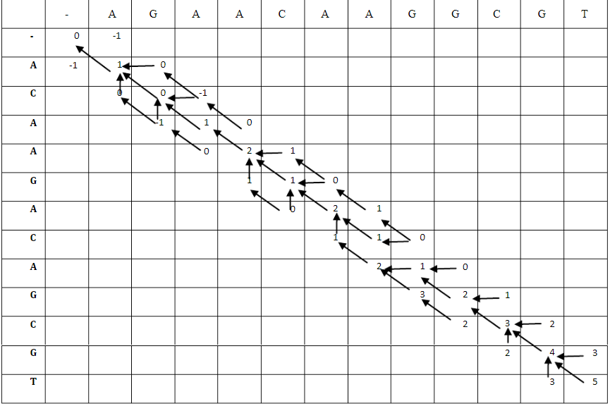
Chase back

Slide 28
Ruslt
A G A A G A C A – G C G T
| | | | | | | | |
A C A A C A – A G G C G T
Time complexity :
O(3m+2) if length of two sequence are different
O(3m+1) if length of two sequence are same
Space complexity :
O(3m+2) if length of two sequence are different
O(3m+1) if length of two sequence are same

Slide 29
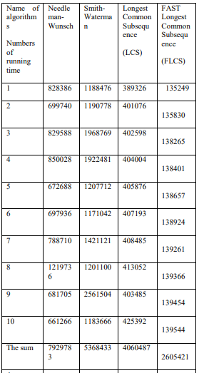
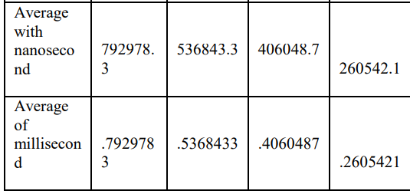
Experimental work
With unreal Suquence

Slide 30
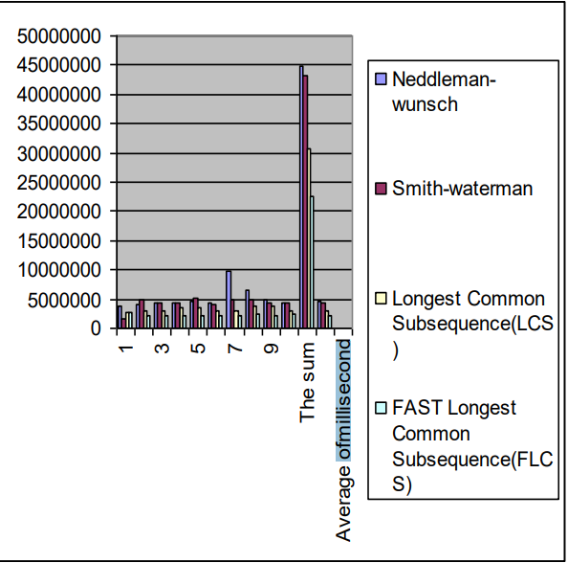
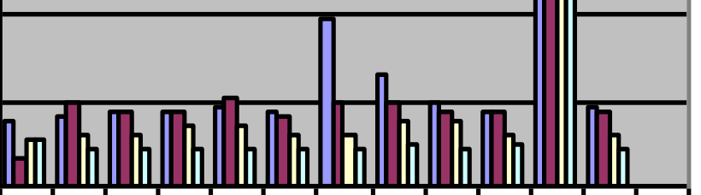
Experimental work
With real Suquence (human insulin)

Slide 31
Thanks

