Slide 1
Derivative Dynamic Time Warping
Eamonn J. Keogh and Michael J. Pazzani. Proceedings of the 2001 SIAM International Conference on Data Mining
Presenter : Jing-Xiang Yang
Date : Mar. 12, 2024

Slide 2
ABSTRACT
Dynamic time warping (DTW) is a technique for aligning time series data, crucial for comparing or averaging sequences with different time axes. It's widely used across various fields including data mining, gesture recognition, robotics, speech processing, manufacturing, and medicine. Despite its success, DTW can yield problematic results due to "singularities," where it excessively warps the time axis to explain Y-axis variability. Existing solutions often constrain warpings, potentially missing the correct alignment. Additionally, DTW may fail to find natural alignments due to slight variations in feature heights. In this paper we address both these problems by introducing a modification of DTW. The crucial difference is in the features we consider when attempting to find the correct warping. Rather than use the raw data, we consider only the (estimated) local derivatives of the data

Slide 3
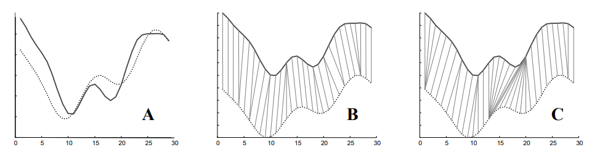
Problem of DTW

Slide 4
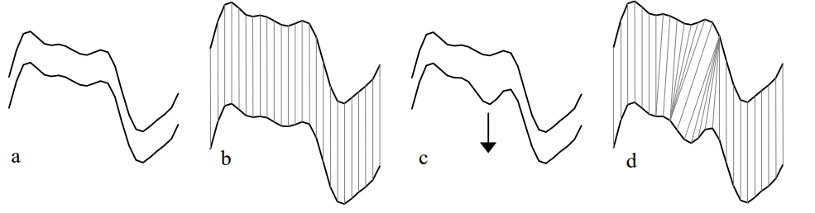
Singularities
It only considers a datapoints Y-axis value.

Slide 5
Y
p
q
X

Slide 6

DDTW
Considers the higher level feature of shape
Obtain information about shape by considering the first derivative
q_{i}
q_{i-1}
q_{i+1}

Slide 7
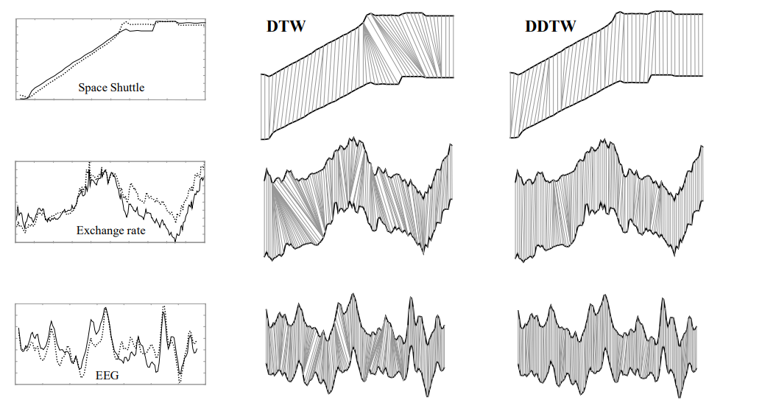
Experiment
Spurious warping

Slide 8
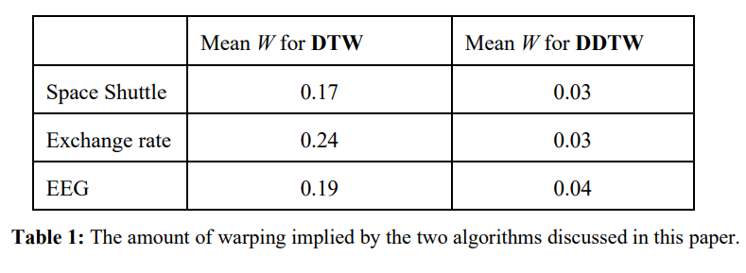

Experiment
Spurious warping
K : warping path length
m : sequence length

Slide 9
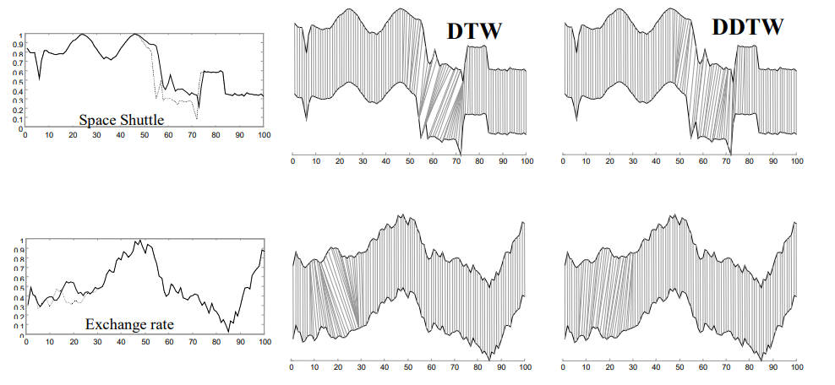
Experiment
Correct warping

Slide 10
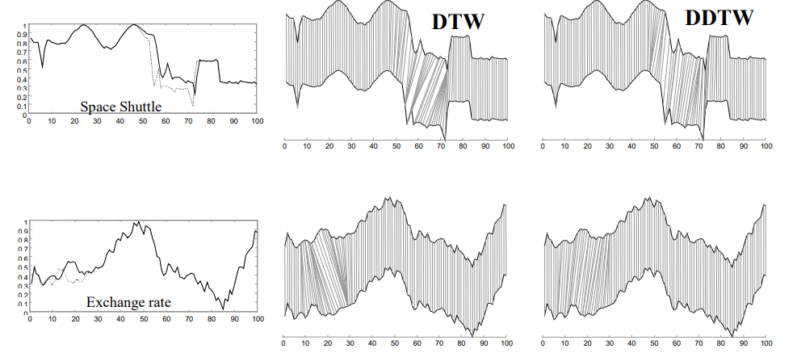
Experiment
correct warping

Slide 11
Thanks

