Slide 1
Order-Preserving Matching with Filtration
Tamanna Chhabra and Jorma Tarhio
13th International Symposium, SEA 2014, Copenhagen, Denmark, June 29 - July 1, 2014
Presenter: Wen-Yu Chang
Date: Mar. 27, 2024

Slide 2
Abstract
The problem of order-preserving matching has gained attention lately. The text and the pattern consist of numbers. The task is to find all substrings in the text which have the same relative order as the pattern. The problem has applications in analysis of time series like stock market or weather data. Solutions based on the KMP and BMH algorithms have been presented earlier. We present a new sublinear solution based on filtration. Any algorithm for exact string matching can be used as a filtering method. If the filtration algorithm is sublinear, the total method is sublinear on average. We show by practical experiments that the new solution is more efficient than earlier algorithms.

Slide 3
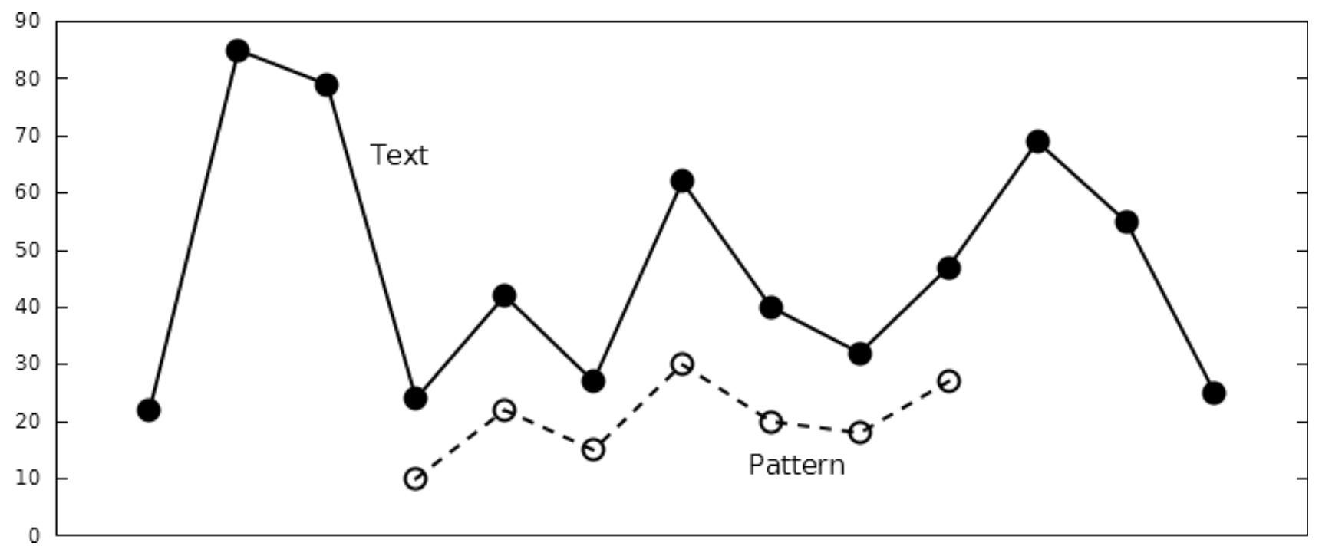
Order-preserving matching
$T=22, 85, 79, 24, 42, 27,62, 40, 32, 47, 69, 55, 25$
$\text{P}=\text{10, 22, 15, 30, 20, 18, 27}$

Slide 4
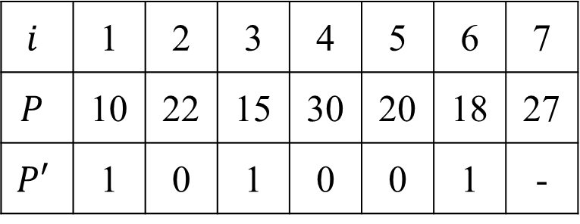
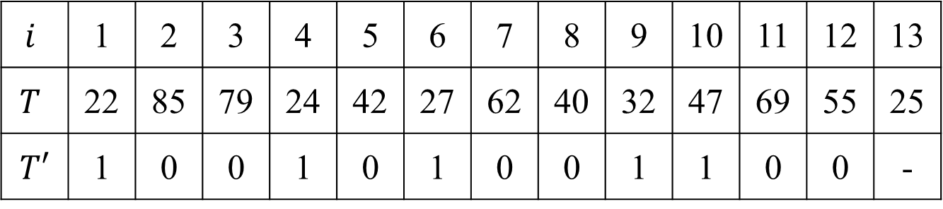
Filtration
It does not correspond to an actual match of $P$ in $T$.
$$i$$ | 1 | 2 | 3 | 4 | 5 | 6 | 7 | 8 | 9 | 10 | 11 | 12 | 13
$$T$$ | 22 | 85 | 79 | 24 | 42 | 27 | 62 | 40 | 32 | 47 | 69 | 55 | 25
$$T′$$ | 1 | 0 | 0 | 1 | 0 | 1 | 0 | 0 | 1 | 1 | 0 | 0 | -
$$i$$ | 1 | 2 | 3 | 4 | 5 | 6 | 7
$$P$$ | 10 | 22 | 15 | 30 | 20 | 18 | 27
$$P′$$ | 1 | 0 | 1 | 0 | 0 | 1 | -

Slide 5
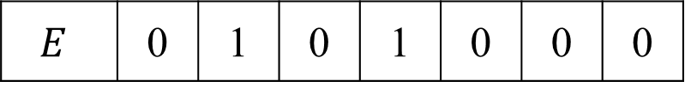
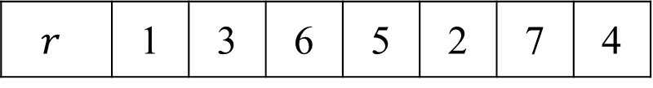
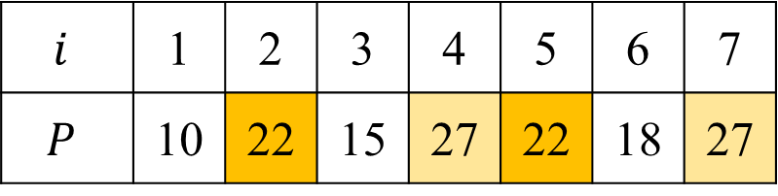
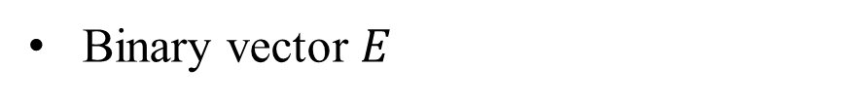
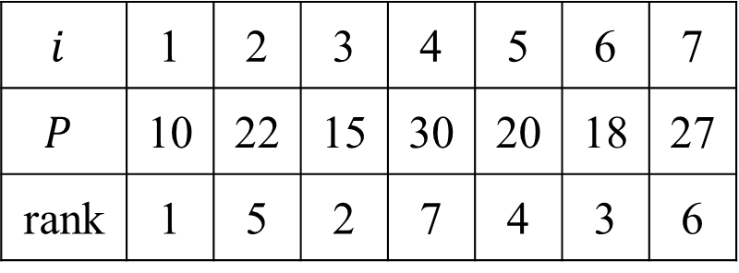
Verification
Binary vector $E$
Auxiliary table $r$
$$i$$ | 1 | 2 | 3 | 4 | 5 | 6 | 7
$$P$$ | 10 | 22 | 15 | 30 | 20 | 18 | 27
rank | 1 | 5 | 2 | 7 | 4 | 3 | 6
$$i$$ | 1 | 2 | 3 | 4 | 5 | 6 | 7
$$P$$ | 10 | 22 | 15 | 27 | 22 | 18 | 27
$$E$$ | 0 | 1 | 0 | 1 | 0 | 0 | 0
$$r$$ | 1 | 3 | 6 | 5 | 2 | 7 | 4

Slide 6
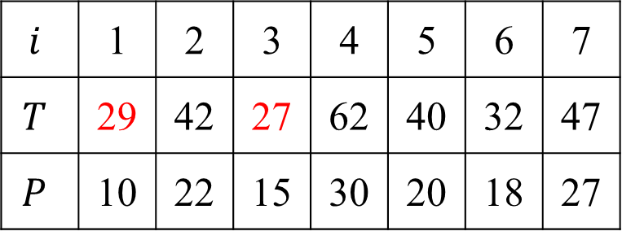
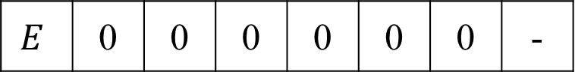
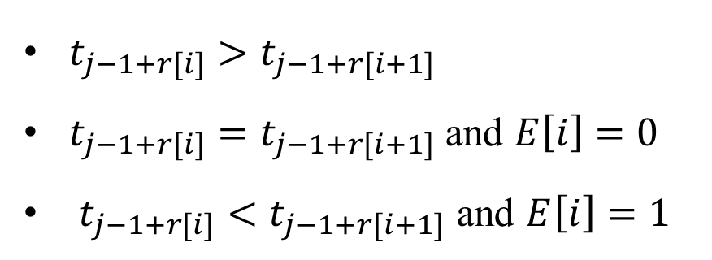
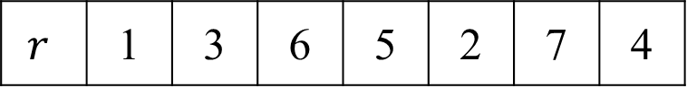
Mismatch
$t_{j−1+r[i]}>t_{j−1+r[i+1]}$
$t_{j−1+r[i]}=t_{j−1+r[i+1]}$ and $E\left[i\right]=0$
$t_{j−1+r[i]}<t_{j−1+r[i+1]}$ and $E\left[i\right]=1$
$$i$$ | 1 | 2 | 3 | 4 | 5 | 6 | 7
$$T$$ | 29 | 42 | 27 | 62 | 40 | 32 | 47
$$P$$ | 10 | 22 | 15 | 30 | 20 | 18 | 27
$$r$$ | 1 | 3 | 6 | 5 | 2 | 7 | 4
$$E$$ | 0 | 0 | 0 | 0 | 0 | 0 | -

Slide 7
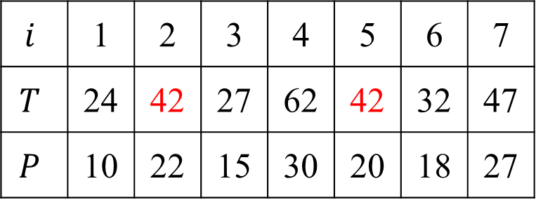
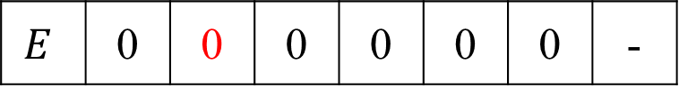
Mismatch
$t_{j−1+r[i]}>t_{j−1+r[i+1]}$
$t_{j−1+r[i]}=t_{j−1+r[i+1]}$ and $E\left[i\right]=0$
$t_{j−1+r[i]}<t_{j−1+r[i+1]}$ and $E\left[i\right]=1$
$$i$$ | 1 | 2 | 3 | 4 | 5 | 6 | 7
$$T$$ | 24 | 42 | 27 | 62 | 42 | 32 | 47
$$P$$ | 10 | 22 | 15 | 30 | 20 | 18 | 27
$$r$$ | 1 | 3 | 6 | 5 | 2 | 7 | 4
$$E$$ | 0 | 0 | 0 | 0 | 0 | 0 | -

Slide 8
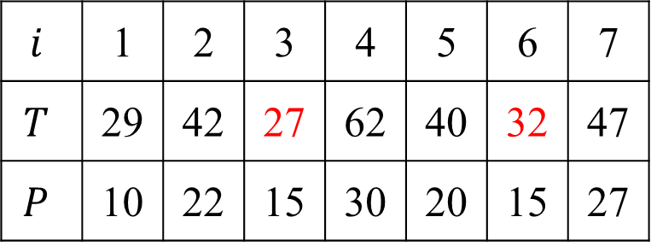
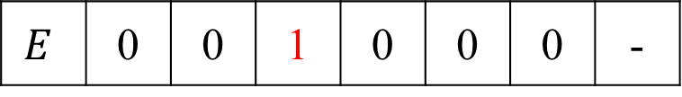
Mismatch
$t_{j−1+r[i]}>t_{j−1+r[i+1]}$
$t_{j−1+r[i]}=t_{j−1+r[i+1]}$ and $E\left[i\right]=0$
$t_{j−1+r[i]}<t_{j−1+r[i+1]}$ and $E\left[i\right]=1$
$$i$$ | 1 | 2 | 3 | 4 | 5 | 6 | 7
$$T$$ | 29 | 42 | 27 | 62 | 40 | 32 | 47
$$P$$ | 10 | 22 | 15 | 30 | 20 | 15 | 27
$$r$$ | 1 | 3 | 6 | 5 | 2 | 7 | 4
$$E$$ | 0 | 0 | 1 | 0 | 0 | 0 | -

Slide 9
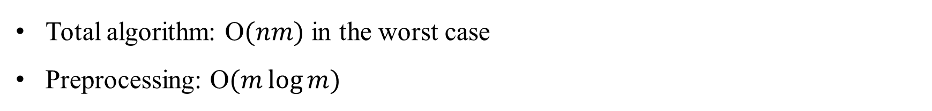
Time Complexity
Total algorithm: O$(nm)$ in the worst case
Preprocessing: O$(m\log{m})$

Slide 10
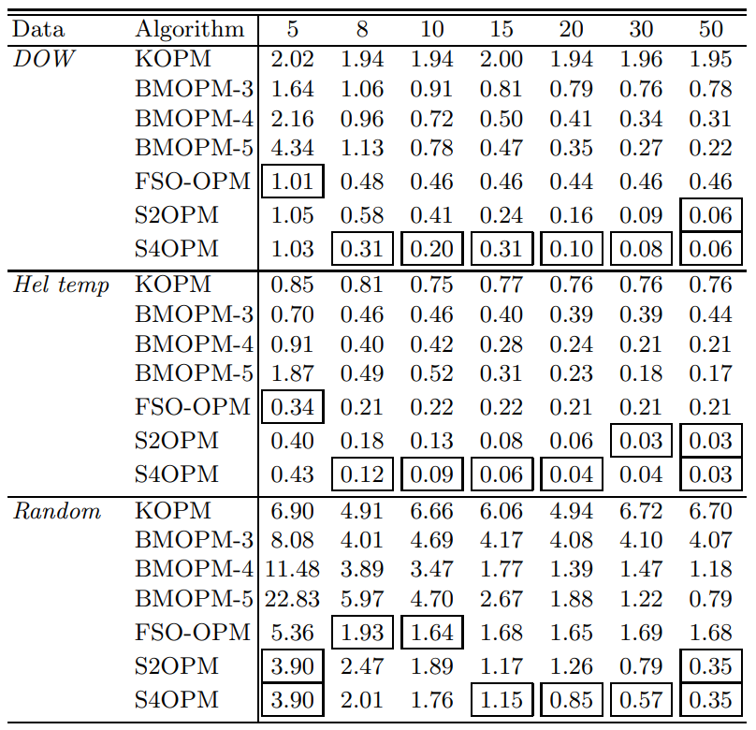
Experiments
Notes:
SBNDM4

