Slide 1
Longest Previous Non-Overlapping Factors Computation
Supaporn Chairungsee; Tida Butrak; Surangkanang Chareonrak; Thana Charuphanthuset
2015 26th International Workshop on Database and Expert Systems Applications, Valencia, Spain
Presenter: Wen-Wen Liao
Date: Mar. 27, 2024
Notes:
特拉維夫市以色列

Slide 2
Abstract
We study the problem of finding the Longest Previous non-overlapping Factor (LPnF) occurring at each position of a string. The notion of LPnF table is a variant of the Longest Previous Factor (LPF) table and is an essential element for the design of efficient algorithms on strings. The LPnF table is related to Ziv-Lempel factorization which is used for text compression. In this paper, we describe an algorithm for computing the LPnF table of a string from its Suffix Automaton. The algorithm runs in linear time on a fixed size alphabet and applications of this algorithm are for text compression.

Slide 3
Lempel-Ziv
Take LZ77 for example
ABABCBABABCAD
ABABCBABABCAD A
ABABCBABABCAD A B
ABABCBABABCAD A B ABC
ABABCBABABCAD A B ABC BABA
ABABCBABABCAD A B ABC BABA BCA
ABABCBABABCAD A B ABC BABA BCA D

Slide 4
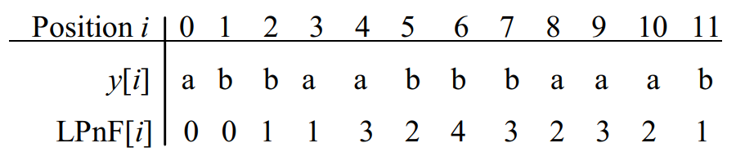
Longest Previous non-overlapping Factors (LPnF)
abbaabbbaaab

Slide 5
Factor
A string x is a factor of a string y if there exist two strings u and v such that y = uxv
x = aba
y = aababaabab
→ x is a factor of y

Slide 6
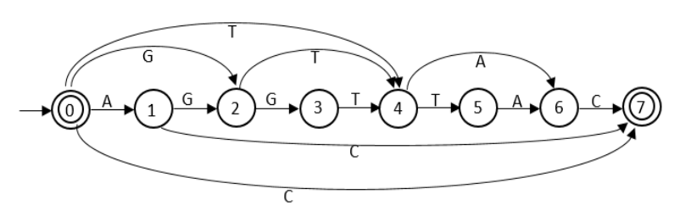
Suffix Automaton
It is the minimal automaton which corresponds to the set of suffixes of w.
w = AGGTTAC

Slide 7
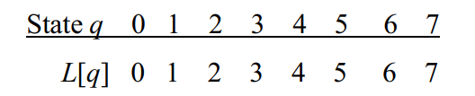
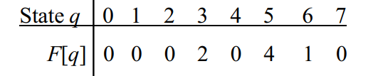
Suffix Automaton
failure link

Slide 8
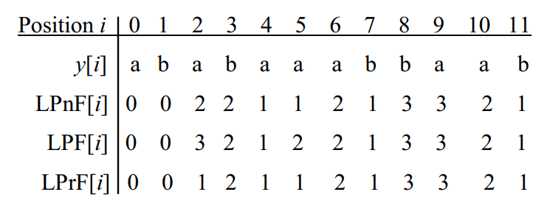
Longest Previous non-overlapping Factor
LPnF[i] = max {k | y[i..i + k - 1] appears in y[0..i - 1]}.

Slide 9
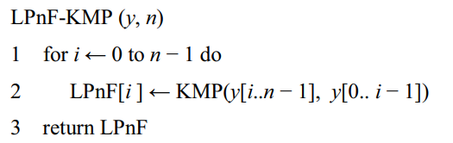

Algorithm- use KMP
KMP time complexity: O($n$)
Overall time complexity: O($n^{2}$)

Slide 10
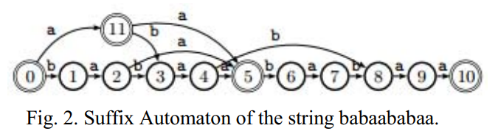
Algorithm- use suffix automaton
babaababaa

Slide 11
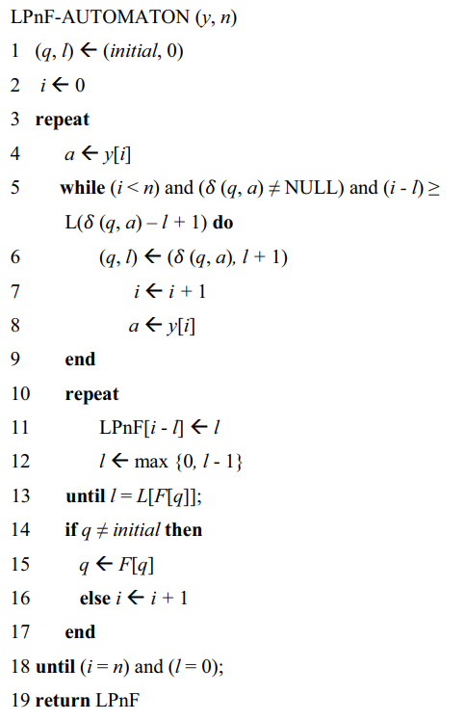
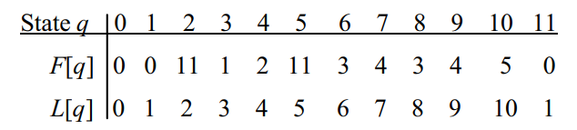
Algorithm- use suffix automaton
babaababaa
 | b | a | b | a | a | b | a | b | a | a
LFnP | 0 | 0 | 1 | 2 | 1 | 2 | 4 | 3 | 2 | 1

Slide 12
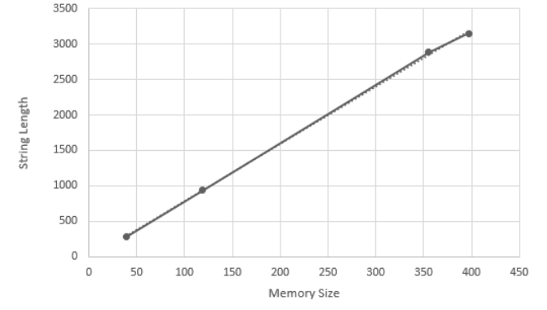
Experimental results

Slide 13
Conclusion
O(n log a) time
linear memory space

