Slide 1
Color-Gray Multi-Image Hybrid Compression–Encryption Scheme Based on BP Neural Network and Knight Tour
Xinyu Gao, Jun Mou, Santo Banerjee, Yushu Zhang
IEEE Transactions on Cybernetics, 53.8 (2023), 5037 - 5047.
Presenter: Hsin-Chang Yu
Date: Mar. 27, 2024

Slide 2
Abstract
In the research of multi-image encryption (MIE), the image type and size are important factors that limit the algorithm design. For this reason, the multi-image (MI) hybrid encryption algorithm that can flexibly encrypt color images and grayscale images of various sizes is proposed. Based on this, combining the back propagation (BP) neural network compression technology and the MI hybrid encryption algorithm, an MI hybrid compression–encryption (MIHCE) scheme can be obtained to reduce the pressure of simultaneous transmission and storage of multiple cipher images.

Slide 3
Abstract
Besides, two chaotic maps are used in the scheme design process. By plotting the phase diagrams under different parameter conditions of the behavior of the chaotic maps in the phase space is exhibited. The MIHCE scheme based on the chaotic maps consists of three parts: 1) compressing the MI cube by using the BP neural network; 2) scrambling the compressed MI cube based on the knight tour problem and chaotic sequences; and 3) diffusing the scrambled MI cube.

Slide 4
Abstract
After the MIHCE is completed, the obtained cipher images are stored and transmitted. Subsequently, the security analysis and compression performance analysis prove the feasibility and safety of the designed compression–encryption scheme.

Slide 5
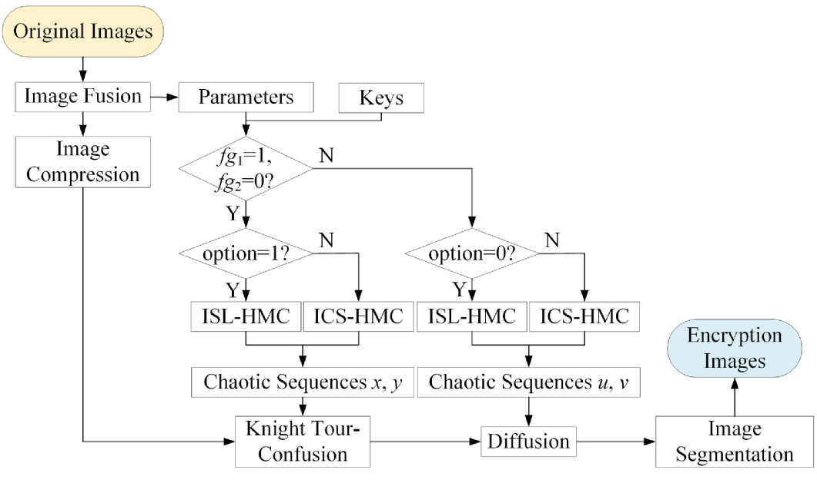
Process

Slide 6
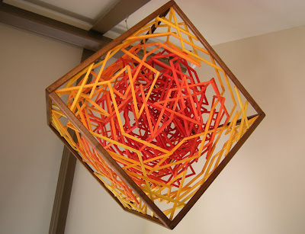
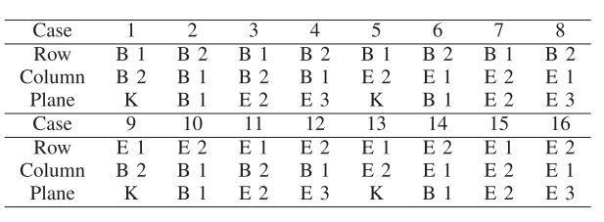
Knight’s Tour in 3-D

Slide 7
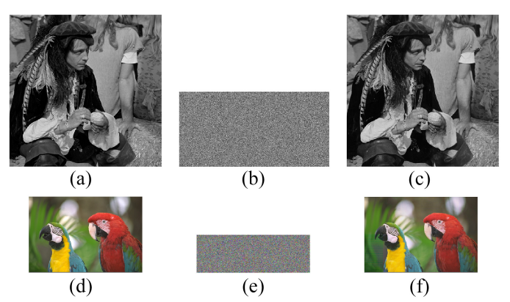
Result

Slide 8
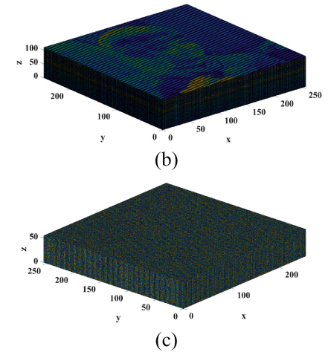
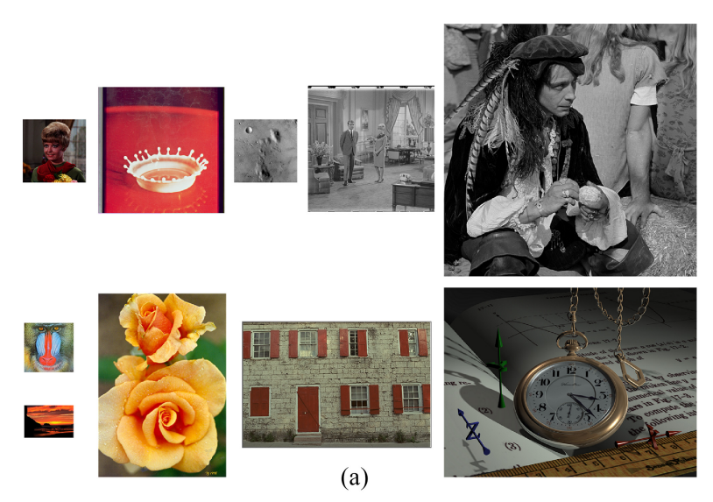
Result

Slide 9
Thanks
Notes:
Given a string S of length n, an integer p ∈ [1..n] is a period of S if S[i] = S[i + p] for all i ∈ [1..n − p].
S[|S| − p + 1] = c

