Slide 1
The use of least significant bit (LSB) and knight tour algorithm for image steganography of cover image
Soo Ann Nie, Ghazali Sulong, Rozniza Ali, Andrew Abel
International Journal of Electrical and Computer Engineering(IJECE), 9.6, 5218-5226.
Presenter: Hsin-Chang Yu
Date: Mar. 27, 2024

Slide 2
Abstract
Steganography is one of the method to communicate in a hidden way. In another word, steganography literally means the practice of hiding messages or information within another data. Previous studies have proposed various steganography techniques using different approaches including Least Significant Bit (LSB), Discrete Cosine Transform (DCT) and Discrete Wavelet Transform (DWT).

Slide 3
Abstract
However, different approaches still have its own weaknesses. Therefore image stenography using Knight Tour Algorithm with Least Significant Bit (LSB) technique is presented. The main objective is to improve the security factor in the stego image. Basically, the proposed technique is divided into two parts which are the sender and receiver side. Then, steganalysis which is a type of attack on stenography algorithm is used to detect the secret message in the cover image by the statistical analysis of pixel values.

Slide 4
Abstract
Chi Square Statistical Attach which is one of the type of steganalysis is used to detect these near-equal Po Vs in images and bases the probability of embedding on how close to equal the even pixel values and their corresponding odd pixel values are in the test image. The Knight Tour Algorithm is applied due to the common Least Significant Bit technique that is weak in security and easily decoded by outsider.

Slide 5
Knight’s Tour

Slide 6
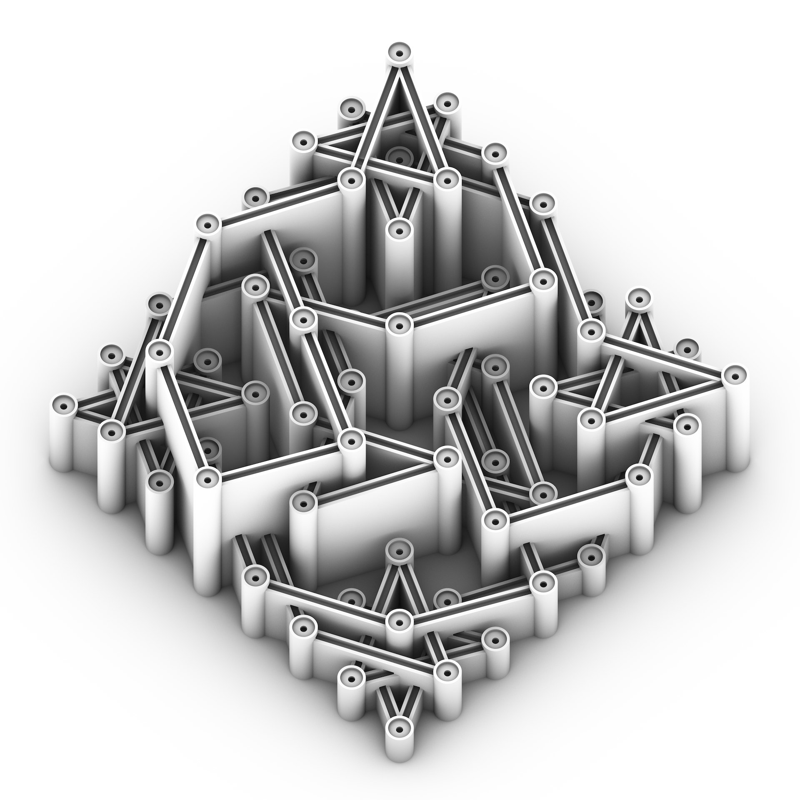
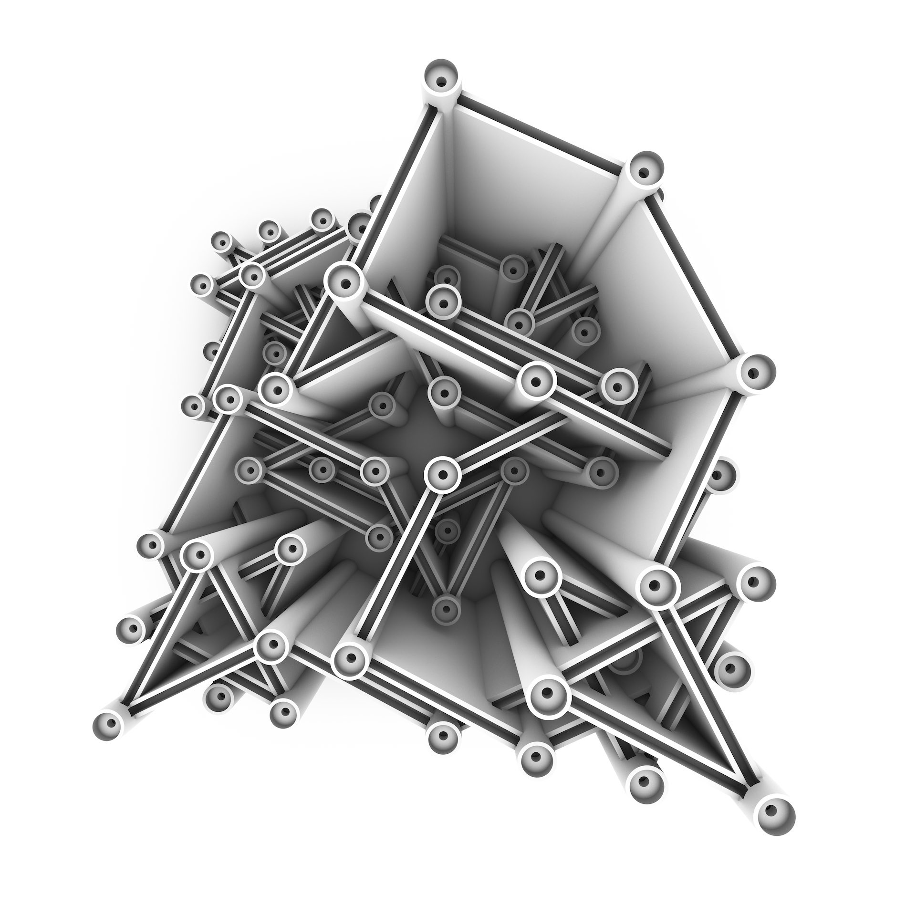

Slide 7
Least Significant Bit (LSB) Steganography

Slide 8
Least Significant Bit (LSB) Steganography
255(11111111) | 0 | 0
252(11111100) | 0 | 0

Slide 9

Stego Image

Slide 10
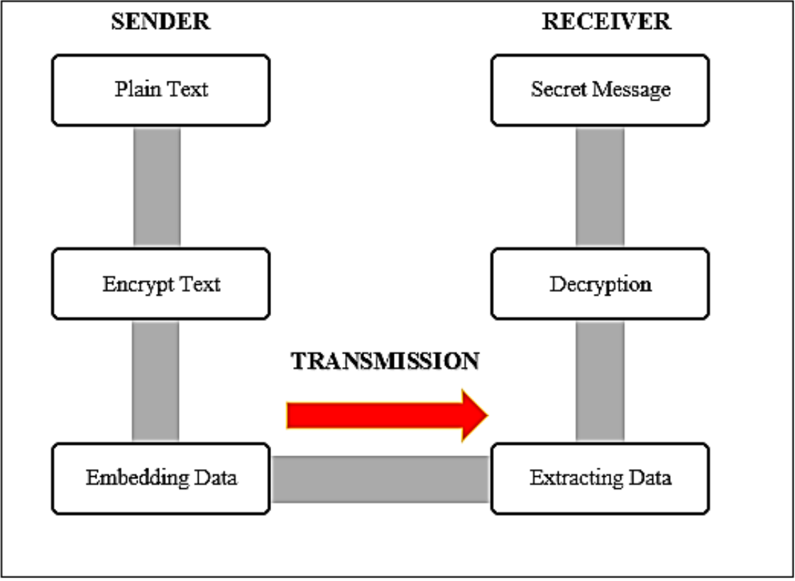
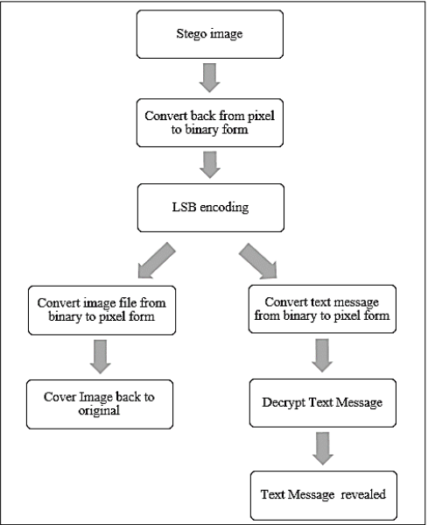
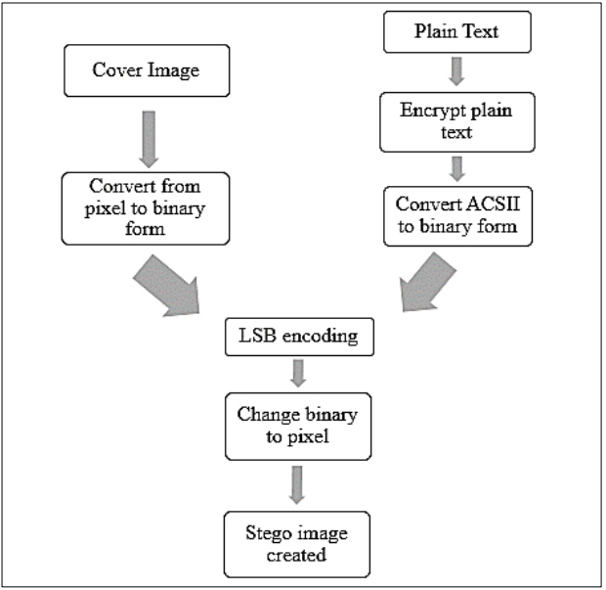
Sender and Receiver

Slide 11
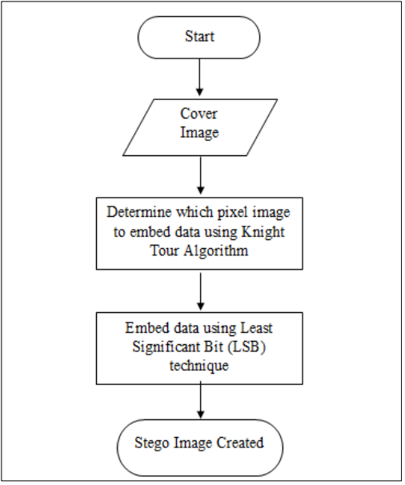
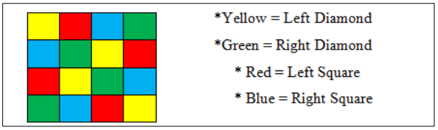
Embedding Stage

Slide 12
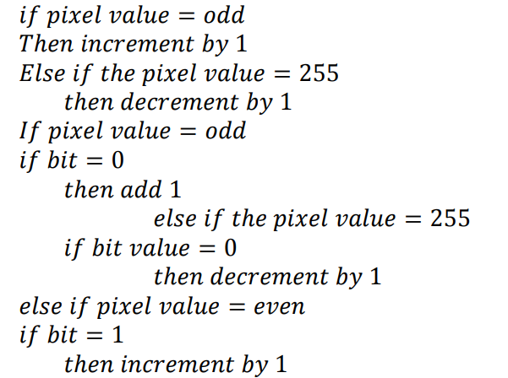
Algorithm

Slide 13
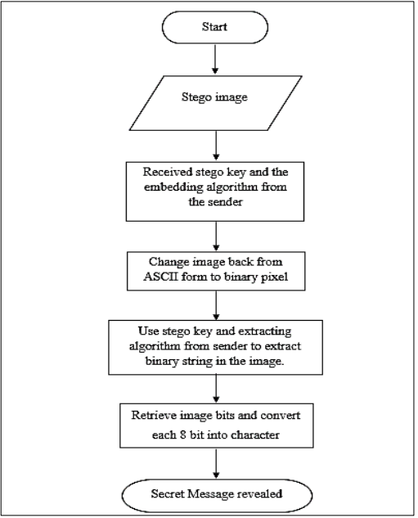
Extraction Stage

Slide 14
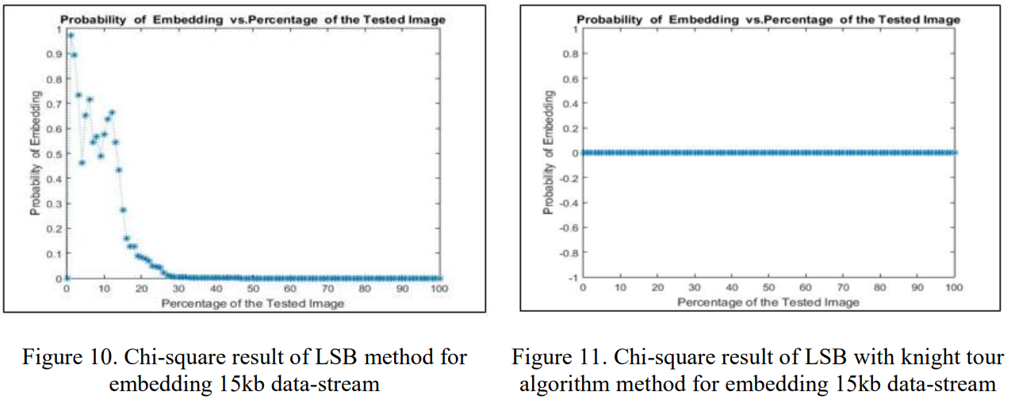
Result

Slide 15
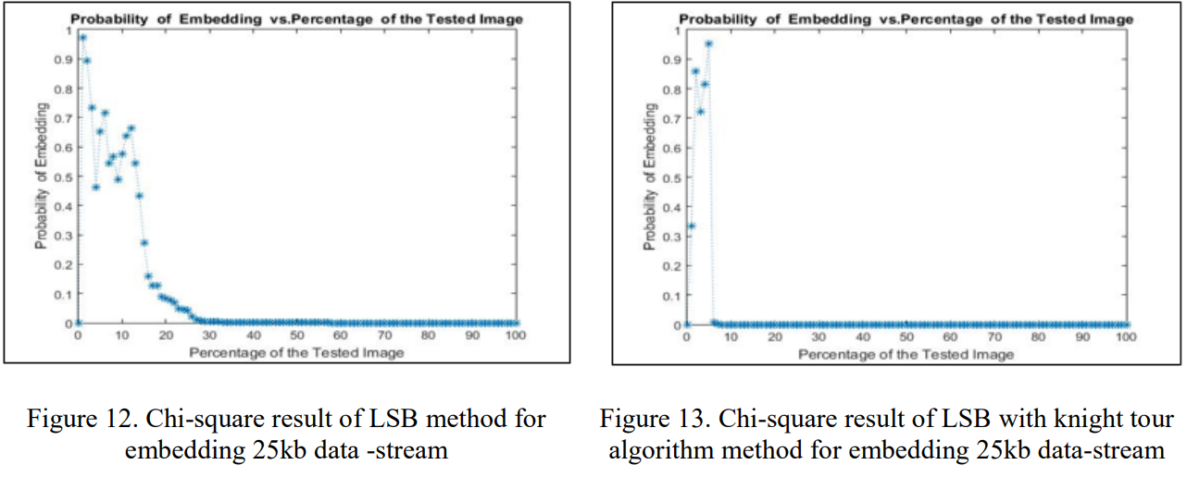
Result

Slide 16
Thanks
Notes:
Given a string S of length n, an integer p ∈ [1..n] is a period of S if S[i] = S[i + p] for all i ∈ [1..n − p].
S[|S| − p + 1] = c

