Slide 1
An efficient method for reconstructing protein backbones from α–carbon coordinates
Journal of Molecular Graphics and Modelling 21 (2002) 119–128
Yoriko Iwata, Atsushi Kasuya, Shuichi Miyamoto
Presenter: Jen-Hui, Wang
Date: July 26, 2006

Slide 2
Abstract
We present an approach for building protein backbones from α-carbon (Cα) coordinates. The approach is analytical and based on the information of favored regions in the Ramachandran map. The backbone construction consists of three parts: prediction of (Φ, Ψ) angle pairs from the Cα trace, generation of atomic coordinates with these (Φ, Ψ) angles, and refinement by subsequent energy minimization. Tests on several known protein structures show that the root mean square deviations in reconstructed backbones are 0.25–0.48Å for coordinates and 14–34◦ for Φ and Ψ angles.

Slide 3
Abstract
The results indicate that our method is one of the best methods proposed in terms of accuracy. It has also been
revealed that the approach is not only robust against errors in Cα coordinates but is also capable of providing equivalent or more reasonable models compared to other known methods. Furthermore, backbone structures were found to be built accurately by using the (Φ, Ψ) angles
from a different structure of the same protein. This suggests that the approach could be effective and useful in homology modeling studies.

Slide 4
Methods
Analytic method:
  Phase I: prediction of (Φ, Ψ) angle pair
    Step 1, 2, 3, 4
  Phase II: calculation of backbone atomic coordinates from the predicted (Φ, Ψ) angles
    Step 5, 6
  Phase III: energy minimization with molecular mechanics
    Step 7

Slide 5
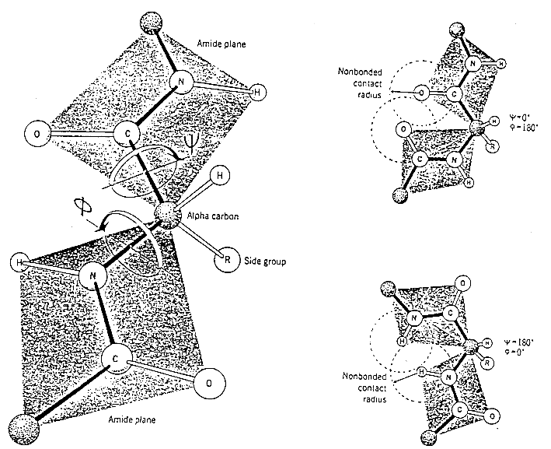
Dihedral Angles

Slide 6
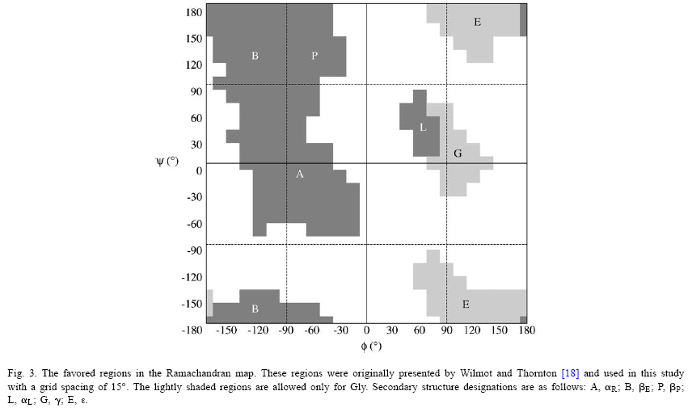
Ramachandran Plot

Slide 7
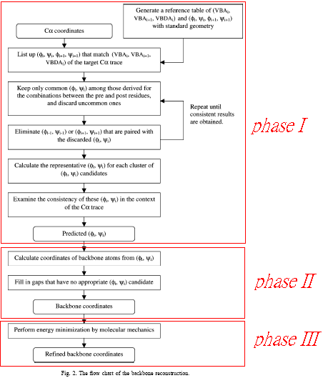
Methods

Slide 8
Methods: Phase I
Step 1.
  With respect to four consecutive residues with standard geometry, dihedral angles of the two central residues (Φ₂ ,Ψ₂) and (Φ₃ ,Ψ₃) were rotated systematically at certain intervals with the favored regions of the Ramachandran map.
  Based on the resultant atomic coordinates of four Cα(C_{α1}—C_{α4}) atoms, the angles VBA₂, VBA₃, and VBDA₂ were calculated and the relationships between these angles and
  (Φ, Ψ) angles were obtained. A reference table of the two VBA as well as one VBDA and the corresponding two adjacent (Φ, Ψ) angles was then generated. VBA and VBDA were tabulated at certain grid intervals.

Slide 9
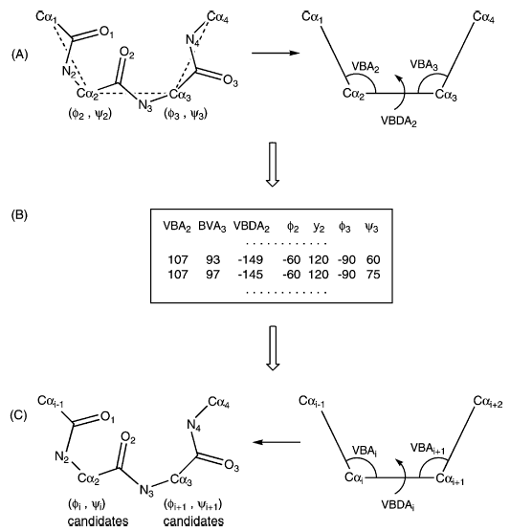
Methods: Phase I

Slide 10
Methods: Phase I
Step 2.
  With regard to the four successive α–carbons (C_{αi-1} – C_{αi+2}) in the target C_{α} trace, VBA_{i}, VBA_{i+1}, and VBDA_{i} were calculated and the possible combinations of (Φ_{i} ,Ψ_{i}) and (Φ_{i+1} ,Ψ_{i+1}) were listed based on the reference table.
  In the case of Pro, a set of dihedral pair angles with Φ angles with were significantly deviated(>30°) from the canonical 68°, were eliminated.
  By repeating this process from the N-terminal straight through to the C-terminal, two kinds of (Φ ,Ψ) candidates were obtained for each residue except for the terminal residues.

Slide 11
Methods: Phase I
Step 2.
  Since the correct (Φ ,Ψ) pair should be include in both series of candidates lists, the common (Φ ,Ψ) pairs were retained and the rest were discarded. At this point, the (Φ_{i} ,Ψ_{i}) sets,
  i.e. (Φ_{i-1} ,Ψ_{i-1}) and (Φ_{i+1} ,Ψ_{i+1}) that were paired with the discarded (Φ_{i} ,Ψ_{i}) were also eliminated.
  For each residue, two series of (Φ ,Ψ) candidates were again examined to keep only the common ones. This elimination process was repeated until no more candidates could be eliminatd.

Slide 12
Methods: Phase I
N-terminal
C-terminal
(Φ₂ ,Ψ₂)
(Φ₃ ,Ψ₃)
(Φ₃ ,Ψ₃)
(Φ₄ ,Ψ₄)
(Φ₃ ,Ψ₃)
(Φ₄ ,Ψ₄)
(Φ₃ ,Ψ₃)
(Φ₄ ,Ψ₄)
(Φ₄ ,Ψ₄)
(Φ₅ ,Ψ₅)
(Φ₄ ,Ψ₄)
(Φ₅ ,Ψ₅)
(Φ₄ ,Ψ₄)
(Φ₅ ,Ψ₅)

Slide 13
Methods: Phase I
Step 3.
  If the difference in Φ and Ψ angles of the original (Φ ,Ψ) candidates was within one grid spacing, these candidates were automatically regarded to be in the same cluster. The representative (Φ ,Ψ) pair at the weight center of the cluster members was then determined by taking the periodicity of the angles into account.
  Most cases have only one cluster, and thus, a single representative (Φ ,Ψ) candidate was obtained for each residue.

Slide 14
Methods: Phase I
Step 4.
  Given the representative (Φ_{i} ,Ψ_{i}) candidate of C_{αi} , orientations of the peptides for C_{αi-1} – C_{αi} and C_{αi} – C_{αi+1} were calculated. By repeating this calculation from the N-terminal to the C-terminal, two estimated orientations of each peptide unit (C_{αi} – C_{αi+1}) were generally obtained from the (Φ_{i} ,Ψ_{i}) and (Φ_{i+1} ,Ψ_{i+1}) pairs
  The conversion of the peptide plane orientations to atomic coordinates was performed on a residue basis with residues in their standard geometry.
  The deviations of the N–C_{α}–C bond angle (A_{NαC}) from the standard (109.3◦) were also computed based on the average atomic positions derived from the two peptide orientations.

Slide 15
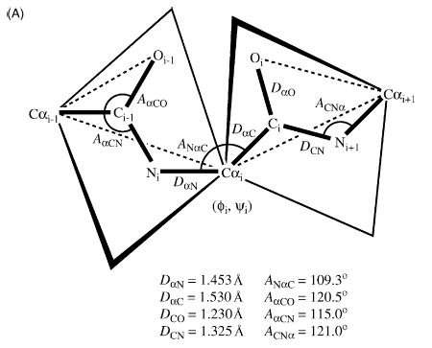
Methods: Phase I

Slide 16
Methods: Phase I
Step 4.
  When multiple candidates were obtained for C_{αi} and/or C_{αi+1}, all combinations were evaluated and the most probable (Φ ,Ψ) candidate was chosen manually based on the deviations.
  By repeating this examination along the C_{α} trace, one appropriate (Φ ,Ψ) pair could generally be determined for each residue except for the terminal residues.

Slide 17
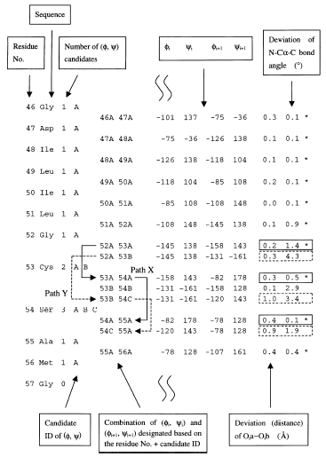

Slide 18
Methods: Phase II
Step 5.
  With respect to the four α-carbons, two estimated orientations of the central peptide plane (C_{αi} – C_{αi+1}) were calculated one from the predicted (Φ_{i} ,Ψ_{i}) and one from the (Φ_{i+1} ,Ψ_{i+1}) angles. Taking the middle of the two orientations as the estimated conformation, the coordinates of the backbone atoms (N, C, and O) were calculated.
  This calculation was repeated from the N-terminal straight through to the C-terminal.

Slide 19
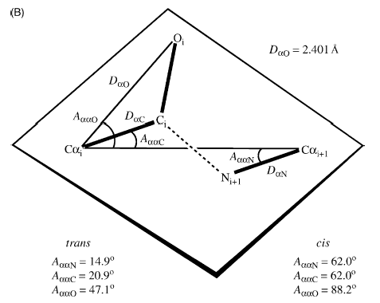
Methods: Phase II

Slide 20
Methods: Phase II
Step 6.
  With regard to the residues for which no appropriate (Φ ,Ψ) candidate was obtained in the previous phase, they were constructed one by one from the neighboring residue whose atomic coordinates had been built. By rotating a peptide group around the virtual axis, the (Φ ,Ψ) angle and N–C_{α}–C bond angle were evaluated to select the best peptide orientation.
  In other words, the orientation with the smallest deviation of N–C_{α}–C bond angle from the standard and with the (Φ ,Ψ) angle in favored regions of the Ramachandran plot was chosen.
  With respect to both terminals, the Φ₁ angle of the N-terminal and Ψ_{n} angle of the C-terminal were set to 180◦ by default.

Slide 21
Methods: Phase III
Energy minimization with molecular mechanics

Slide 22
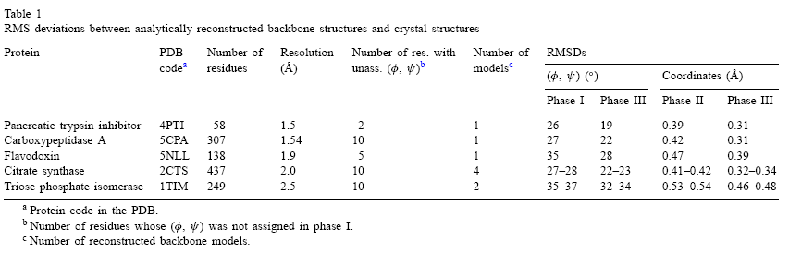
Results

Slide 23
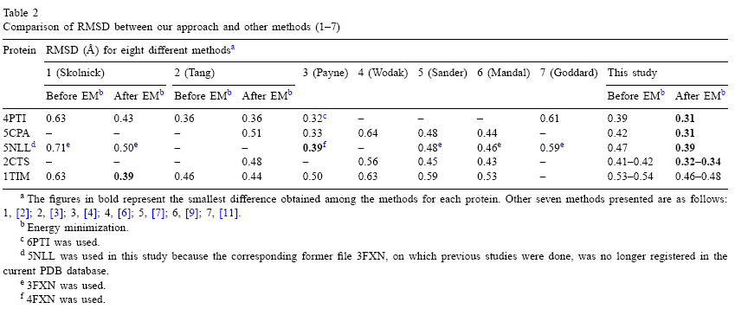
Results

