Slide 1
On maximal suffixes and constant-space linear-time versions of KMP algorithm
Wojciech Rytter
Theoretical Computer Science 299, pp. 763-774, 2003
Presenter: Yung-Hsing Peng
Date: Aug. 31, 2006

Slide 2
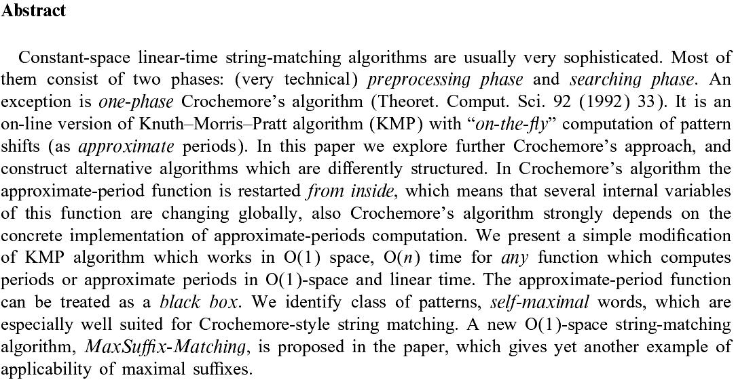

Slide 3
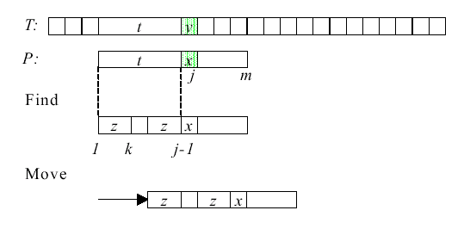
Principle of KMP Algorithm
a
a

Slide 4
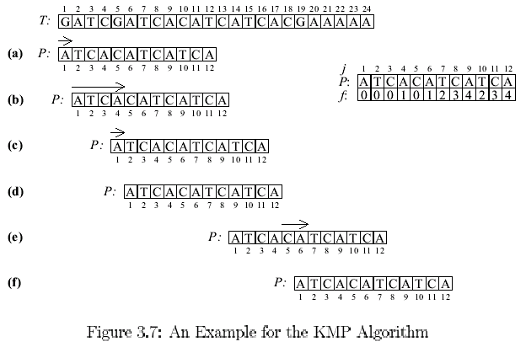
An Example for KMP Algorithm
Phase 2
Phase 1
matched

Slide 5
Correctness of the Searching Phase
mismatch
Text
Pattern
matches
i₁
i₂
i_{x}
Should we test any position i_{x} such that i₁≤ i_{x} ≤i₂ ?
No, it’s a contradiction to the definition of prefix function.
Question: Why this can be done in linear time?

Slide 6
Recursive Algorithm for Computing f
f(f(i-1))
f(i)
f(i-1)
f(f(i-1))
Concept: If the blue part (longest prefix) cannot be extended anymore, try the grey one (2nd longest prefix). Recursively do this until the length of obtained prefix is zero.
Question: Why this can be done in linear time?

Slide 7
Time Complexity of KMP Algorithm
Time complexity: O(m+n)
  O(m) for computing function f
  O(n) for searching P

Slide 8
The Main Idea
It takes O(m) space to store the table for function f.
The author showed that the KMP algorithm can be implemented in O(1) space.
→ f can be dynamically computed

Slide 9
The Shift Function Period
In fact, the function f can be written as the distances of shifts (called Period in the following content).
We have Period(j) = j – f(j).
j
1 | 2 | 3 | 4 | 5 | 6 | 7 | 8 | 9 | 10 | 11 | 12
A | T | C | A | C | A | T | C | A | T | C | A
0 | 0 | 0 | 1 | 0 | 1 | 2 | 3 | 4 | 2 | 3 | 4
1 | 2 | 3 | 3 | 5 | 5 | 5 | 5 | 5 | 8 | 8 | 8
P
f
Period

Slide 10
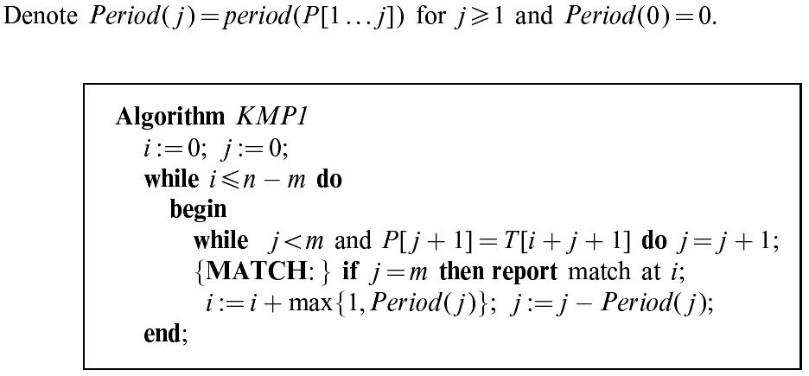
Pseudo Code for the KMP Algorithm (1/2)
This is the classical KMP algorithm that we are familiar with.

Slide 11
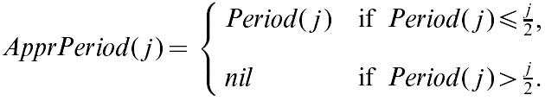
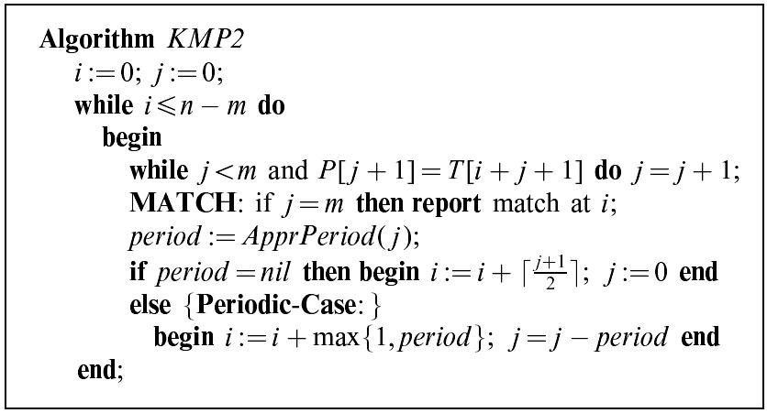
Pseudo Code for the KMP Algorithm (2/2)
Only shift j/2 even if it can shift more
A modified KMP algorithm that causes some extra comparisons.
However, it was shown that KMP2 is also an O(n) time algorithm.
The idea of “shift j/2” is very important. (Note that j + j/2 + j/4 + j/8 +…. = 2j)

Slide 12
The Self-maximal Pattern
Let MaxSuf be a function that returns the maximal suffix.
P₁=baaaabba, we have MaxSuf(P₁)=bba
P₂=baaaabaa, we have MaxSuf(P₂)=baaaabaa=P₂
P₂ is a self-maximal pattern.
The periods of self-maximal pattern can be computed more easily.

Slide 13
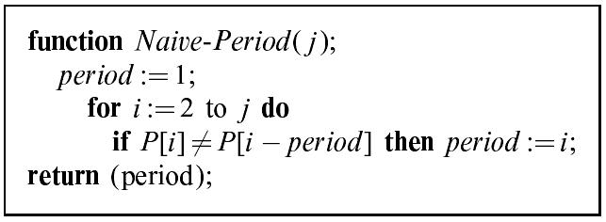
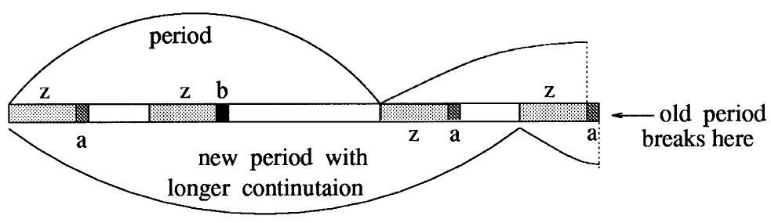
Computing Periods for a Self-maximal Patterns
No recursion
b a a a a b a a
1 2 3 4 5 5 5 5
Verification
i-k
i
Z should be empty, otherwise it is a contradiction to the definition of self-maximal pattern. → period(i) should be i, rather than i-k

Slide 14
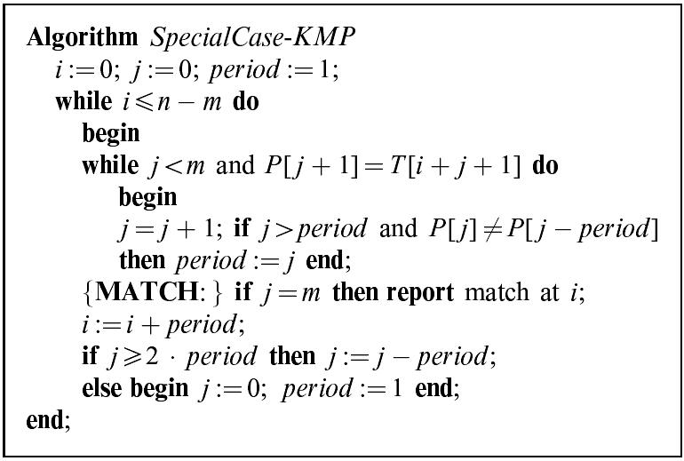
KMP for Self-maximal Patterns (1/2)
Computing periods dynamically
→ shift period (reuse period)
→ Get ready to re-compute period
It runs in O(n) time and O(1) space.
The time complexity of re-computing period is up to O(j)

Slide 15
Our Goal
Now we can implement KMP algorithm on self-maximal patterns in O(n) time and O(1) space
→ How to extend this idea to general patterns?

Slide 16
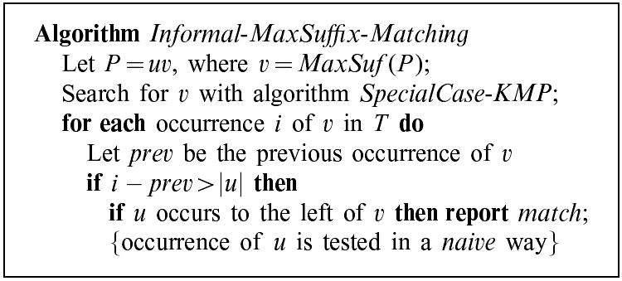
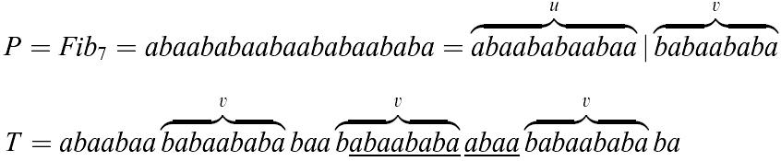
The MaxSuffix Algorithm
Preprocessing
Important!
Check this
Only the third v should be checked.
Because P cannot contain more than one v, otherwise v is not the MaxSuffix of P.
The checks are non-overlap → We obtain an O(n) time and O(1) space KMP algorithm?

Slide 17
Final Question
The preprocessing phase in the MaxSuffix algorithm computes v = MaxSuf(P)
Can this be done in O(|P|) time and O(1) space?
Yes, see next page

Slide 18
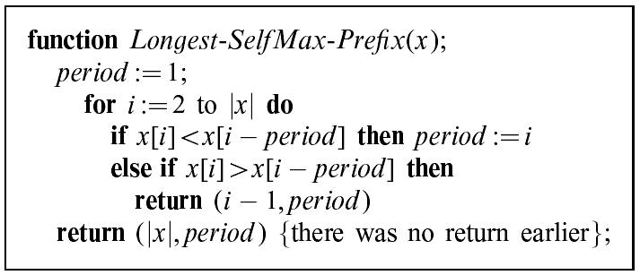
Preprocessing by Using Longest-SelfMax-Prefix
Ex: Let P = baaaabaaabaab, where MaxSuf(P)=baab. One can repeatedly
use the above function and remove the longest-selfmax-prefix.
Remove baaaa
Remove baaa
b a a a a b a a a b a a b
1 2 3 4 5 5 5 5 5 X
b a a a b a a b
1 2 3 4 4 4 4 X
b a a b
1 2 3 3
Success!
→ MaxSuf(P) can be determined in O(|P|) time and O(1) space.

Slide 19
Conclusion
The MaxSuffix algorithm implements the KMP algorithm in O(n) time and O(1) space, with O(|P|) time and O(1) space preprocessing on P.
In fact, the author showed that this preprocessing can further be avoided. An on-line version of constant-space linear time KMP was proposed in this paper.
→ Please read it by yourself.

