Slide 1
Predicting rRNA-, RNA-, and DNA-binding proteins from primary structure with support vector machines
Xiaojing Yu, Jianping Cao, Yudong Cai, Tieliu Shi, Yixue Li
Journal of Theoretical Biology, 2005
Presenter : Hsiao-Yen Chang
Data : Aug, 31, 2006

Slide 2
Abstract
In the post-genome era, the prediction of protein function is one of the most demanding tasks in the study of bioinformatics. Machine learning methods, such as the support vector machines (SVMs), greatly help to improve
the classification of protein function.
In this work, we integrated SVMs, protein sequence amino acid composition, and associated physicochemical properties into the study of nucleic-acid-binding proteins prediction. We developed the binary classifications for rRNA-, RNA-, DNA-binding proteins that play an important role in
the control of many cell processes.

Slide 3
Each SVM predicts whether a protein belongs to rRNA-, RNA-, or DNA-binding protein class. Self-consistency and jackknife tests were performed on the protein data sets in which the sequences identity was <25%. Test results show that the accuracies of rRNA-, RNA-, DNA-binding SVMs
predictions are ~84%, ~78%, ~72%, respectively.
The predictions were also performed on the ambiguous and negative data set. The results demonstrate that the predicted scores of proteins in the ambiguous data set by RNA- and DNA-binding SVM models were distributed around zero, while most proteins in the negative data set were predicted as negative scores by all three SVMs. The score distributions agree well with the prior knowledge of those proteins and show the effectiveness of sequence associated physicochemical properties in the protein function prediction.
The software is available from the author upon request.

Slide 4
Introduction
Nucleic-acid-binding proteins
  DNA-binding proteins play a central role in transcription, packaging, rearrangement, replication and repair (Luscombeand hornton, 2002).
  RNA-binding proteins interact with various RNAs at different stages of protein synthesis to control the process of protein synthesis.

Slide 5
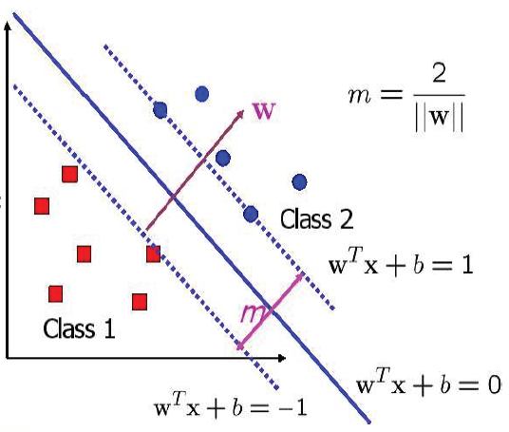
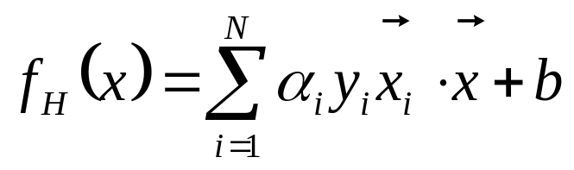
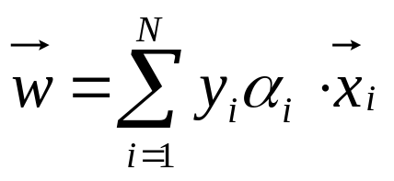
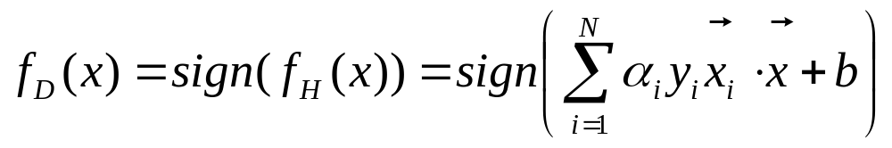
Support vector machines
Optimal separating hyperplane (OSH)
  α_{i} is the Lagrange multipliers
Decision function

Slide 6
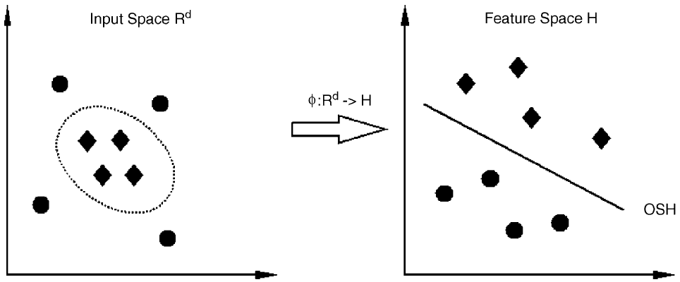
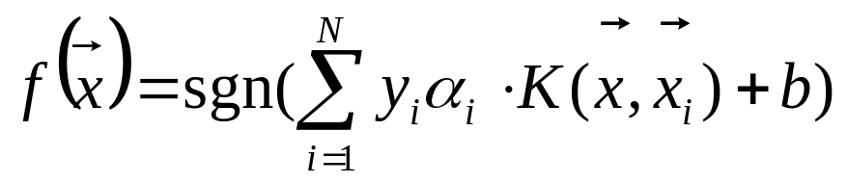
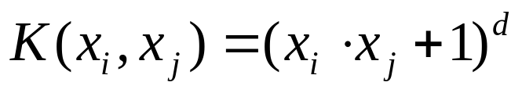
Support vector machines
Soft margin
Kernel function
  polynomial kernel function of degree d which can revert to the linear function when d=1.
  radial basic function (RBF) kernel.
Decision function
  It is well known that the linear kernel function does better in avoiding over-fitting than nonlinear function (Joachims, 1998; Cortes and Vapnik, 1995;Vapnik, 1995).
  http://svmlight.joachims.org/

Slide 7
Feature vector
Hydrophobicity (Chothia and Finkelstein, 1990)
  Arg, Lys, Glu, Asp, Gln, and Asn as polar
  Gly, Ala, Ser, Thr, Pro, His, and Tyr as neutral
  Cys, Val, Leu, Ile, Met, Phe, and Trp as hydrophobic
Secondary structure (Frishman and Argos, 1997)
  helix, strand, and coil
Solvent accessibility (Mucchielli-Giorgi et al., 1999)
  buried or exposed
Normalized Van Der Waal volume, polarity, and polarizability (Dubchak et al., 1999)
Amino acid composition

Slide 8
Feature vector
Three descriptors, composition (C), transition (T), and distribution (D), were used to describe the global composition of each protein properties (Dubchak et al., 1995).
C is the percent of amino acids of certain properties.
T is the frequency of which amino acids of a certain property is followed by amino acids of a different property.
D measures the percent of sequence length within which the first, 25%, 50%, 75% and 100% of the amino acids of a certain property, such as polar, is located, respectively.

Slide 9
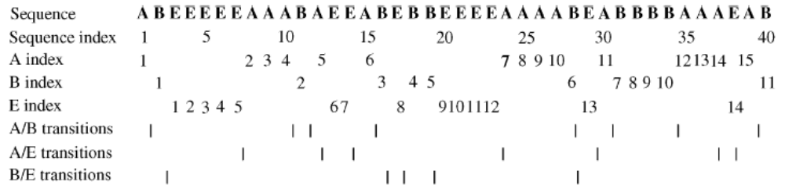
C= {15/40=37.5% , 11/40=27.5 % , 14/40= 35 %}
T= {8/39=20.5% , 7/39=17.9% , 5/39=12.8%}
D= {1/40=2.5% , 10/40=25% , 25/40=62.5% , 30/40=75% , 39/40=97.5%}
{2/40=5% , 16/40=40% , 28/40=70% , 32/40=80% , 40/40=100% }
{3/40=7.5% , 6/40=15% , 14/40=35% , 22/40=55% , 38/40=95% }

Slide 10
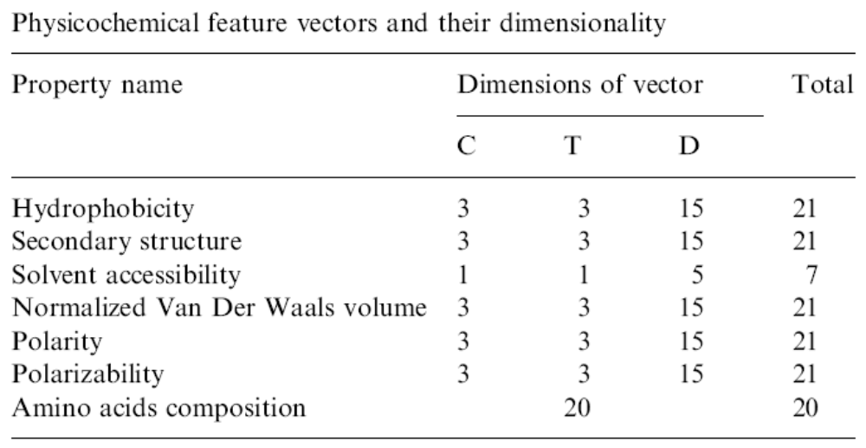
Feature vector
A protein sequence is represented by a 132-dimensional feature vector. (Dubchak et al., 1995)

Slide 11
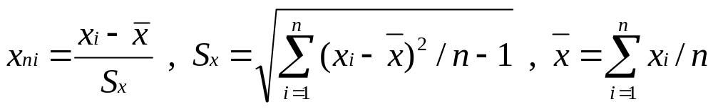
Feature vector
Normalization function
Accuracy measure
  Sensitivity = TP/(TP+FN)
  Specificity = TN/(TN+FP)
  Accuracy = (TP+TN)/(TP+TN+FP+FN)

Slide 12
Data sets
Swiss-Prot database
  Positive
    rRNA-binding : 176
    RNA-binding : 754
    DNA-binding : 2306
  Contrast
    Suspect of implying RNA/DNA-binding functionality.
  Negative : 17779
    Removing the proteins in the ‘‘contrast’’ data set from the Swiss-Prot database.
  Ambiguous : 18061
    Removing the three ‘‘positive’’ data sets from the ‘‘contrast’’ data set.

Slide 13
Data sets
For the calculation of physicochemical properties, protein sequences with length >6000aa or <50aa were moved.
Proteins containing irregular amino acid characters such as ‘‘x’’ and ‘‘z’’ were also removed.
Moreover, redundancy among sequences in ‘‘positive’’ and ‘‘negative’’ data sets was removed by using CD-HIT (Liet al., 2001) and PISCES (Wang and Dunbrack, 2003) program, with a threshold of 25%.
  CD-HIT is a program for clustering large protein database at high sequence identity threshold. (Adam Godzik's lab)
  PISCES is a public server for culling sets of protein sequences from the Protein Data Bank (PDB) by sequence identity and structural quality criteria.

Slide 14
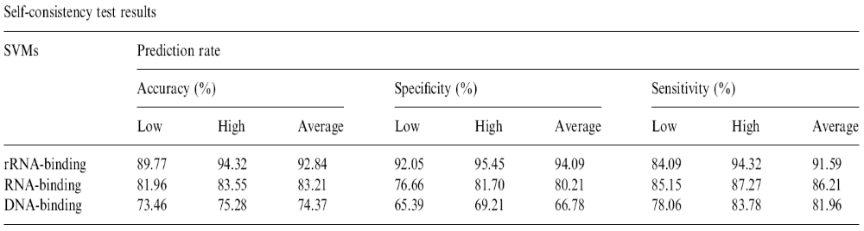
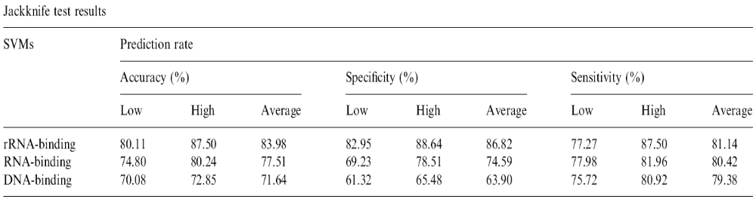
Results

Slide 15
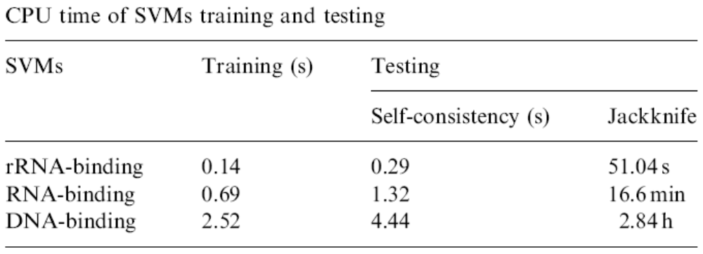
Results
We used Dell OptiPlex GX260 computer with an Intel Pentium4 2.40GHz CPU.
The experiment results indicate that with the increase in the size of training data set, the time cost increased nonlinearly.

Slide 16
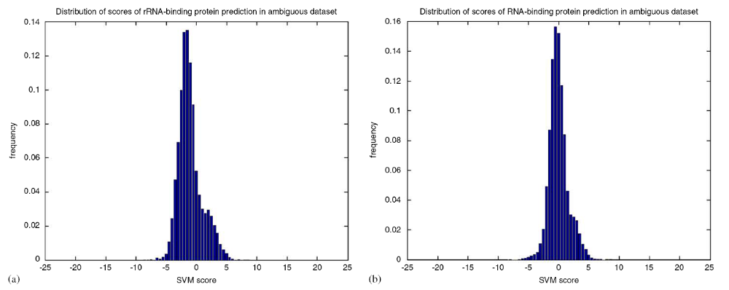
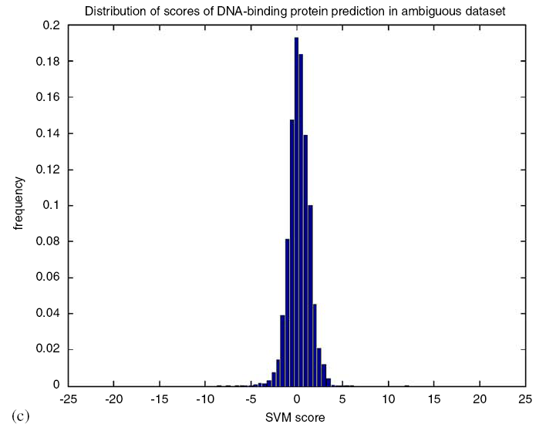
Discussion

Slide 17
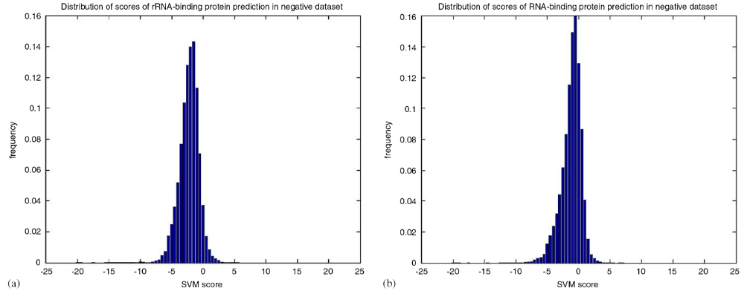
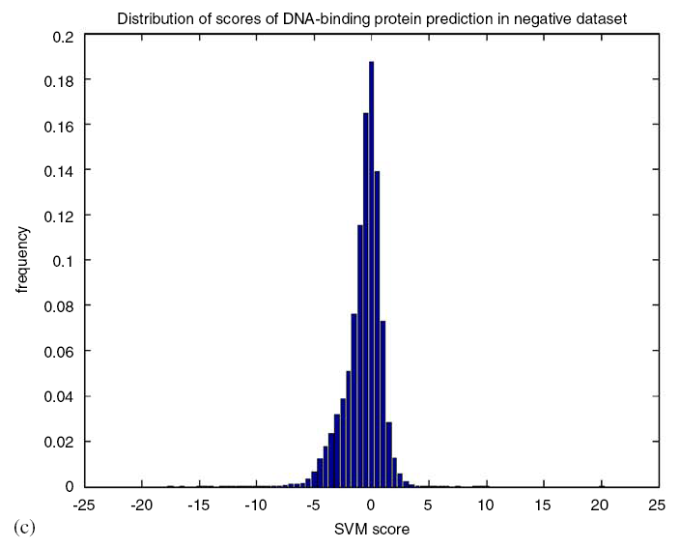
Discussion

Slide 18
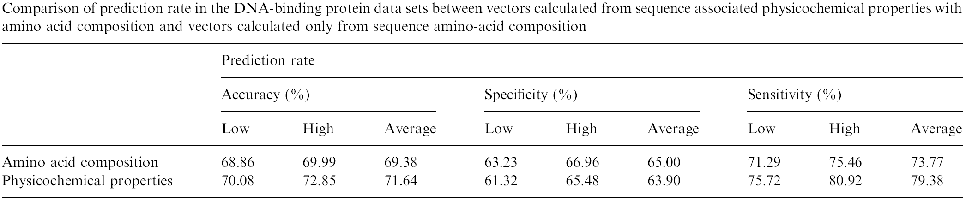
Discussion
Vectors, generated from sequence associated physicochemical properties and amino acid composition in this work, were compared to the ones calculated only from sequence amino acid composition (Hua and Sun, 2001).

