Slide 1
Optimization of Traffic Lights at Crossroads
DING-WEI HUANG and WEI-NENG HUANG
International Journal of Modern Physics C Vol. 14, No. 5 (2003) 539-548
Presenter： Shiuan-Wen Chen
Date： Aug. 31, 2006

Slide 2
Abstract
We study the influence of traffic lights on the traffic flow in cities. The urban traffic is simulated in the cellular automata framework. Both the deterministic and probabilistic models are discussed. The effects of speed limit and stochastic noise are analyzed. The operation of a traffic light is characterized by two parameters: signal period and phase allocation. With two traffic lights on road, one more parameter is prescribed: synchronization shift. The results of tuning these parameters are presented in the fundamental diagram. We examine the traffic flow and discuss the choice of optimized setting in different density regions.

Slide 3
1. Introduction
Traditionally the technique for investigating such problem has been by deterministic optimization process or recently by fuzzy logic control.
But these methods overlook the subtle dependence of real traffic situations such as driver behavior and vehicle interaction, and the subsequent phase transition as the vehicle density varies has never been considered.
To take into account the real traffic subtleties, cellular automata (CA) has been one of the most intuitive and efficient methods.

Slide 4
1. Introduction
The Binham-Middleton-Levine (BML) model for city traffic and Nagel-Schreckenberg (NaSch) model for highway traffic can be combined for a realistic description of urban traffic flow.
BML:用一個N*N的二維方形點陣來表示城市交通網絡，N是方形點陣的邊長，每一格點具有三種情況，每一格點上可以有一輛由南向北的車輛，或者有一輛由西向東的車輛，或者沒有車輛。基數時間點，東西向車子前進一格，偶數時間點，南北向車子前進一格，當前方格點有其他車輛佔據，則此車輛只能在原來的位置上等待。

Slide 5

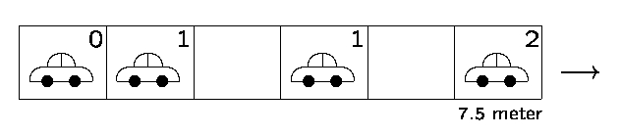
1. Introduction
velocity
NaSch:
Rules:
  Acceleration:v_{j} = min (v_{j} + 1, v_{max})
  Braking: v_{j} = min ( v_{j} , d_{j}-1)
  Randomization: v_{j} = v_{j} – 1 (with probability p)
  Motion:每一部車依據上述三個規則所產生的新速度前進，使得新的距離為x_{j} = x_{j} + v_{j}

Slide 6
2. A Single Traffic Light
The general behavior of vehicles is prescribed by the well known cellular automata traffic model, the NaSch model. There are only two parameters in the model: the speed limit v_{max} and the stochastic braking probability p.
In the special case of v_{max} = 1 and p = 0, the model reduces to the asymmetric simple exclusion processes (ASEP)
q
q

Slide 7
2. A Single Traffic Light
To simulate the urban traffic, the lattice site L reflects the distance between two traffic lights in the down town area.
Typically a lattice of L = 100 corresponds to a distance of 750 m.
The operation of the traffic light is characterized by two parameters: the signal period T and the ratio allocated to green phase α.

Slide 8
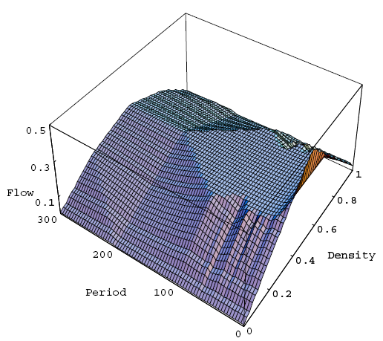
2. A Single Traffic Light
We note that the reflect symme-
try along the line ρ = 0.5 is an
artifact of vmax = 1.
We also notice that the traffic
flow increases with the decrease
of signal period when T is very small.

Slide 9
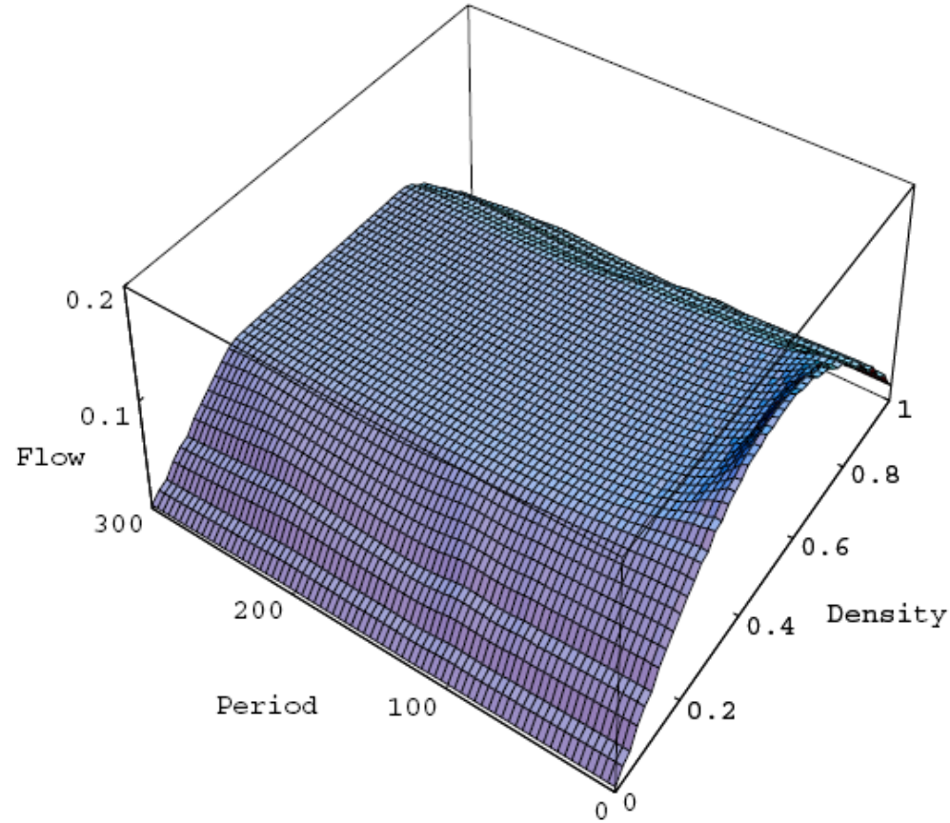
2. A Single Traffic Light
The traffic flow are mainly determined
by the vehicular density and becomes
Insensitive to the signal period especially
when the period is large.
It is interesting to note that the
introduction of stochastic noise leads
to significant reduction of the traffic
flow,especially in the intermediate
density region.

Slide 10
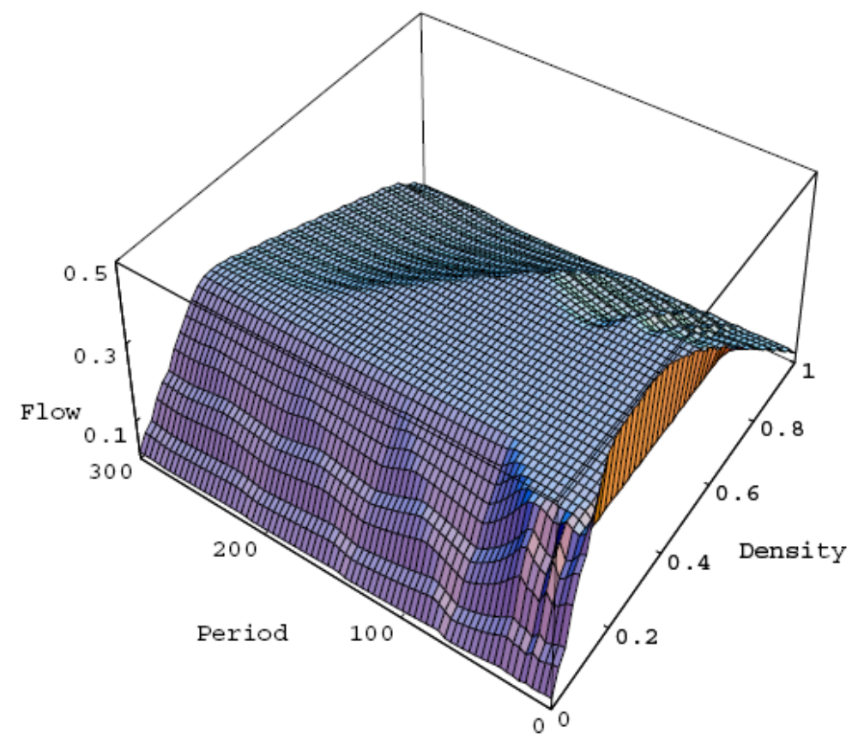
2. A Single Traffic Light
Increasing the speed limit would
surely increase the traffic flow.
The capacity, i.e., the height of
the plateau, is expected to rise and
shift toward the low density region.
The boundary between the plateau
and the oscillations appears to be a
Straight line along a denite vehicular
density.

Slide 11
2. A Single Traffic Light
The flow enhances with the increase of ratio α.
The domain of the low-density oscillations is unaffected by varying the ratio α, and the boundary between the plateau and the high-density oscillations moves almost linearly with the parameter .
With the scaled axes (ρα)and (T/L), the domain boundaries are characterized only by v_{max} and p, i.e., the two parameters modeling the vehicular behavior.

Slide 12
3. Control Strategy
As the results are mainly determined by the vehicular behavior, the setting of the model parameters is important.
When the NaSch model is applied to the highway traffic, the vehicular behavior can be well described by the setting: v_{max} = 5 and p = 0.5 .
In contrast, the urban traffic should be characterized by a much lower speed limit. A reasonable setting for the urban traffic would be v_{max} = 3 and p = 0.1, see Fig. 3.

Slide 13
3. Control Strategy
When the vehicular density is around the intermediate density region, the highest flow can be easily maintained.
Outside the plateau region, either in the low density region or in the high density region, the observed oscillations imply that the traffic flow is very sensitive to the signal period.
If the location of the last peak was selected as the optimal signal period, the traffic flow will be less sensitive to the deviation of setting.

Slide 14
3. Control Strategy
From Fig. 3, a setting around T~35 s is appropriate in the low density region; in the high density region, the appropriate setting becomes T~120 s.
When the traffic light operates in these optimal signal periods, the traffic flow can be restored to or even surpass the capacity without traffic light at the corresponding density.
In summary, the traffic light should operate at only two different signal periods according to the vehicular density: one for the low density region, the other for the high density region.

Slide 15
4. Two Traffic Lights
On a ring of L sites, two traffic lights were set up with a separation of L/2.
With another traffic light on road, one more control parameter is prescribed: the synchronized shift or delay δ, which is understood as the time delay between these two traffic lights regarding the starting of green phase.
The two traffic lights are assumed to operate with the same period T and the same ratio α. With such system configuration, a naive symmetry between δ and -δ is expected.

Slide 16
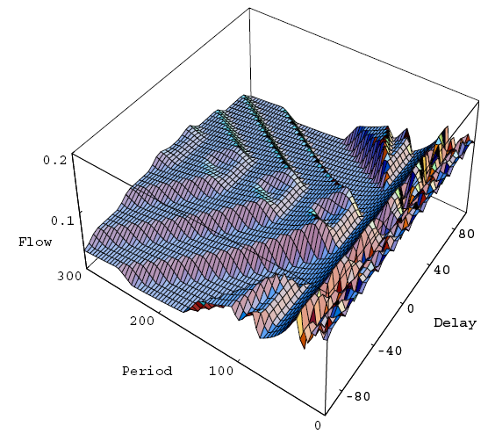
4. Two Traffic Lights
With a short delay, the traffic flow can
be maintained at the same value as in
the case of a single traffic light, i.e.,
the second traffic light will not further
obstruct the traffic.
The highest flow can be achieved with
a short signal period and a short delay.

Slide 17
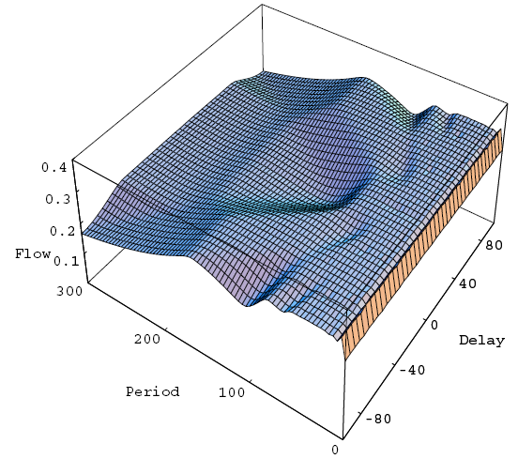
4. Two Traffic Lights
When the delay is set to zero, the
traffic condition is the worst.
However, with an appropriate delay, the
traffic flow can be brought to its
maximum with the very same setting
of the signal period.
It is interesting to note that in contrast
to the low density region, the setting of
the delay becomes irrelevant as the signal
period becomes very large.

