Slide 1
Algorithm for Rapid Reconstruction of Protein Backbone from Alpha Carbon Coordinates
Journal of Computational Chemistry, Vol. 18, No. 1, 80-85 (1997)
MARIUSZ MILIK, ANDRZEJ KOLINSKI, and JEFFREY SKOLNICK
Presenter: Jen-Hui, Wang
Date: September 7, 2006

Slide 2
Abstract
A method for generating a full backbone protein structure from the coordinates of α-carbons, is presented. The method extracts information from known protein structures to generate statistical positions for the reconstructed atoms. Tests on a set of proteins structures show the algorithm to be of comparable accuracy to existing procedures. However, the basic advantage of the presented method is its simplicity and speed. In a test run, the present program is shown to be much faster than existing database searching algorithms, and reconstructs about 8000 residues per second. Thus, it may be included as an independent procedure in protein folding algorithms to rapidly generate approximate coordinates of backbone atoms.

Slide 3

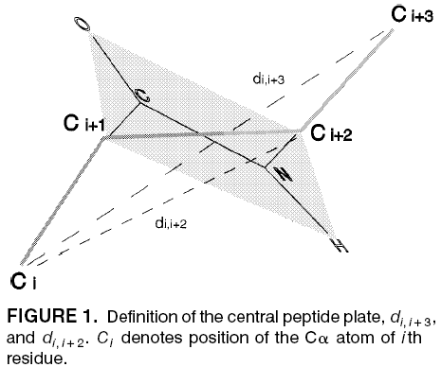
Method
The local conformation of the peptide backbone fragment is represented by:
d_{i-1,i+1 ,} d_{i,i+2 ,} d_{i-1,i+2}
d_{i,i+3} = χ|v_{i-1} + v_{i} + v_{i+1}|
  χ = sign[(v_{i-1} × v_{i})∙v_{i+1}]

Slide 4
chirality
Cα_{i+2}
Cα_{i}
Cα_{i+1}
Cα_{i-1}
Cα_{i}
Cα_{i+1}
Cα_{i-1}
Cα_{i+2}

Slide 5

Alanine

Slide 6
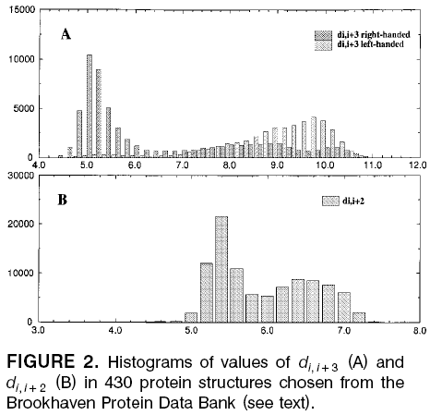
Method
Most of the values for d_{i,i+2} lie between 4.6 and 7.6 Å, and the d_{i,i+3} values lie between 4.2 and 11.0 Å.
use a 0.3-Å grid in the local conformation class.
have 4800 possible local conformations for four residue peptide fragments in the presented representation.
calculated the average positions of C, O, N, and C_{β} atoms in a local coordinate system

Slide 7
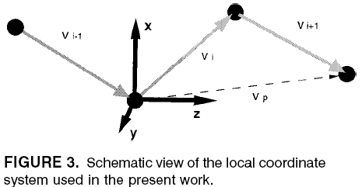

Method
A table containing average positions of C, N, O, and Cβ atoms for all types of local peptide structures was stored and used as a starting point in the process of backbone reconstruction.
The case of cis-proline was treated separately, as it is an amino acid with unusual internal geometry.

Slide 8
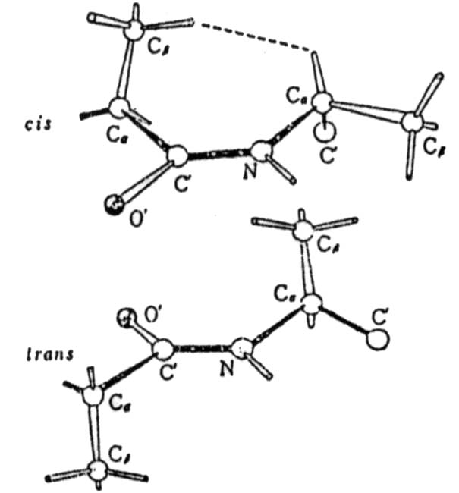
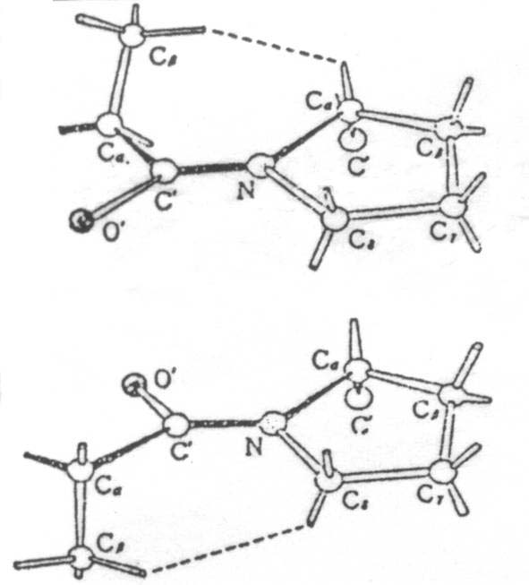
Peptide兩側之Cα若是cis form，兩個R-group會互斥，故都呈trans form。但
對X-Pro而言，cis、trans皆有互斥作用，故 trans:cis = 4:1
Ala-Ala
X-Pro

Slide 9
Method
For all backbone atom reconstruction for a given residue i, proceeds as follows:
  1. Calculate the values of internal distances, d_{i-1,i+1} , d_{i,i+2} , and
  d_{i-1,i+2} , and chirality.
  2. Find the class of local conformation, according to the values of internal distances and chirality, using the grid definition.
  3.Find in the database the average Cα→C, Cα →N, C →O, and Cα → Cβ vector, in the local system. When the local conformation class is not in database, takes the values for the closest represented local conformation class. For cis-prolines, these vectors are taken from a separate database. The Cα → Cβ vector is not calculated for glycines.

Slide 10
Method
  4. Build the local coordination system.
  5.Rotate the vectors from the local to the laboratory coordinate system and calculate the actual values of atomic coordinates.
The problem of calculating the backbone atomic coordinates for the first and two last residues of the chain was approximately solved by using virtual residues on both ends of the chain. The coordinates of the ”dummy” residues were calculated by repetition of the first and last two vectors.

Slide 11
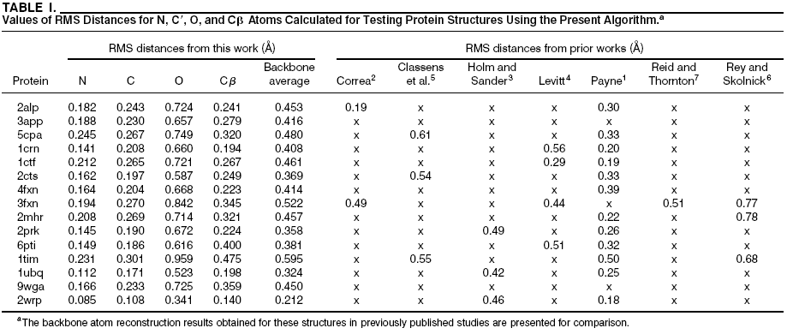
Results and Discussion

Slide 12
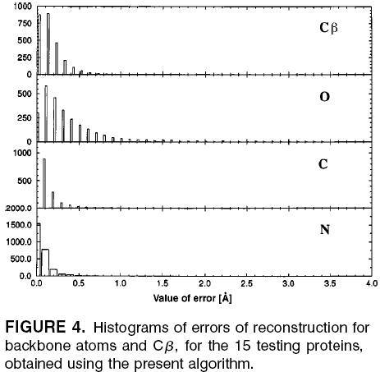
Results and Discussion
Most reconstruction errors for the N and C atoms are less than 0.5 Å, and there is no example where the error is larger than 1.0 Å
The distribution of errors is broader for oxygen atom reconstruction and, in a few cases, errors are larger than 2.0 Å, with a maximal reconstruction error of about 3.5 Å.
The large values of reconstruction errors occur mostly in the loop or turn fragments and on the surface of proteins.

Slide 13
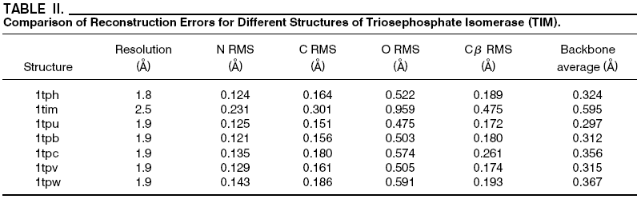
Results and Discussion
The quality of the crystallographic structure affects the error of reconstruction.

Slide 14
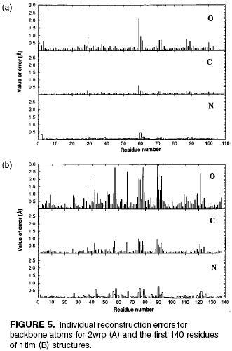
Results and Discussion
Even in the worst case, the reconstruction of the nitrogen and carbon atoms is satisfactory, most of the errors are smaller than 0.5Å.
However, the errors of reconstruction of carbonyl oxygens are much larger, most of the large errors happened in residues situated on the surface of the structure.

