Slide 1
A Unifying Generalization of Sperner’s Theorem
M. Beck, X. Wang, and T. Zaslavsky
Submitted, 2001
Reporter: Chiou-Ting Tseng
Date: Feb. 13, 2007

Slide 2
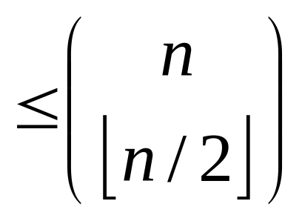
Sperner’s Theorem
Suppose A₁, A₂, ..., A_{m} ⊆ S such that A_{k} ⊄ A_{j}
for k ≠ j. Then m . Furthermore,
this bound can be attained for any n.

Slide 3
Example 1
S={a, c, f, h, k}, n=5
A₁={a, c, f}, A₂={a, h}, A₃={c, f, k}, A₄={a, k}
A₁={a, c}, A₂={a, f}, A₃={a, h}, A₄={a, k}, A₅={c, f}, A₆={c, h}, A₇={c, k}, A₈={f, h}, A₉={f, k}, A₁₀={h, k}
m=10
Suppose the n input elements are {1, 2, ..., n} in the following PowerPoint's.

Slide 4
Antichain
Subsets of power set of S in which any two elements are incomparable (no inclusion).
S={1, 2, 3, 4, 5}, {{1, 3, 4}, {3, 5}, {1, 2, 4, 5}} is an antichain

Slide 5
Lattice
Lattice is the graph to represent the relation between the subsets of a given set.
For a n element set, its lattice has 2^{n} nodes.
The nodes in the lattice represents the selected subset.
The edges (a, b) in the lattice means a be transit to b by selecting one more element.

Slide 6

Theorem 1.2
r-chain free
Note that for r=1, we obtain Sperner’s Theorem

Slide 7
Example 2
S={1, 2, 3, 4, 5, 6}
A={{1, 2}, {1, 2, 4},{2, 4}, {2, 4, 6}, {2, 3, 5 6}}, then r = 2.
C(6, 3), C(6, 2), C(6, 4), ...

Slide 8
Weak Composition
We define a weak composition of S into p parts as an ordered p-tuple (A₁, . . . ,A_{p}) of sets A_{k}, possibly void, such that A₁, . . . ,A_{p} are pairwise disjoint and A₁∪...∪A_{p} = S.
S={1, 2, 3, 4, 5, 6}, {{1, 4, 5},{6},{2, 3}} and {{1, 2, 3, 4}, {}, {5, 6}} are p = 3

Slide 9


Theorem 1.3

Slide 10
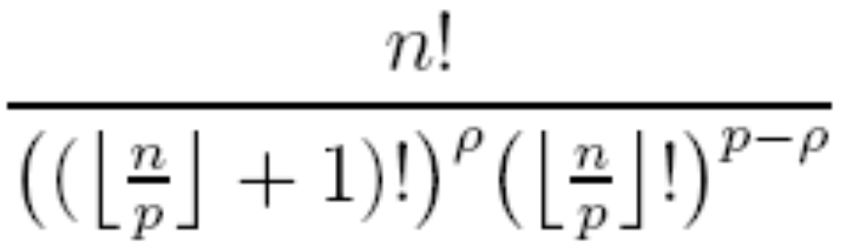
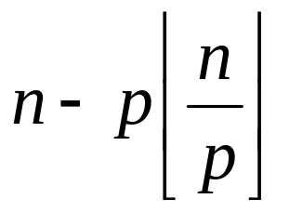
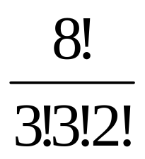
Largest Multinomial Coefficient
The largest p-multinomial coefficient can be written explicitly as
where ρ=
n=8, p=3, it is

Slide 11
Example
S={1, 2, 3, 4, 5, 6}
A₁={{1, 4, 5}, {2, 6}, {3}}
A₂={{2, 5}, {1, 3}, {4, 6}}
A₃={{3}, {1, 4, 5} {2, 6}}
are three A’s satisfying the condition.

Slide 12
Relation with Sperner’s Theorem
If A₁, A₂, ..., A_{m} ⊆ S form an antichain, then S-A₁, S-A₂, ..., S-A_{m} also forms an antichain. Hence the m weak compositions (A_{j} , S−A_{j}) of S into two parts satisfy Meshalkin’s conditions and Sperner’s inequality follows.

Slide 13
Theorem 1.4’
The original paper have another condition that A_{j0} ⊂ A_{j1}
⊂... ⊂ A_{jq}.

Slide 14
Example 4
n=7, q=3, ⎣(n-q)/2⎦=2
{4, 5}, {1, 4, 5}, {1, 2, 4, 5}, {1, 2, 3, 4, 5}
{4, 6}, {1, 4, 6}, {1, 2, 4, 6}, {1, 2, 3, 4, 6}
{4, 7}, {1, 4, 7}, {1, 2, 4, 7}, {1, 2, 3, 4, 7}
{5, 6}, {1, 5, 6}, {1, 2, 5, 6}, {1, 2, 3, 5, 6}
{5, 7}, {1, 5, 7}, {1, 2, 5, 7}, {1, 2, 3, 5, 7}
{6, 7}, {1, 6, 7}, {1, 2, 6, 7}, {1, 2, 3, 6, 7}

Slide 15
Theorem 1.4
Let n > 0. Suppose (A_{j} ,B_{j}) are m pairs of sets such that A_{j} ∩ B_{j} = ∅ for all j, A_{j} ∩ B_{k} ≠∅ for all j≠k, and all |A_{j} | + |B_{j} | ≤ n. Then m ≤ C(n, ⌊n/2⌋) and this bound can be attained for every n.
If in Theorem 1.4’, we let A_{j}=A_{j0}, B_{j}=S-A_{jq}, n replaces n-q (discard the first q elements), it becomes Theorem 1.4.

Slide 16
Example 5
{4, 5}, {6, 7}
{4, 6}, {5, 7}
{4, 7}, {5, 6}
{5, 6}, {4, 7}
{5, 7}, {4, 6}
{6, 7}, {4, 5}

Slide 17
Relation with Sperner’s Theorem
Sperner’s inequality follows as the special case in which A₁, . . . ,A_{m} ⊆ S form an antichain and B_{j} = S − A_{j}.
S={1, 2, 3, 4, 5}
A₁={1, 2}, B₁={3, 4, 5}
A₂={2, 4}, B₂={1, 3, 5}
A₃={3, 5}, B₃={1, 2, 4}
A₄={4, 5}, B₄={1, 2, 3}

Slide 18
Weak Partial Composition
We define a weak partial composition of S into p parts as an ordered p-tuple (A₁, . . . ,A_{p}) such that A₁, . . . ,A_{p} are pairwise disjoint sets, possibly void, and A₁∪...∪A_{p} ⊆ S.
If we do not specify the superset S then we simply talk about a weak set composition into p parts (this could be a weak composition of any set).

Slide 19
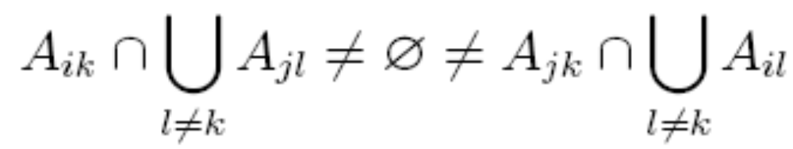
Theorem 1.5 (Main Theorem)
Fix integers p ≥ 2 and r ≥ 1. Suppose (A_{j1}, . . . , A_{jp}) for j = 1, . . . , m are different weak set compositions into p parts with the condition that, for all k ∈ [p] and all I ⊆ [m] with |I| = r + 1, there exist distinct i, j ∈ I such that either A_{ik} = A_{jk} or
and let n := max_{1≤j≤m} (|A_{j1}|+ ... + |A_{jp}|). Then m is bounded by the sum of the r^{p} largest p-multinomial coefficients for integers less than or equal to n.

Slide 20
Example
S = {1, 2, 3, 4, 5, 6, 7}, p = 3
A₁ = {{1, 2}, {3, 5}, {4, 6, 7}}
A₂ = {{1, 2}, {3, 7}, {4, 5, 6}}
A₃ = {{1, 3, 5}, {2, 4, 6, 7}, {}}
A₄ = {{3, 6}, {2, 4, 7}, {1, 5}}
I = {1, 2, 4}, r = 2

Slide 21
r-chain Free Alike
k
i
a
b
j
b
a
So A_{ik} ⊄ A_{jk}, A_{jk} ⊄ A_{ik}

Slide 22
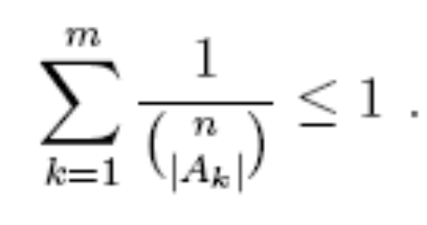
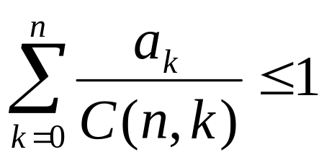
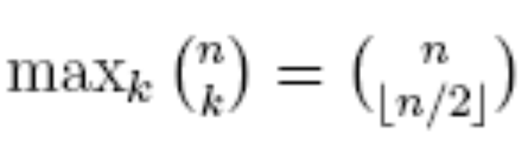
LYM Inequality
Suppose A₁, . . . ,A_{m} ⊆ S such that A_{k} ⊄ Aj for k ≠ j. Then
Sperner’s inequality follows immediately by noting that

Slide 23

Proof

Slide 24
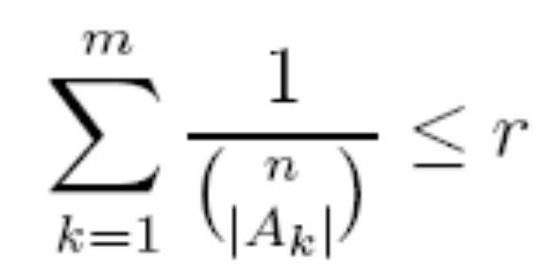
Theorem 2.2
Suppose {A₁, . . . ,A_{m}} ⊆ P(S) contains no chains with r+1 elements. Then
Theorem 1.2 is not straightforward.

Slide 25
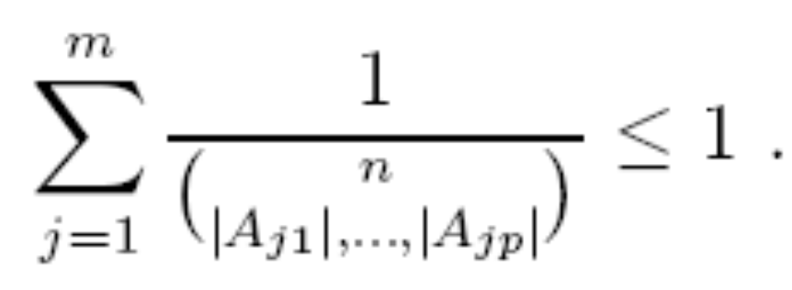
Theorem 2.3
Suppose (A_{j1}, . . . ,A_{jp}) for j = 1, . . . ,m are different weak compositions of S into p parts such that for each k ∈ [p] the set {A_{jk} : 1 ≤ j ≤ m} (ignoring repetitions) forms an antichain. Then
Theorem 1.3 follows immediately.

Slide 26
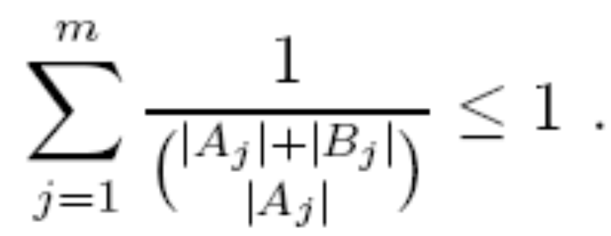
Theorem 2.4
Suppose (A_{j} ,B_{j}) are m pairs of sets such that A_{j} ∩ B_{j} = ∅ for all j and A_{j} ∩ B_{k} ≠ ∅ for all j ≠ k. Then
Theorem 1.4 is an immediate consequence.

Slide 27
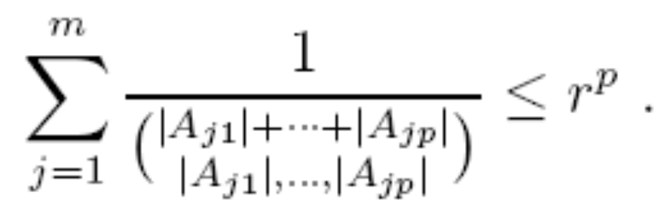
Theorem 2.5
Let p ≥ 2 and r ≥ 1. Suppose (A_{j1}, . . . ,A_{jp}) for j = 1, . . . ,m are different weak compositions (of any sets) into p parts satisfying the same condition as in Theorem 1.5. Then

Slide 28
Example 2.1
The complicated hypothesis of Theorem 2.5 cannot be replaced by the assumption that each A_{k} is r-chain-free, because then there is no LYM bound independent of n.

Slide 29
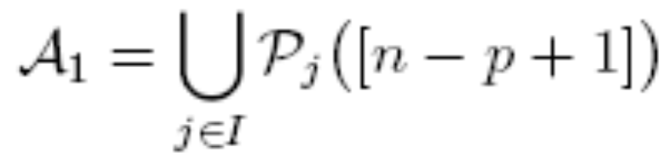
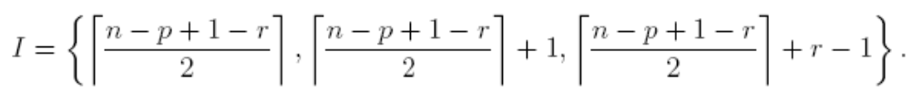
Assumption
Let n ≫ p ≥ 2, S = [n], and Ǻ = {(A, {n}, {n − 1}, . . . , {n − p + 2}) : A ∈ Ǻ₁} where Ǻ₁ is a largest r-chain-free family in [n − p + 1], specifically,
where

Slide 30
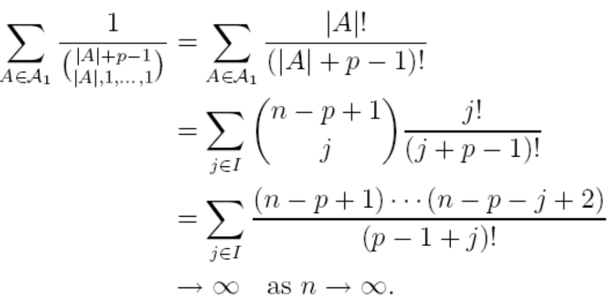
Proof
|A|=j
There is no possible upper bound in terms of n.

Slide 31

Relation
Let us say a maximal chain separates the weak composition (A₁, . . . ,A_{p}) if there exist elements ∅ = X₀ ⊆ X_{l1} ⊆ ・ ・ ・ ⊆ X_{lp} = S of the maximal chain such that A_{k} ⊆ X_{lk} − X_{lk−1} for each k.
There are
maximal chains separating (A₁, . . . ,A_{p}).

Slide 32
Example
S={1, 2, 3,,4, 5, 6}
A={{1, 4}, {2}, {3, 6}}
X₀= ∅
X₁={4}
X₂={1, 4}, l₁
X₃={1, 2, 4}, l₂
X₄={1, 2, 3, 4}
X₅={1, 2, 3, 4, 5}
X₆={1, 2, 3, 4, 5, 6} = S, l₃

Slide 33
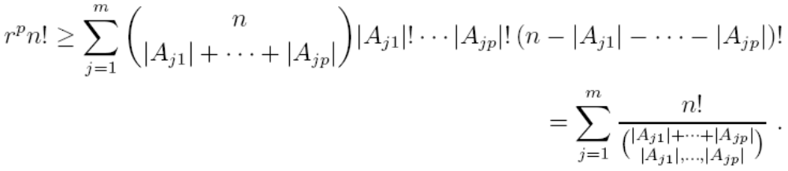
Proof of Theorem 2.5
We claim that every maximal chain separates at most r^{p} weak partial compositions of |S|.
By proving that there are at most r different kinds of symbol in every position.

Slide 34
Lemma 3.1
Suppose M₁, . . . , M_{N} ∈ R satisfy M₁ ≥ M₂ ≥ ... ≥ M_{N} ≥ 0, and let R be an integer with 1 ≤ R ≤ N. If q₁, . . . , q_{N} ∈ [0, 1] have sum
q₁ + ... + q_{N} ≤ R ,
then
q₁M₁ + ... + q_{N}M_{N} ≤ M₁ + ... +M_{R} .

Slide 35
Example
M= 8, 7, 7, 5, 4, 2, 0.5
q=0.5, 0.7, 0.3, 0.1, 0.5, 0.4, 0.3, Σq=2.8
R can be 3~7
ΣqM=4 + 4.9 + 2.1 + 0.5 + 2 + 0.8 + 0.15 =14.45
8 + 7 + 7 = 22

Slide 36
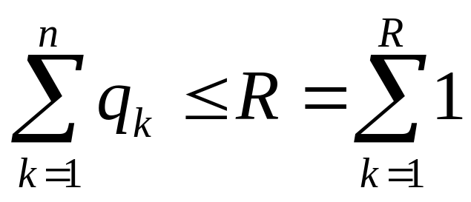
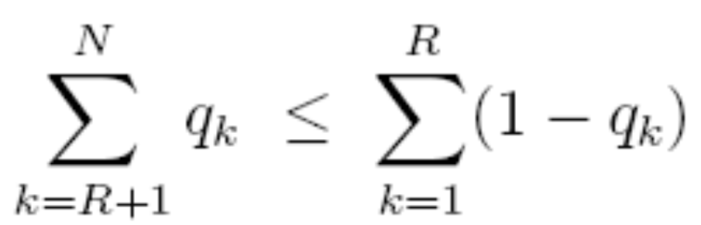
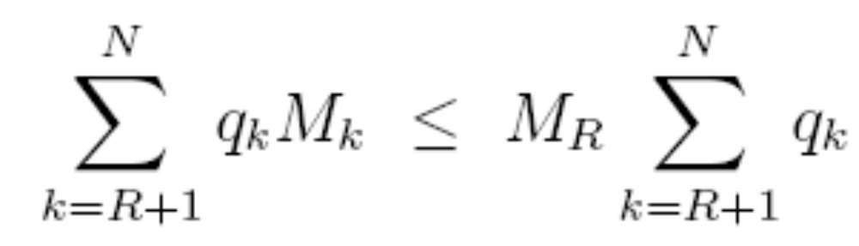
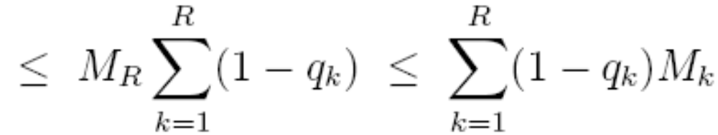
Proof

Slide 37


Proof of Theorem 1.5
q_{k}’ := |C(a₁, . . . , a_{p})| /M_{k}’
N replaced by the number of p-tuples (a₁, . . . , a_{p}) whose sum is at most n, that is C(n+p, p).
R replaced by min(N, r^{p}).

Slide 38

Theorem 1.2/2.2, 1.3/2.3
Suppose (A_{j1}, . . . ,A_{jp}) are m different weak compositions of S into p parts such that for each k ∈ [p − 1], the set {A_{jk} : 1 ≤ j ≤ m} is r-chain-free. Then
Consequently, m is bounded by the sum of the r^{p−1} largest p-multinomial coefficients for n.

Slide 39
Example
S={1, 2, 3, 4, 5, 6, 7}, p=3, r=2
A₁={{2, 3}, {4, 5, 6, 7}, {1}}
A₂={{3, 4}, {5, 6, 7}, {1, 2}}
A₃={{6}, {3, 5, 7}, {1, 2, 4}}
A₄={{5, 6}, {2, 7}, {1, 3, 4}}

Slide 40
Corollary 4.2
Fix p ≥ 2 and r ≥ 1. Suppose (A_{j1}, . . . ,A_{jp}) are m different weak partial compositions of an n-set S into p parts such that for each k ∈ [p], the set {A_{jk} : 1 ≤ j ≤ m} is r-chain-free. Then m is bounded by the sum of the r^{p} largest (p+1)-multinomial coefficients for n.
No LYM inequality is possible.

Slide 41
Example
S={1, 2, 3, 4, 5, 6, 7}, p=2, r=2
A₁={{2, 3}, {4, 5, 6, 7}},{1}
A₂={{3, 4}, {5, 6, 7},}, {1, 2}
A₃={{6}, {3, 5, 7}} , {1, 2, 4}
A₄={{5, 6}, {2, 7}} , {1, 3, 4}

Slide 42

Theorem 1.2/2.2, 1.4/2.4
Let r be a positive integer. Suppose (A_{j} ,B_{j}) are m pairs of sets such that A_{j} ∩ B_{j} = ∅ and, for all I ⊆ [m] with |I| = r + 1, there exist distinct i, j ∈ I for which A_{j} ∩ B_{k} ≠ ∅ ≠ A_{k} ∩ B_{j}. Let n = max_{j} (|A_{j} | + |B_{j} |). Then
Consequently, m is bounded by the sum of the r largest binomial coefficients C(n’, k) for 0 ≤ k ≤ n’ ≤ n. This bound can be attained for all n and r.

Slide 43
Example
If A_{k} forms an antichian, B_{k}=S-A_{k}, then it would satisfy the condition.
S={1, 2, 3, 4, 5}
{{1, 3, 4}, {2, 5}}
{{3, 5}{1, 2, 4}}
{{1, 2, 4, 5},{3}}
r=1 for 1.4/2.4

Slide 44
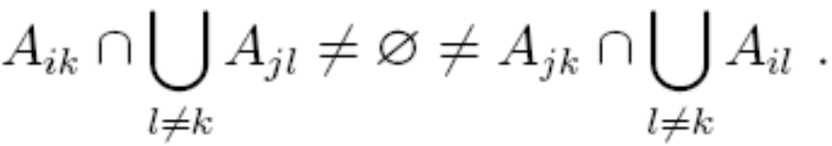

Theorem 1.3/2.3, 1.4/2.4
Suppose (A_{j1}, . . . ,A_{jp}) are m different weak set compositions into p parts with the condition that, for all k ∈ [p] and all distinct i, j ∈ [m], either A_{ik} = A_{jk} or
and let n ≥ max_{j} (|A_{j1}| + ... + |A_{jp}|.) Then
Consequently, m is bounded by the largest p-multinomial coefficient for n. The bound can be attained for every n and p.

Slide 45
Attainability
Although the bounds in all the previously known Sperner generalizations of Section 1 can be attained, for the most part that seems not to be the case in Theorem 1.5.
The key difficulty appears in the combination of r-families with compositions.

Slide 46
Proposition 5.6
The bound in Corollary 4.1 cannot be attained if 2 ≤ r ≤ 5 and p ≥ 3 and n ≥ r − 1, except possibly when r = 2, p|n, and p = 3, 4, 5, or when r = 4, p ≥ 4, and n = 2p − 1, or when r = 5, p = 3, and n = 10.

