Slide 1
Longest common subsequence between run-length-encoded strings: a new algorithm with improved parallelism
Valerio Freschi, Alessandro Bogliolo
Information Processing Letter 90 (2004) 167-173
Date: Mar. 7, 2007
Introducer: Chia-Hung Chang

Slide 2
Abstract
Data compression can be used to simultaneously reduce memory, communication and computation requirements of string comparison. In this paper we address the problem of computing the length of the longest common subsequence (LCS) between run-length-encoded (RLE) strings. We exploit RLE both to reduce the complexity of LCS computation from O(M × N) to O(mN + Mn − mn), where M and N are the lengths of the original strings and m and n the number of runs in their RLE representation, and to improve the inherent parallelism of the proposed algorithm, so that it may execute in O(m + n) steps on a systolic array of M + N units.
We also discuss the application of the proposed algorithm to the related problem of edit distance (ED) computation.

Slide 3

Introduction

Slide 4
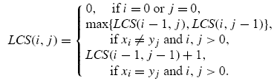
Background

Slide 5
Background (cont’d)
String “accccttggg” = 1a,4c,2t,3g
Input elements
Root elements
Output elements
Inner elements

Slide 6
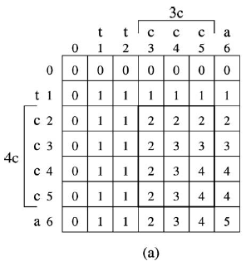

Slide 7
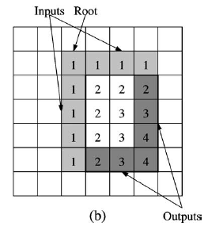

Slide 8
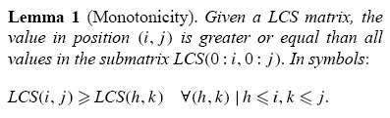
The proposed approach

Slide 9
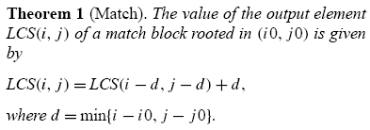

Slide 10
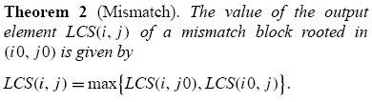

Slide 11


Slide 12
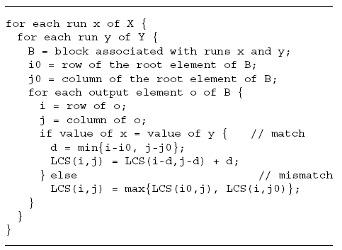

Slide 13
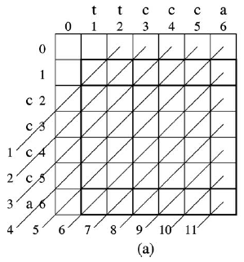

Slide 14
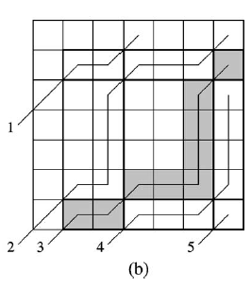

Slide 15
Conclusion
Time complexity :
  O(mN + Mn − mn)
It can be executed in O(m+n) steps by a systolic array of M + N units

