Slide 1
Parameterized Matching with Mismatches
Apostolico, Erdos and Lewenstein
Journal of Discrete Algorithms,
Vol. 5, Issue 1, pp. 135-140, 2007
Date: November 7, 2026
Introducer: Hsing-Yen Ann

Slide 2
Abstract
The problem of approximate parameterized string searching consists of finding, for a given text x = x₁x₂ ... x_{n} and pattern y = y₁ y₂ ... y_{m} over respective alphabets Σ_{t} and Σ_{p} the injection π from Σ_{p} to Σ_{t} maximizing the number of matches between π(y) and x_{i} x_{i+1} ... x_{i+m-1} (i = 1, 2, ..., n-m+1). We examine the special case where both strings are run-length encoded, and further restrict to the case where one of the alphabets is binary. For this case, we give a construction working in time O(n + (r_{p} × r_{t})α(r_{t}) log(r_{t})), where r_{p} and r_{t} denote the number of runs in the corresponding encodings for y and x, respectively, and α is the inverse of the Ackermann’s function.

Slide 3




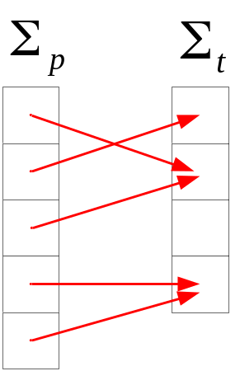
Approximate Parameterized Searching (APS) Problem (1/2)
Input two run-length encoded strings
T: length n, r_{t} runs
P: length m, r_{p} runs
For each T_{i}, find an injection from to , such that the Hamming distance is minimized.

Slide 4

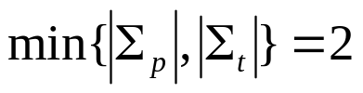
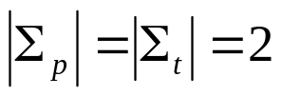

Approximate Parameterized Searching (APS) Problem (2/2)
The general problem of APS can be solved in
by reduction to bipartite graph matching.
In this paper, the restriction is .
Consider the case first, it can be solved in O(n log n) by the convolution method and the authors' goal is to solve it in time .

Slide 5
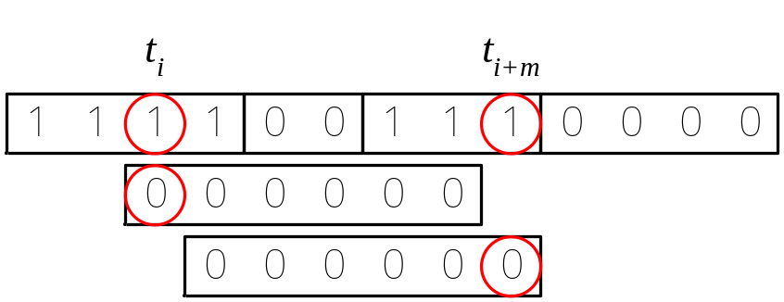
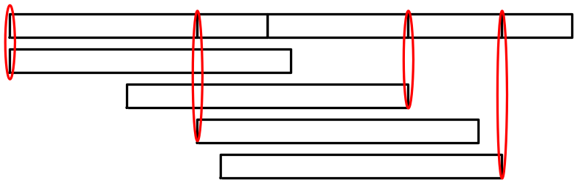
Considering a Single-Run Pattern
Let c(i) denotes the number of matches between T_{i..i+m} and P, there are only 3 cases:
t_{i}=t_{i+m}: c(i+1)=c(i)
t_{i}≠t_{i+m} and t_{i}=p₁: c(i+1)=c(i)-1
t_{i}≠t_{i+m} and t_{i} ≠p₁: c(i+1)=c(i)+1
The slope is never changed before a bump happens.

Slide 6


Considering a Multiple-Run Pattern (1/2)
For each location i in T, the runs of P can be divided into 3 sets while a unit shift happens:
S_{i}: the number of matches will stay
DU_{i}: a unit decrement occurs
IU_{i}: a unit increment occurs
Let i+k+1 be the location that the next bump occurs,
then and .

Slide 7



Considering a Multiple-Run Pattern (2/2)
There are at most bumps needed to be managed and the time complexity is by using O(n) auxiliary space.
By applying integer finger merging techniques, there is an algorithm that uses O(m) auxiliary space.

Slide 8

When Only One of the Alphabets is Binary (1/2)
Each bump involving the character is called an σ-bump.
The hits at every σ-bump can be computed consecutively in O(1) time.
There is an algorithm to compute the hits at every σ-bump for every character .
This can be converted into a geometric problem:
given line segments and wish to find their upper envelope.

Slide 9



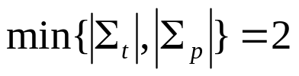
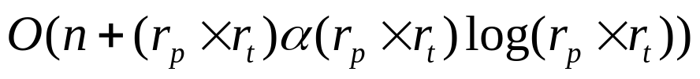
When Only One of the Alphabets is Binary (2/2)
The is upper envelope for k segments can be solved in time and storage [4].
Conclusion:
There is an algorithm for computing parameterized matching when
.
!?

