Slide 1
A GRASP Algorithm to Solve the Unicost Set Covering Problem
Joaquín Bautista, Jordi Pereira
Computers & Operations Research 34 (2007) 3162 – 3173
Presenter: Chiao-Wei Chiu (邱喬偉)
Date: Apr. 19, 2007

Slide 2
Abstract
The set covering problem (SCP) is a well-known combinatorial optimization problem.
This paper presents a GRASP algorithm to solve a special SCP case known in the literature as the unicost set covering problem.
The algorithm incorporates a local improvement procedure based on the heuristics to solve binary constraint satisfiability problems (SAT).
The quality of the proposed algorithm is tested on a set of reference instances, comparing the obtained results with those found in the literature. Our algorithm improves the best-known solutions for many of these instances.

Slide 3
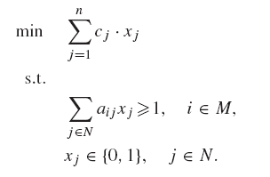
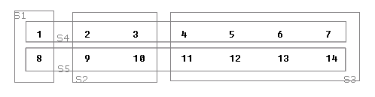
SCP Definition
min: x1 + x2 + x3 + x4 + x5
1: x1 + x4 ≧1
2,3: x2 + x4 ≧1
4,5,6,7: x3 + x4 ≧1
8: x1 + x5 ≧1
9,10: x2 + x5 ≧1
11,12,13,14: x3 + x5 ≧1
M elements, N sets
cj : cost of Sj
aij: 1 if i is belong to Sj
xj: 1 if Sj is selected
The decision version of set cover is NP-complete, and the optimization version of set cover is NP-hard.

Slide 4
Transform to MAX SAT
min: x1 + x2 + x3 + x4 + x5
1: x1 + x4 ≧1
2,3: x2 + x4 ≧1
4,5,6,7: x3 + x4 ≧1
8: x1 + x5 ≧1
9,10: x2 + x5 ≧1
11,12,13,14: x3 + x5 ≧1
W: {-x1 , -x2 , -x3 , -x4 , -x5 }
1: x1 | x4
2,3: x2 | x4
4,5,6,7: x3 | x4
8: x1 | x5
9,10: x2 | x5
11,12,13,14: x3 | x5

Slide 5
Greedy SCP Heuristic
Select the set which covers the most elements
until all element is marked “covered”.
In the example, the solution is:
Greedy: 3 sets (S3, S2, S1)
Optimal: 2 sets (S4, S5)

Slide 6
Solution
To get the optimal solution, we must consider all the possible cases.
  Time complexity is O(2^{N})
If N is large, we should use randomized algorithm to get a good solution.

Slide 7
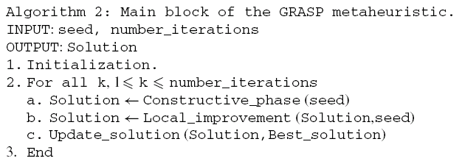
GRASP Algorithm
Greedy randomized adaptive search procedures (GRASP) is a random iterative optimization procedure.

Slide 8


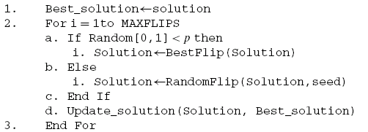
Detail
Constructive Phase:
Local Improvement

Slide 9
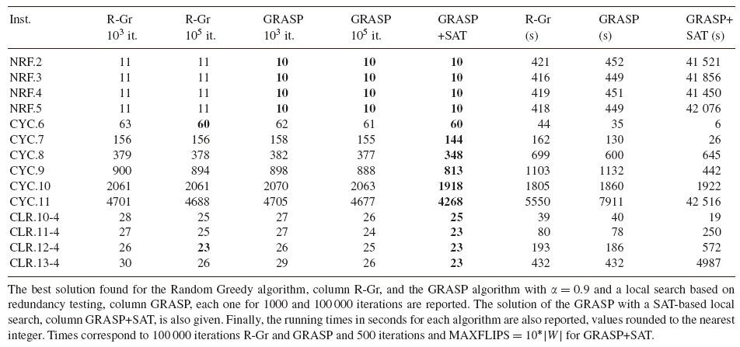
Result

