Slide 1
Automatic analysis of the structure of children’s drawing and writing
Céline Rémia, Carl Frélicotb, Pierre Courtellemontb
Pattern recognition , Vol. 35, pp.1059–1069, 2002
Reporter: Chiou Yi Hor
Date: May 02, 2007

Slide 2
Outline
Introduction
Previous Works
Methodology of this work

Slide 3
Introduction
The aim of this work is to build an objective tool for the detection of graph-motor difficulties involving disorders in the writing of children.
It defines exercises that facilitates children’ graph-motor (【醫】 書寫運動) skills.
Low-level and high-level discriminative primitives (features) are identified and then used for children classification.

Slide 4
Outline
Introduction
Previous Works
Methodology of this work

Slide 5
General Processes on Handwriting or Character Recognition
Preprocessing
  Producing a form suitable for recognition without any other disturbing elements
Normalization
  Producing a word image with similar size, position and orientation to the templates
Feature extraction
  Retrieving discriminative primitives (descriptors)
Classification

Slide 6
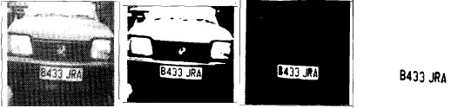
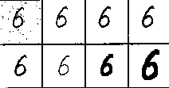
Related Works about Handwriting or Character Recognition
Preprocessing
  Oringinal->Binarization->region growing(x2)
  Smoothing->Contrast enhancement-> Skeletonization->Dilation

Slide 7
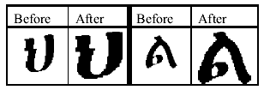
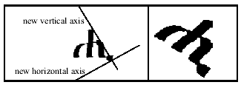
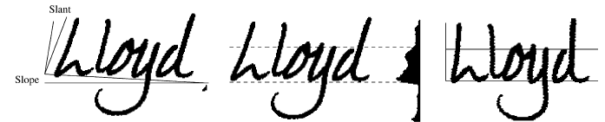
Related Works about Handwriting or Character Recognition
Normalization
  For size
  For orientation
  For slope and slant

Slide 8
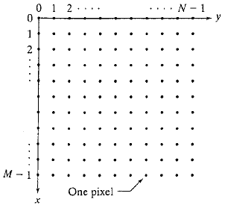
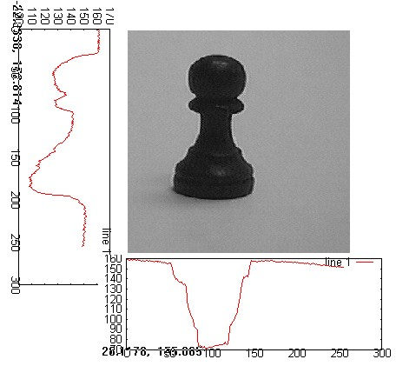
Related Works about Handwriting or Character Recognition
Feature
  NxN Bitmap (template matching)
  Integral projection signature

Slide 9
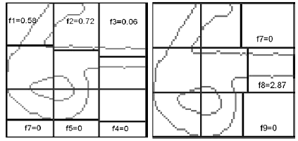
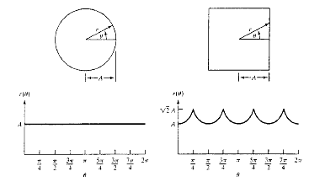
Related Works about Handwriting or Character Recognition
Feature
  Block-based feature
  Contour-based feature

Slide 10
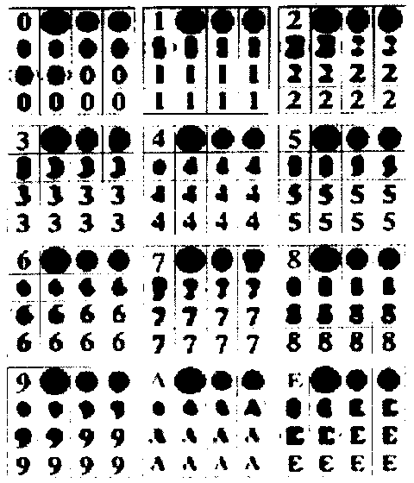
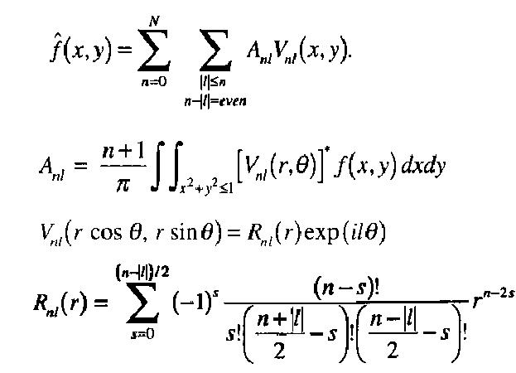


Related Works about Handwriting or Character Recognition
Feature
  Moment-based feature
Reconstructed image
Feature

Slide 11
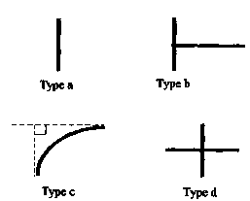
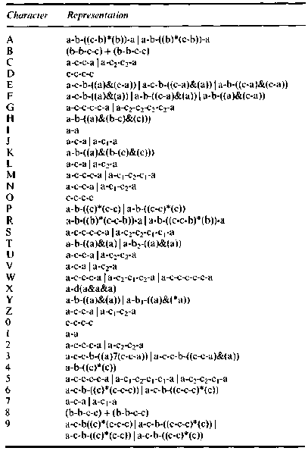
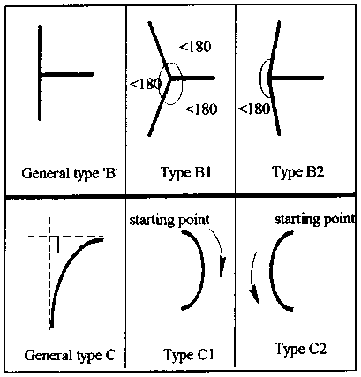
Related Works about Handwriting or Character Recognition
Feature
  Shape primitives (lines, curves, ...)

Slide 12
Related Works about Handwriting or Character Recognition
Feature
  Transform based (DFT, DCT, DWT, …)

Slide 13
Related Works about Handwriting or Character Recognition
Feature Selection
  Possible to achieve (feature) dimension reduction and thus facilitate training & classification
  Extracting full features but using only a subset of combinations of full features for classification
    Principal component analysis
    Discriminant analysis
  Extracting only a subset of full features and using these features for classification
    Branch and Bound (optimal or sub-optimal)
    Information gain
    Statistical methods

Slide 14
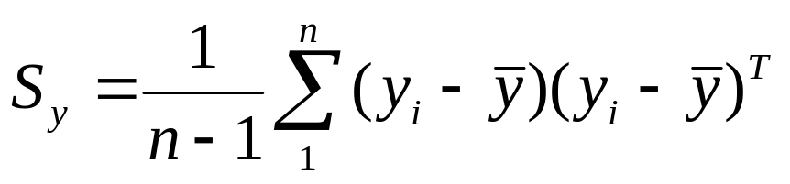
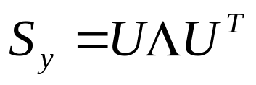
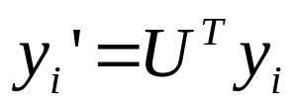
Related Works about Handwriting or Character Recognition
Feature Selection
  Principal component analysis
    Get covariance matrix of measurements y_{i}
    Calculate eigen-value & eigen-vector
    Transform into principal coordinates

Slide 15
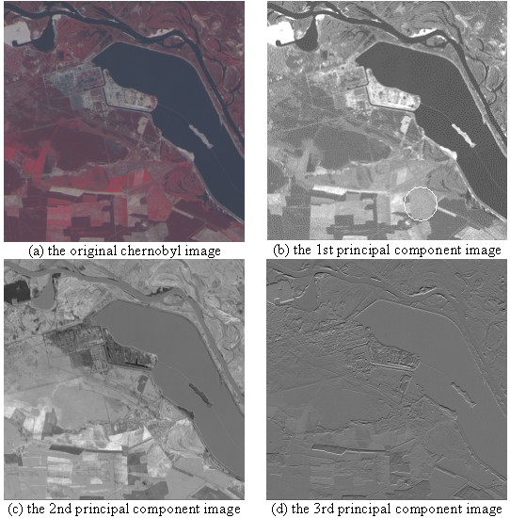
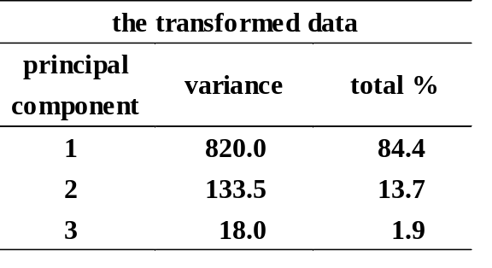
Related Works about Handwriting or Character Recognition
Feature Selection
  Principal component analysis

Slide 16
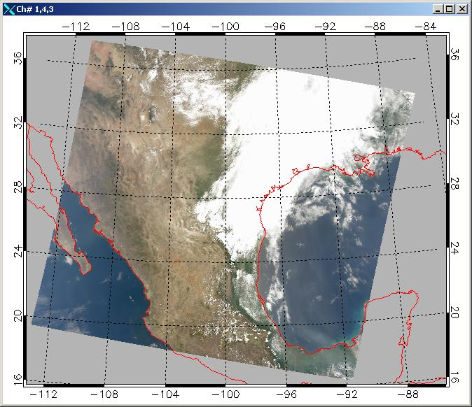
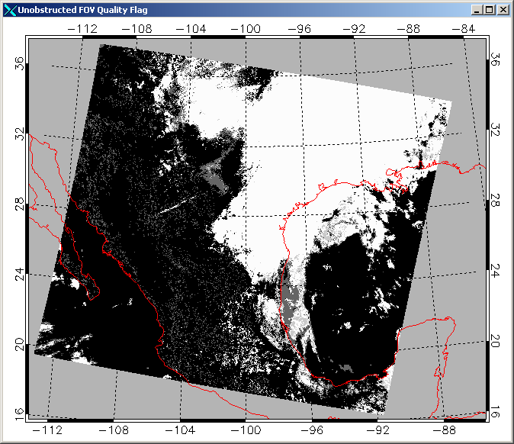
MODIS Level 1B & Cloud mask
Level1 SDSs
36 channels
Pixel to pixel
Cloudy, Clear (water, coast, desert, land)
Level2
cloud mask

Slide 17
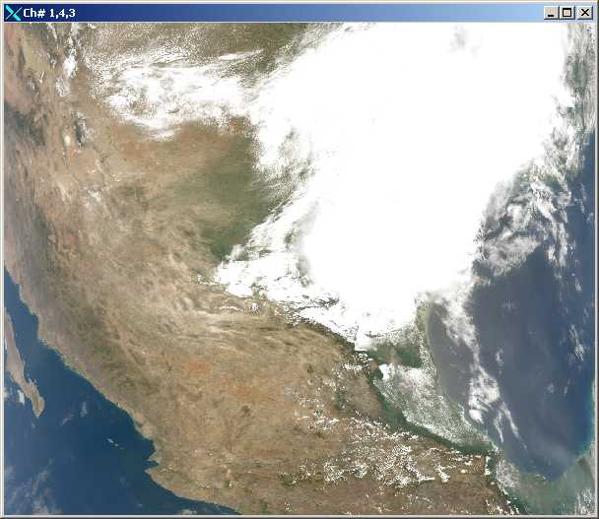
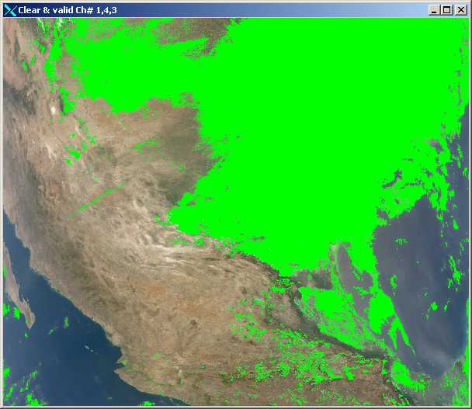
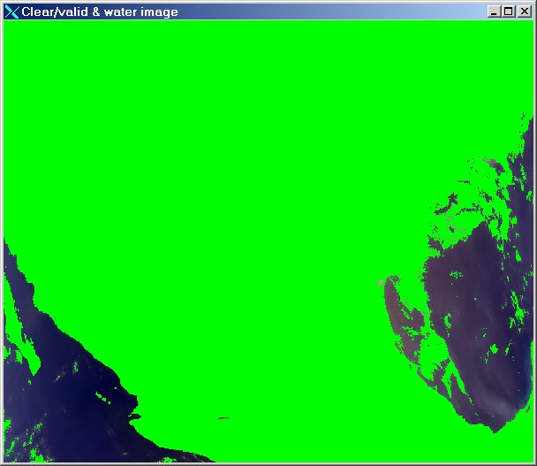
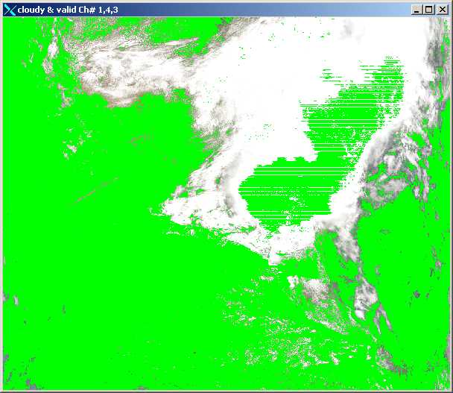
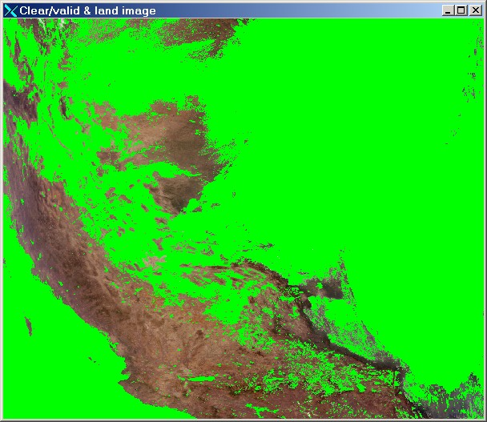
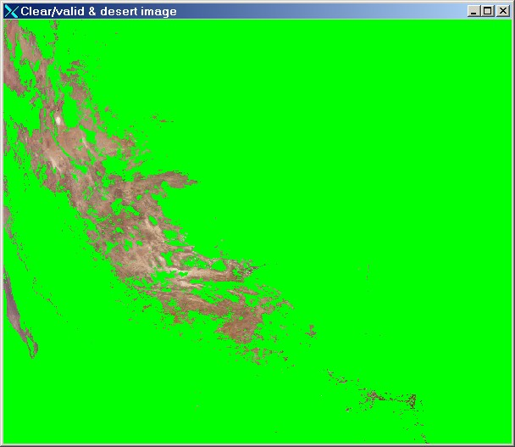
Segmentation with cloud mask
original image
clear & valid
water
cloudy & valid
land
desert

Slide 18
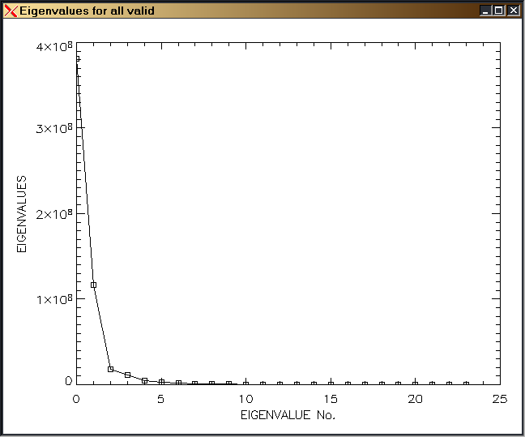
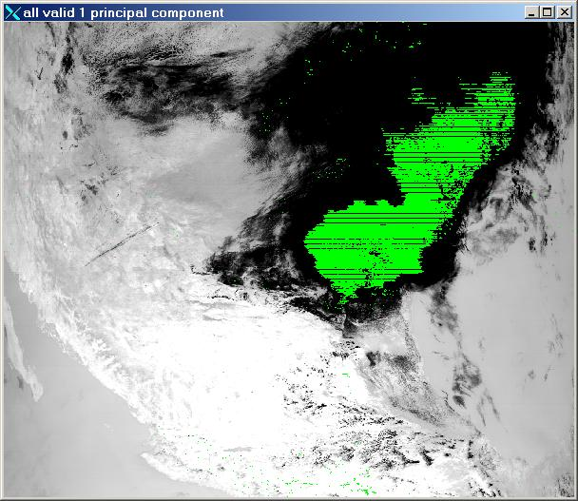
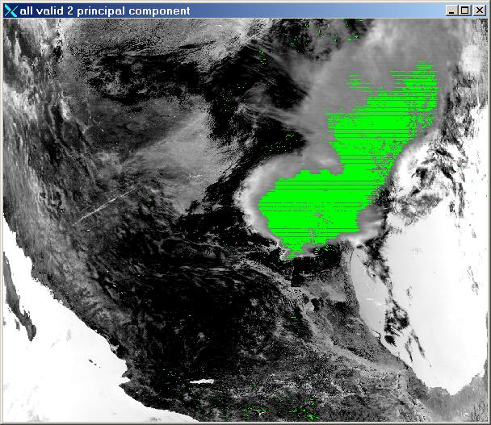
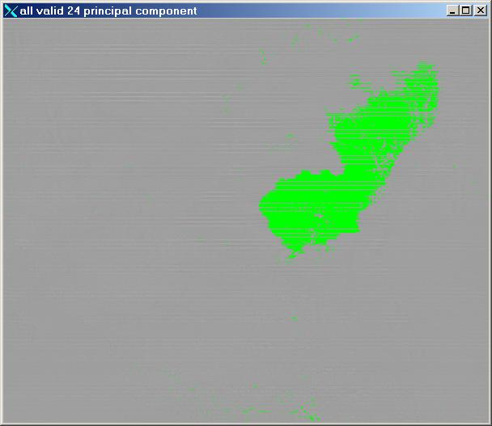
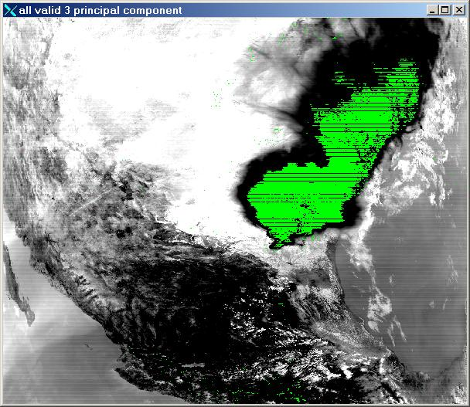
PCA Results

Slide 19
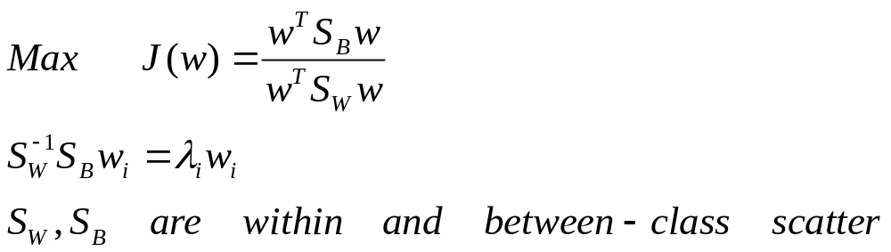
Related Works about Handwriting or Character Recognition
Feature Selection
  Fisher Linear Discriminant (FLD)
    Maximize between-class scatter over within-class scatter

Slide 20
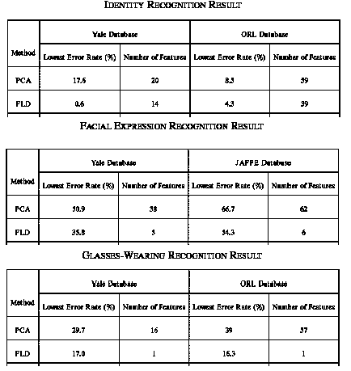
Related Works about Handwriting or Character Recognition
Feature Selection
  Some comparisons using PCA and FLD for face recognition

Slide 21
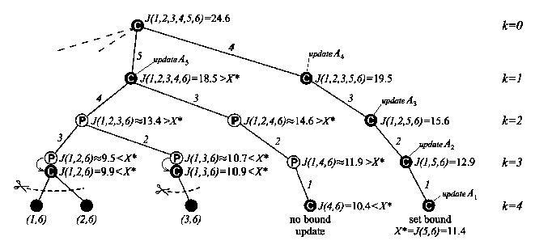
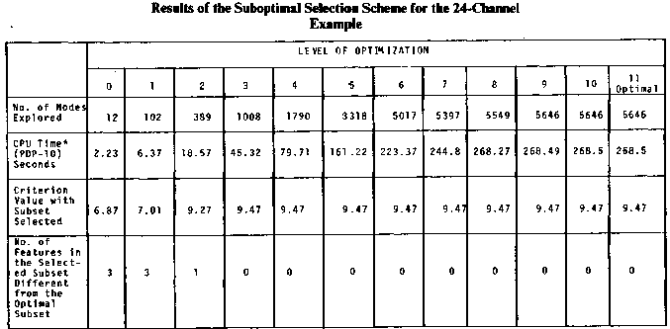
Related Works about Handwriting or Character Recognition
Feature Subset Selection
  Branch and Bound Algorithm

Slide 22

Related Works about Handwriting or Character Recognition
Feature Subset Selection
  Information Gain
    Being a measure of the effectiveness of an attribute in classifying the training data and simply the expected reduction in entropy caused by partitioning the examples according to this attribute
    The information gain, Gain(S, A) of an attribute A, relative to a collection of examples S, is defined as
    Where Values(A) is the set of all possible values for attribute A, and S_{v} is the subset of S for which attribute A has value v (i.e., S_{v} = { s∈S⎥ A(s) = v })

Slide 23
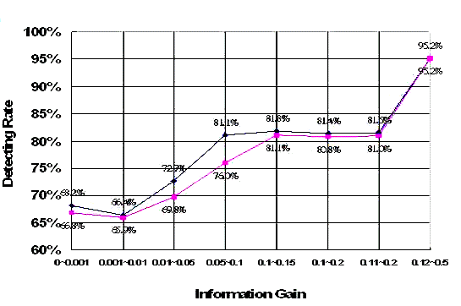
Related Works about Handwriting or Character Recognition
Feature Subset Selection
  Information Gain (Continued)

Slide 24
Related Works about Handwriting or Character Recognition
Classification
  Artificial Neural Network
  Linear Discriminant Function
    Support vector machine
  Non-metric methods
    CART (Classification And Regression Trees), ID3, C4.5
    Structural methods
      Edit distance (dynamic programming), syntactic methods
  Statistical methods
    Euclidean or Mahalanobis distance, Bayes-Gaussian classifier
  Hashing
    Glyph hashing achieves classification of constant-time complexity
  Hidden Markov Models

Slide 25
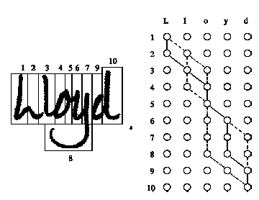
Related Works about Handwriting or Character Recognition
Classification using dynamic programming
  Find an optimal cost path to match a sequence of M letters with a sequence of N words

Slide 26
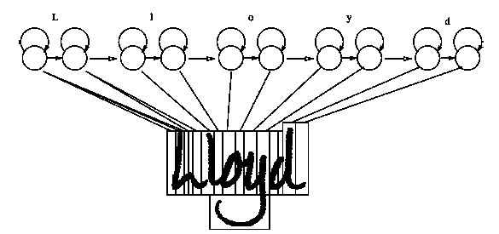
Related Works about Handwriting or Character Recognition
Classification using HMM
  The hidden states are the letters of a possible interpretation.
  The observations are the feature vectors extracted from the primitive segments.

Slide 27
Outline
Introduction
Previous Works
Methodology of this work

Slide 28
Methodology
This work performs
  Drawing Strategy Recognition
    Using both spatial & temporal structure of the layout to estimate children’ drawing tendencies
  School Level Recognition
    Identifying children who have writing or academic difficulties

Slide 29
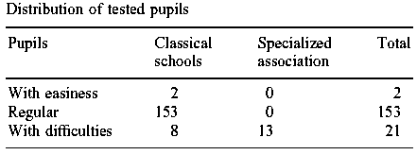
Methodology
Instrument
  Digitalized tablet set
Children
  Two primary schools
  Five school levels (6 years old for youngest)
  Their ability identified by experts

Slide 30
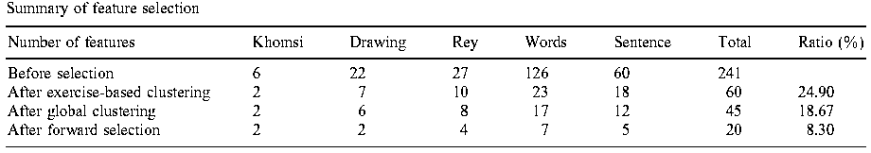
Methodology
Experiment
  To extract low-level features
    Khomsi: the test of understanding in reading
    Drawing: the test of drawing (Bender & Meulenbroek)
    Rey: the test of psychomotor (【醫】 精神性運動的) abilities to control movement kinematics
    Words: find out the variations with or without visual monitoring
    Sentences: the test of graphomotricity (醫】 書寫運動) in Social Science

Slide 31
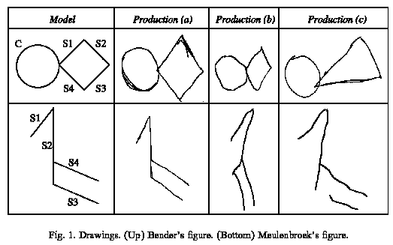
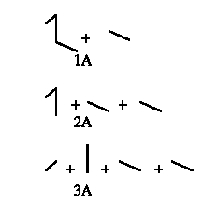
Drawing Strategy Recognition
Input - Test Layout
Output – Drawing Strategies

Slide 32
Drawing Strategy Recognition
Approach
  Segmentation
    Using the local speed, angle variation and curve distance to detect model changes
  Straight line identification
  Circle & square identification
  Analysis of the grammar of actions
    Detecting the order to reproducing the drawing components
    Grammar of actions: motor production rules used by the children to copy a drawing

Slide 33
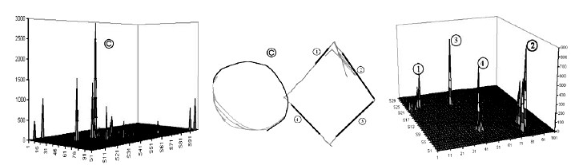
Drawing Strategy Recognition
Straight line , circle & square detection
  Line & circle: by Hough Transform
  Square: by lines

Slide 34
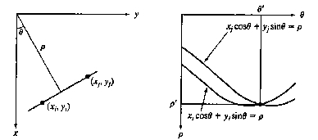
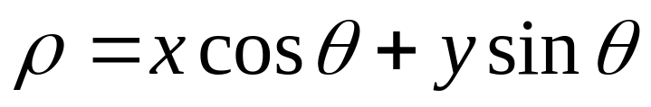


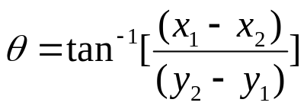
Drawing Strategy Recognition
Line Hugh Transformation
(x,y)為原始影像座標
(ρ,θ)為轉換後座標

Slide 35
Drawing Strategy Recognition
Line Hugh Transformation
  將每一像素點由(x,y)轉換至(ρ,θ)
  在(ρ,θ)座標系上找尋累積多點之座標點(x_{i},y_{i})
  每一(x_{i},y_{i})即代表一個線段
  可以適應被測物位置變化與旋轉，但累積能量受線段長短影響

Slide 36
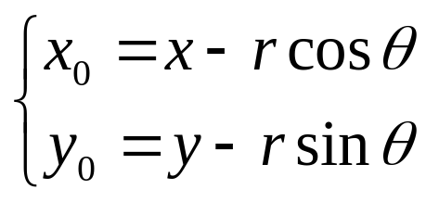
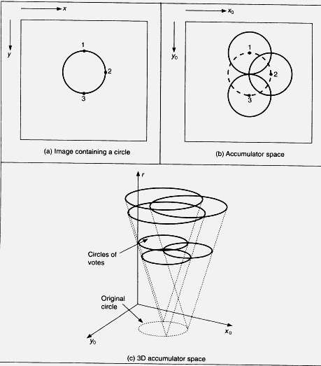
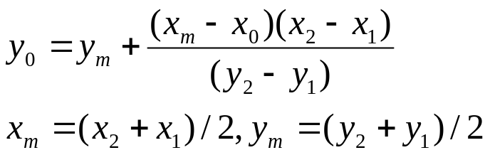
Drawing Strategy Recognition
Circle Hugh Transformation
(x,y,θ)為原始影像座標
(x₀,y₀,r)為轉換後座標

Slide 37
Drawing Strategy Recognition
Circle Hugh Transformation
  將每一像素點由(x,y,θ)轉換至(x₀,y₀,r)(or (x₀,y₀))
  在(x₀,y₀,r) (or (x₀,y₀))座標系上找尋累積多點之座標點(x_{i},y_{i},r_{i}) (or (x_{i},y_{i}))
  每一(x_{i},y_{i},r_{i}) (or (x_{i},y_{i}))即代表一個圓
  可以適應被測物位置變化與大小變化(如半徑、旋轉)

Slide 38

Drawing Strategy Recognition
Results
  Radical changes on the strategy of the graphomotricity (【醫】 書寫運動) during level 3

Slide 39

School Level Recognition
Approach
  Feature subset selection
    Test-based clustering (241->60)
      Remove redundant features within each test
    Global clustering (60->45)
      Remove redundant features between different tests
    Forward selection (45->20)
      Preserve the most relevant features
  Classification
    Mahalanobis distance
Vector to be classified
Mean vector of i’th class
Within-class covariance matrix

Slide 40



School Level Recognition
Test-based clustering for feature subset selection
    Within each level & kind of test, standardize each feature
    Perform hierarchical clustering procedure
      Index to merge two features
    Select the optimal cut and then the feature subset
      Select the feature which is closest to the cluster center
Are children, I’th original feature, I’th standardized feature, school level, expected value and variance

Slide 41

School Level Recognition
Test-based clustering for feature subset selection
For the Rey test only, 10/27 features are preserved.
60/241 features are preserved for all tests.

Slide 42
School Level Recognition
Global clustering for feature subset selection
  Perform the identical procedure as test-based clustering to the 60 selected features
  To check whether some features from different test are similar or not
  45 features are preserved

Slide 43

School Level Recognition
Forward selection for feature subset selection
  Use Wilks criterion as the cost function during the feature selection procedure
    W and V represent within-class and mixed-class covariance (= within-class+between-class covariance)
  20 features are preserved

Slide 44

School Level Recognition
Forward selection for feature subset selection

Slide 45


School Level Recognition
Results
First & second position

