Slide 1
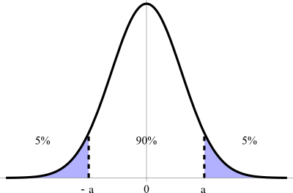
The Model Confidence Set
Peter R. Hansen, Asger Lunde, and James M. Nason
Econometrica, Vol. 79, No.2, pp. 453-497, 2011
Presenter: Hung-Hsin Chen (陳紘昕)
Date: Nov. 5, 2013

Slide 2
Abstract
This paper introduces the model confidence set (MCS) and applies it to the selection of models. A MCS is a set of models that is constructed such that it will contain the best model with a given level of confidence. The MCS is in this sense analogous to a confidence interval for a parameter. The MCS acknowledges the limitations of the data, such that uninformative data yield a MCS with many models, whereas informative data yield a MCS with only a few models. The MCS procedure does not assume that a particular model is the true model; in fact, the MCS procedure can be used to compare more general objects, beyond the comparison of models. We apply the MCS procedure to two empirical problems. First, we revisit the inflation forecasting problem posed by Stock and Watson (1999), and compute the MCS for their set of inflation forecasts. Second, we compare a number of Taylor rule regressions and determine the MCS of the best regression in terms of in-sample likelihood criteria.

Slide 3
equal predictive ability (EPA) [Diei95]
predictive ability properties [West96]
Reality Check (RC) [Whit00]
Stepwise-RC [Roma05]
Superior Predictive Ability (SPA) [Hans05]
Stepwise-SPA [Hsu10]
Model confidence set(MCS) [Hans11]
EPA for multiple models [Mari12]
RC for nested model [Clar12]

Slide 4
Reference
[Dieb95] F. X. Diebold and R. S. Mariano, "Comparing predictive accuracy," Journal of Business & economic statistics, vol. 20, 1995.
[West96] K. D. West, "Asymptotic inference about predictive ability," Econometrica: Journal of the Econometric Society, pp. 1067-1084, 1996.
[Whit00] Halbert White, “A REALITY CHECK FOR DATA SNOOPING,” Econometrica, Vol. 68, No. 5, pp. 1097-1126, 2000
[Roma05] Romano, J. P. and M. Wolf,. “Stepwise multiple testing as formalized data snooping,” Econometrica, Vol . 73, pp. 1237–1282, 2005.
[Hans05] P.R. Hansen, “A test for superior predictive ability, ” Journal of Business and Economic Statistics, Vol. 23, No. 4, pp. 365-380, 2005.
[Hans11] P. R. Hansen, A. Lunde, and J. M. Nason, "The Model Confidence Set," Econometrica, vol. 79, pp. 453-497, 2011.
[Hsu10] Po-Hsuan Hsu , Yu-Chin Hsub, Chung-Ming Kuan, “Testing the predictive ability of technical analysis using a new stepwise test without data snooping bias,” Journal of Empirical Finance, Vol. 17, pp. 471-484, 2010.
[Clar12] T. E. Clark and M. W. McCracken, "Reality checks and comparisons of nested predictive models," Journal of Business & Economic Statistics, vol. 30, 2012.
[Mari12] R. S. Mariano and D. Preve, "Statistical tests for multiple forecast comparison," Journal of Econometrics, vol. 169, pp. 123-130, 7// 2012.

Slide 5
Data snooping bias
Data snooping occurs when a given set of data is used more than once for purposes of inference or model selection. When such data reuse occurs, there is always the possibility that any satisfactory results obtained may simply be due to chance rather than to any merit inherent in the method yielding the results.

Slide 6
Data snooping bias
由於財務資料難以重複實驗的侷限性，個別的研究者通常利用相同的資料進行研究，卻忽略了將這種重複利用相同資料進行研究，所產生對資料的過度推論或是推論錯誤，稱為 資料窺探(data snopping)問題。
當模型(基金、股票或交易策略或是預測模型)數目眾多時，因data snooping而產生的偏誤會更加嚴重

Slide 7
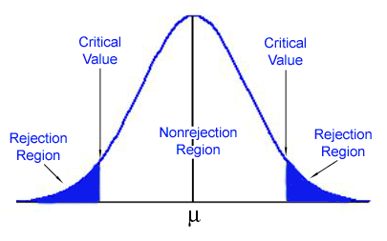
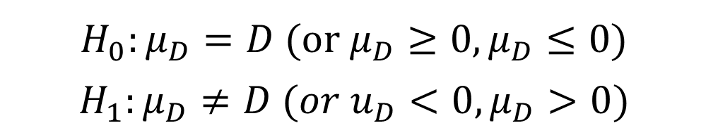
Hypothesis test
$$H_{0}:μ_{D}=D (or μ_{D}≥0, μ_{D}≤0)$$
$$H_{1}:μ_{D}≠D (or u_{D}<0, μ_{D}>0)$$

Slide 8
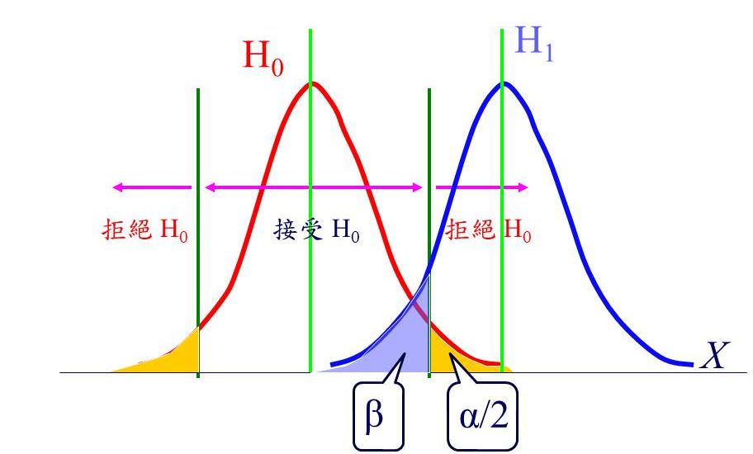
Hypothesis test
 |  | Null Hypothesis H₀ (虛無假設)
 |  | H₀ is true (H₁ is False) | H₀ is false (H₁ is True)
Alternative hypothesis H₁ （對立假設） | Reject | Type I error (False Positive, α) | Correct (True Positive, 1-α)
 | Fail to reject | Correct (True Negative, 1-β) | Type II error (False Negative, β)

Slide 9
Multiple comparison
AIDS檢驗、肝癌、肺癌檢驗正確性如下表
Test\real | 沒生病 | 生病
陽性 | FP, 1% (type I error, α) | TP, 99%
陰性 | TN, 98% | FN, 2% (type II error, β)
三種檢驗各自獨立互不影響，
小明做上述三種檢驗後，若檢驗結果均為陽性，
則小明真的同時得到AIDS, 肝癌與肺癌的機率為：
99%*99%*99%=97.03%
type I error (FP)的機率α=2.97%

Slide 10
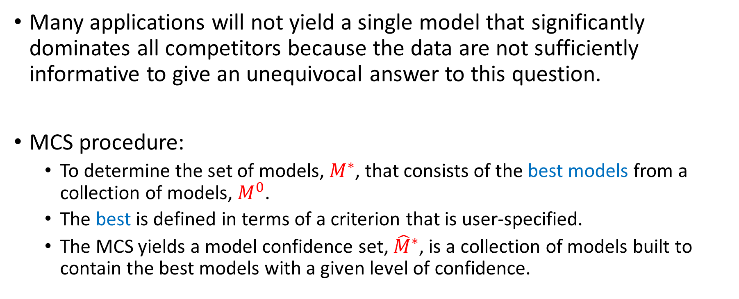
Introduction
Many applications will not yield a single model that significantly dominates all competitors because the data are not sufficiently informative to give an unequivocal answer to this question.
MCS procedure:
To determine the set of models, $M^{∗}$, that consists of the best models from a collection of models, $M^{0}$.
The best is defined in terms of a criterion that is user-specified.
The MCS yields a model confidence set, ${\hat{M}}^{∗}$, is a collection of models built to contain the best models with a given level of confidence.

Slide 11
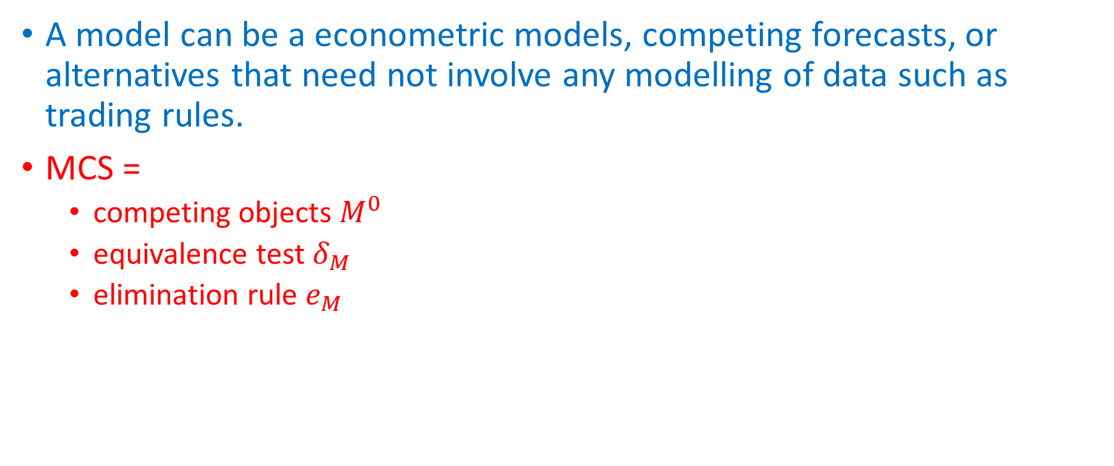
Theory of MCS
A model can be a econometric models, competing forecasts, or alternatives that need not involve any modelling of data such as trading rules.
MCS =
competing objects $M^{0}$
equivalence test $δ_{M}$
elimination rule $e_{M}$

Slide 12
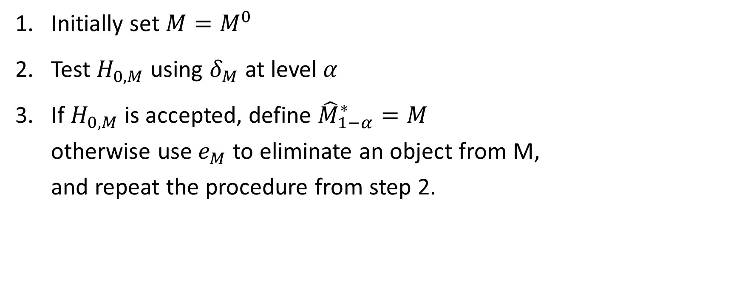
MCS procedure
Initially set $M=M^{0}$
Test $H_{0,M}$ using $δ_{M}$ at level $α$
If $H_{0,M}$ is accepted, define ${\hat{M}}_{1−α}^{∗}=M$ otherwise use $e_{M}$ to eliminate an object from M, and repeat the procedure from step 2.

Slide 13
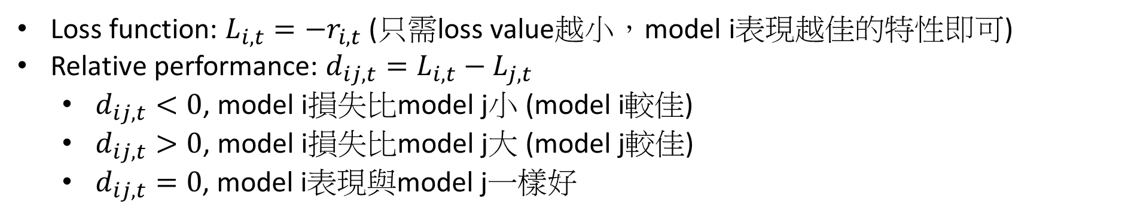
Example: 檢定指數報酬率
ROI(%) | 2012/11/20 | 2012/11/21 | 2012/11/22 | 2012/11/23 | 2012/11/26 | 2012/11/27 | 2012/11/28 | 2012/11/29 | 2012/11/30
1.TAIEX | 0.2347 | -0.8016 | 0.2436 | 3.0996 | 1.1106 | 0.3082 | 0.0637 | 0.9229 | 1.0211
2.HIS | -0.1589 | 1.3947 | 1.0167 | 0.7854 | -0.2381 | -0.0813 | -0.6182 | 0.9854 | 0.4904
3.S&P500 | 0.0663 | 0.2320 | 0.0000 | 1.3026 | -0.2030 | -0.5227 | 0.7856 | 0.4270 | 0.0162
4.Nikkei225 | -0.1154 | 0.8737 | 1.5644 | 0.0000 | 0.2364 | 0.3660 | -1.2198 | 0.9941 | 0.4801
Loss function: $L_{i,t}=−r_{i,t}$ (只需loss value越小，model i表現越佳的特性即可)
Relative performance: $d_{ij,t}=L_{i,t}−L_{j,t}$
$d_{ij,t}<0$, model i損失比model j小 (model i較佳)
$d_{ij,t}>0$, model i損失比model j大 (model j較佳)
$d_{ij,t}=0$, model i表現與model j一樣好

Slide 14
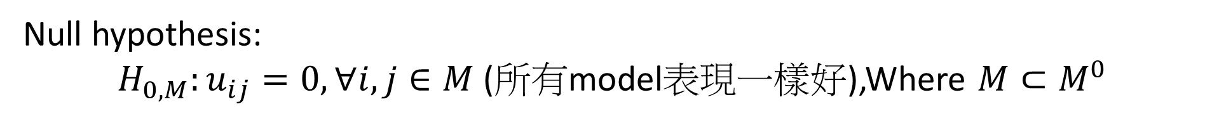
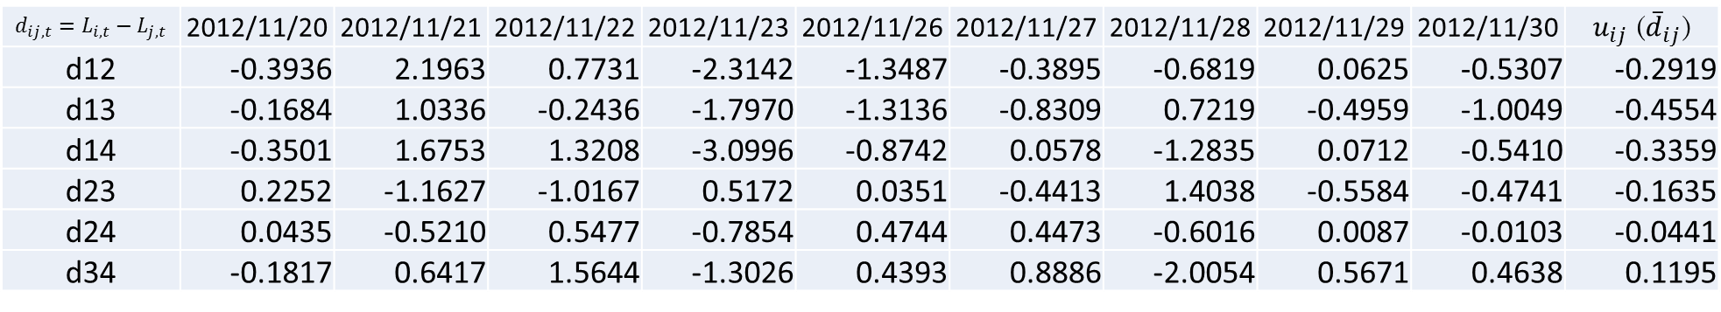
Difference matrix:
$$d_{ij,t}=L_{i,t}−L_{j,t}$$ | 2012/11/20 | 2012/11/21 | 2012/11/22 | 2012/11/23 | 2012/11/26 | 2012/11/27 | 2012/11/28 | 2012/11/29 | 2012/11/30 | $u_{ij}$ (${\overline{d}}_{ij}$)
d12 | -0.3936 | 2.1963 | 0.7731 | -2.3142 | -1.3487 | -0.3895 | -0.6819 | 0.0625 | -0.5307 | -0.2919
d13 | -0.1684 | 1.0336 | -0.2436 | -1.7970 | -1.3136 | -0.8309 | 0.7219 | -0.4959 | -1.0049 | -0.4554
d14 | -0.3501 | 1.6753 | 1.3208 | -3.0996 | -0.8742 | 0.0578 | -1.2835 | 0.0712 | -0.5410 | -0.3359
d23 | 0.2252 | -1.1627 | -1.0167 | 0.5172 | 0.0351 | -0.4413 | 1.4038 | -0.5584 | -0.4741 | -0.1635
d24 | 0.0435 | -0.5210 | 0.5477 | -0.7854 | 0.4744 | 0.4473 | -0.6016 | 0.0087 | -0.0103 | -0.0441
d34 | -0.1817 | 0.6417 | 1.5644 | -1.3026 | 0.4393 | 0.8886 | -2.0054 | 0.5671 | 0.4638 | 0.1195
Null hypothesis:
$H_{0,M}:u_{ij}=0, ∀i,j∈M$ (所有model表現一樣好),Where $M⊂M^{0}$

Slide 15
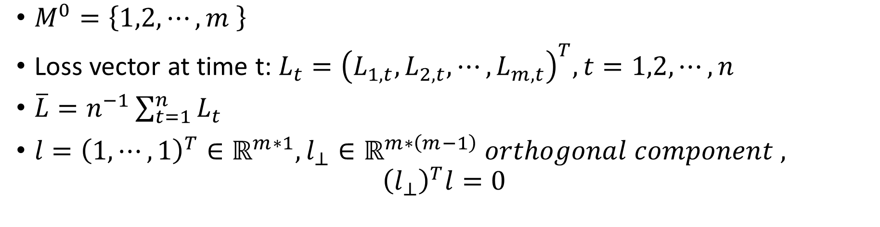
$M^{0}=\left\{1,2,⋯,m \right\}$
Loss vector at time t: $L_{t}={\left(L_{1,t},L_{2,t},⋯,L_{m,t}\right)}^{T}, t=1,2,⋯,n$
$\overline{L}=n^{−1}\sum_{t=1}^{n}{L_{t}}$
$l={\left(1,⋯,1\right)}^{T}∈ℝ^{m∗1}, l_{⊥}∈ℝ^{m∗\left(m−1\right)} orthogonal component ,$ ${\left(l_{⊥}\right)}^{T}l=0$

Slide 16

Difference matrix在null hypothesis下，當n趨近無窮大時，會分配收斂至常態分佈
But it is difficult to estimate covariance matrix $Σ∈ℝ^{m∗m}$

Slide 17

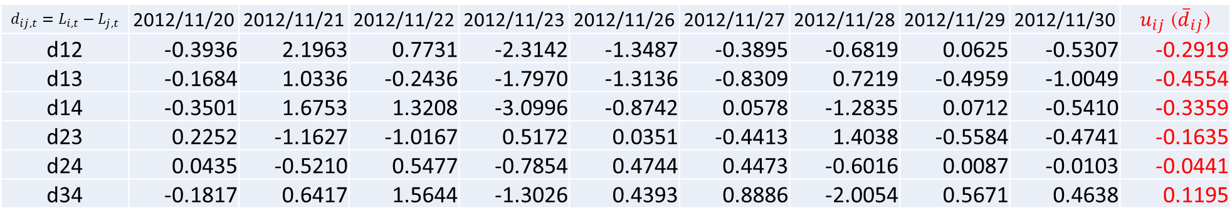
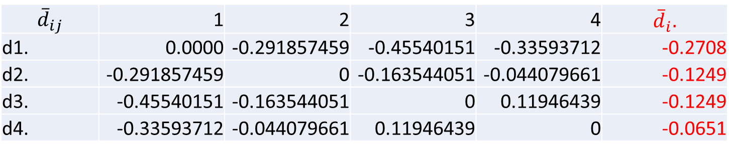
Construct statistic
$$d_{ij,t}=L_{i,t}−L_{j,t}$$ | 2012/11/20 | 2012/11/21 | 2012/11/22 | 2012/11/23 | 2012/11/26 | 2012/11/27 | 2012/11/28 | 2012/11/29 | 2012/11/30 | $u_{ij}$ (${\overline{d}}_{ij}$)
d12 | -0.3936 | 2.1963 | 0.7731 | -2.3142 | -1.3487 | -0.3895 | -0.6819 | 0.0625 | -0.5307 | -0.2919
d13 | -0.1684 | 1.0336 | -0.2436 | -1.7970 | -1.3136 | -0.8309 | 0.7219 | -0.4959 | -1.0049 | -0.4554
d14 | -0.3501 | 1.6753 | 1.3208 | -3.0996 | -0.8742 | 0.0578 | -1.2835 | 0.0712 | -0.5410 | -0.3359
d23 | 0.2252 | -1.1627 | -1.0167 | 0.5172 | 0.0351 | -0.4413 | 1.4038 | -0.5584 | -0.4741 | -0.1635
d24 | 0.0435 | -0.5210 | 0.5477 | -0.7854 | 0.4744 | 0.4473 | -0.6016 | 0.0087 | -0.0103 | -0.0441
d34 | -0.1817 | 0.6417 | 1.5644 | -1.3026 | 0.4393 | 0.8886 | -2.0054 | 0.5671 | 0.4638 | 0.1195
$${\overline{d}}_{ij}≡n^{−1}\sum_{t=1}^{n}{d_{ij,t}}, {\overline{d}}_{i.}≡m^{−1}\sum_{j∈M}{{\overline{d}}_{ij}}$$
$${\overline{d}}_{ij}$$ | 1 | 2 | 3 | 4 | $${\overline{d}}_{i}.$$
d1. | 0.0000 | -0.291857459 | -0.45540151 | -0.33593712 | -0.2708
d2. | -0.291857459 | 0 | -0.163544051 | -0.044079661 | -0.1249
d3. | -0.45540151 | -0.163544051 | 0 | 0.11946439 | -0.1249
d4. | -0.33593712 | -0.044079661 | 0.11946439 | 0 | -0.0651

Slide 18
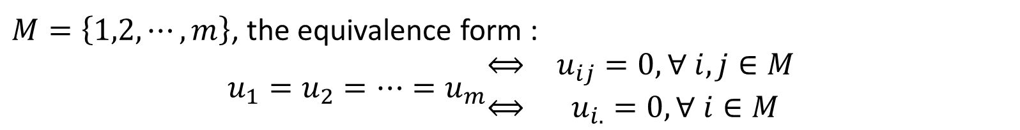
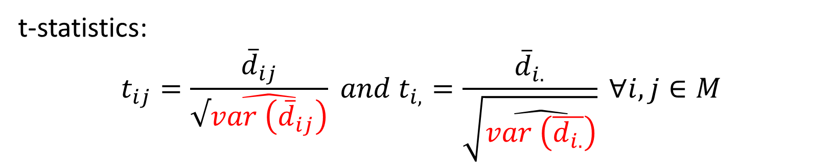
Constructing statistics
t-statistics:
$$t_{ij}=\frac{{\overline{d}}_{ij}}{√\hat{var \left({\overline{d}}_{ij}\right)}} and t_{i,}=\frac{{\overline{d}}_{i.}}{\sqrt{\hat{var \left(\overline{d_{i.}}\right)}}} ∀i,j∈M$$
$M=\left\{1,2,⋯,m\right\}$, the equivalence form :
$$u_{1}=u_{2}=⋯=u_{m}\begin{matrix}⟺ & u_{ij}=0, ∀ i, j∈M \\ ⟺ & u_{i.}=0, ∀ i∈M\end{matrix}$$

Slide 19
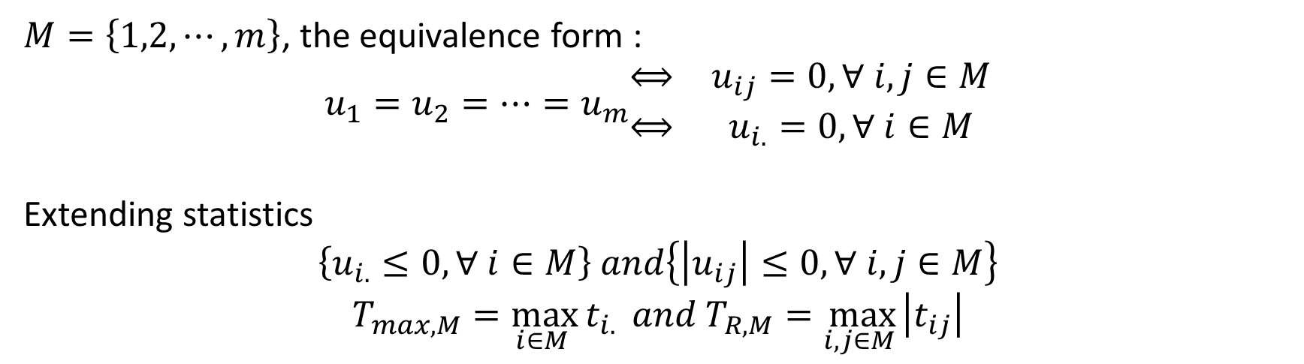
Extending statistics
$M=\left\{1,2,⋯,m\right\}$, the equivalence form :
$$u_{1}=u_{2}=⋯=u_{m}\begin{matrix}⟺ & u_{ij}=0, ∀ i, j∈M \\ ⟺ & u_{i.}=0, ∀ i∈M\end{matrix}$$
Extending statistics
$$\left\{u_{i.}≤0, ∀ i∈M\right\} and\left\{\left|u_{ij}\right|≤0, ∀ i,j∈M\right\}$$
$$T_{max,M}=\max_{i∈M }{t_{i.}} and T_{R,M}=\max_{i,j∈M }\left|t_{ij}\right|$$

Slide 20
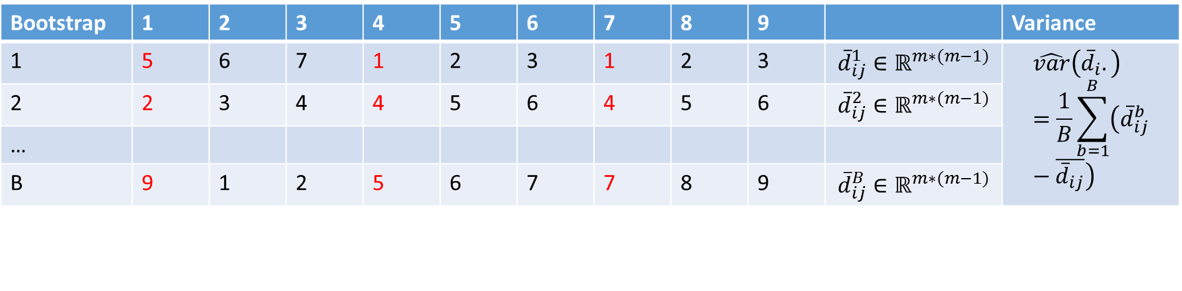
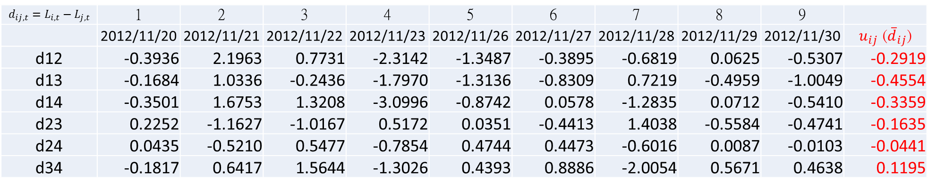
Block bootstrap with length l=3 (for time series)
original
$$d_{ij,t}=L_{i,t}−L_{j,t}$$ | 1 | 2 | 3 | 4 | 5 | 6 | 7 | 8 | 9
 | 2012/11/20 | 2012/11/21 | 2012/11/22 | 2012/11/23 | 2012/11/26 | 2012/11/27 | 2012/11/28 | 2012/11/29 | 2012/11/30 | $u_{ij}$ (${\overline{d}}_{ij}$)
d12 | -0.3936 | 2.1963 | 0.7731 | -2.3142 | -1.3487 | -0.3895 | -0.6819 | 0.0625 | -0.5307 | -0.2919
d13 | -0.1684 | 1.0336 | -0.2436 | -1.7970 | -1.3136 | -0.8309 | 0.7219 | -0.4959 | -1.0049 | -0.4554
d14 | -0.3501 | 1.6753 | 1.3208 | -3.0996 | -0.8742 | 0.0578 | -1.2835 | 0.0712 | -0.5410 | -0.3359
d23 | 0.2252 | -1.1627 | -1.0167 | 0.5172 | 0.0351 | -0.4413 | 1.4038 | -0.5584 | -0.4741 | -0.1635
d24 | 0.0435 | -0.5210 | 0.5477 | -0.7854 | 0.4744 | 0.4473 | -0.6016 | 0.0087 | -0.0103 | -0.0441
d34 | -0.1817 | 0.6417 | 1.5644 | -1.3026 | 0.4393 | 0.8886 | -2.0054 | 0.5671 | 0.4638 | 0.1195
Bootstrap | 1 | 2 | 3 | 4 | 5 | 6 | 7 | 8 | 9 |  | Variance
1 | 5 | 6 | 7 | 1 | 2 | 3 | 1 | 2 | 3 | $${\overline{d}}_{ij}^{1}∈ℝ^{m∗(m−1)}$$ | $$\hat{var}\left({\overline{d}}_{i}.\right)=\frac{1}{B}\sum_{b=1}^{B}{\left({\overline{d}}_{ij}^{b}−\overline{{\overline{d}}_{ij}}\right)}$$
2 | 2 | 3 | 4 | 4 | 5 | 6 | 4 | 5 | 6 | $${\overline{d}}_{ij}^{2}∈ℝ^{m∗(m−1)}$$
…
B | 9 | 1 | 2 | 5 | 6 | 7 | 7 | 8 | 9 | $${\overline{d}}_{ij}^{B}∈ℝ^{m∗(m−1)}$$

Slide 21

Sequential testing
Data statistics $T_{max}=\max_{i∈M }{t_{i.}}=\frac{{\overline{d}}_{i.}}{\sqrt{\hat{var \left(\overline{d_{i.}}\right)}}}$
Bootstrap statistics $T_{b,max}=\max_{i∈M }{t_{b,i.}}=\frac{{\overline{d}}_{b,i.}}{\sqrt{\hat{var \left(\overline{d_{b,i.}}\right)}}}$
P-value of $H_{0,M}, p=\frac{1}{B}\sum_{b=1}^{B}{1\left\{T_{max}>T_{b,max}\right\}}$
If $p<α$, reject $H_{0,M} and e_{M}=arg\max_{i}{t_{i.}}$ is eliminated from M
Repeat steps 2-4 until first acceptance.

Slide 22

Thanks for your listening!

