Slide 1
Application of a hybrid of genetic algorithm and particle swarm optimization algorithm for order clustering
R.J. Kuo , L.M. Lin
Decision Support Systems 49 (2010) 451–462
Presenter : Huang Ting-Yao
2013-11-05

Slide 2
Abstract
This study proposes an evolutionary-based clustering algorithm based on a hybrid of genetic algorithm (GA) and particle swarm optimization algorithm (PSOA) for order clustering in order to reduce surface mount technology (SMT) setup time.
Simulational results via Iris, Glass, Vowel and Wine benchmark data sets indicate that the proposed evolutionary-based clustering algorithm is more accurate than the GA-based and PSOA-based clustering algorithms.

Slide 3
Abstract
In addition, the model evaluation results which use order information provided by an international industrial personal computer (PC) manufacturer show that the proposed algorithm is also superior to GA-based and PSOA-based clustering algorithms.
Through order clustering, scheduling orders that belong to the same cluster together can reduce production time as well as machine idle time.

Slide 4
Genetic Algorithm
基因演算法是人類依照生物學中「適者生存，不適者淘汰」的觀念所發展出來的一種演算法
利用「選擇、複製」、「交配」、「突變」等步驟去尋找最適合環境的基因
基本上「基因演算法」就是一個解決最佳化問題的工具
隨機產生初始族群
計算適應函數
選擇、複製
交配
終止條件
否
突變
是
收斂得解

Slide 5
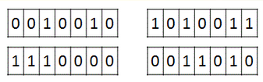


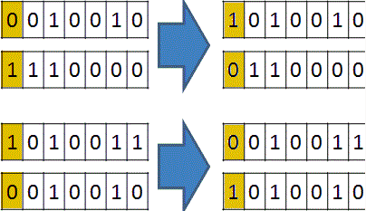
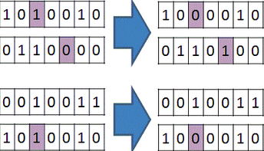
Genetic Algorithm
隨機產生初始族群
計算適應函數
選擇、複製
交配
終止條件
否
突變
是
收斂得解

Slide 6
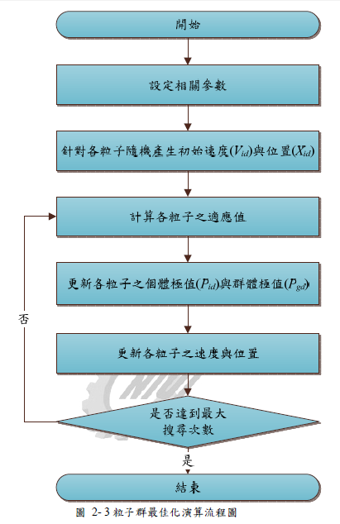
Particle swarm optimization algorithm
各個粒子具有「記憶性」並會參考其它粒子的「訊息」來決定移動的方向進而找到全域最佳解
和「基因演算法」一樣「粒子群演算法」同樣是拿來解決最佳化問題的工具
隨機產生初始速度(Vid)
適應度評估
最佳經驗之
更新
移動粒子
滿足結束準則
否
是
輸出群體最佳位置

Slide 7
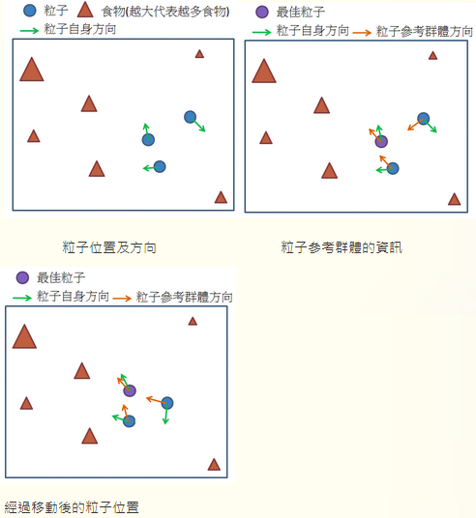


Particle swarm optimization algorithm
「粒子群演算法」
主要採用了下列兩個觀念
依自身經驗決定飛行方向
參考別人的經驗決定飛行方向
Notes:
發現別人比自己更好，就會參考並學習

Slide 8
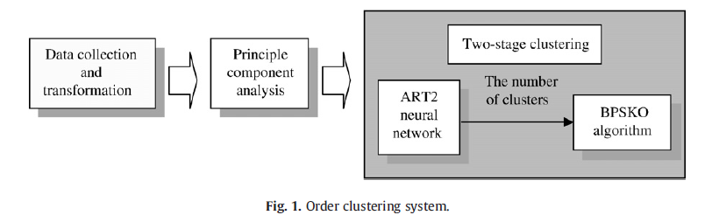
Order clustering system

Slide 9
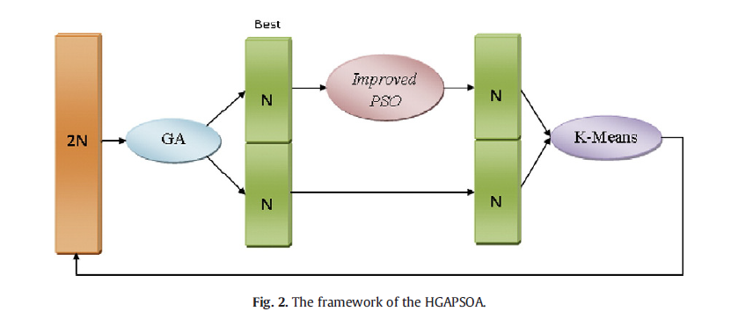
HGAPSOA

Slide 10
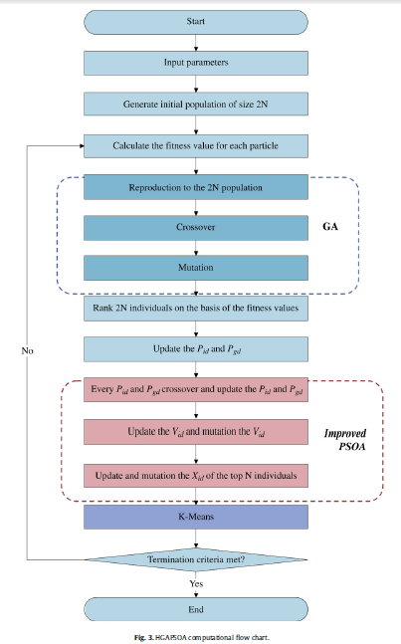

Slide 11
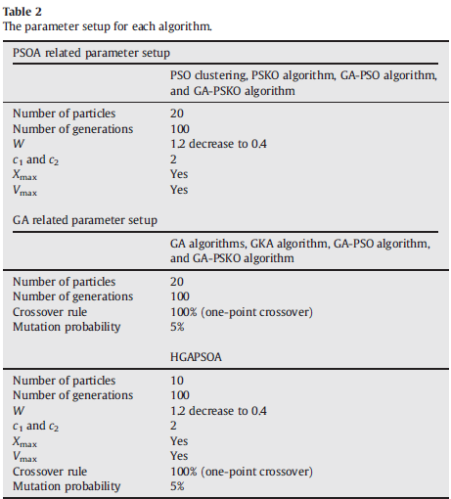


Slide 12

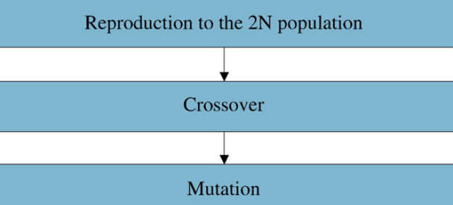



Slide 13
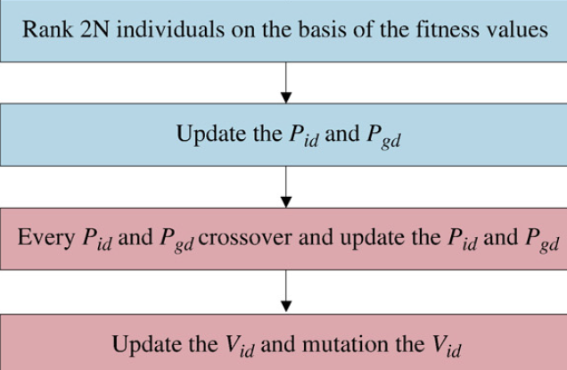

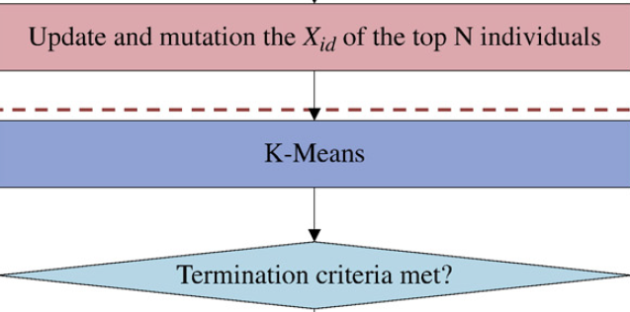
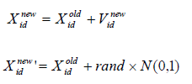


Slide 15



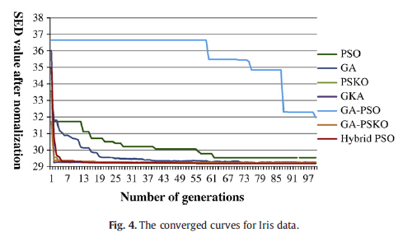
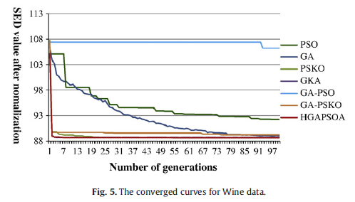
Result analysis (converged speed)

Slide 16
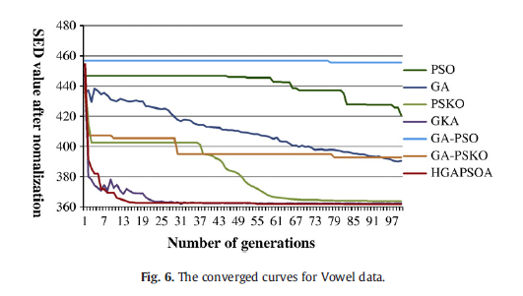
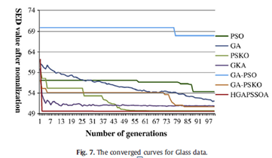
Result analysis (converged speed)

Slide 17
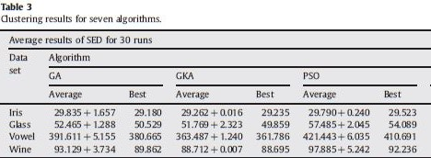
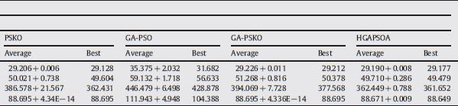
Result analysis (accuracy)

Slide 18

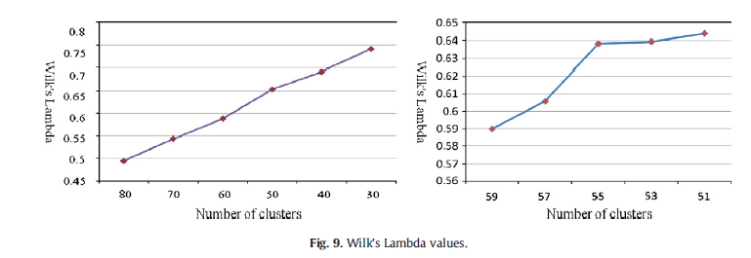
實證分析(Determination of cluster number)
組內變異以及總變異的比例，判定哪個是最好的分群區間

Slide 19
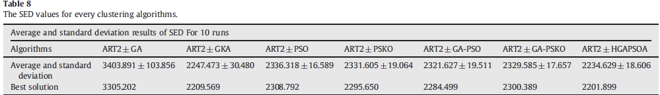
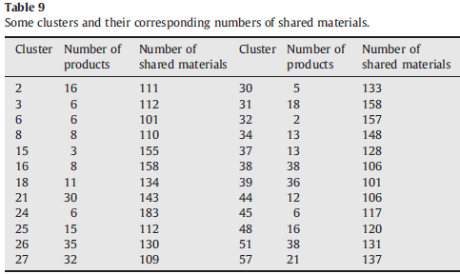
實證分析(comparsion)

Slide 20
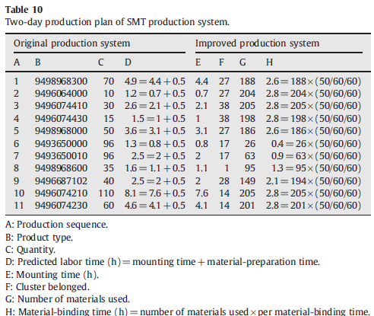
Performance evaluation for production line-changes

Slide 21
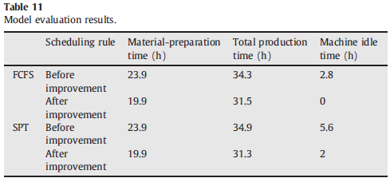
Model evaluation results

Slide 22
Conclusions
This study has proposed a two-stage clustering algorithm, ART2+HGAPSOA, for clustering analysis. The simulation results have shown that HGAPSOA outperforms GA, GKA, PSO, PSKO, GA-PSO and GAPSKO algorithms in four data sets.

