Slide 1
Homology modeling of membrane proteins: A critical assessment
Ch. Surendhar Reddy, K. Vijayasarathy, E. Srinivas, G. Madhavi Sastry, G. Narahari Sastry
Computational Biology and Chemistry
Vol.30, 2006, 120–126

Slide 2
Abstract
Evaluation and validation of homology[相同; 異體同形; 同族關係] modeling protocols are indispensable for membrane proteins as experimental determination of their three-dimensional structure is an arduous[困難的; 費力的] task. The prediction ability of Modeller, MOE, InsightII-Homology and Swiss-PdbViewer (SPV) with different sequence alignments CLUSTALW, BLAST and 3D-JIGSAW have been assessed. The sequence identity of the target and template was chosen to be in the range of 25–35%.

Slide 3
Abstract
Validation protocols to assess the structure, fold and stereochemical[立體化學的] quality, are employed by comparing with experimental structures. Two different ranking schemes are suggested to evaluate the performance of each methodology based on the validation scores. While unambiguous preference for any given procedure did not surface, statistically Modeller and the sequence alignment technique, 3D-JIGSAW, gave best results amongst the chosen protocols. The present study helps in selecting the right protocols when modeling membrane proteins, which form a major class of drug targets.

Slide 4
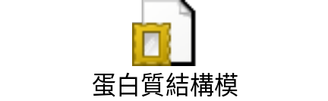
同源模擬法(Homology modeling)
將目標蛋白質序列與現存於蛋白質結構資料庫(PDB)已知序列進行比對，尋找出最好的三維結構模板(Template)，以此模板為模型將目標序列導入後，取得三維結構模型，經分子動能(molecular dynamics)及能量最小化(energy minimization)運算，以獲得目標序列的蛋白質結構。此方法的缺點是當現存資料庫中沒有類似之結構序列或序列相似度較低(<30%)時，就無法以此一方法進行預測，即使強行利用此法模擬，其預測的結果可信度也不高。
http://www.bio.fju.edu.tw/excel/content05/html/63.htm‎

Slide 5
同源模擬法(Homology modeling)
同源模擬法主要應用在藥物設計(drug design)、蛋白質特定突變(site-specific mutation)研究或蛋白質活性區域(active site)分析﹔由於以比較同源性的方式，具有相當的可信度，其結構的變異相對較低，因此是目前蛋白質結構模擬中，最常使用的方法。
限制為:在預測蛋白質時，同類蛋白質至少需有一種晶體結構或核磁共振結構已知。遇到序列相似度低時，就無法預測或是預測的結果可信度很低。
http://www.bio.fju.edu.tw/excel/content05/html/63.htm‎

Slide 6
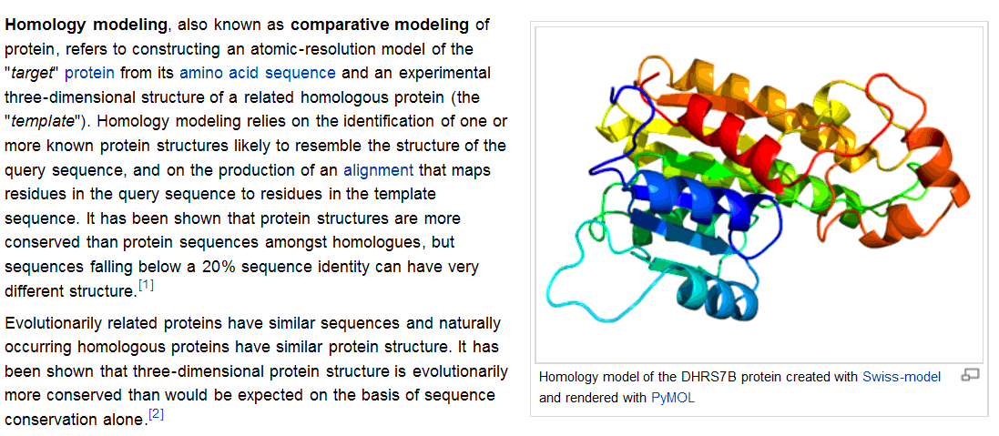
Homology modeling
http://en.wikipedia.org/wiki/Homology_modeling

Slide 7
實驗目的與架構
The central dogma[教條] in homology modeling techniques is the right choice of alignment between sequences.
Sequence
alignment
Homology
modeling
Evaluation
CLUSTALW
3D-JIGSAW
BLAST
Modeller
MOE
Homology module of InsightII (IH)
InsightII-Homology + Modeller (IHM)
Swiss-PdbViewer
RMSD
SCS
TM-score
RC

Slide 8
實驗資料
Membrance proteins
  Target (testing) sequence identity between 25% and 32%
  Template (training) structures whose percentage identity ranges between 25% and 32% with the target sequence whose 3D-structure is known have been chosen to build the models.
The RMSD values between the target and the template are by and large[大體上; 基本上] below 3A

Slide 9
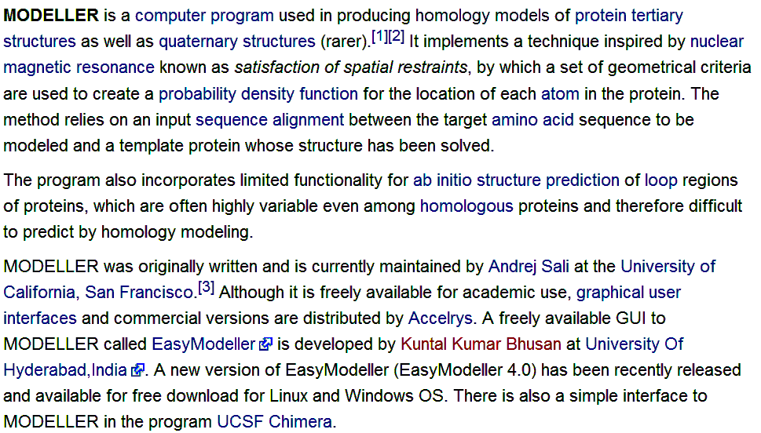
MODELLER
http://en.wikipedia.org/wiki/MODELLER

Slide 10
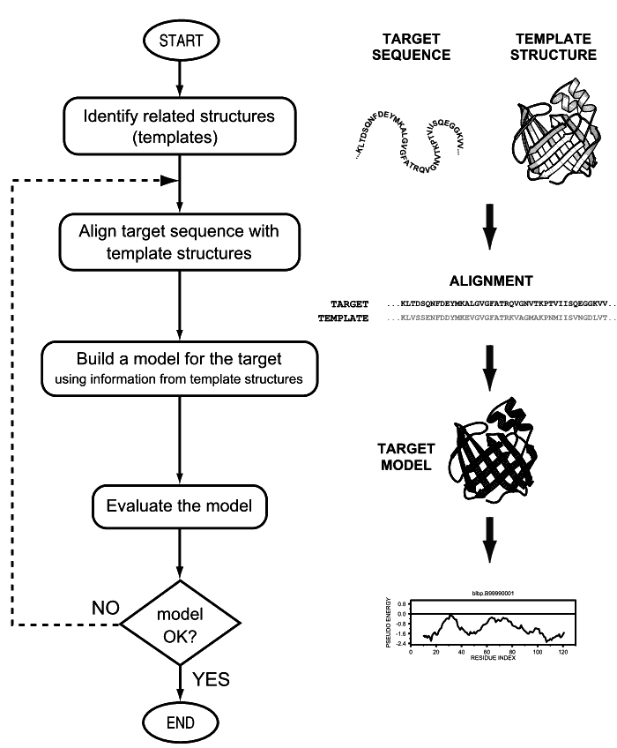
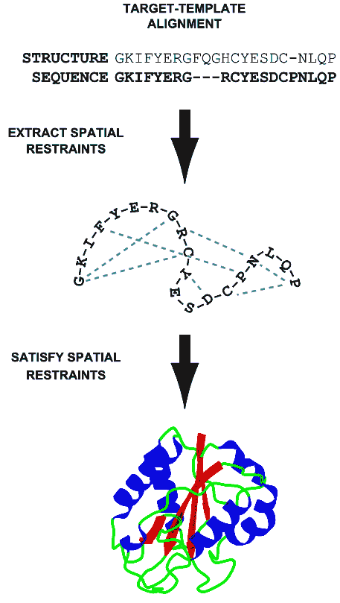
Modeller
http://salilab.org/modeller/
András Fiser and Andrej Sali, "Comparative protein structure modeling"

Slide 11
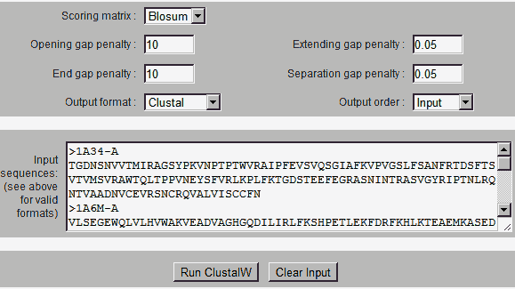
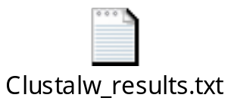
ClustalW
http://embnet.vital-it.ch/software/ClustalW.html

Slide 12
RMSD (root mean square deviation)
A method to assess the quality of the resulting full-length modelling
Not taking the alignment coverage into consideration
  A template with a 2 Å RMSD to native having 50% alignment coverage is not necessarily better for structure modeling than one with a RMSD of 3 Å but having 80% alignment coverage.
http://en.wikipedia.org/wiki/Root-mean-square_deviation_(bioinformatics)

Slide 13
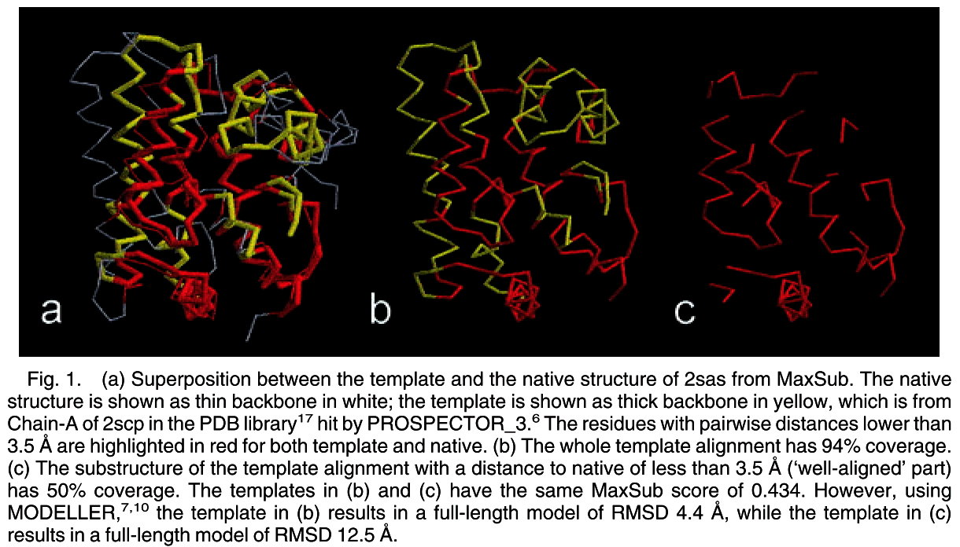
RMSD (root mean square deviation)

Slide 14
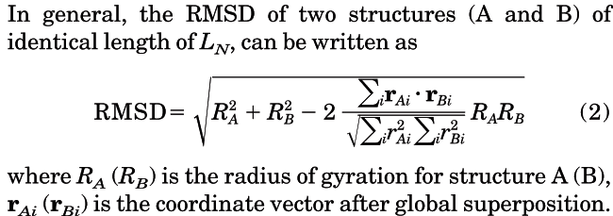
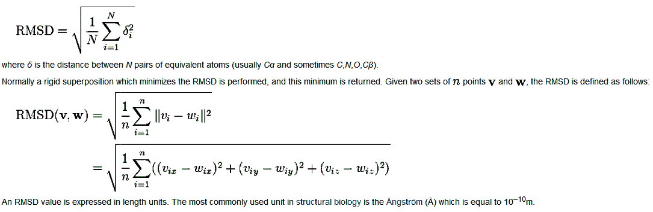
RMSD (root mean square deviation)
http://en.wikipedia.org/wiki/Root-mean-square_deviation_(bioinformatics)

Slide 15
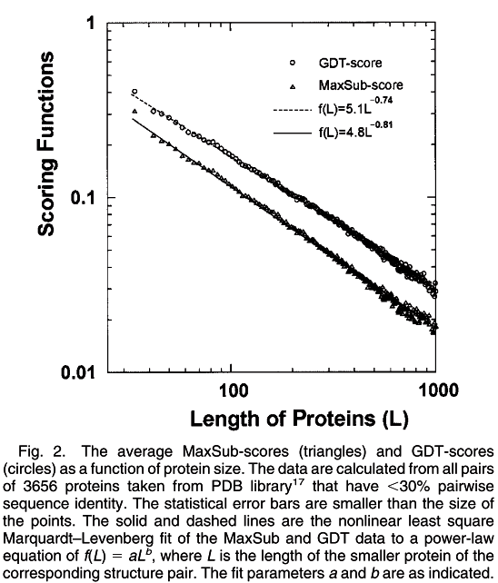
Problems on other measuring scores is the dependence of the score magnitudes on the evaluated proteins’ size. In other words, one must address the issue of what the corresponding score value of a pair of randomly related structures would be.
Yang Zhang et al., " Scoring Function for Automated Assessment of Protein Structure Template Quality "

Slide 16

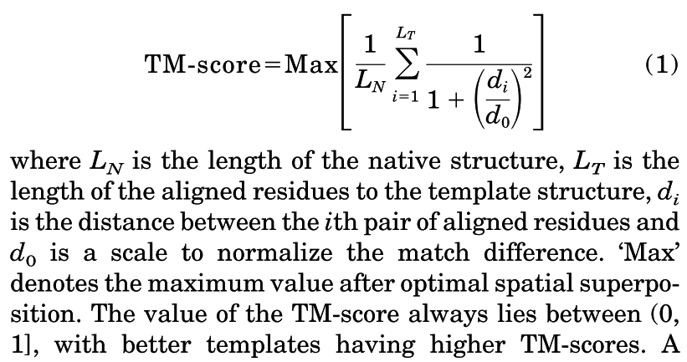
TM-score
Yang Zhang et al., " Scoring Function for Automated Assessment of Protein Structure Template Quality "

Slide 17
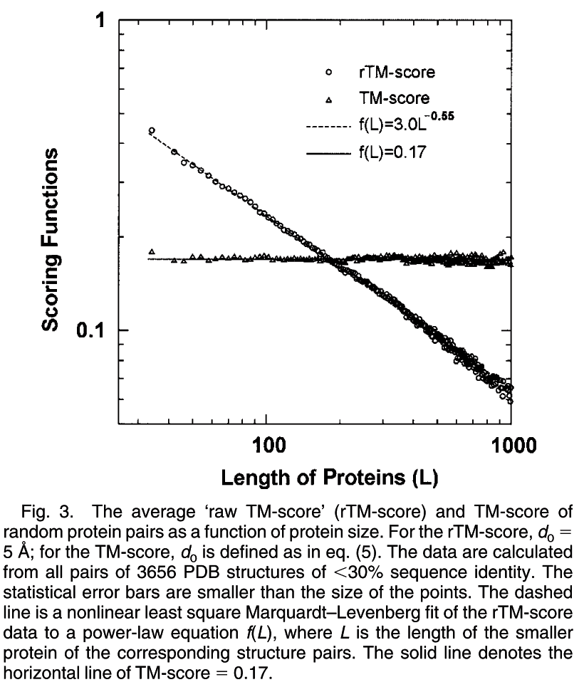
Yang Zhang et al., " Scoring Function for Automated Assessment of Protein Structure Template Quality "

Slide 18
The implementation issue of TM-score
To find the spatially optimal superposition of the template and the native structure that has the maximum TM-score, we use an iterative search algorithm. The process was repeated till the rotation matrix is converged.
Several initial conditions are given for the searching process and the highest TM-score is reported.
Yang Zhang et al., " Scoring Function for Automated Assessment of Protein Structure Template Quality "

Slide 19
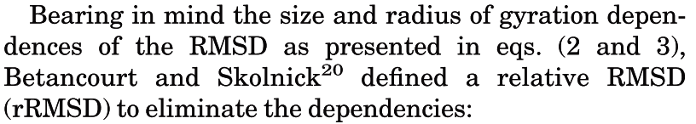
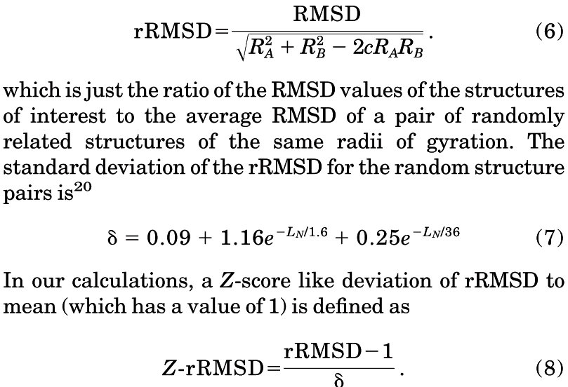
Z-Score of Relative RMSD
Yang Zhang et al., " Scoring Function for Automated Assessment of Protein Structure Template Quality "

Slide 20
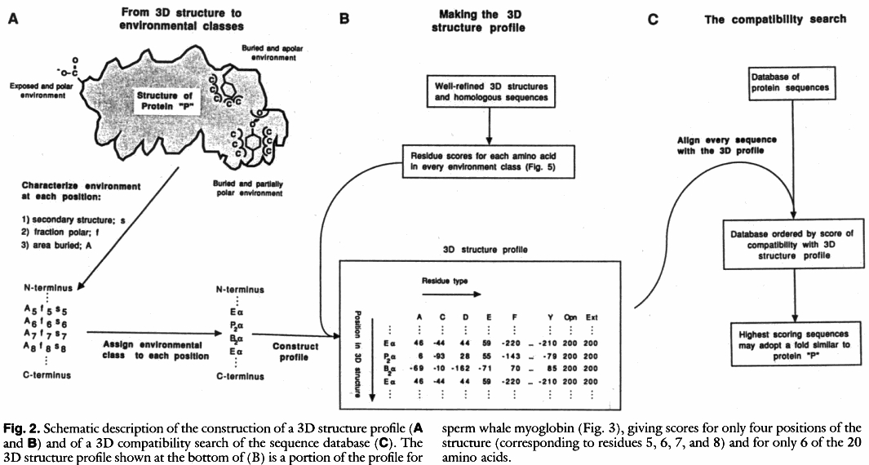
Self-compatibility scores (SCS)
Eisenberg_Science_1991_A method to identify protein sequences that fold into a known three-dimensional structure

Slide 21
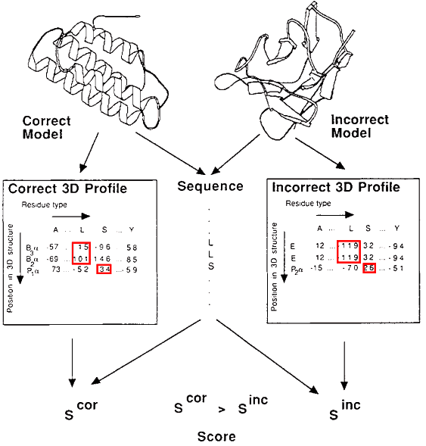
Self-compatibility scores (SCS)
-119
-119
26
15
101
34
Luthy et al. et al., " Assessment of protein models with three-dimensional profiles "

Slide 22
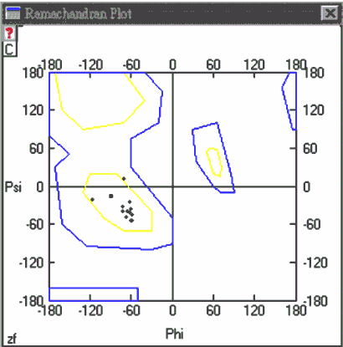
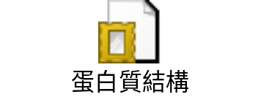
Ramachandran Plots
Ranmachandran plots展現出結構中所有residues的ψ角和Ψ角之扭轉角度(不包含chain termini)。在圖中所代表的區域，黃色區域內黑點存在的地方是表示ψ角和Ψ角最容易的組合方式，而藍色區域外面則表示sterically disallowed conformation的區域。理想的情況下，希望有90％以上的residues可以位於圖上的黃色核心區域。而residues落在核心區域裡的百分比，則可作為stereochemical quality的一個指標。
http://www.bio.fju.edu.tw/excel/content05/html/33.htm
http://mordred.bioc.cam.ac.uk/~rapper/rampage.php

Slide 23
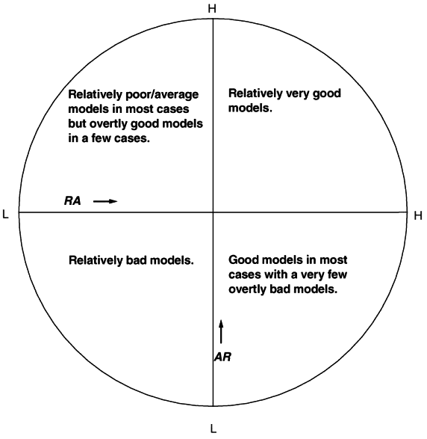
Rank then average (RA) or
Average then rank (AR)
Method1
  Scores: 100, 50, 50
  Ranks: 2, 1, 1
Method2
  Scores: 65, 65, 65
  Ranks: 1, 2, 2
Method1
  Avg score: 67
  Avg rank: 1.3
Method2
  Avg score: 65
  Avg rank: 1.7
Method1 vs Method2
  AR: 2, 1
  RA: 1,2
The higher the better

Slide 24
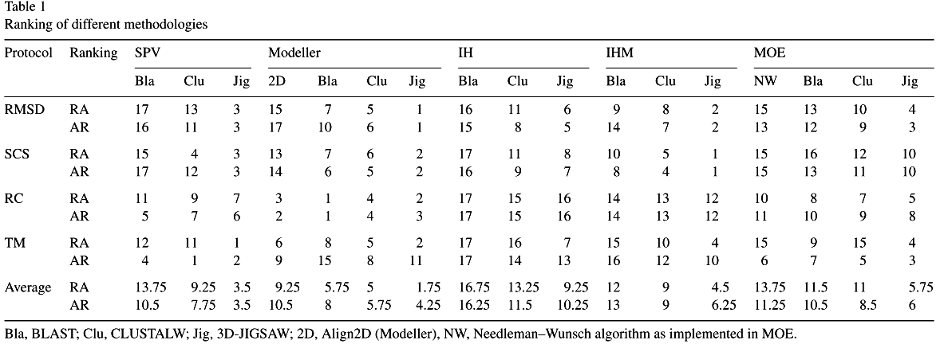
Experimental results
The lower the better
Modeller with 3D-JIGSAW alignment statistically gave models with relatively lowest RMSD values.
All methods gave lowest ranks with 3D-JIGSAW sequence alignment according to both ranking schemes followed by CLUSTALW.

Slide 25
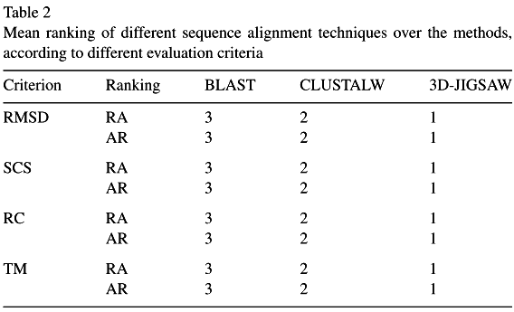
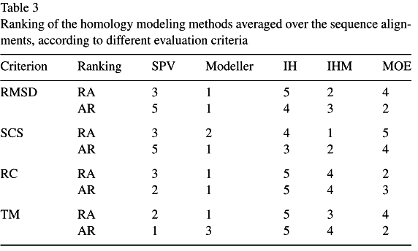
The lower the better
Both RA and AR ranks signify the best performance of 3D-JIGSAW amongst sequence alignments. All the methods performed better with 3D-JIGSAW sequence alignment.
All sequence alignments statistically performed best with Modeller.

Slide 26
An evaluation of automated homology modelling methods at low target–template sequence similarity
James A. R. Dalton and Richard M. Jackson
BIOINFORMATICS
Vol. 23, No. 15, pages 1901–1908, 2007

Slide 27
實驗目的與架構
Test dataset
Template
evaluation
SABmark
CE-MC
Sequence
alignment
Homology
modeling
Evaluation
SAlign
Staccato v1
3D-Coffee v3.79
Modeller v8.2
Nest v1.0
Builder v1.0
SegMod/ENCAD v1.0
Swiss-Model
RMSD
Z-score

Slide 28
Test dataset - SABmark
The modelling dataset was constructed from the SABmark database that contains sequences of low sequence identity (0–50%)
156 targets were extracted from SABmark. These targets and their respective templates (five for each target) constituted single-domain sequences from within the same SCOP Family, ensuring structural similarity amongst members
http://bioinformatics.oxfordjournals.org/content/21/7/1267.full
此Server已經連不上

Slide 29
CE-MC: a multiple protein structure alignment server
A web-based facility for the alignment of multiple protein structures based on C-α coordinate distances, using combinatorial extension (CE) and Monte Carlo (MC) optimization methods.
The user can also select optional Z-score cutoff and distance cutoff parameters. The Z-score cutoff is used to filter out the chains that have average Z-score below the cutoff, where the average Z-score for each chain is calculated from all pairwise Z-score values. This option is very useful for eliminating some very distant structures in the set that may reduce the overall alignment quality.
http://nar.oxfordjournals.org/content/32/suppl_2/W100.long
此Server已經連不上

Slide 30
Model evaluation
(1) Superposition of model onto native structure with the structure alignment program Structal (Gerstein and Levitt, 1998) and calculation of root mean square deviation (RMSD) of C-alpha atoms with ‘compare-structures’ function from Modeller v8.2.
(2) Generation of Z-score, a measure of statistical significance between matched structures, for the model using the structure alignment program CE, with scores >=4 indicating good structural similarity (Shindyalov and Bourne, 1998).

Slide 31
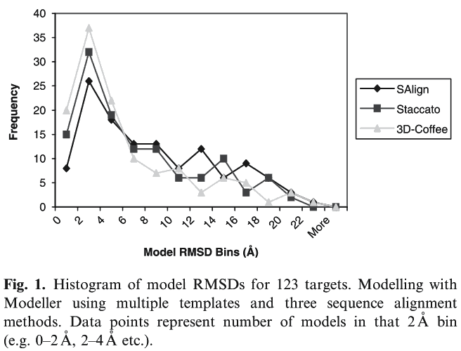
Sequence alignment benchmark
Each target was modelled with 3, 4 or 5 templates (i.e. multiple template modelling)
3D-Coffee generates noticeably more models of low RMSD and fewer models of high RMSD compared to the two other methods.

Slide 32
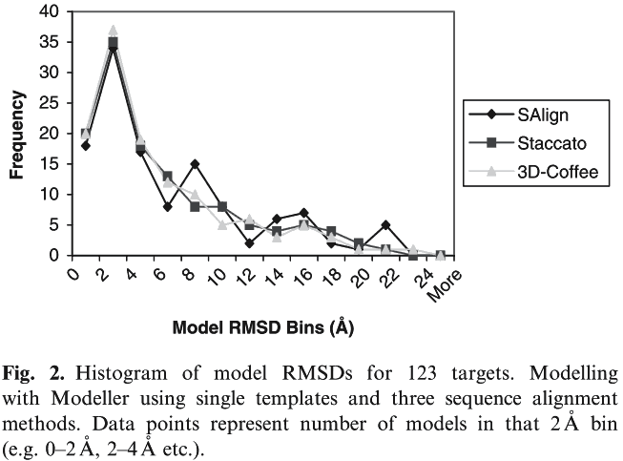
Sequence alignment benchmark
Each target was modelled with with just one, the best template in the group selected by lowest E-value (i.e. single-template modelling)

Slide 33
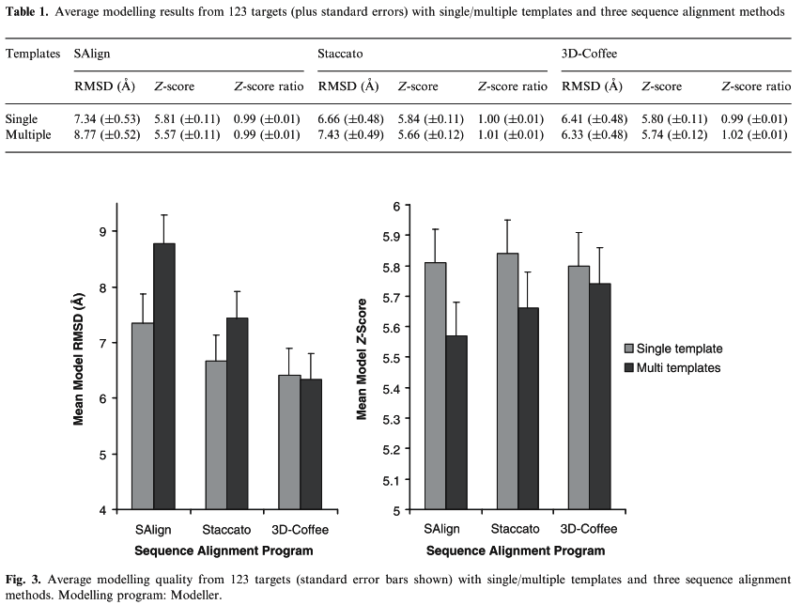

Slide 34
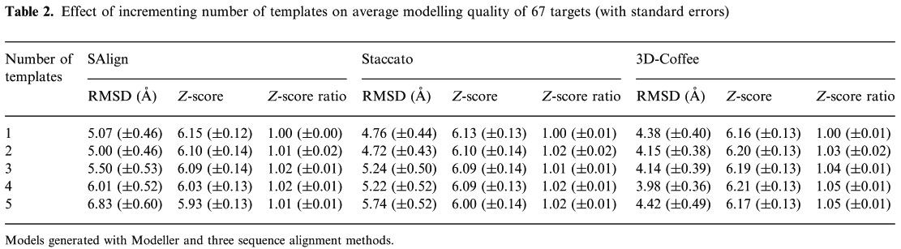
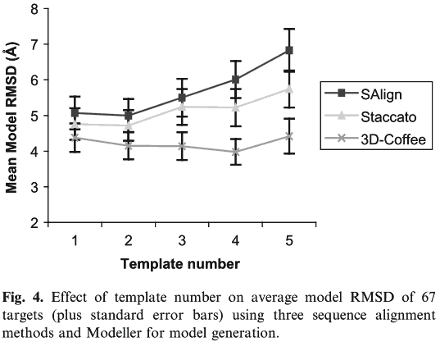
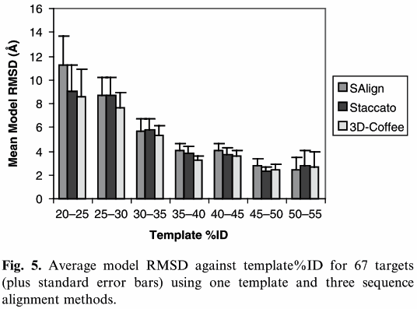

Slide 35
