Slide 1
Identification of Common Molecular Subsequences Journal of Molecular Biology vol. 147 pp. 195-197 (1981)
T.F. Smith
Northern Michigan University U.S.A.
M.S. Waterman
Los Alamos Scientific Laboratory
Presentor：Hsin-Chuan Yuan

Slide 2
Abstract
The identification of maximally homologous subsequences among sets of long sequences is an important problem in molecular sequence analysis. The problem is straightforward only if one restricts consideration to contiguous subsequences (segments) containing no internal deletions or insertions. The more general problem has its solution in an extension of sequence metrics developed to measure the minimum number of “events” required to convert one sequence into another.

Slide 3
Abstract
In this letter we extend the above ideas to find a pair of segments, one from each of two long sequences, such that there is no other pair of segments with greater similarity (homology). The similarity measure used here allows for arbitrary length deletions and insertions.

Slide 4


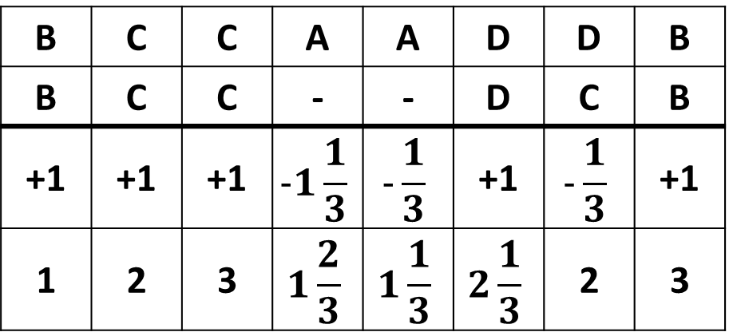
Algorithm
1, match
s={
-1/3, mismatch
B | C | C | A | A | D | D | B
B | C | C | - | - | D | C | B
+1 | +1 | +1 | $$-1\frac{1}{3}$$ | $$-\frac{1}{3}$$ | +1 | $$-\frac{1}{3}$$ | +1
1 | 2 | 3 | $$1\frac{2}{3}$$ | $$1\frac{1}{3}$$ | $$2\frac{1}{3}$$ | 2 | 3

Slide 5
Example
 | - | C | A | G | C | C | U | C | G | C | U | U | A | G
- | 0 | 0 | 0 | 0 | 0 | 0 | 0 | 0 | 0 | 0 | 0 | 0 | 0 | 0
A | 0 | 0 | 1 | 0 | 0 | 0 | 0 | 0 | 0 | 0 | 0 | 0 | 1 | 0
A | 0 | 0 | 1 | 0.7 | 0 | 0 | 0 | 0 | 0 | 0 | 0 | 0 | 1 | 0.7
U | 0 | 0 | 0 | 0.7 | 0.3 | 0 | 1 | 0 | 0 | 0 | 1 | 1 | 0 | 0.7
G | 0 | 0 | 0 | 1 | 0.3 | 0 | 0 | 0.7 | 1 | 0 | 0 | 0.7 | 0.7 | 1
C | 0 | 1 | 0 | 0 | 2 | 1.3 | 0.3 | 1 | 0.3 | 2 | 0.7 | 0.3 | 0.3 | 0.3
C | 0 | 1 | 0.7 | 0 | 1 | 3 | 1.7 | 1.3 | 1 | 1.3 | 1.7 | 0.3 | 0 | 0
A | 0 | 0 | 2 | 0.7 | 0.3 | 1.7 | 2.7 | 1.3 | 1 | 0.7 | 1 | 1.3 | 1.3 | 0
U | 0 | 0 | 0.7 | 1.7 | 0.3 | 1.3 | 2.7 | 2.3 | 1 | 0.7 | 1.7 | 2 | 1 | 1
U | 0 | 0 | 0.3 | 0.3 | 1.3 | 1 | 2.3 | 2.3 | 2 | 0.7 | 1.7 | 2.7 | 1.7 | 1
G | 0 | 0 | 0 | 1.3 | 0 | 1 | 1 | 2 | 3.3 | 2 | 1.7 | 1.3 | 2.3 | 2.7
A | 0 | 0 | 1 | 0 | 1 | 0.3 | 0.7 | 0.7 | 2 | 3 | 1.7 | 1.3 | 2.3 | 2
C | 0 | 1 | 0 | 0.7 | 1 | 2 | 0.7 | 1.7 | 1.7 | 3 | 2.7 | 1.3 | 1 | 2
G | 0 | 0 | 0.7 | 1 | 0.3 | 0.7 | 1.7 | 0.3 | 2.7 | 1.7 | 2.7 | 2.3 | 1 | 2
G | 0 | 0 | 0 | 1.7 | 0.7 | 0.3 | 0.3 | 1.3 | 1.3 | 2.3 | 1.3 | 2.3 | 2 | 2
GCCAUUG
GCC--UCG

Slide 6
Conclusions
This algorithm not only puts the search for pairs of maximally similar segments on a mathematically rigorous basis but it can be efficiently and simply programmed on a computer.

