Slide 1
Longest Common Subsequences of Two Random Sequences
Author(s): Vacláv Chvátal and David Sankoff Source: Journal of Applied Probability, Vol. 12, No. 2 (Jun., 1975), pp. 306-315
Date: 2013/12/30
Presenter: 周展億

Slide 2
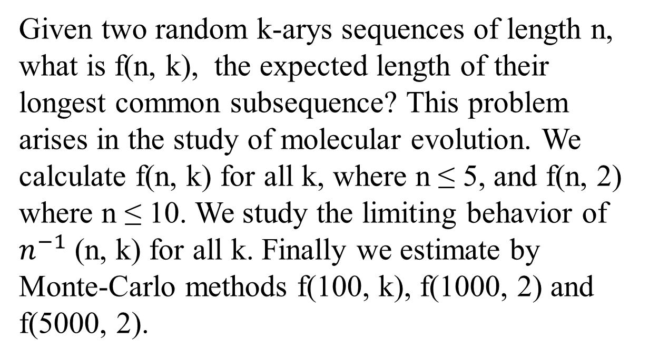
Abstract
Given two random k-arys sequences of length n, what is f(n, k), the expected length of their longest common subsequence? This problem arises in the study of molecular evolution. We calculate f(n, k) for all k, where n ≤ 5, and f(n, 2) where n ≤ 10. We study the limiting behavior of $n^{−1}$(n, k) for all k. Finally we estimate by Monte-Carlo methods f(100, k), f(1000, 2) and f(5000, 2).

Slide 3
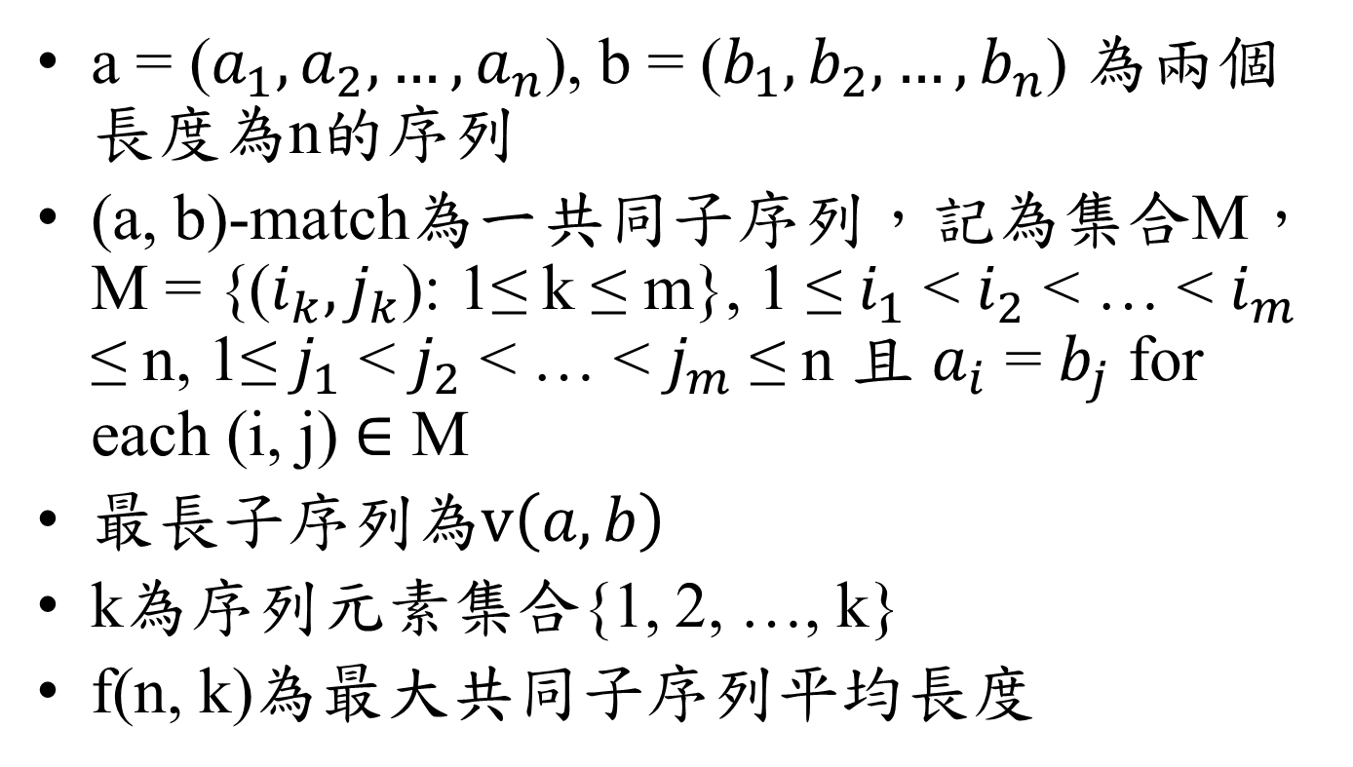
Introduction
a = ($a_{1},a_{2},…,a_{n}$), b = ($b_{1},b_{2},…,b_{n}$) 為兩個長度為n的序列
(a, b)-match為一共同子序列，記為集合M，M = {($i_{k},j_{k}$): 1≤ k ≤ m}, 1 ≤ $i_{1}$ < $i_{2}$ < … < $i_{m}$ ≤ n, 1≤ $j_{1}$ < $j_{2}$ < … < $j_{m}$ ≤ n 且 $a_{i}$ = $b_{j}$ for each (i, j) $∈$ M
最長子序列為$v\left(a,b\right)$
k為序列元素集合{1, 2, …, k}
f(n, k)為最大共同子序列平均長度

Slide 4
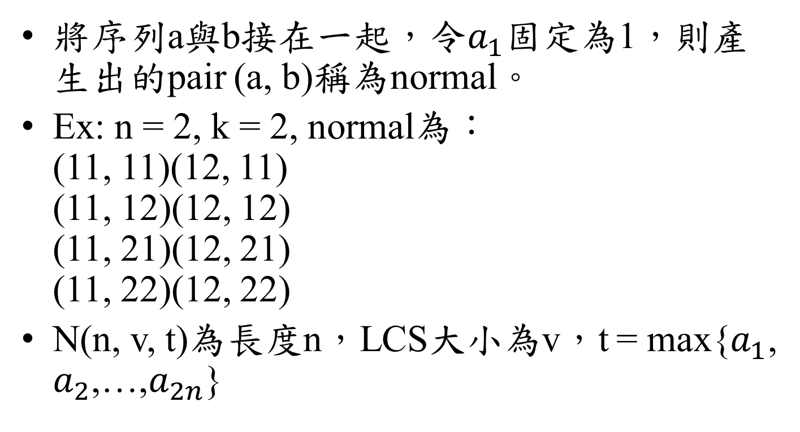
Exact formulae for f(n, k) with small n
將序列a與b接在一起，令$a_{1}$固定為1，則產生出的pair (a, b)稱為normal。
Ex: n = 2, k = 2, normal為： (11, 11)(12, 11) (11, 12)(12, 12) (11, 21)(12, 21) (11, 22)(12, 22)
N(n, v, t)為長度n，LCS大小為v，t = max{$a_{1}$, $a_{2}$,…,$a_{2n}$}

Slide 5
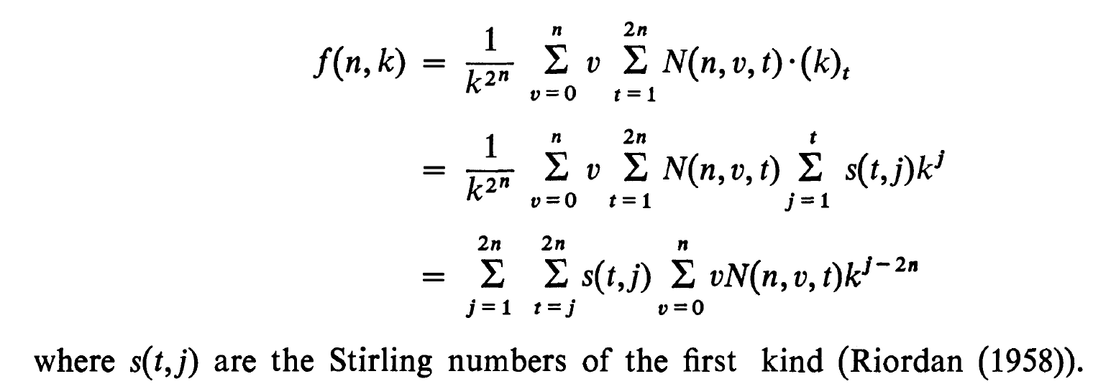
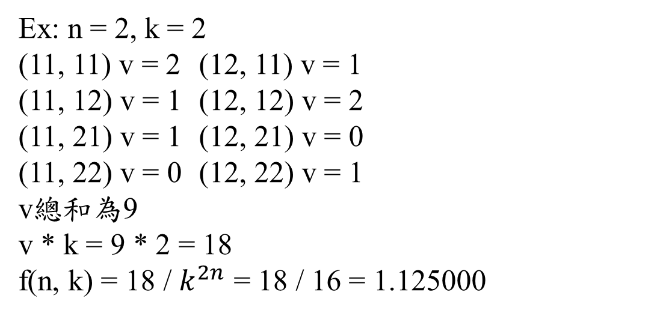
Exact formulae for f(n, k) with small n
Ex: n = 2, k = 2 (11, 11) v = 2 (12, 11) v = 1 (11, 12) v = 1 (12, 12) v = 2 (11, 21) v = 1 (12, 21) v = 0 (11, 22) v = 0 (12, 22) v = 1 v總和為9 v * k = 9 * 2 = 18
f(n, k) = 18 / $k^{2n}$ = 18 / 16 = 1.125000

Slide 6
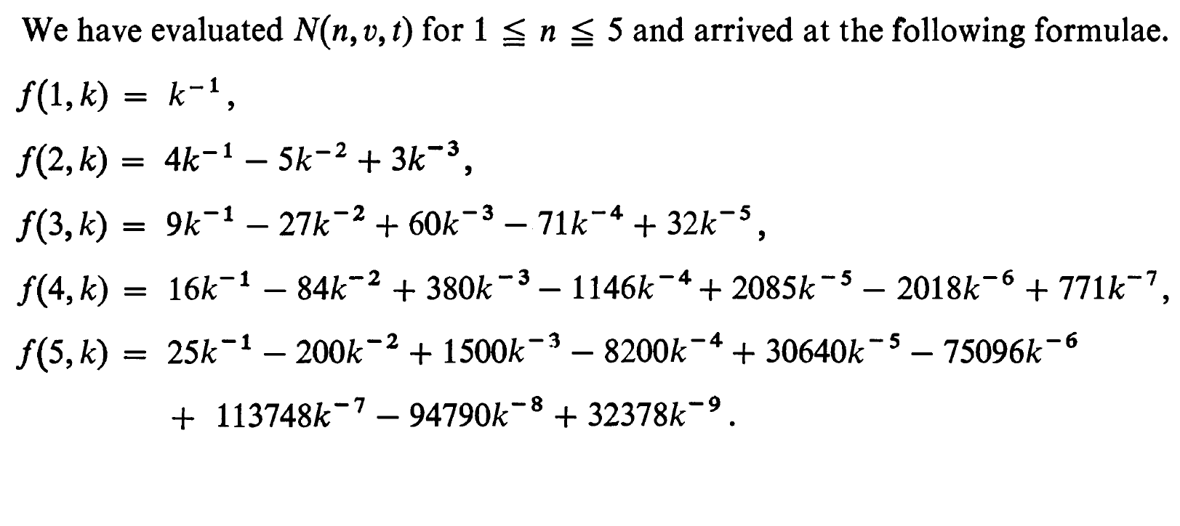
Exact formulae for f(n, k) with small n

Slide 7
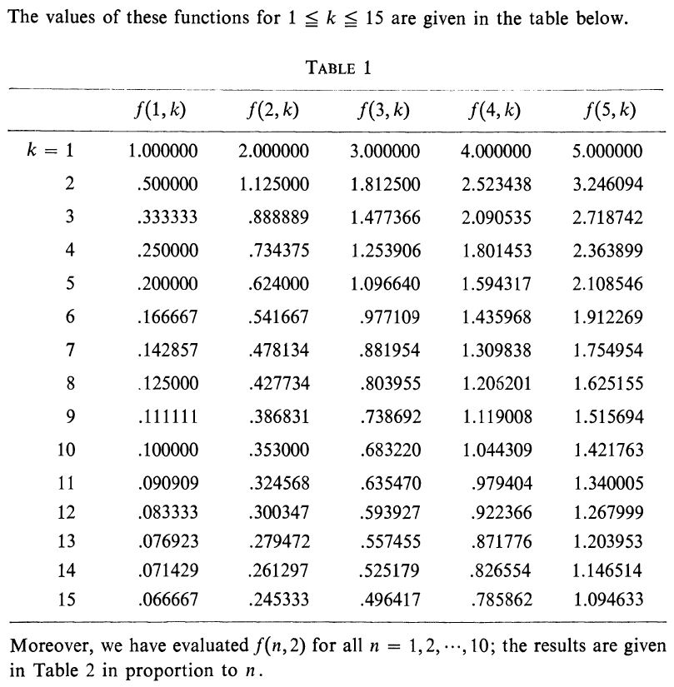
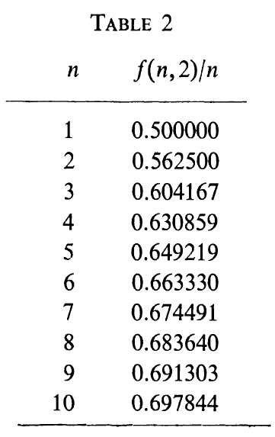

Slide 8

Limiting behavior of f(n, k)
$c_{k}$ =$\lim_{n→∞}{n^{−1}}$f(n, k)
Is $c_{2}$ = 1 ?
$\lim_{k→∞}$ $c_{k}$ = 0

Slide 9
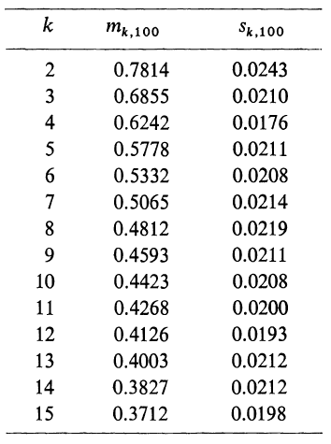
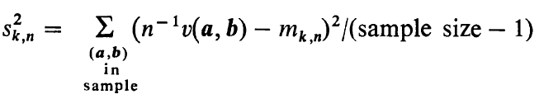
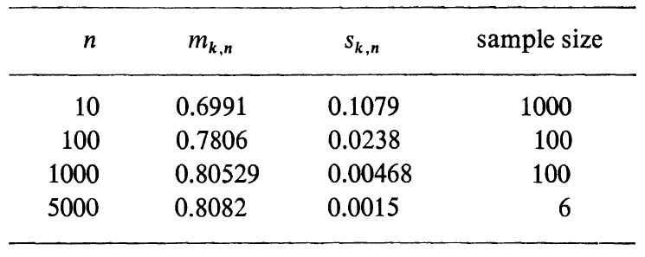
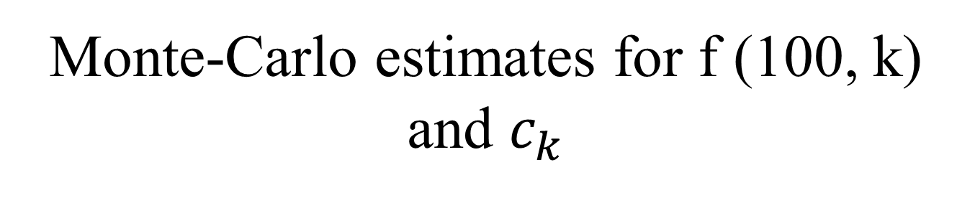
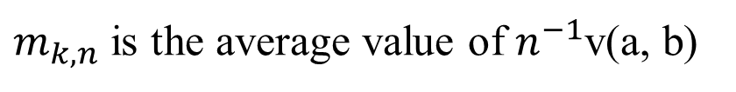
Monte-Carlo estimates for f (100, k) and $c_{k}$
$m_{k,n}$ is the average value of $n^{−1}$v(a, b)
k = 2
On the basis of these simulations, it seems fair to conjecture that c2 > 4/5

