Slide 1
The Complexity of Some Problems on Subsequences
and Supersequences
DAVID MAIER
Journal of the ACM (JACM)
Volume 25 Issue 2, April 1978 Pages 322-336
Presenter: Jun-Yi Fang
Date:2013.12.30

Slide 2
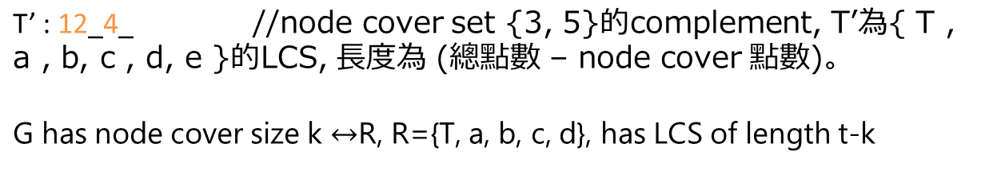
“_”為輔助標示，不為字元
T : 12345 //所有的點集合;
a
b
c
d
1
a : _2345 12_45 // 1 - 3
2
b : 1_345 12_45 // 2 - 3
3
c : 12_45 1234_ // 3 - 5
d : 1234_ 123_5 // 5 - 4
4
5

Slide 3
// k.k表示4r + 2t 個 k 字符
T: 0.0✱✱0.0✱✱0.0✱✱0.0✱✱0.0 1.1✱1.1✱1.1✱1.1✱1.1✱1.1 0.0✱✱0.0✱✱0.0✱✱0.0✱✱0.0
a: 0.00.0✱✱0.0✱✱0.0✱✱0.0 1.11.1✱1.1✱1.1✱1.1✱1.1 0.0✱✱0.0✱✱0.0✱✱0.0✱✱00
// _ b c d _ 2 3 4 5 a b c d
1.1✱1.1✱1.11.1✱11✱1.1 0.00.0✱✱0.0✱✱0.0✱✱0.0
1 2 _ 4 5 _ b c d
b: 0.0✱✱0.00.0✱✱0.0✱✱0.0 1.1✱1.11.1✱1.1✱1.1✱1.1 0.0✱✱0.0✱✱0.0✱✱0.0✱✱00
1.1✱1.1✱1.11.1✱11✱1.1 0.0✱✱0.00.0✱✱0.0✱✱0.0
c: 0.0✱✱0.0✱✱0.00.0✱✱0.0 1.1✱1.1✱1.11.1✱1.1✱1.1 0.0✱✱0.0✱✱0.0✱✱0.0✱✱00
1.1✱1.1✱1.1✱1.1✱111.1 0.0✱✱0.0✱✱0.00.0✱✱0.0
d: 0.0✱✱0.0✱✱0.0✱✱0.00.0 1.1✱1.1✱1.1✱1.1✱1.11.1 0.0✱✱0.0✱✱0.0✱✱0.0✱✱00
1.1✱1.1✱1.1✱1.11.1✱1.1 0.0✱✱0.0✱✱0.0✱✱0.00.0
T: abcd 12345 abcd
a: _bcd _2345 abcd 12_45 _bcd // 1 - 3
b: a_cd 1_345 abcd 12_45 a_cd // 2 - 3
c: ab_d 12_45 abcd 1234_ ab_d // 3 - 5
d: abc_ 1234_ abcd 123_5 abc_ // 5 - 4
1
a
b
c
d
2
3
4
5

Slide 4
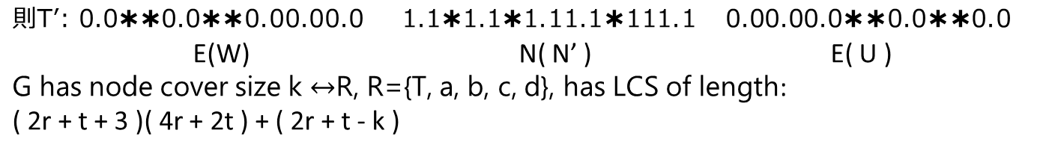
N ={1, 2, 3, 4, 5}, N’={3, 5}
a: (1, 3 )
b: (2, 3 )
c: (3, 5 )
d: (5, 4 )
(s, t), s ϵN’ → (s, t) ϵ W ;Else (s, t) ϵ U
{c, d}ϵ W
{a, b} ϵ U
1
a
b
c
d
2
3
4
5
T’:ab__ 12_4_ __cd
T: abcd 12345 abcd
a: _bcd _2345 abcd 12_45 _bcd
b: a_cd 1_345 abcd 12_45 a_cd
c: ab_d 12_45 abcd 1234_ ab_d
d: abc_ 1234_ abcd 123_5 abc_
//若d改成(4, 5)
T’:ab__ 12_4_ __cd
T: abcd 12345 abcd
a: _bcd _2345 abcd 12_45 _bcd
b: a_cd 1_345 abcd 12_45 a_cd
c: ab_d 12_45 abcd 1234_ ab_d
d: abc_ 123_5 abcd 1234_ abc_

Slide 5
T: 0.0110.0110.0110.0110.0 1.101.101.101.101101.1 0.0110.0110.0110.0110.0
a: 0.00.0110.0110.0110.0 1.11.101.101.101101.1 0.0110.0110.0110.01100
1.101.101.11.101101.1 0.00.0110.0110.0110.0
b: 0.0110.00.0110.0110.0 1.101.11.101.101101.1 0.0110.0110.0110.01100
1.101.101.11.101101.1 0.0110.00.0110.0110.0
c: 0.0110.0110.00.0110.0 1.101.101.11.101101.1 0.0110.0110.0110.01100
1.101.101.101.10111.1 0.0110.0110.00.0110.0
d: 0.0110.0110.0110.00.0 1.101.101.101.11101.1 0.0110.0110.0110.01100
1.101.101.101.10111.1 0.0110.0110.0110.00.0
T’: 0.0110.0110.00.00.0 1.101.101.11.10111.1 0.00.00.0110.0110.0
T: abcd 12345 abcd
a: _bcd _2345 abcd 12_45 _bcd
b: a_cd 1_345 abcd 12_45 a_cd
c: ab_d 12_45 abcd 1234_ ab_d
d: abc_ 1234_ abcd 123_5 abc_
T’:ab__ 12_4_ __cd
1
a
b
c
d
2
3
4
5

Slide 6
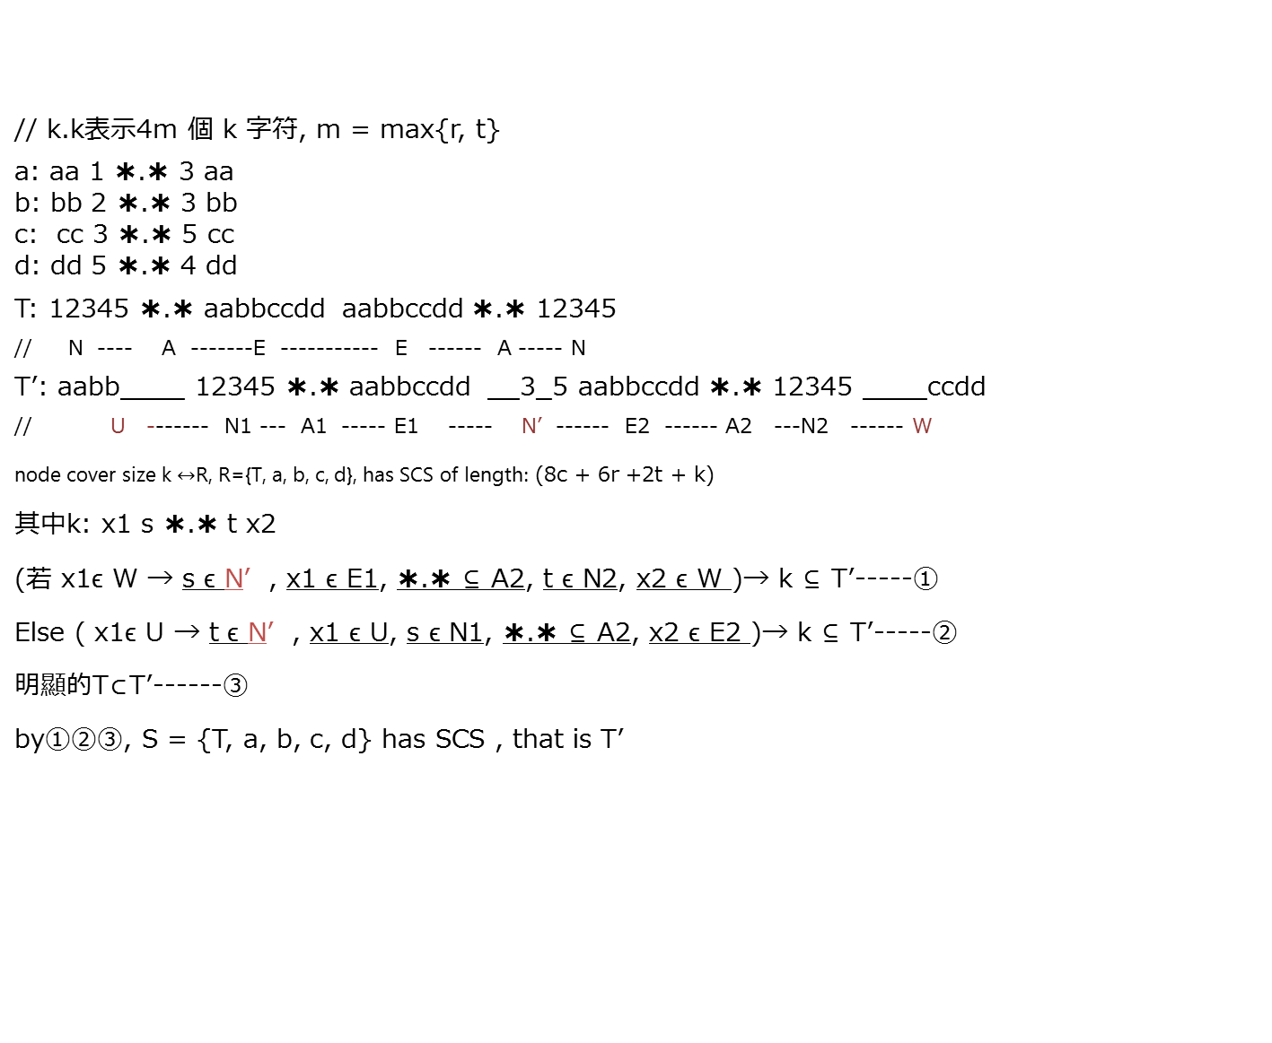
//(s, t), s ϵN’ → (s, t) ϵ W ;Else (s, t) ϵ U
W = {c, d} ,
U = {a, b}
N = {1, 2, 3, 4, 5},
N’ = {3, 5}
1
a
b
c
d
2
3
4
5
a: aa --------1 ----- ✱.✱---------------3----aa
b: bb -------2 ----✱.✱ --------------3------bb
c: cc------3 --------------✱.✱------5-------cc
d: dd------5------------✱.✱-----4-----------dd
T: 12345 ✱.✱ aabbccdd aabbccdd ✱.✱ 12345
T’: aabb____ 12345 ✱.✱ aabbccdd __3_5 aabbccdd ✱.✱ 12345 ____ccdd

Slide 7
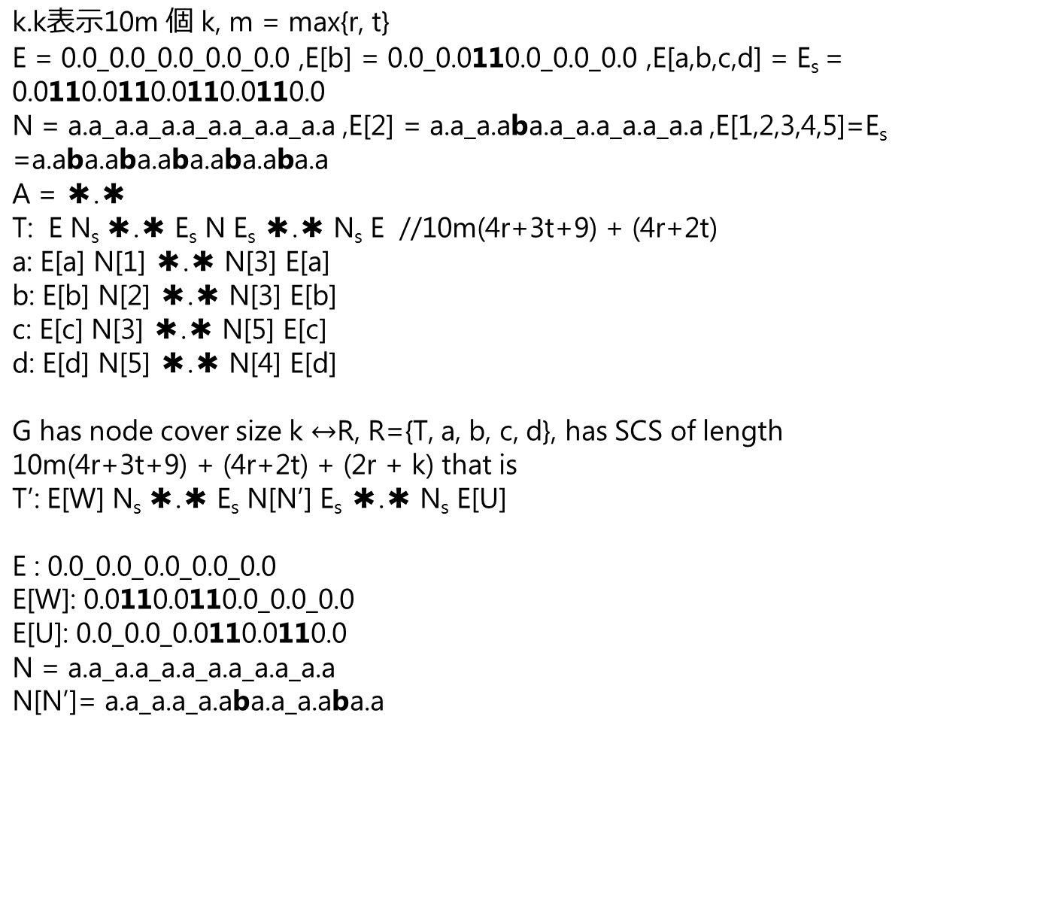
1
a
b
c
d
2
3
4
5
//(s, t), s ϵN’ → (s, t) ϵ W ;Else (s, t) ϵ U
W = {c, d} ,
U = {a, b}
N = {1, 2, 3, 4, 5},
N’ = {3, 5}

