Slide 1
An O(NP) Sequence Comparison Algorithm
Sun WU, Udi MANBER *, Gene MYERS * *
Information Processing Letters 35 (1990) 317-323
Presenter:De-Sheng Chan
2015/03/10

Slide 2
Abstract
Let A and B be two sequences of length M and N respectively, where without loss of generality N ≧ M, and let D be the length of a shortest edit script (consisting of insertions and deletions) between them. A parameter related to D is the number of deletions in such a script, P=D/2-(N-M)/2. We present an algorithm for finding a shortest edit distance of A and B whose worst-case running time is O(NP) and whose expected running time is O(N+PD). The algorithm is simple and is very efficient whenever A is similar to a subsequence of B. It is nearly twice as fast as the O(ND) algorithm of Myers, and much more efficient when A and B differ substantially in length.

Slide 3
Shortest Edit Script (SES)
A = a₁a₂a₃…a_{M} = acbdeacbed
B = b₁b₂b₃…b_{N} = acebdabbabed,
M = 10, N = 12, M ≦ N
delete / insert
SES = D = 6, P = 2
P = D/2 – (N-M)/2
because there are D insertions and deletions and N – M more insertions than deletions.
acebdeacbbabed
acebdabbabed

Slide 4
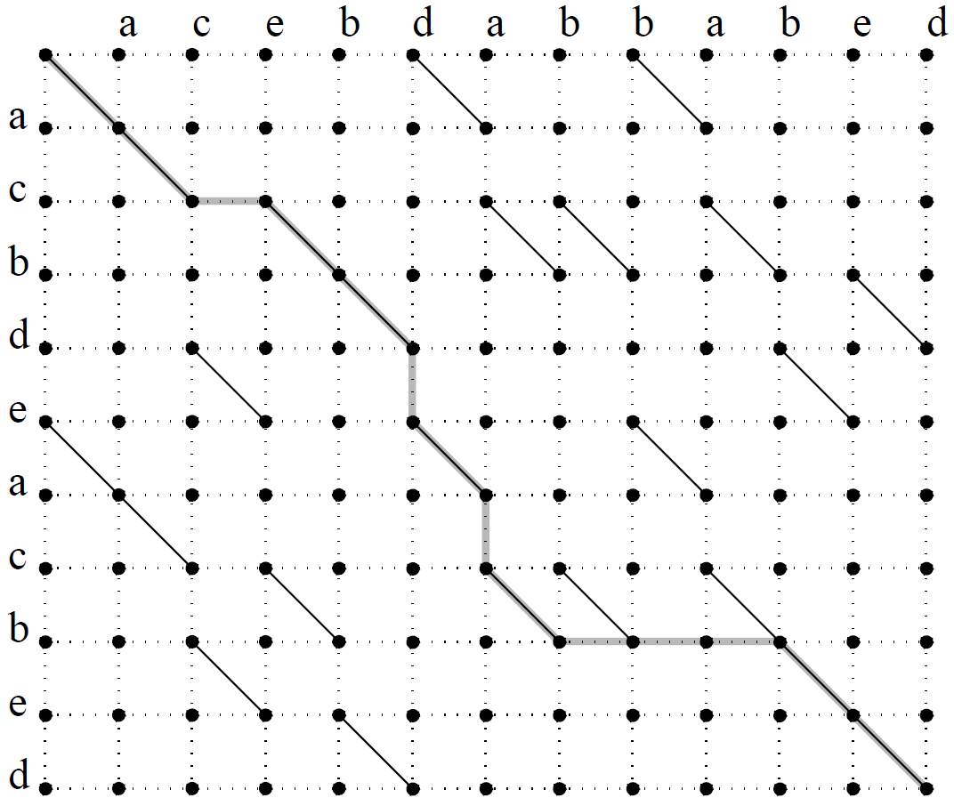


Slide 5
Diagonal k
M = 10, N = 12
∆ = N – M = 2
Diagonal ∆ = 2
0
1
2
. . .
12
-1
-2
Vertex(3, 7) on
diagonal 4.
.
.
.
-10

Slide 6
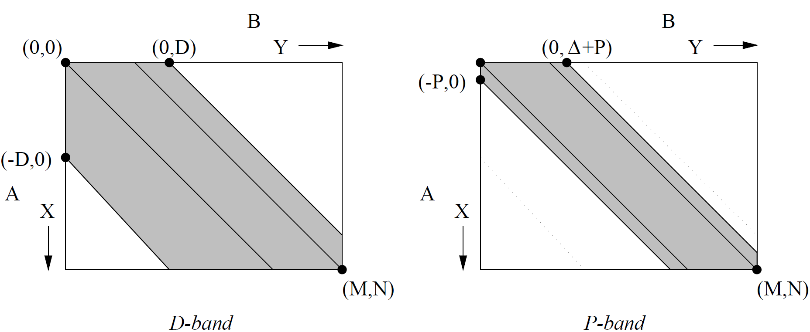
D-band and P-band
Myers, An O(ND) difference algorithm
and its variations.

Slide 7
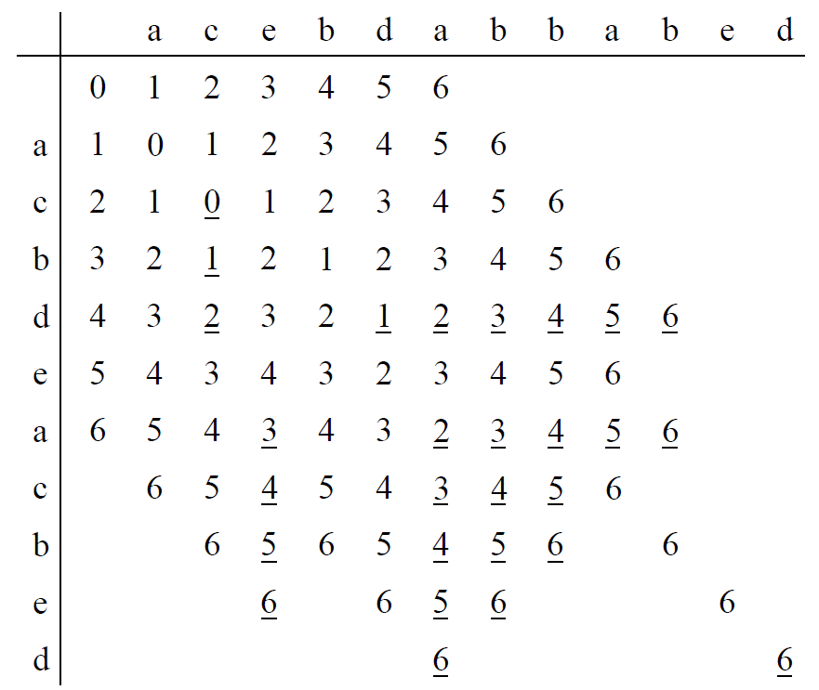
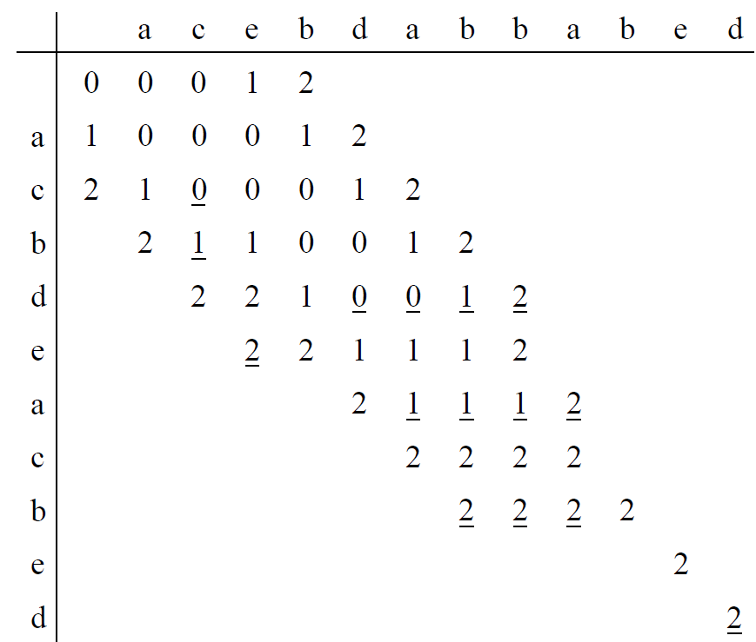
D-values and P-values
D-values
P-values
P = D/2 – (N-M)/2

Slide 8
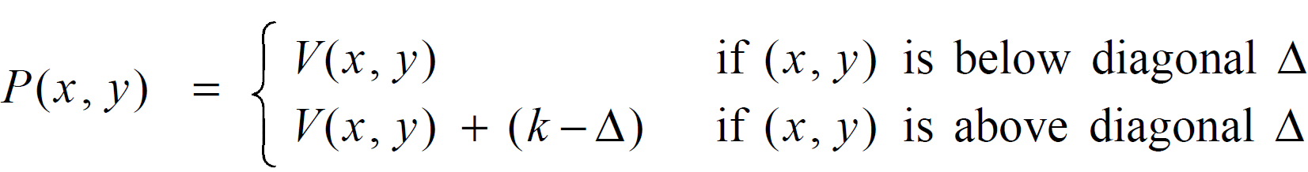
Compressed Distance
V(x, y) : the number of vertical
edges in a short path to (x, y)

Slide 9

Farthest p-points
fp(0, 0) = 2
fp(1, 0) = 5
fp(2, 0) = 6
FP(0) = {(2, 2), (4, 5), (4, 6)}

Slide 10
snake(k, y)
snake(k, y) = max{z: a_{y+1-k} … a_{z-k} = b_{y+1} … b_{z}}.
snake(1, 3) = 5

Slide 11
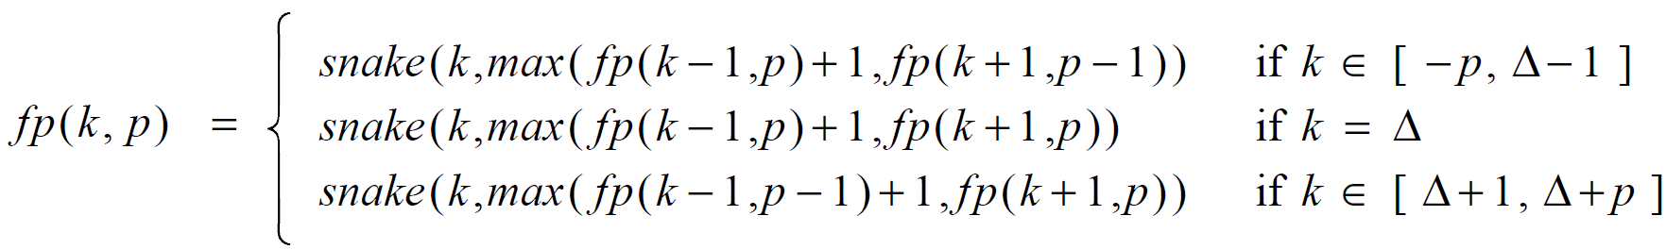
fp(k, p)

Slide 12
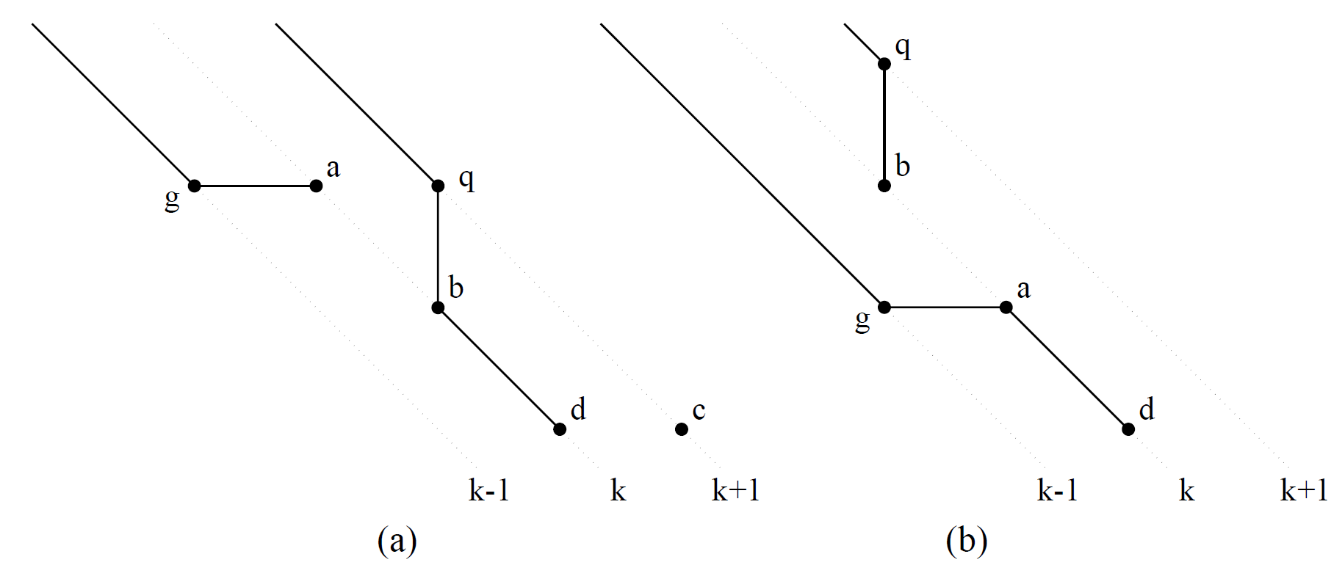
fp(k, p)
p-1
p
p-1
p
p
p
p
p

Slide 13
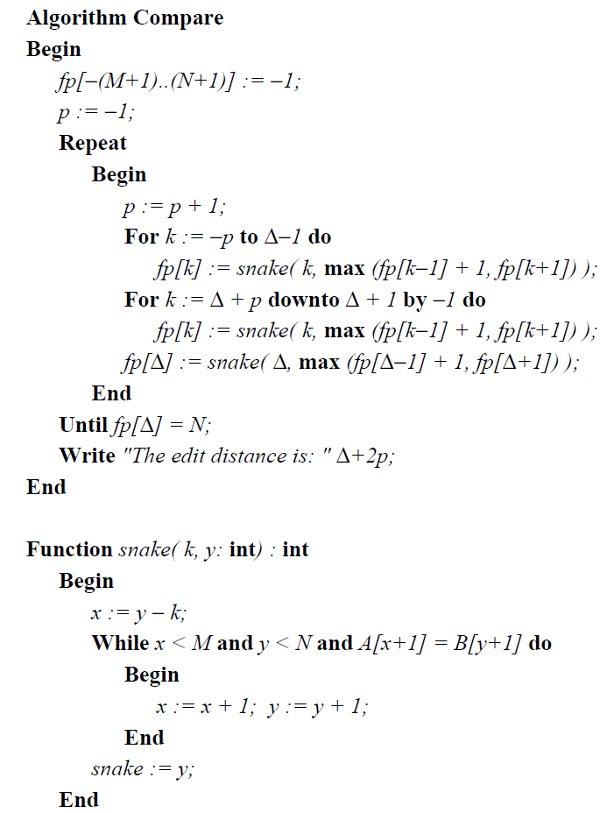
The O(NP) algorithm

Slide 14
Example
A = acbdeacbed , B = acebdabbabed
P = 0
fp[0] = 2, fp[1] = 5, fp[2] = 6
P = 1
fp[-1] = 2, fp[0] = 6, fp[1] = 7
fp[2] = 8, fp[3] = 7
P = 2
fp[-2] = 3, fp[-1] = 7, fp[0] = 8
fp[1] = 9, fp[2] = 12, fp[3] = 9
fp[4] = 8

Slide 15
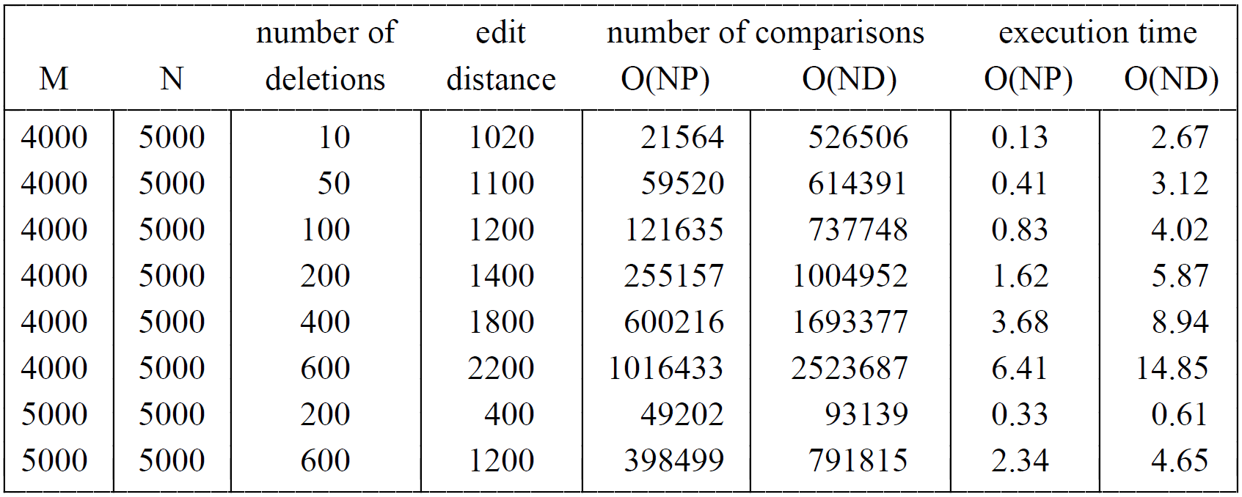
Experimental Results

Slide 16
Thanks for listening

