Slide 1
Fast optimization of hyperparameters for support vector regression models with highly predictive ability
Hiromasa Kaneko, Kimito Funatsu
Chemometrics and Intelligent Laboratory Systems 142 (2015) pp. 64–69
Presenter: Ding Yao, Huang
Date:2015/3/10

Slide 2
Abstract
Support vector regression (SVR) attracts much attention in chemometrics as a nonlinear regression method due to its theoretical background. In SVR modeling, three hyperparameters must be set beforehand.
The optimization method based on grid search (GS) and cross-validation (CV) is employed normally in the selection of the SVR hyperparameters. However, this takes enormous time.
Although theoretical techniques exist to decide the values of the SVR hyperparameters, predictive ability of SVR models is not considered in the decision.

Slide 3
Abstract
We therefore proposed a method based on the GS and CV method and theoretical techniques for fast optimization of the SVR hyperparameters, considering predictive ability of SVR models.
After values of two hyperparameters are decided theoretically, each hyperparameter is optimized independently with GS and CV. The highly predictive ability of SVR models and small computational time for the proposed method are confirmed through the case studies using real data sets.

Slide 4
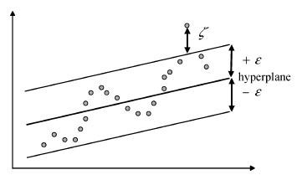

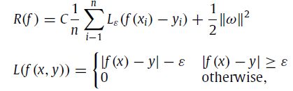

Introduction (Support Vector Regression)
Support Vector Regression 是結構誤差風險最小化原則，兼具經驗誤差風險和信賴區間雙方影響，而不是單方面求經驗誤差最小化
x_{i} 是輸入向量，y_{i} 是實際目標值
是經驗誤差風險(empirical error risk)

Slide 5
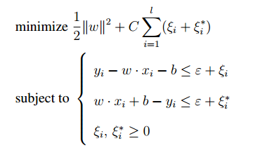
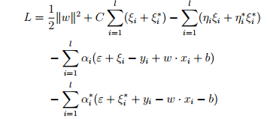

Introduction (Support Vector Regression)
利用 Lagrange multiplier

Slide 6
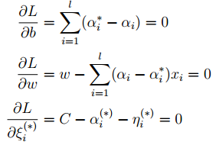
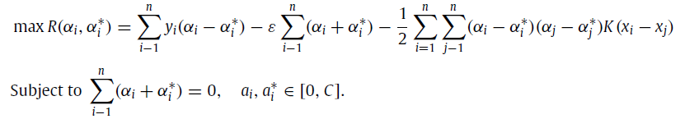
Introduction (Support Vector Regression)
對偶最大化

Slide 7


Support vector regression (kernel function)
根據Karush-Kuhn-Tucker(KKT) conditions 解b
可發現計算 f(x) 的複雜度和 x 的維度 無關，Support Vector (α_{i} − α_{i}∗ 不為零的 instances) 的個數有關
將線性系統 轉成 非線性系統
kernel function
linear: u'*v
polynomial: (gamma*u'*v + coef0)^degree
radial basis function: exp(-gamma*|u-v|^2)
sigmoid: tanh(gamma*u'*v + coef0)

Slide 8
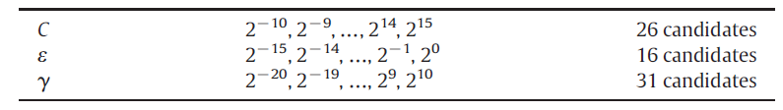
Introduction(GS)
Grid search
C | 2⁻¹⁰ | 2⁻⁵ | 2⁰ | 2⁵ | 2¹⁰
ε | 2⁻¹⁰ | 2⁻⁵ | 2⁰ | 2⁵ | 2¹⁰
γ | 2⁻¹⁰ | 2⁻⁵ | 2⁰ | 2⁵ | 2¹⁰

Slide 9
Introduction(GS)
Grid search
C | 2⁻¹⁰ | 2⁻⁵ | 2⁰ | 2⁵ | 2¹⁰
ε | 2⁻¹⁰ | 2⁻⁵ | 2⁰ | 2⁵ | 2¹⁰
γ | 2⁻¹⁰ | 2⁻⁵ | 2⁰ | 2⁵ | 2¹⁰

Slide 10
Introduction(GS)
Grid search
C | 2⁻¹⁰ | 2⁻⁵ | 2⁰ | 2⁵ | 2¹⁰
ε | 2⁻¹⁰ | 2⁻⁵ | 2⁰ | 2⁵ | 2¹⁰
γ | 2⁻¹⁰ | 2⁻⁵ | 2⁰ | 2⁵ | 2¹⁰
Total : 26*16*31=12896

Slide 11
Introduction(CV)
Cross validation:
Evaluating the predictive ability of SVR model
Blue : training data Yellow : test data

Slide 12
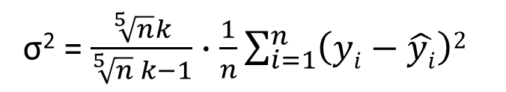
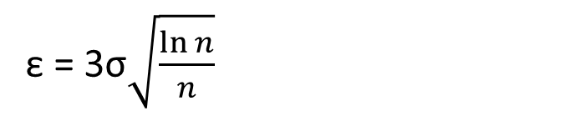
Introduction(ThD)
Analytical selection C directly from the training data
C = max(|m_{y} + 3S_{y}|,| m_{y} - 3S_{y} |)
m_{y} is the average of y
S_{y} is the standard deviation of y
ε = 3σ$\sqrt{\frac{\ln{n}}{n}}$
n is the number of training data
k is recommended to be 3
σ² = $\frac{\sqrt[5]{n}k}{\sqrt[5]{n} k−1}∙\frac{1}{n}\sum_{i=1}^{n}{\left(yi−\hat{yi}\right)2}$
V. Cherkassky, Y.Ma, Practical selection of SVM parameters and noise estimation for SVM regression, Neural Netw. 17 (2004) 113–126

Slide 13


Introduction(ThD)
Although this theoretical decision takes little time because CV is not required and no SVR model is constructed, predictive ability of SVR models is not considered through the decision procedure.
V. Cherkassky, Y.Ma, Practical selection of SVM parameters and noise estimation for SVM regression, Neural Netw. 17 (2004) 113–126

Slide 14
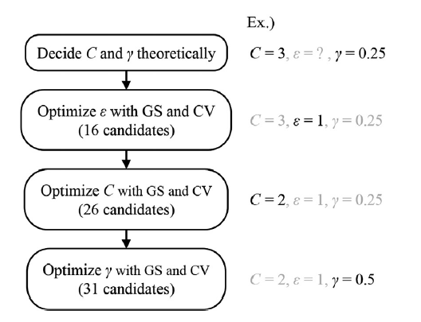
Proposed method

Slide 15
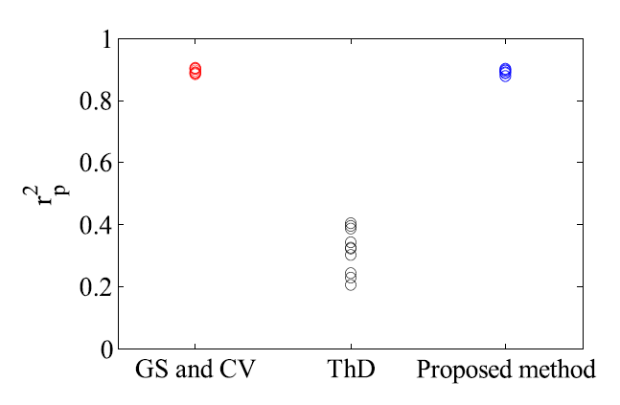
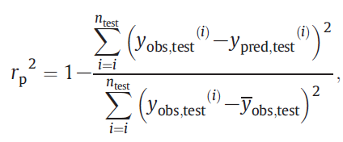
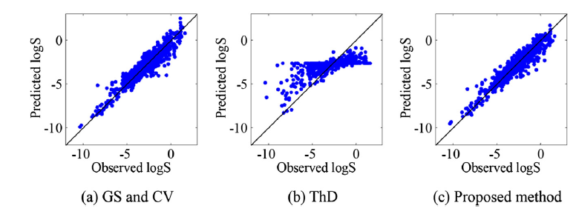
Results
(aqueous solubility)
Randomly 10 times

Slide 16
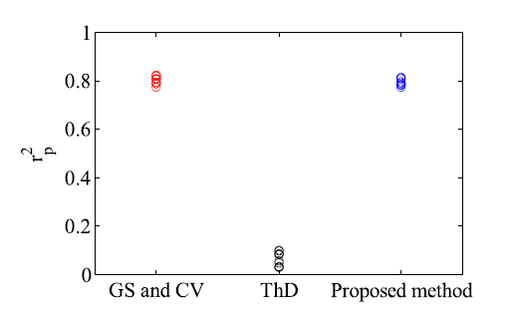
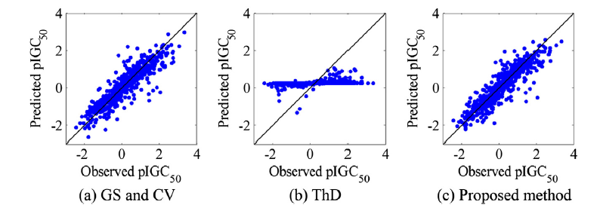
Results
(pIGC50)

Slide 17
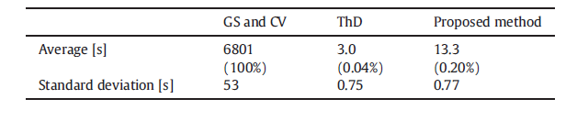
Results(time)

Slide 18
Conclusions
In this paper, a fast optimization method of the SVR hyperparameters is proposed by combining the theoretical techniques and the GS and CV method.
After C and γ are decided theoretically, ε, C and γ are optimized with GS and CV independently. Therefore the proposed method can consider predictive ability of SVR models and needs little time for optimizing the SVR hyperparameters.
Through the case studies using the QSPR data and QSAR data, it was confirmed that the SVR hyperparameters with which the predictive SVR models could be constructed were able to be quickly selected by using the proposed method.
As is mentioned in “Proposed method”, the proposed method can be combined with external validation instead of CV.
Notes:
QSPR QSAR 指的是化合物結構參數跟生物活性數據以一定的數學模型關聯起來的定量關係

