Slide 1
Restricted LCS
Zvi Gotthilf, Danny Hermelin,
Gad M. Landau, and Moshe Lewenstein
String Processing and Information Retrieval
Lecture Notes in Computer Science Volume 6393,,pp. 250-257(2010)
Presenter: Shian-Liang Lin

Slide 2
Abstract
The Longest Common Subsequence (LCS) of two or more strings is a fundamental well-studied problem which has a wide range of applications throughout computational sciences.
When the common sub-sequence must contain one or more constraint strings as subsequences,the problem becomes the Constrained LCS (CLCS) problem.
In this paper we consider the Restricted LCS (RLCS) problem, where our goal is finding a longest common subsequence between two or more strings that
does not contain a given set of restriction strings as subsequences.
First we show that in case of two input strings and an arbitrary number of re-
striction strings the RLCS problem is NP-hard.
Afterwards, we present a dynamic programming solution for RLCS and we show that this algorithm implies that RLCS is in FPT when parameterized by the total length of the restriction strings. In the last part of this paper we present two approximation algorithms for the hard variants of the problem.
Notes:
http://en.wikipedia.org/wiki/Parameterized_complexity

Slide 3
Definition
Given m input strings A₁,…,A_{m} and l
restriction strings B₁,…,B_{l}, the Restricted LCS (RLCS) problem is the problem of computing the (length of the) longest common subsequence of A₁,…,A_{m} that does not contains each of B₁,…,B_{l} as a subsequence.
Example:
A₁: a b b a a A₂: a b a b a
B₁: a b
RLCS : b b a (3)

Slide 4
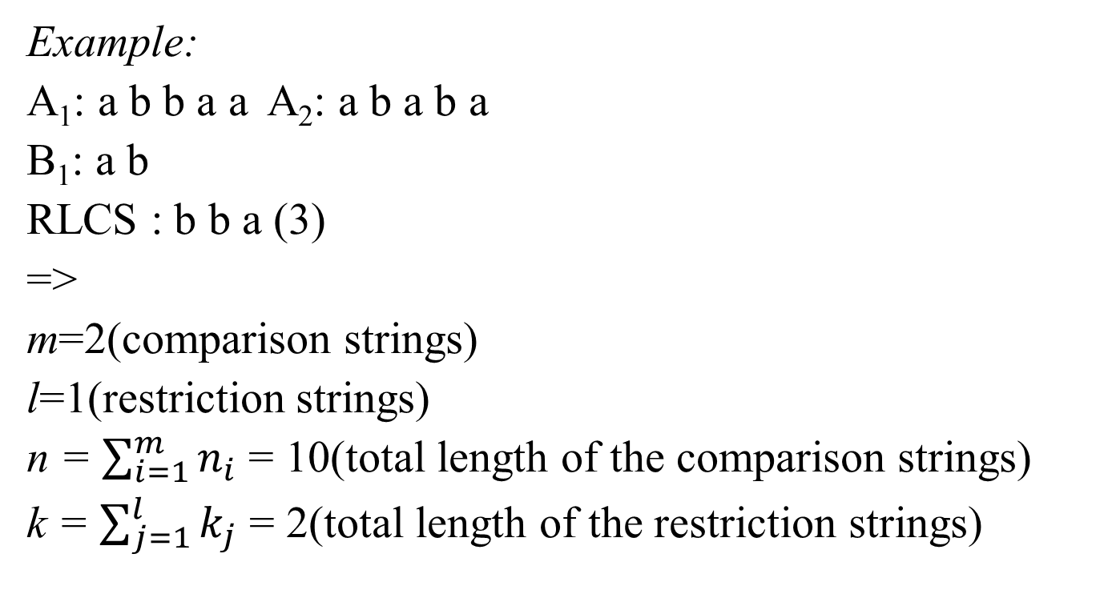
Preliminaries(1/2)
Example:
A₁: a b b a a A₂: a b a b a
B₁: a b
RLCS : b b a (3)
=>
m=2(comparison strings)
l=1(restriction strings)
n = $\sum_{i=1}^{m}{n_{i}}$ = 10(total length of the comparison strings)
k = $\sum_{j=1}^{l}{k_{j}}$ = 2(total length of the restriction strings)

Slide 5
Preliminaries(2/2)
The first assumption :
all restriction strings have length at least 2
The second assumption :
all i ∈ {1,…,m} and all j ∈ {1,…,l}, we have k_{j} ≤n_{i}

Slide 6
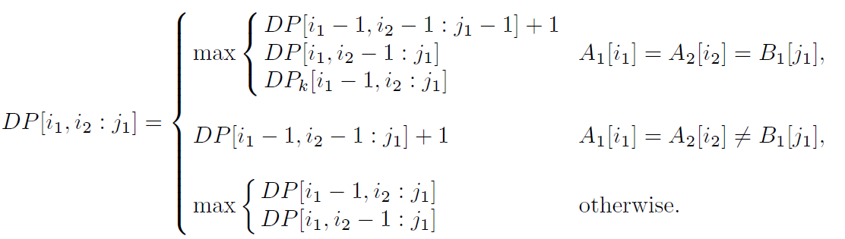
Exact Algorithms
Example:
A₁: a b b a a
A₂: a b a b a
B₁: a b
RLCS : b b a (3)
B₁[1]=a |  |  | a | b | a | b | a
 |  | 0 | 1 | 2 | 3 | 4 | 5
 | 0 | 0 | 0 | 0 | 0 | 0 | 0
a | 1 | 0 | 0 | 0 | 0 | 0 | 0
b | 2 | 0 | 0 | 1 | 1 | 1 | 1
b | 3 | 0 | 0 | 1 | 1 | 2 | 2
a | 4 | 0 | 0 | 1 | 1 | 2 | 2
a | 5 | 0 | 0 | 1 | 1 | 2 | 2
B₁[2]=b |  |  | a | b | a | b | a
 |  | 0 | 1 | 2 | 3 | 4 | 5
 | 0 | 0 | 0 | 0 | 0 | 0 | 0
a | 1 | 0 | 1 | 1 | 1 | 1 | 1
b | 2 | 0 | 1 | 1 | 1 | 1 | 1
b | 3 | 0 | 1 | 1 | 1 | 2 | 2
a | 4 | 0 | 1 | 1 | 2 | 2 | 3
a | 5 | 0 | 1 | 1 | 2 | 2 | 3
O(n^{m+l} )time

Slide 7
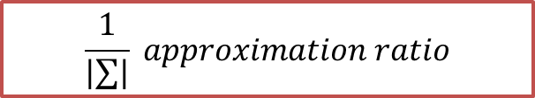
Approximation Algorithms
$$\frac{1}{|∑|} approximation ratio$$
Algorithm I:
1. For every s ∈ Σ and every i ∈ {1,…,m} , compute the number of occurrences Occ_{i}(s) of s in A_{i}.
2. For every s ∈ Σ compute:
- Occ(s), the minimum between Occ₁(s),…,Occ_{m}(s).
- Cons(s), the length of the shortest restriction string that does not contain any symbol besides s. If no such restriction string exists, Cons(s) =∞.
-Val(s), the minimum between Occ(s) and Cons(s).
3. Find s ∈ Σ with maximal Val(s) and return s^{Val(s)}.
 | s=‘a’ | s=‘b’
Occ₁(s) | 3 | 2
Occ₂(s) | 3 | 2
Occ(s) | 3 | 2
Cons(s) | ∞ | ∞
Val(s) | 3 | 2
Step3
Example:
A₁: a b b a a
A₂: a b a b a
B₁: a b
Step1
s^{Val(s)}=aaa
Step2

Slide 8
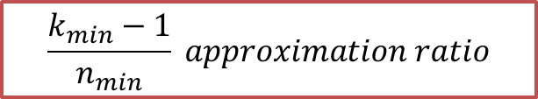
Approximation Algorithms
$$\frac{k_{min}−1}{n_{min}} approximation ratio$$
Algorithm II:
1. Compute the LCS S of A₁,…,A_{m}
2. Return the prefix of length k_{min} - 1 of S
Example:
A₁: a b b a a
A₂: a b a b a
B₁: a b
Step1:
LCS=abba,abaa
Step2:
k_{min}=2
prefix of length k_{min} - 1 of LCS
=a

Slide 9
thanks for your listening

Slide 10
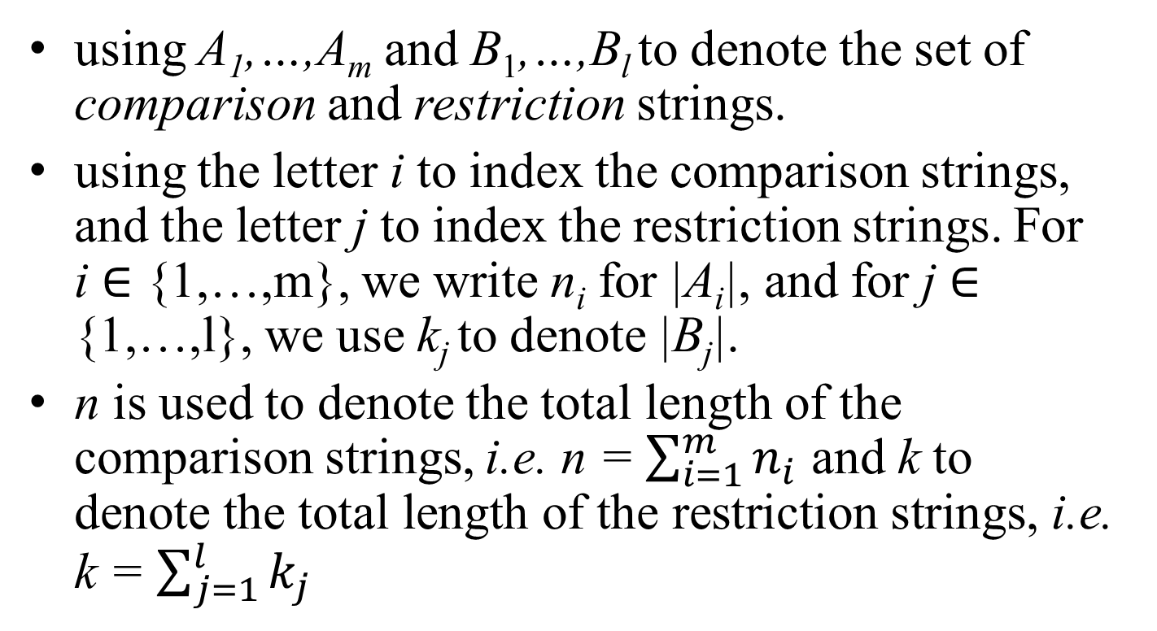
Preliminaries
using A₁,…,A_{m} and B₁,…,B_{l} to denote the set of comparison and restriction strings.
using the letter i to index the comparison strings, and the letter j to index the restriction strings. For i ∈ {1,…,m}, we write n_{i} for |A_{i}|, and for j ∈ {1,…,l}, we use k_{j} to denote |B_{j}|.
n is used to denote the total length of the comparison strings, i.e. n = $\sum_{i=1}^{m}{n_{i}}$ and k to denote the total length of the restriction strings, i.e. k = $\sum_{j=1}^{l}{k_{j}}$

